Slide 1

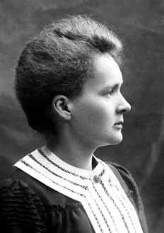
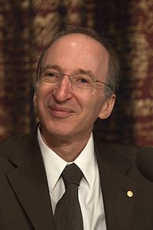
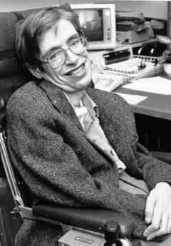
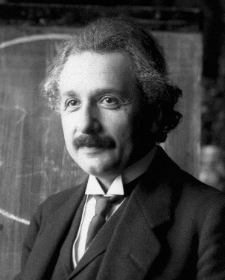
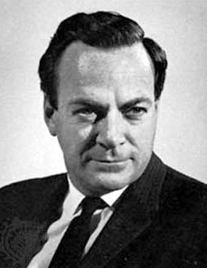
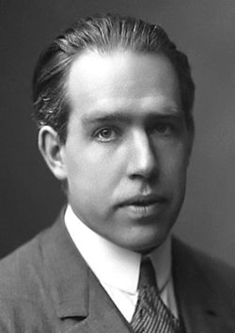
Marie Curie
Saul Perlmutter
Stephen Hawking
0k
16k
34k
TEAM PHYSICS
TEAM PHYSICS
TEAM PHYSICS
Discovered radioactivity
Pioneered medical radiation therapy
Proved universe is expanding
Developed theory of cosmology
Studied black holes
Albert Einstein
Richard Feynman
Niels Bohr
94k
74k
16k
TEAM PHYSICS
TEAM PHYSICS
TEAM PHYSICS
Developed theory of relativity,
law of photoelectric effect
Developed theory of quantum electrodynamics
Developed model of atom,
principle of complementarity

Slide 2
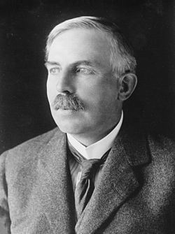
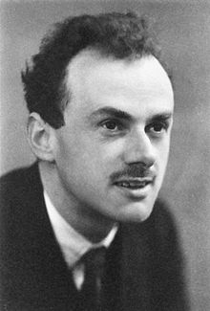
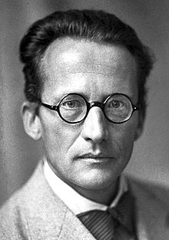
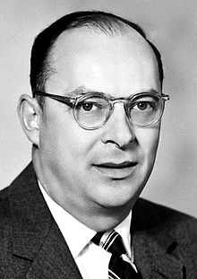
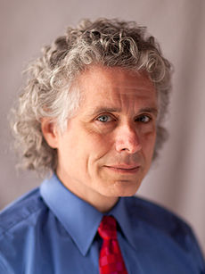
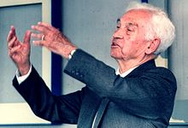
Ernest Rutherford
Paul Dirac
Erwin Schrodinger
3k
50k
10k
TEAM PHYSICS
TEAM PHYSICS
TEAM PHYSICS
Discovered radiation half-life
Discovered element transmutation
Predicted existence of antimatter
Proposed “Schrodinger’s Cat”
John Bardeen
Steven Pinker
Ernst Mayr
26k
55k
55k
39k
TEAM PHYSICS
TEAM BIOMED
PSYCHOLOGY
TEAM BIOMED
Invented transistor
Dev. theory of superconductivity
Developed theory of language acquisition
Defined species,
modern evolutionary biology

Slide 3
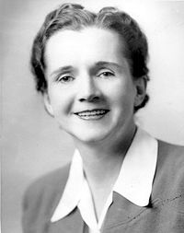
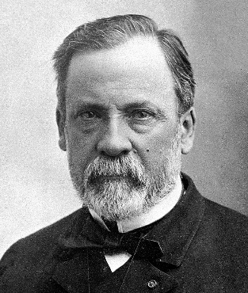
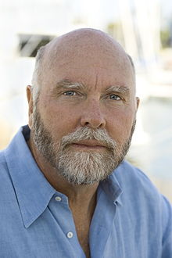
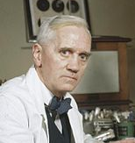
Rosalind Franklin
Rachel Carson
Louis Pasteur
4k
13k
3k
TEAM BIOMED
TEAM BIOMED
TEAM BIOMED
Discovered structure of DNA, molecular structure of viruses
Inspired conservation and environmental movements
Invented vaccination
Proved germ theory of disease
Henry Heimlich
Alexander Fleming
Craig Venter
1k
5k
58k
TEAM BIOMED
TEAM BIOMED
TEAM BIOMED
CS
Invented “Heimlich maneuver”
Discovered Penicillin
Sequenced the human genome

Slide 4
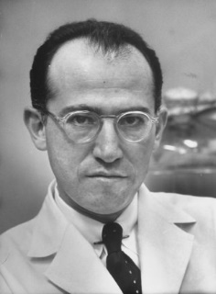
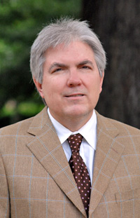
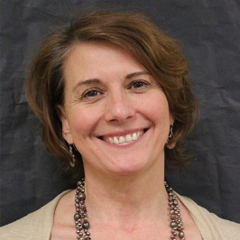
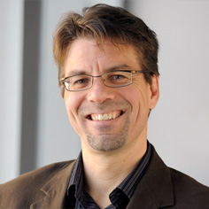
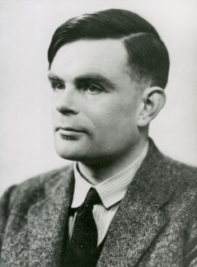
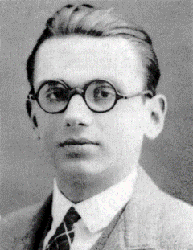
Jonas Salk
Danielle McNamara
Arthur Graesser
3k
12k
35k
TEAM BIOMED
TEAM
CS
PSYCHOLOGY
TEAM
CS
PSYCHOLOGY
Invented polio vaccine
Leader in text mining and
discourse processing
Invented AutoTutor
Studied discourse comprehension
Ken Koedinger
Alan Turing
Kurt Godel
16k
31k
4k
TEAM
CS
PSYCHOLOGY
TEAM
CS
PHILOSOPHY
TEAM
CS
Co-developed Cognitive Tutor, Knowledge-Learning-Instruction Theory
Developed first theory of computer
Led cryptographic efforts
Developed incompleteness theorem

Slide 5
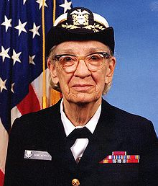
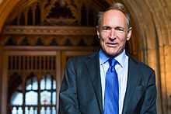
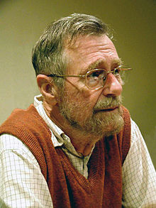
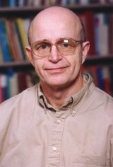
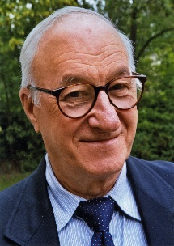
Grace Hopper
Tim Berners-Lee
Edsger Dijkstra
0k
44k
43k
TEAM
CS
TEAM
CS
TEAM
CS
Invented compiler
Coined term “debugging”
Invented World Wide Web
Invented core Computer Science algorithms
Herbert Simon
John Anderson
Albert Bandura
259k
117k
229k
TEAM
PSYCHOLOGY
PHILOSOPHY
TEAM
PSYCHOLOGY
TEAM
PSYCHOLOGY
Invented concept of satisficing
Developed cognitive architecture
Co-developed Cognitive Tutor
ACT-R Theoretical Framework
Developed self-efficacy theory

Slide 6
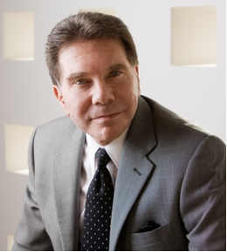
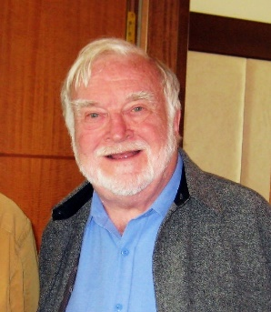
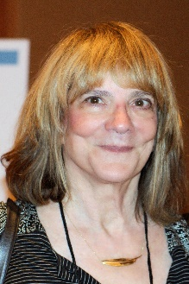
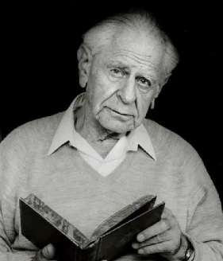
Bob Cialdini
Mihalyi Csikszentmihalyi
Walter Mischel
20k
71k
29k
TEAM
PSYCHOLOGY
TEAM
PSYCHOLOGY
TEAM
PSYCHOLOGY
Studied science of persuasion
Developed Flow Theory
Studied delay of gratification
Invented marshmallow test
Thomas Kuhn
Elizabeth Loftus
Karl Popper
PARADIGM
SHIFT
102k
43k
60k
TEAM
PHILOSOPHY
TEAM
PSYCHOLOGY
TEAM
PHILOSOPHY
PARADIGM SHIFT
Studied memory and
eyewitness testimony
Developed theory of positivism

Slide 7
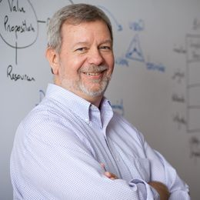
Paul Feyerabend
Imre Lakatos
Dick Buchanan
47k
21k
3k
TEAM
PHILOSOPHY
TEAM
PHILOSOPHY
TEAM
PHILOSOPHY
Argued against universal methodological rules
Developed theory of
progressive theory
Created core theory of design
Created concept of wicked problem

