Slide 1
Adaptive Learning Systems
EDUC5100
Fall 2022

Slide 2
Welcome!

Slide 3
Any questions about Assignment 1 system signup?
Looks like we have a few people who haven’t signed up yet (which is fine, you have another week to do so)

Slide 4
Any questions about Assignment 1 paper requirements?

Slide 5
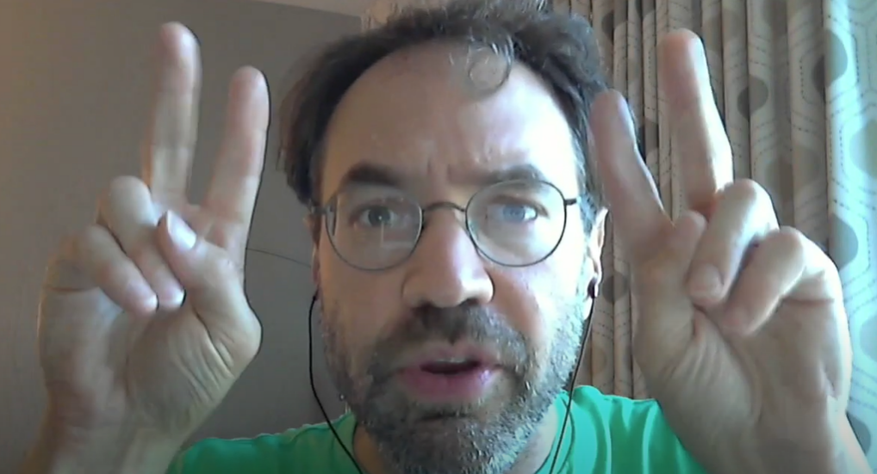
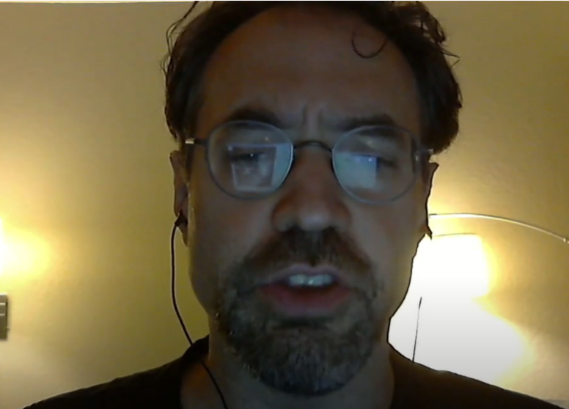

Three paradigms for what an intelligent tutoring system should accomplish
Knowledge Communication
Procedural Skill
Knowledge Construction

Slide 6
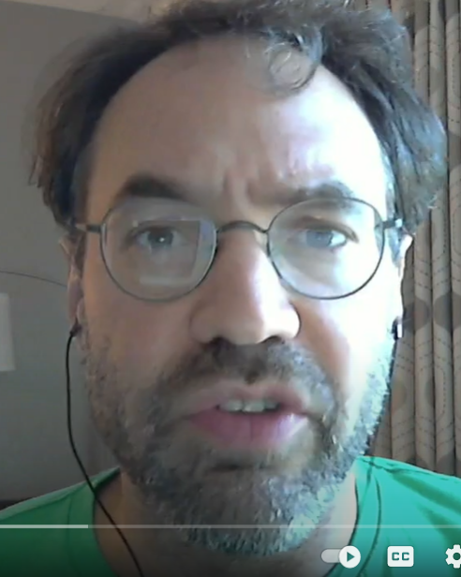

Knowledge Communication
Can anyone summarize this perspective?

Slide 7

Development of Procedural Skill
Can anyone summarize this perspective?

Slide 8

Construction of Complex Knowledge
Can anyone summarize this perspective?

Slide 9

Construction of Complex Knowledge
Can anyone summarize this perspective?

Slide 10
Which of these was this week’s video?

Slide 11
Does anyone want to argue…
That one of these paradigms is usually best?
(Go for it)

Slide 12
Contexts
For what kind of content
And in what kind of learning situation
Might each paradigm be best?

Slide 13
Knowledge Communication metaphors
“Supporting the acquisition of knowledge”
“Programming the knowledge into the student”
“Pouring it in their head” (“Depositing it in their head” – Freire)
What are the differences between these metaphors?

Slide 14
“Doing the task like an expert”
When is this an appropriate instructional goal?
When is it not?

Slide 15
Knowledge Construction and Dialogue
Both this video and a lot of Graesser’s examples involve a dialogue
Bodong Chen’s work (not an intelligent tutor) uses asycnronous scaffolded discussion to support knowledge construction – effectively a very slow dialogue
Is dialogue the best way to do knowledge construction?
What are some other ways?

Slide 16
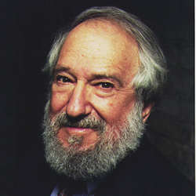
Constructionism

Slide 17
Constructionism
Learning by creating
Very open-ended
Logo
Lego Mindstorms (early)
Not adaptive learning/ITS

Slide 18
During learning
Should we try to be efficient (knowledge communication) or repetitive (skill building)?

Slide 19
During learning
Should we try to be efficient (knowledge communication) or repetitive (skill building)?
Note: we’ll come back to this Sep 29

Slide 20
During learning
Should we seek to expose the learner to contradictions (in dialogue) or avoid them (in knowledge communication and skill building)?
Does it depend on what the student is learning? If so, how?

Slide 21
Why aren’t knowledge construction dialogues used more?
“Knowledge construction is the learning paradigm of the future. And it always will be. Hah.”

Slide 22
Final Questions? Comments?

Slide 23
If there’s a couple minutes
Herb Simon story on decomposition and chunking

Slide 24
If there’s a couple minutes
Did anyone follow up on the video’s recommendation of (Reder & Anderson, 1999)
  “The hippie is in the church”
This technique really works! Try it at home!

Slide 25
Upcoming classes
September 15
  Knowledge Tracing and Mastery Learning
  System signup due
September 22
  Knowledge Graphs and Prerequisite Tracing
September 29 VIRTUAL
  Memory Optimization and Spiraling Review

Slide 26
The End

