Slide 1
Adaptive Learning Systems
EDUC5100
Fall 2022

Slide 2
Educational Games
A lot of them out there, and more every year

Slide 3
Why is that?
Games are engaging
No kid stands in line all night to get the latest version of AutoTutor or ASSISTments

Slide 4

There are exceptions, of course…
Waiting to buy
Aplusix: Algebra Assistant,
not
Final Fantasy LXXIX: LEGO Call of Mario

Slide 5
Games are fun
And kids play them a lot
It’s often difficult to get adolescents to put hours into studying (or adults)
But these same adolescents often will play computer games for dozens of hours (or hundreds)
(cf. Brown, 2005; Fisher, 2005)

Slide 6
Gamification
What is gamification?

Slide 7
Gamification
“Process of adding game-like elements to something so as to encourage participation”

Slide 8
Gamification
“Process of adding game-like elements to something so as to encourage participation”
“Gamification can be a miraculous way to boost engagement with monotonous tasks at work and beyond, or an over-hyped strategy doomed to fail.” (Milkman, 2021)

Slide 9
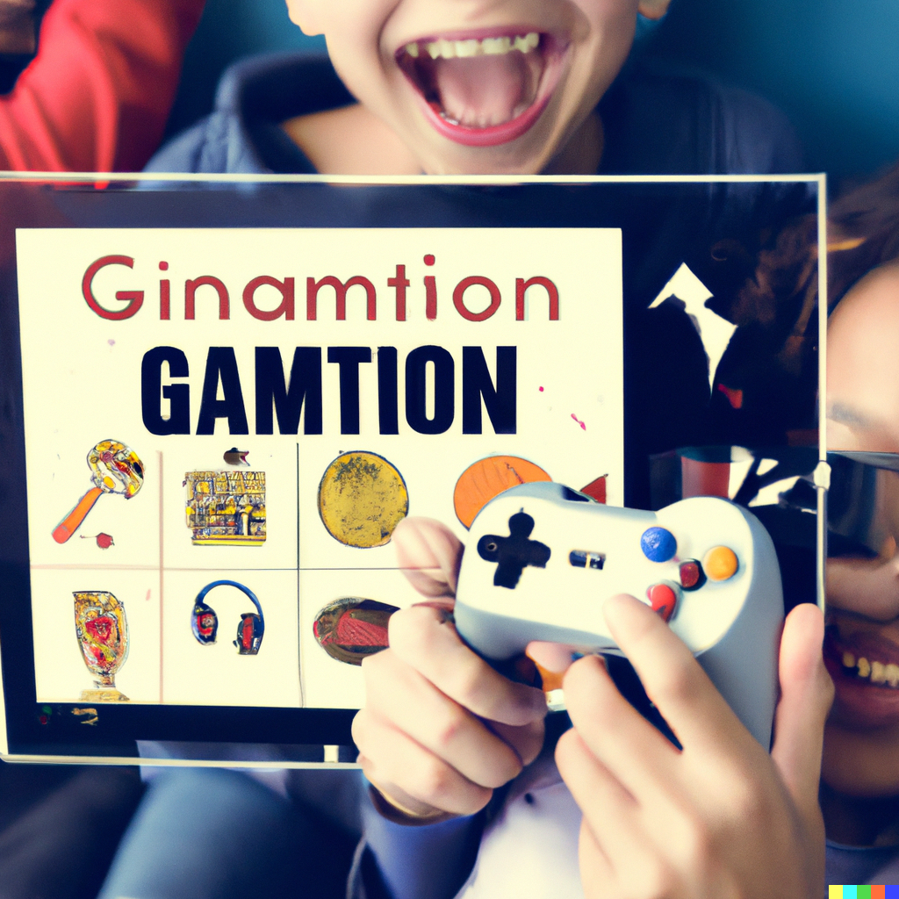
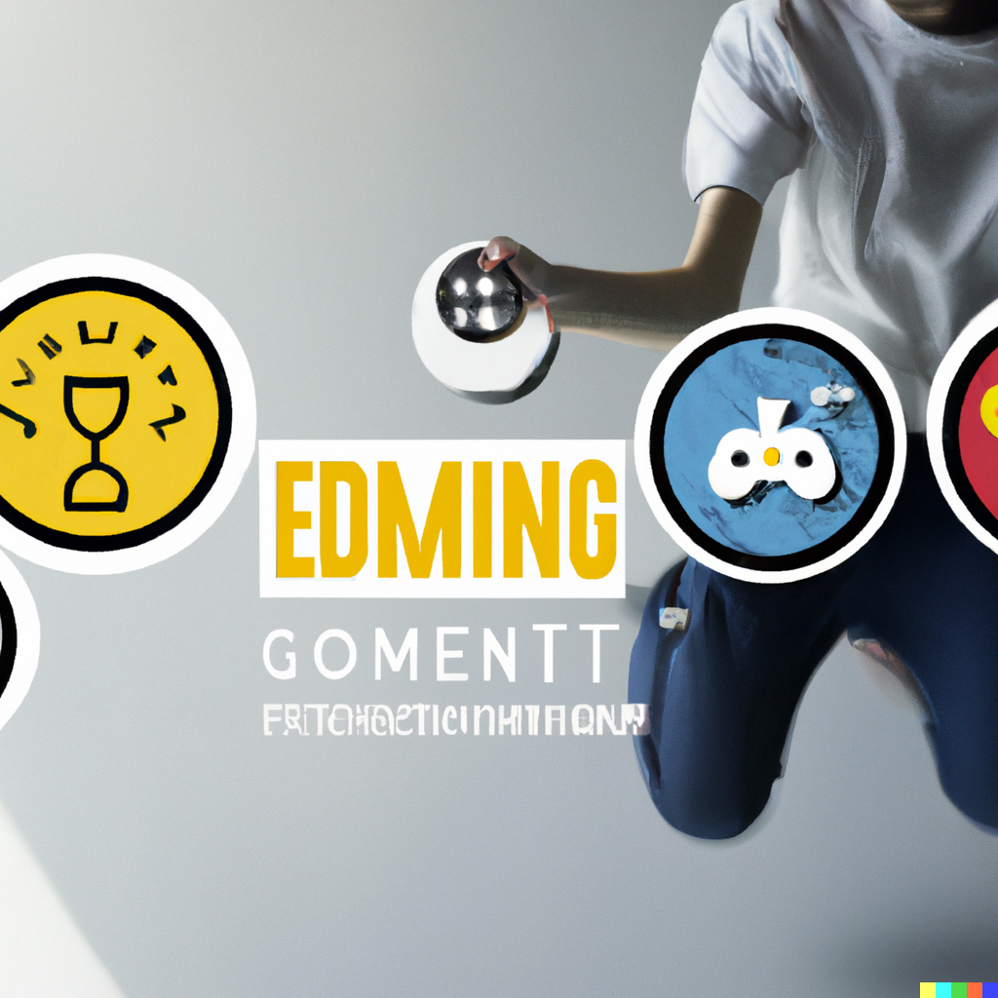
Even DALL-E 2 is Excited By “The Exciting Power of Gamification”

Slide 10

But to others, it’s simply (Bruckman, 1999)

Slide 11
Gamification-Based Rewards Systems
Used in many digital learning platforms
Some successes
Increase motivation and learning (Tahir and Mitrovic, 2020)
More and faster concept completion (Li et al., 2012)
Stronger engagement (Li et al., 2012)
Incentives for desired behaviors (Long and Aleven, 2011)

Slide 12
Gamification-Based Rewards Systems
However, if poorly designed…
Students focus on short-term outcomes rather than long-term (Long and Aleven, 2011)
Adopt behaviors targeted to rewards not learning (Long and Aleven, 2011; Wang et al., 2022)
Reduce long-term intrinsic motivation for learning (Lepper & Greene, 1978)

Slide 13
What’s the difference
Educational game (EG)
Non-Educational game (NEG)
Gamification (GF)

Slide 14
What’s the difference
Educational game (EG)
Non-Educational game (NEG)
Gamification (GF)
Let’s play, um, a game
I will show you a system
In the chat window, put what category you would give it

Slide 15
What’s the difference
Educational game (EG)
Non-Educational game (NEG)
Gamification (GF)
Let’s play, um, a game
I will show you a system
In the chat window, put what category you would give it
We’ll discuss cases where there is disagreement

Slide 16
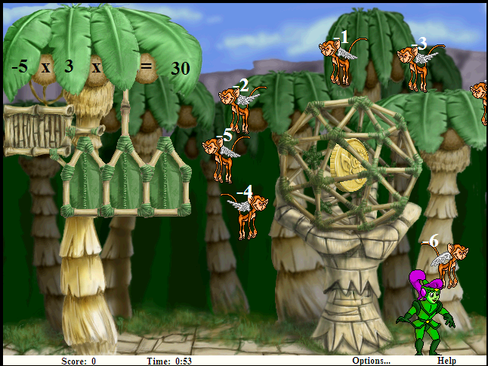
MathBlaster

Slide 17
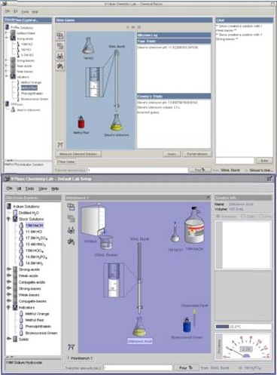
“Chemistry Game” (Yaron et al., 2010)

Slide 18
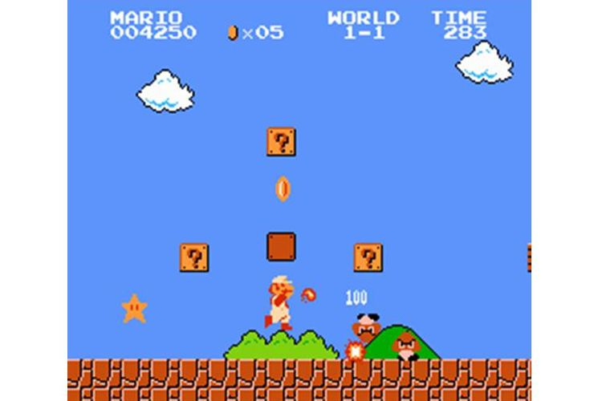
Super Mario Bros

Slide 19
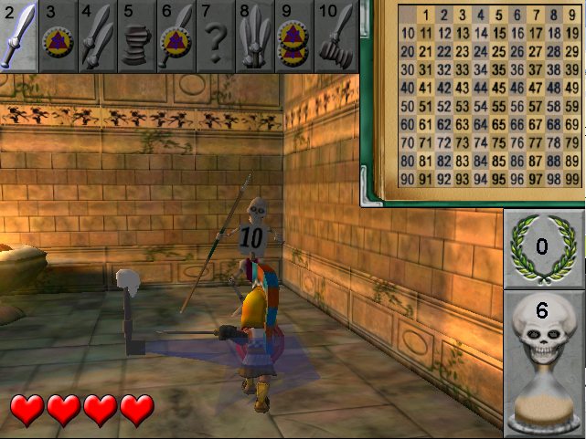
Zombie Division

Slide 20
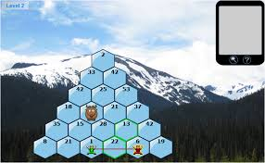
Prime Climb

Slide 21
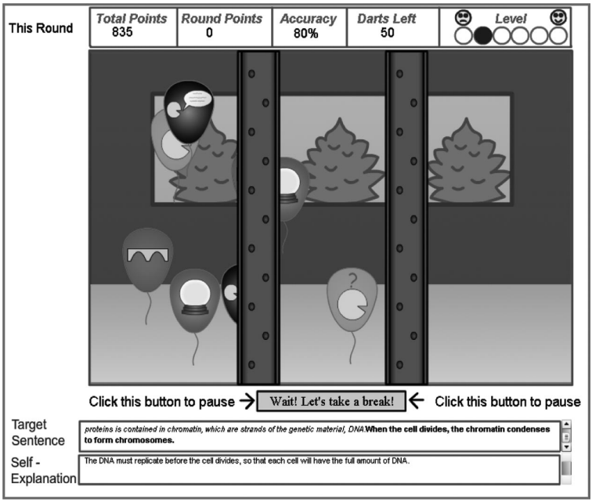
iSTART-ME

Slide 22
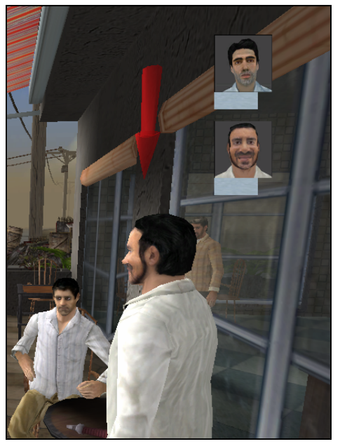
Tactical Language Training System

Slide 23
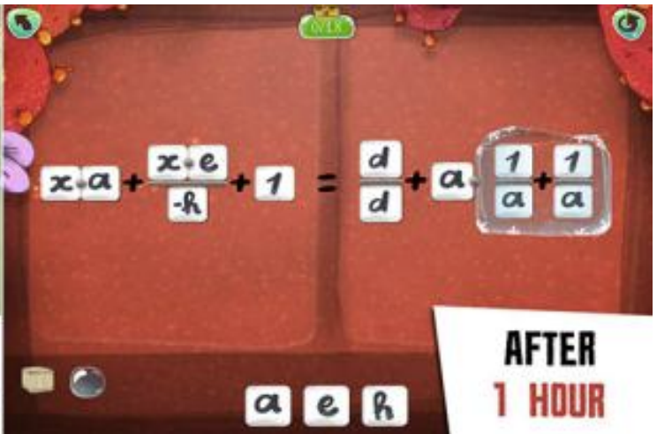
DragonBox

Slide 24
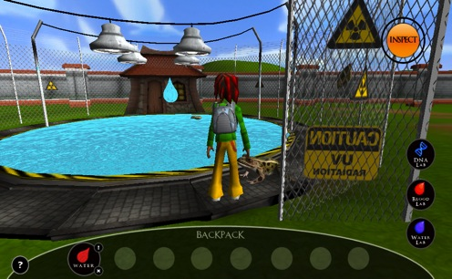
Virtual Performance Assessment

Slide 25
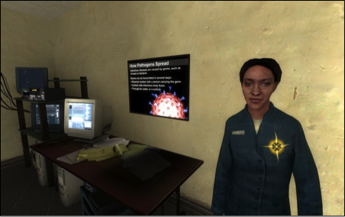
Crystal Island

Slide 26
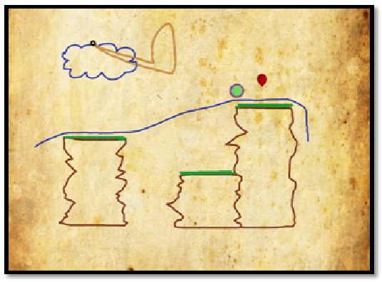
Physics Playground

Slide 27
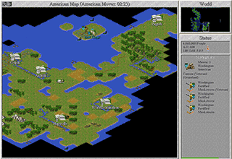
Civilization II

Slide 28
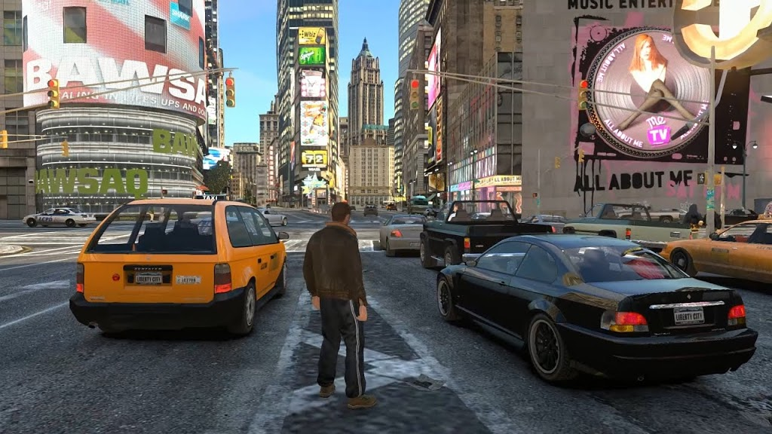
Grand Theft Auto 4

Slide 29
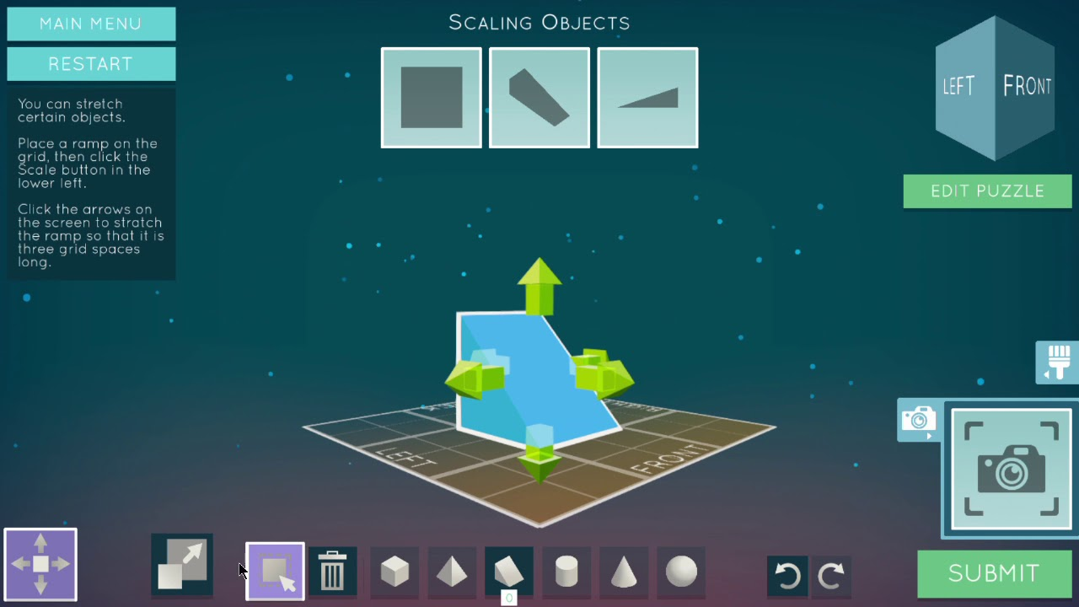
Shadowspect

Slide 30
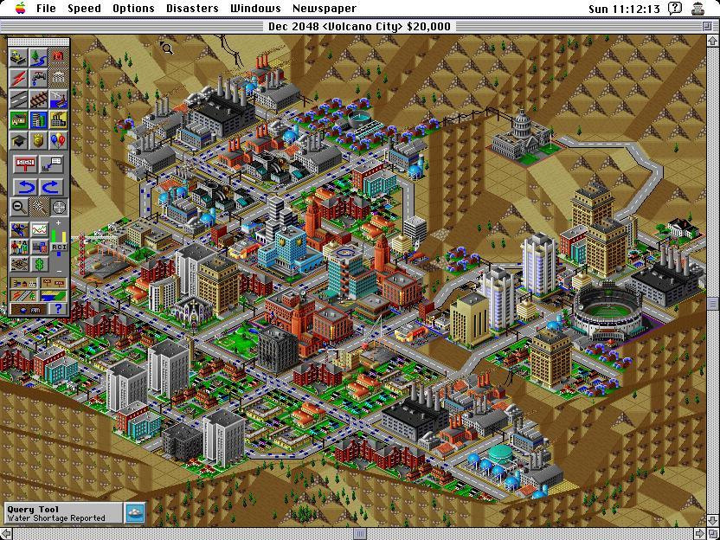
SimCity 2000

Slide 31
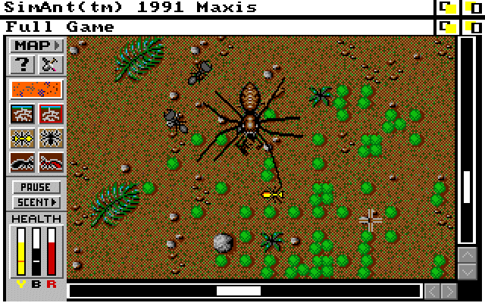
SimAnt

Slide 32
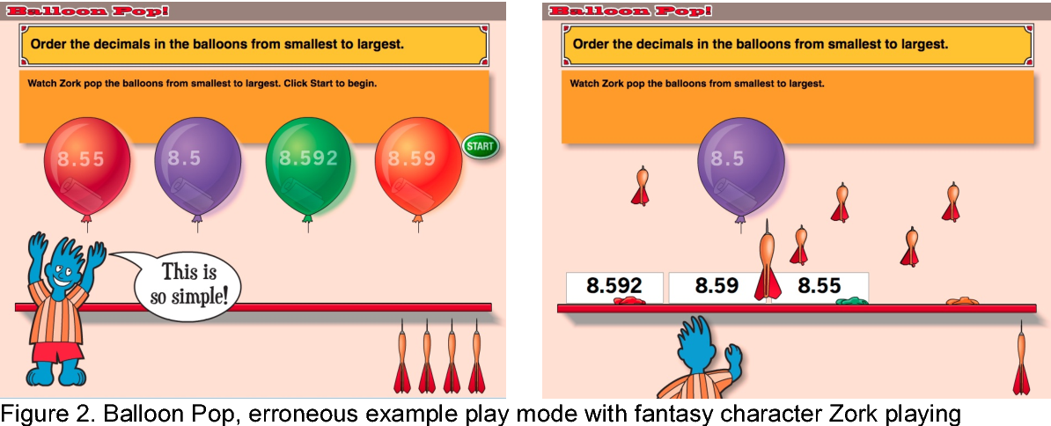
Decimal Point

Slide 33
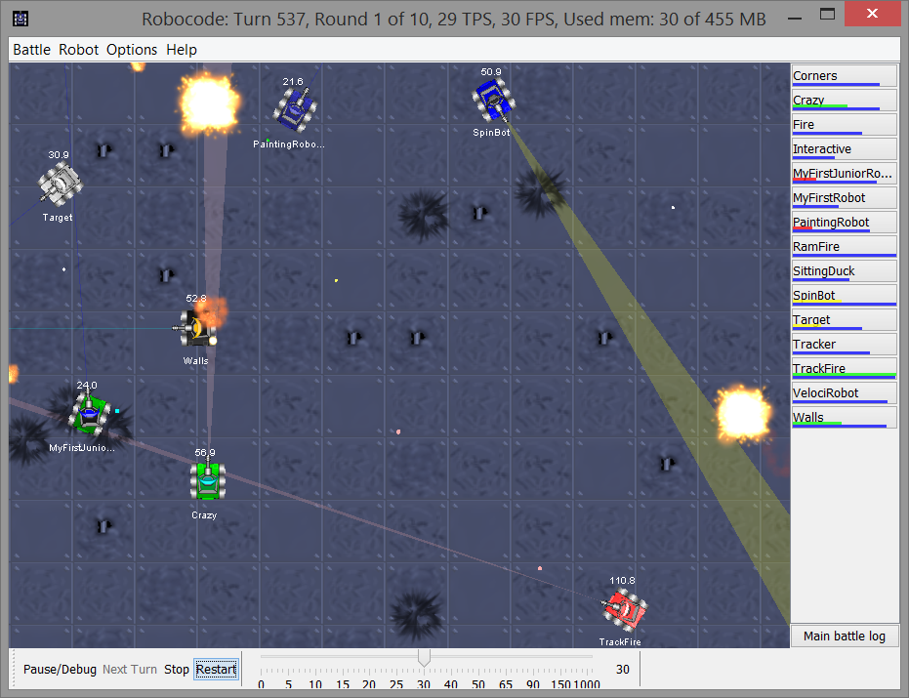
Robocode

Slide 34
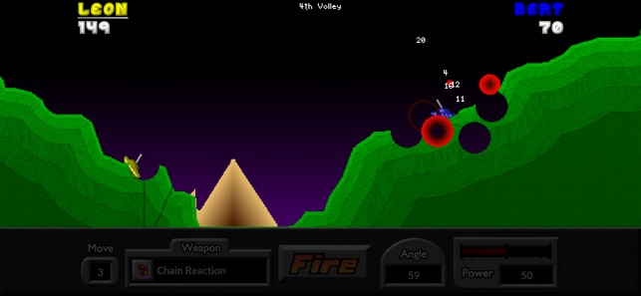
Pocket Tanks

Slide 35
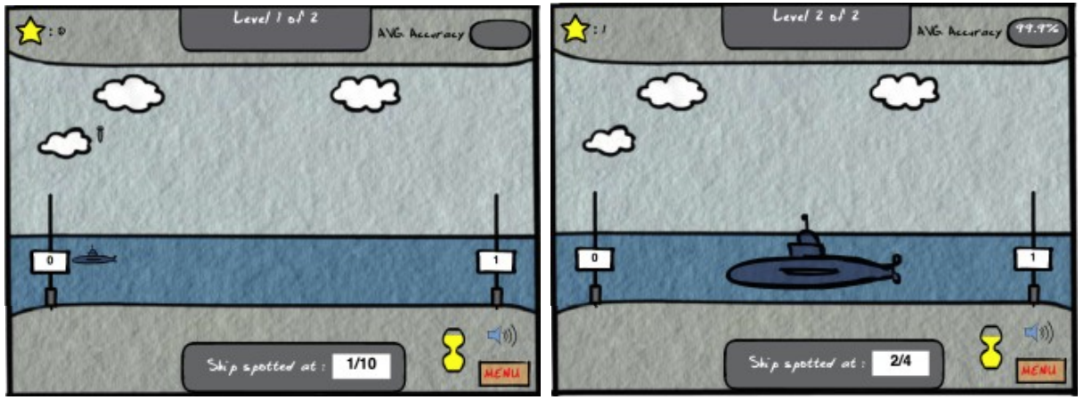
Battleship Numberline

Slide 36
Can you identify
The key attributes that differentiate an educational game from a non-educational game?

Slide 37
Can you identify
The key attributes that differentiate an educational game from a gamified learning system?

Slide 38
Comments? Questions?

Slide 39
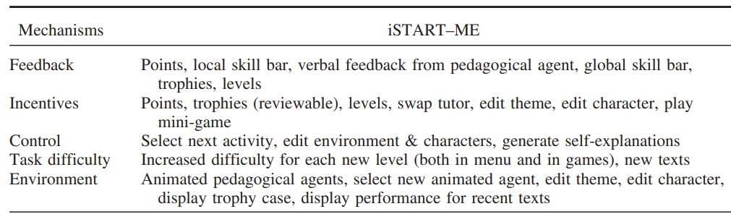
Gamification Features
(Jackson & McNamara, 2013)
Do all of these seem like gamification?
Comments? Questions?

Slide 40
Gamification Features
(Jackson & McNamara, 2013)
Incentives
  What might be some ways to mess this up?

Slide 41
Gamification Features
(Jackson & McNamara, 2013)
Incentives
  What might be some ways to mess this up?
  “Hidden Cost of Reward” (Lepper & Greene, 1978)
  Replicated in games (Long & Aleven, 2014)
  Players can be over-responsive to incentives and distorts behavior to earn rewards (Wang et al., 2022)

Slide 42
Gamification Features
(Jackson & McNamara, 2013;
Kim & Shute, 2015)
Control/Personalization
  What might be some ways to mess this up?

Slide 43
Gamification Features
(Jackson & McNamara, 2013;
Kim & Shute, 2015)
Control/Personalization
  What might be some ways to mess this up?
  Some students spend inordinate amounts of time dressing up their avatars (if you let them)
  (Feldon & Kafai, 2008)

Slide 44
Gamification Features
(Jackson & McNamara, 2013)
Task Difficulty
  What might be some ways to mess this up?

Slide 45
Gamification Features
(Jackson & McNamara, 2013)
Task Difficulty
  What might be some ways to mess this up?
  If difficulty is too high, players quit – and ideal difficulty for motivation can be lower than expected (Lomas et al., 2013)
  Matches findings from behaviorism waaaaay earlier
  But ideal difficulty for motivation leads to less learning (Lomas et al., 2013)

Slide 46
Gamification Features
(Malone, 1981)
Extrinsic Fantasy
  Fantasy unrelated to game task
  (Whether or not embedded in core game mechanic)

Slide 47
Gamification Features
(Malone, 1981)
Extrinsic Fantasy
  What might be some ways to mess this up?

Slide 48
Gamification Features
(Malone, 1981)
Intrinsic Fantasy
  Fantasy directly related to game task

Slide 49
Gamification Features
(Malone, 1981)
Intrinsic Fantasy
  What might be some ways to mess this up?

Slide 50
Gamification Features
(Lomas et al., 2017)
Novelty
  Operationalized as frequency of changing gaming parameters

Slide 51
Gamification Features
(Lomas et al., 2017)
Novelty
  What might be some ways to mess this up?

Slide 52
Gamification Features
(Lomas et al., 2017)
Suspense
  How close the player is to losing

Slide 53
Gamification Features
(Lomas et al., 2017)
Suspense
  What might be some ways to mess this up?

Slide 54
Gamification Features
(Johnson et al., 2005)
Fish Tanks and Sandboxes
  Initially give player version of game with fewer features (Fish Tank) or where student can’t lose (Sandboxes)

Slide 55
Gamification Features
(Johnson et al., 2005)
Fish Tanks and Sandboxes
  What might be some ways to mess this up?

Slide 56
Gamification Features
(Wouters & van Oostendrop, 2017)
Narrative

Slide 57
Gamification Features
(Wouters & van Oostendrop, 2017)
Narrative
  What might be some ways to mess this up?

Slide 58
Gamification Features
(Wouters & van Oostendrop, 2017)
Narrative
  What might be some ways to mess this up?
  Several studies find improved engagement but uncertain learning effect (Wouters & van Oostendrop, 2017)

Slide 59
Anti-Gamification Feature
(Mayer et al., 2019)
Prompting player to write self-explanations during gameplay
Leads to better learning
But does the game still feel like a game?

Slide 60
Other Features?
Has anyone here seen another gamification feature they would like to discuss?

Slide 61
Beyond the game
Several papers find that providing non-game activities relevant to game concepts before or after gameplay improves learning (Mayer et al., 2019)
What are your thoughts on this?

Slide 62
Breakout Task
In a minute, I will put you into breakout rooms
Your task: take Aplusix: Algebra Assistant and make it fun (without totally rewriting it)
Try to come up with ideas you think will genuinely work

Slide 63
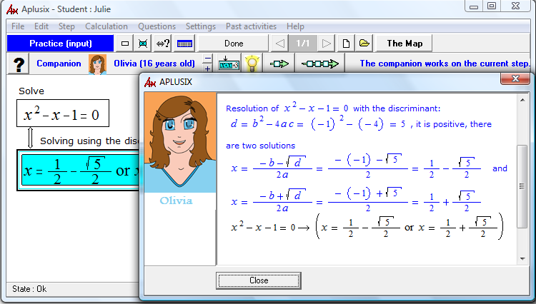
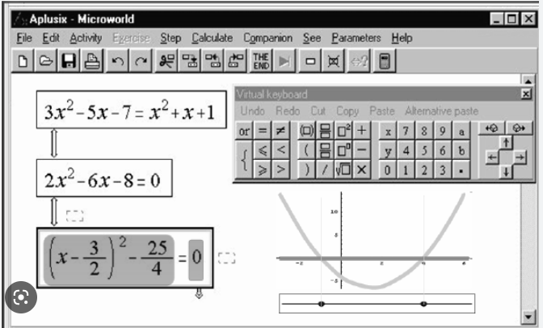

Slide 64
Let’s share out some of the ideas

Slide 65
If there’s time
Deep-dive on learning engineering to optimize a rewards system
(Wang et al., 2022)

Slide 66
Context: Kupei AI Learning System
AI-driven learning system tutoring 3rd-12th grade students in English and Math in China
Study run from April 22, 2021 to June 17, 2021
5726 students
27785 concepts and 1,393,529 actions (working on a concept)

Slide 67

Kupei AI Learning System
Courses → Grade → Units → Concepts
Practice activities and video learning content
Diagnostic test before each unit
  Computer-adaptive test to determine what concepts unknown, to focus student practice time
  Optional but recommended
Students can be assessed as mastering concepts in either test or practice
Student Unit Learning Screen
The large orange button says “test” and the red button at the bottom right says “practice.” In this unit, there are 15 concepts to master. The progress bar next to the practice button shows mastery progress for each concept.
Translation courtesy of my co-authors, since I can’t read Chinese

Slide 68
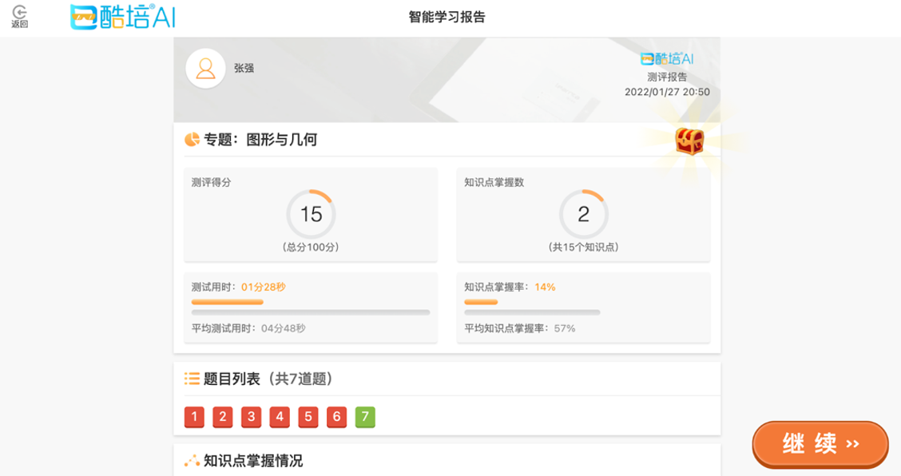
Mastery
Concept proficiency three levels: unmastered, basic mastery, and advanced mastery
Bayesian Knowledge Tracing
(Corbett & Anderson, 1995)
Unmastered = <80% probability of knowing a skill
Basic Mastery = 80% to 95%
Advanced Mastery = >95%
Advanced mastery earned from practice
Basic mastery earned from tests or practice
Concepts connected on a knowledge graph
Results Screen After Diagnostic Test
The left circle shows the student received a score of 15/100. The right circle shows the number of concepts mastered in the unit, which is 2/15. The bottom row of numbers from 1 to 7 are the questions the student answered in the diagnostic test: red means they answered the question incorrectly and green means they answered correctly.

Slide 69
Versions
Learning engineering iterations to guide student time allocation and effort

Slide 70
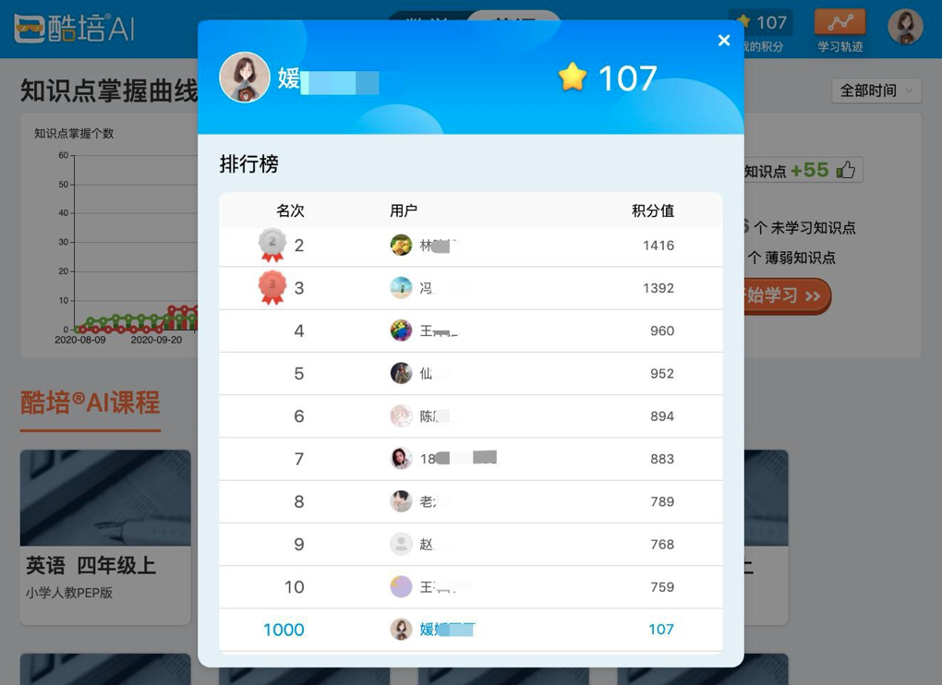
Three Iterations of Re-Design
Version 0 (initial) through V3
Developing and modifying a point-based rewards system
  Adjusting the amount of points given in different situations
  Leaderboard to show students their relative success
Leaderboard
Students are ranked based off the number of points, or stars, they earned in comparison with their classmates.

Slide 71
Quasi-Experimental Approach
Switch condition on certain date
Compare between time-slices
Disadvantages:
  Risk of some contamination between conditions
  Less clear causal inference
Advantages:
  Convenience
  No unequal treatment of students using system at same time
  No resentful demoralization
  See how much and how quickly students adapt to design change

Slide 72
Version 0 (V0) - April 22 to April 28
(and before)
Control version with no point system implemented
Basis to compare the results of adding a point system on student learning

Slide 73
Version 1 (V1) - April 29 to May 8
Purpose: Impact of point system on student behavior
One point given for both English and Math basic mastery
Points can only be earned through practice

Slide 74
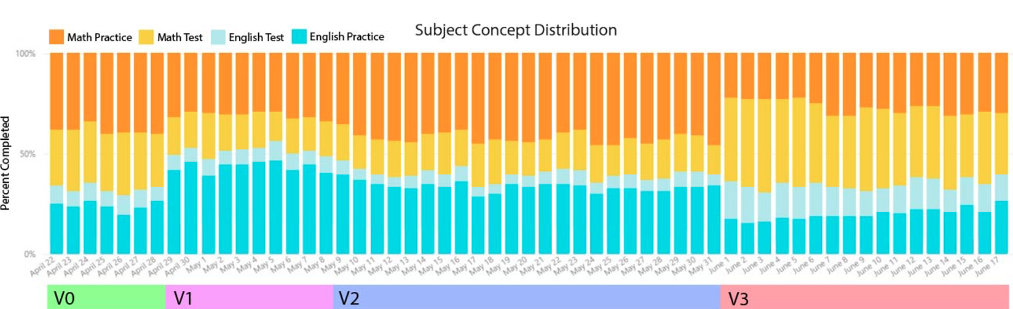
Version 1 (V1) - Learning Behavior
Students completed more English than Math concepts
  47.4% for English in V0 → 59.5% in V1
  English faster to complete, so easier to earn points
Students completed more practice than tests
  49.1% for practice in V0 → 60% in V1
  No points given in tests
Subject Concept Distribution
Student proportion of completed concepts in Math practice, Math test, English test, and English practice by day

Slide 75
Version 1 (V1) - Learning Improvement
Increase in Math basic mastery rate
  59.4% in V1 → 60.8% in V2
Increase in Math and English advanced mastery rate
  39.6% in V1 for Math→
41.6% in V2
  49.7% in V1 for English → 52.6% in V2
  Time spent to achieve basic mastery decreased in English
  Median of 35.7 seconds
Time increased in Math
  Median of 7.3 seconds

Slide 76
Version 1 (V1) - Key Takeaways
Students behavior driven by points
  Increase practice since students can only earn points through practice
  Increase English since took less time to achieve basic mastery
Overall improvement, especially English

Slide 77
Version 2 (V2) - May 9 to May 31
Purpose: balance proportion of time spent in English and Math
Made earning basic mastery for English worth one point and Math practice worth three points

Slide 78
Version 2 (V2) - Learning Behavior
More Math concepts completed, balancing overall proportion of Math and English completed
  44.7% for Math in V1 →
49.3% in V2
Increase practice over tests
  56.6% for practice in V1 → 66.5% in V2
Subject Concept Distribution
Student proportion of completed concepts in Math practice, Math test, English test, and English practice by day

Slide 79
Version 2 (V2) - Learning Improvement
Increase English basic mastery rate
  71% in V1 → 73% in V2
Slight decrease in English advanced mastery rate
  49.5% in V1 → 47.7% in V2
Increase in median time spent to earn basic mastery for Math and English
  734.67 median seconds for Math in V1 → 813.97 seconds in V2
  347.45 median seconds for English in V1 → 377.6437 seconds in V2

Slide 80
Version 2 (V2) - Key Takeaways
Adding more points to Math successfully balanced out time spent on Math and English courses
Students spent even more time practicing since they can’t earn points through tests
But time per concept learned is going up…

Slide 81
Version 3 (V3) - May 9 to May 31
Purpose: Increase diagnostic test usage
Students can earn points through achieving basic mastery on tests

Slide 82
Version 3 (V3) - Learning Behavior
Students completed more tests compared to practice
  35.4% tests completed in V2 → 53.6% in V3
Subject Concept Distribution
Student proportion of completed concepts in Math practice, Math test, English test, and English practice by day

Slide 83
Version 3 (V3) - Learning Improvement
Median time to achieve basic mastery decreased in English and Math
  372.4 median seconds for English in V2 → 326.2 seconds in V3,
  773.2 median seconds for Math in V2 → 560.3 in V3
Basic mastery decreased for English
  67.8% in V2 → 64.7% in V3
Advanced mastery rate decreased for Math and English
  2.6% decrease in Math
  7.1% decrease in English

Slide 84
Version 3 (V3) - Key Takeaways
Allowing students to earn points on tests encouraged them to take tests and not skip
Tests allow students to master concepts faster
  Decrease in median time to achieve basic mastery for Math and English
Decrease in advanced mastery rate for both subjects since tests only give basic mastery, not advanced, and students do not have a point-based incentive to earn advanced mastery

Slide 85
Study Conclusions

Slide 86
Conclusions
Point system improves learning efficiency (less time to master and higher mastery rate)
Students are incentivized to do tasks that earn them points quickly
  English takes less time than Math
  Practice only gives points
This incentive addressed through engineering point distribution for different activities
Point distribution guides student learning behavior

Slide 87
Limitations
Rapid iterations → impact changes blend together
Longer periods of each version needed for clearer differences
Clear and unquestionable evidence requires randomized comparison on entirely new students
  Students who used multiple versions might react to new versions differently than those who did not

Slide 88
Future Studies
Each iteration’s impact on other aspects of learning besides mastery
  Students can do problems across grade level and could choose content from younger grades for easier points
Differences in older versus younger students in each version
Compare gaming the system (frequency and form) by condition
(cf. Zou et al., 2022 -- gaming in Kupei)

Slide 89
Future Studies
Analyze impact of V4 implemented after this study
  Allowed students to earn an additional point for advanced mastery
Conduct efficacy study comparing final version to a control condition

Slide 90
Broader Comments or Questions?

Slide 91
Upcoming classes
Dec 8
  Back to in-person!
  A/B Testing and Iterative Refinement
Dec 15
  Intelligent Tutoring Systems in the Classroom

Slide 92
The End

