Slide 1
Adaptive Learning Systems
EDUC5100
Fall 2022

Slide 2
Welcome!

Slide 3
Any questions about
Assignment 3

Slide 4
Agents
Software characters who interact with students and help improve their learning experience in some fashion
  Affect
  Motivation
  Self-Regulated Learning Strategies
  Learning
Through a variety of dialogue and non-verbal strategies

Slide 5
A lot of difference
In agent appearance
In interaction strategies
Field still trying to come to consensus on how to do this “right”

Slide 6
Some Agents

Slide 7
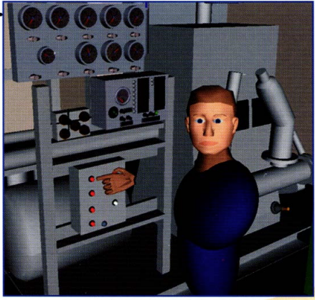
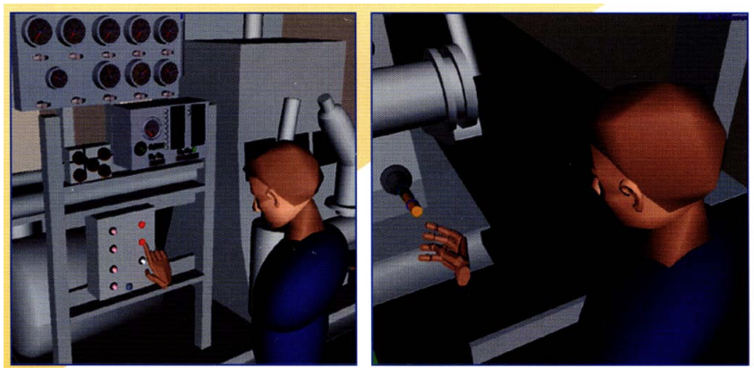
Steve
(Johnson & Rickel, 1997)

Slide 8
Steve
(Johnson & Rickel, 1997)
Uses physical actions to illustrate actions to learners
Steve can explain those actions in detail on demand
Can adapt procedures to the state of the physical world – i.e. if learner missed some steps of procedure and got other steps wrong, he can adjust his demonstration

Slide 9
Questions? Comments?

Slide 10
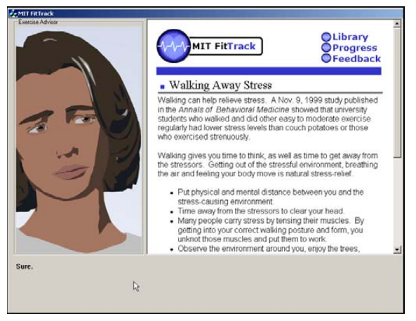
Laura (Bickmore, 2003;
Bickmore & Picard, 2004)

Slide 11
Laura (Bickmore, 2003;
Bickmore & Picard, 2004)
Laura
  coaches undergraduates on exercise behaviors over several sessions
  uses speech and non-verbal gestures to provide empathic feedback based on student responses
    Concerned expression if student says they were not feeling well
    Happy expression if student says they have exercised a lot lately
    “Empathy dialogues” for
      students reporting continuing illness, stress, tiredness, injury
      students reporting anger, disappointment, frustration

Slide 12
Laura (Bickmore, 2003;
Bickmore & Picard, 2004)
Two versions
  Empathic feedback, no empathic feedback
  Between-subjects comparison
Users liked empathic version better (self-report measures)
No difference in exercise behaviors

Slide 13
Comments? Questions?

Slide 14
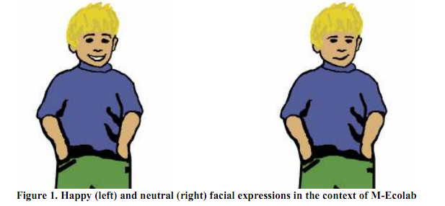
Paul (M-Ecolab)
(Rebolledo-Mendez, du Boulay & Luckin,
2005, 2006)

Slide 15
Paul (M-Ecolab)
Incorporated into ITS for ecology for late elementary-school students
Paul assesses effort, confidence, and independence with machine-learned models

Slide 16
Paul (M-Ecolab)
Paul responds with changes of tone of voice, gestures, and motivational messages
  Expression of concern when student does poorly
  Encouraging messages
    “For the next node try to make fewer errors”
    “Be bold and take on a challenge”

Slide 17
Paul (M-Ecolab)
Paul leads to more help-seeking, but reduces self-perception of independence
Paul leads to higher learning for students who performed average or poorly on post-test
Paul does not lead to differences in affect frequency, but delight is more persistent (Rodrigo, Rebolledo-Mendez, Baker, et al., 2008)

Slide 18
Comments? Questions?

Slide 19
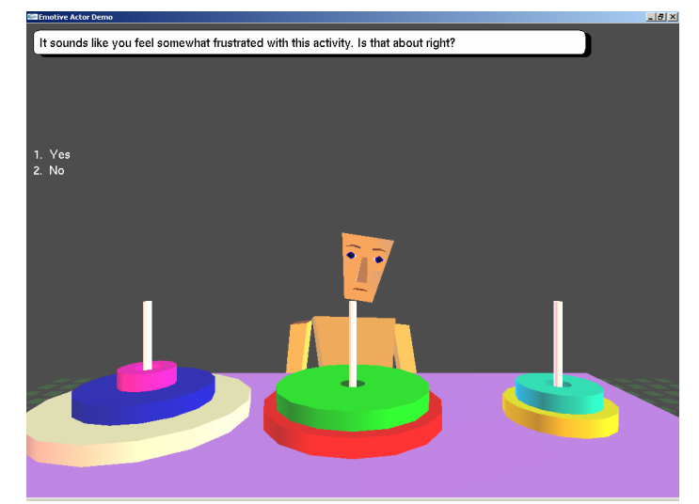
Casey
(Burleson, 2006)

Slide 20
Casey
(Burleson, 2006)
Children taught about Towers of Hanoi in lab setting
Affect monitored by sensors
  Flow, Stuck/Frustration

Slide 21
Casey
(Burleson, 2006)
Agent 2x2 intervention
  non-verbal mirroring of affect, or unrelated affect
  affect support or task-related support
Affect support
  “On a scale from 1 to 7, how frustrated are you feeling right now?”
  “It sounds like you feel somewhat frustrated with this activity. Is that about right?”

Slide 22
Results
No effect on motivation or self-reported frustration
Affect interventions reduced persistence in activity
Learning not measured

Slide 23
Comments? Questions?

Slide 24
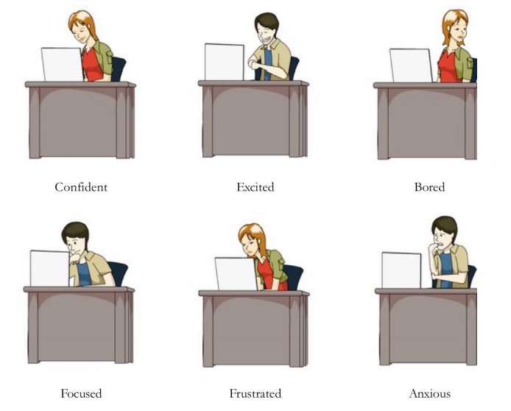
Jake and Jane
(Arroyo et al., 2009)

Slide 25
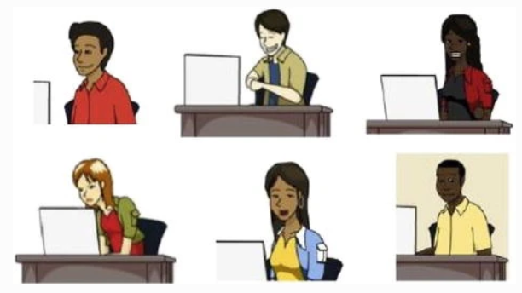
Jake and Jane v2
(Arroyo et al., 2014)

Slide 26
Jake and Jane
Incorporated into Wayang Outpost, ITS for high school mathematics

Slide 27
Jake and Jane
System asks how student is feeling every five minutes
  Confident, Anxious, Frustrated, Excited, Interested, Bored
Learning companion displays affect student reported in their most recent self-report

Slide 28
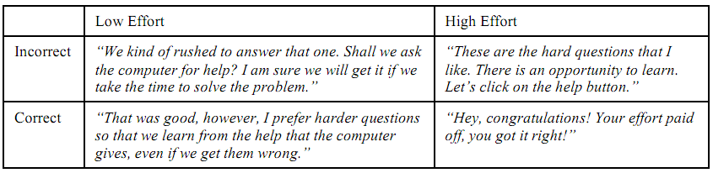
Jake and Jane
Learning companion gives one of 50 meta-cognitive/motivational message at beginning of problem or after first attempt by the student

Slide 29
Jake and Jane
Increased interest
Reduced boredom
Female agent led to better results than male, for students of both genders
  Increased math self-concept and liking
Led to better help-seeking
Did not lead to better learning

Slide 30
Comments? Questions?

Slide 31
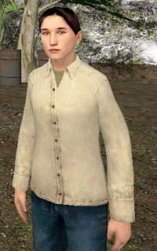
Jin
(Robison, McQuiggan, & Lester, 2009)

Slide 32
Jin
Embedded in Crystal Island, a narrative-centered learning environment for middle school biology

Slide 33
Jin
Reacts in three different ways
Parallel empathy – shows same affect as student
  “Yes, I’m very frustrated as well!”
Reactive empathy – tries to alter student’s affective state
  “I can understand why you are frustrated, but if you keep working, I’m sure you will figure it out.”
Task-based (non-empathic) feedback

Slide 34
Jin
Assesses student affect by asking student their affect every time an interaction starts or ends between Jin and the student
  “Hi Alex, how are you feeling?”
  “How are you feeling now?”
  Anger, anxiety, boredom, confusion, curiosity, delight, excitement, flow, frustration, sadness, fear
    Sadness and fear almost never reported

Slide 35
Jin
Parallel empathy sustains affective states better than reactive empathy
  Leading flow to be more sustained
  But also leading frustration, boredom, anxiety to be more sustained
I could not find learning gains reported

Slide 36
AutoTutor
(Graesser & Person, 2010;
D’Mello, Craig, Fike, & Graesser, 2010)
You may remember AutoTutor from such classes as last week

Slide 37
AutoTutor
You may remember AutoTutor from past classes
The simple presence/absence of the talking head had no impact (Graesser et al., 2003)

Slide 38
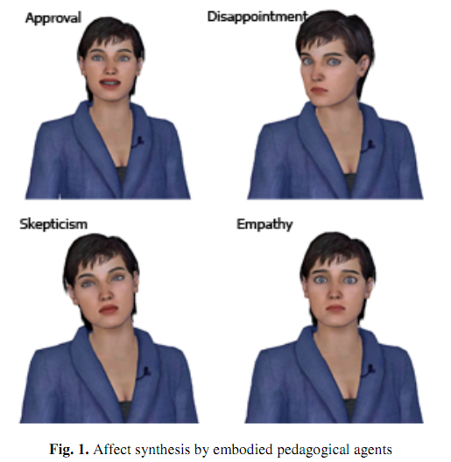
Affective AutoTutor
(D’Mello et al., 2008, 2013)

Slide 39
AutoTutor: Affect Response Modalities
Supportive
  Attributes emotion to material instead of learner
  “This stuff can be kind of dull sometimes, so I’m gonna try and help you get through it. Let’s go.”
  “Hang in there a bit longer. Things are about to get interesting.”
  “Some of this material can be confusing. Just keep going and I am sure you will get it.”
  “I know I do not always convey things clearly. I am always happy to repeat myself if you need it. Try this one.”
  “I know this material can be difficult, but I think you can do it, so let’s see if we can get through the rest of this problem.”

Slide 40
AutoTutor: Affect Response Modalities
Shake-up
  Attributes emotion to learner
  “This material has got you confused, but I think you have the right idea. Try this.”
  “You are not as confused as you might think. I’m actually kind of impressed. Keep it up.”
  “Geez this stuff sucks. I’d be bored too, but I gotta teach what they tell me.”

Slide 41
AutoTutor: Affect Response Modalities
Rude
  Rude/sarcastic responses
  “Aren’t you the little genius.”
  “I thought you were bright, but I sure pegged you wrong.”
  “You know, confusion is just God’s way of telling you that you’re not smart enough for this material.”

Slide 42
Results
(D’Mello et al., 2009, 2010)
Supportive tutor significantly improves learning
  Affect is stronger for students with lower prior knowledge
(Undergraduate) students find rude tutor hilarious

Slide 43
Non-affective embodied interactions
Guru (AutoTutor) (Olney et al., 2012)
https://www.youtube.com/watch?v=FjhXGYnowBY
How does Guru use physical gestures?

Slide 44
Non-affective embodied interactions
Guru (AutoTutor) (Olney et al., 2012)
https://www.youtube.com/watch?v=FjhXGYnowBY
Significant improvement on post-test and delayed post-test

Slide 45
Comments? Questions?

Slide 46
Scooter (Baker et al., 2006)
Scooter.avi

Slide 47
Scooter (Baker et al., 2006)
Scooter responds when students game the system
  Negative emotion
  Supplementary exercises which provide opportunities to learn content bypassed by gaming
Reduces gaming
Improves learning for students who previously gamed

Slide 48
Comments? Questions?

Slide 49
Multiple agents

Slide 50
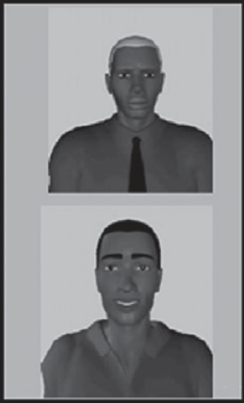
Baylor et al. (2009)
More effective to split into cognitive/affective support agents

Slide 51
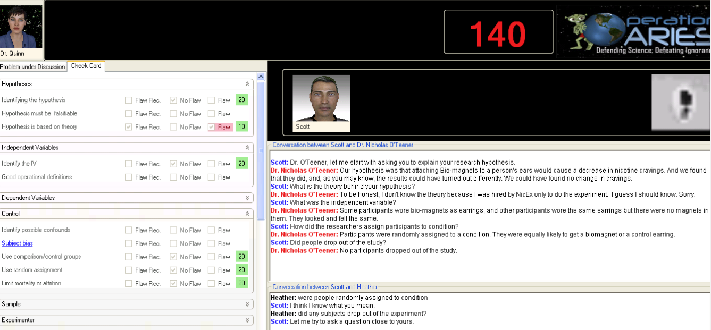
Operation ARIES/ARA
(Millis et al., 2011)
Mentor agent and adversary/rival agents

Slide 52
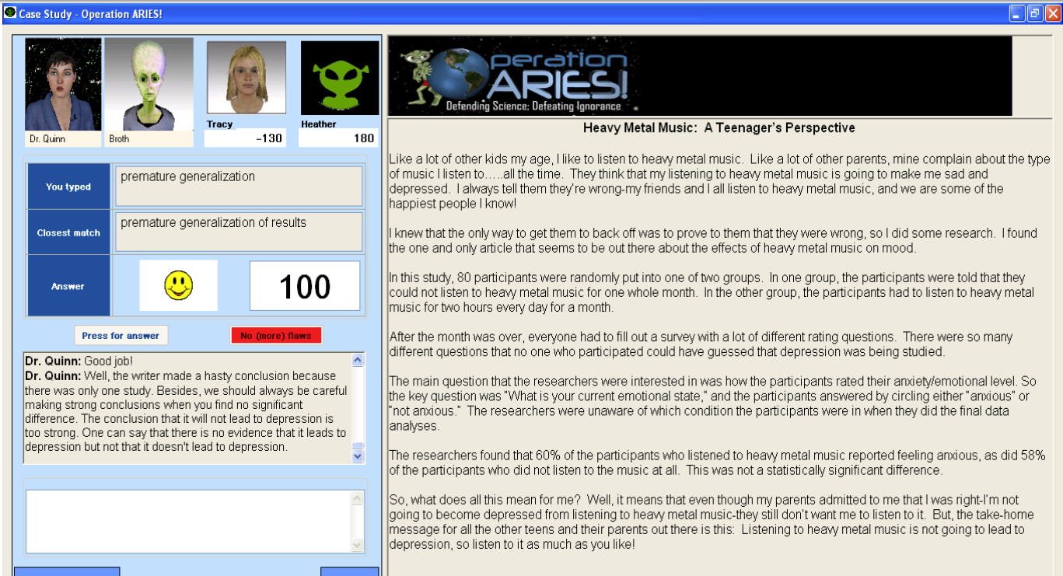
Operation ARIES/ARA
(Millis et al., 2011)

Slide 53
Operation ARIES/ARA
Interrogating possible adversaries
Competing with peers
Watching two agents interacting and then deciding which argument to believe
Discussing with tutor agent while peer agent periodically chimes in
Teaching peer agent with feedback from tutor agent
Positive learning impacts (Graesser et al., 2017)

Slide 54
Operation ARIES/ARA
(Millis et al., 2011)

Slide 55
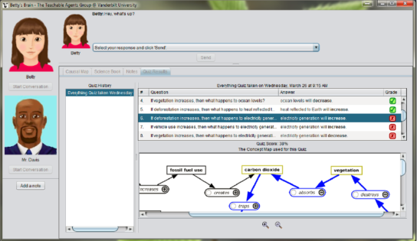
Betty’s Brain
Learn by teaching student agent
Feedback from mentor agent
Discussed in
class a few
weeks ago

Slide 56
Comments? Questions?

Slide 57
Some details of mentor agent design

Slide 58
Baylor & Kim (2003);
Moreno & Flowerday (2006)
Students like mentor agents of the same race more
But learn more from mentor agents of a different race

Slide 59
Plant et al. (2009); Arroyo et al. (2014)
Students tend to learn more from female agents than male agents

Slide 60
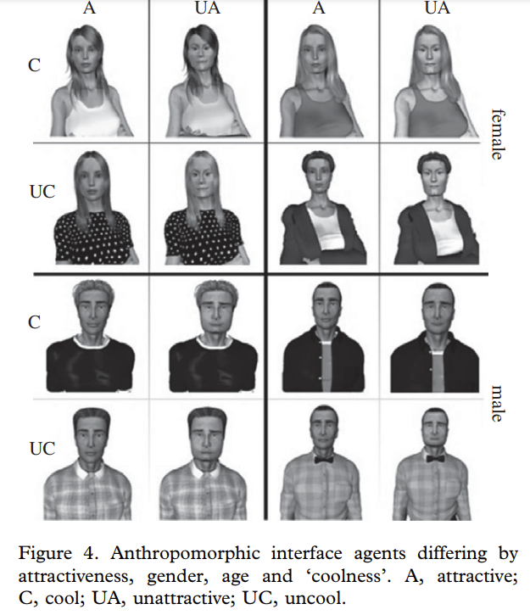
Yee & Bailenson (2007); Bailenson et al. (2008); Plant et al. (2009)
More attractive agents produce more positive responses
But “uncool” agents tend to produce better attitudes for engineering domains
“Cool and young” and “uncool and old” better than “Cool and old” or “uncool and young”

Slide 61
Comments? Questions?

Slide 62
What other systems/findings do readings cover

Slide 63
Klein et al (2002) proposed design principles for affective agents
Which I think could really be applied to any agents

Slide 64
Klein et al (2002) proposed design principles for affective agents
Actively solicit information about the individual’s state (particularly emotional)
Solicit information in a timely fashion
Make sure the user is able to express what she is feeling (e.g. affective label choices are appropriate)
Provide feedback, especially on emotional content
Allow for repair if the feedback is judged wrong
Convey a sense of sympathy to the user
Communicate a sense of empathy to the user as well
Convey to the user the sense that his emotional state is valid

Slide 65
Are these principles reasonable?
Actively solicit information about the individual’s state (particularly emotional)
Solicit information in a timely fashion
Make sure the user is able to express what she is feeling (e.g. affective label choices are appropriate)
Provide feedback, especially on emotional content
Allow for repair if the feedback is judged wrong
Convey a sense of sympathy to the user
Communicate a sense of empathy to the user as well
Convey to the user the sense that his emotional state is valid

Slide 66
What else
What else seemed to characterize the more successful agents?

Slide 67
Broader Comments or Questions?

Slide 68
Upcoming classes
Dec 1
  Games and Gamification
  VIRTUAL CLASS
  NO OFFICE HOURS
Dec 8
  A/B Testing and Iterative Refinement
Dec 15
  Intelligent Tutoring Systems in the Classroom

Slide 69
The End

