Slide 1
Foundations of
Teaching and Learning
November 15, 2021

Slide 2
Assignment 4
Overview
Any comments or questions?

Slide 3
Motivation, Interest, and Engagement
Each a large enough topic that they could easily be a class by themselves
Today is necessarily going to be an overly-rapid survey
Still, please ask lots of questions and share your thoughts

Slide 4
Engagement and Disengagement
Cognitive
Behavioral
Affective (will be discussed in mid-December)
(Fredricks et al., 2004)

Slide 5
Cognitive Engagement
Sometimes operationalized through questionnaires (often using self-reports of behaviors that sound more to me like self-regulated learning behaviors)

Slide 6
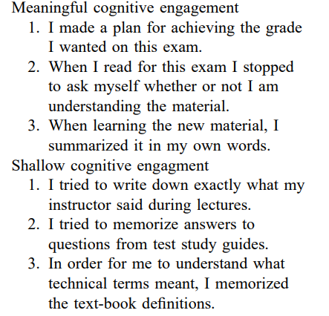
Cognitive Engagement Instrument
(Greene & Miller, 1996)

Slide 7
Alternative measures
Measuring mental effort using EEG (Mills et al., 2017)
Experience sampling for mind wandering (Schooler et al., 2005)
Measuring mind wandering using interaction data (Mills & D’Mello, 2015) or eye tracking (Reichle et al., 2010; Hutt et al., 2017)

Slide 8
Behavioral engagement
Considered both in long-term and short-term
Measured in a range of ways
  Self-report
  Observation
  Interaction logs (see review in Baker & Rossi, 2014)

Slide 9
Behavioral engagement: longer-term
Attendance
School dropout
College attendance
Participation in career pipeline
Grit (will discuss in a minute)

Slide 10
Behavioral engagement: short-term
Off-Task Behavior
Gaming the System
Carelessness
Wheel-Spinning

Slide 11
Behavioral engagement: short-term
Off-Task Behavior
Gaming the System
Carelessness
Wheel-Spinning
Evidence is stronger for longitudinal negative impact of gaming the system and carelessness than off-task behavior!
(Pardos et al., 2014; San Pedro et al., 2014; Almeda & Baker, 2020)

Slide 12
Grit

Slide 13
Grit
My personal story of repeated failure and continual struggle on the way to UPenn

Slide 14
What is grit?

Slide 15
What is grit?
“Perseverance and passion for long-term goals.”

Slide 16
Does grit matter?
Recent meta-analysis (Crede et al., 2016) reported as finding that grit doesn’t matter
But a closer reading of that meta-analysis indicates that, across 88 studies, grit is associated with better long-term outcomes
However, the self-discipline and persistence aspects of grit matter more than the passion aspect

Slide 17
Is grit a unitary construct?
Crede et al (2016) argue that passion and perseverance are separate

Slide 18
Is all persistence good?

Slide 19
Wheel-spinning
Beck & Gong (2013) find that many students complete 10 of the same type of problem in a learning system without reaching mastery

Slide 20
Wheel-spinning
Beck & Gong (2013) find that many students complete 10 of the same type of problem in a learning system without reaching mastery
Anecdotally, I’ve seen data where a student completed 141 of the same type of problem without reaching mastery

Slide 21
Wheel-spinning, grit, and outcomes
Adjei et al. (2021) study relationship to college attendance years later
  Grit associated with positive outcomes years later
  Quitting too quickly is associated with negative outcomes
  Wheel-spinning had null effect

Slide 22
How do we avoid wheel-spinning while being gritty?
AKA how do we convert wheel-spinning to grit?
What strategies can we use, or ask our students to use?

Slide 23
What is deliberate practice?
Why is it important?

Slide 24
Should we always be gritty anyways?
Can any of you name situations where you are glad you weren’t gritty?

Slide 25
How…
How do we get our students to be gritty on important tasks?
Pursuing their passions (that matter) with continued and deliberate effort

Slide 26
Past experiences
Has anyone here worked in a school or organization that tried to create grit? Was it successful?

Slide 27
Thoughts? Comments? Questions?

Slide 28
Self-theories
(Dweck & Leggett, 1988; Dweck, 2000)
Theory of Fixed Intelligence
  “Entity Theory”, “Fixed Mindset”
  Intelligence is not changeable
  Some people are smart and some people are dumb
Theory of Malleable Intelligence
  “Incremental Theory”, “Growth Mindset”
  Intelligence can be increased through one’s efforts
  Everyone can become smarter

Slide 29
Generally positive evidence for Growth Mindset interventions
Associated with improving grades across middle school (Blackwell et al., 2009)
Improved grades for high school students (Paunesku et al., 2015)
Improved GPA for high school students (Yeager et al., 2016)
Null effect in large study of students entering college for retention or GPA (Yeager et al., 2016)

Slide 30
Past experiences
Has anyone here worked in a school or organization that tried to create a growth mindset? Was it successful?

Slide 31
How should growth mindset interventions be delivered?
Yeager seems to find positive effects for text messages delivered by internet.
Class DoJo uses cartoons.
Which is the best way to do this? Should teachers be involved?

Slide 32
Questions? Comments?

Slide 33
Delay of Gratification
https://www.youtube.com/watch?v=QX_oy9614HQ

Slide 34
Delay of Gratification
Several studies by Walter Mischel have found that the ability to wait to eat the marshmallow are associated with better life outcomes

Slide 35


Slide 36
Past experiences
Has anyone here worked in a school or organization that tried to encourage delay of gratification? Was it successful?

Slide 37
Questions? Comments?

Slide 38
Goals
Historically referred to as “goal orientation” (Pintrich, 2000)
But typically term “orientation” is now dropped based on evidence that student goals are situationally determined and malleable
  cf. McNeil & Alibali, 2000

Slide 39
Core Goals
Learning/Mastery Goals (Dweck & Elliott, 1983)
Performance-Approach Goals (Elliot & McGregor, 2002)
Performance-Avoidance Goals (Elliot & McGregor, 2002)
Work Avoidance Goals (Harackiewicz et al., 1997)

Slide 40
Correlations to Outcomes:
Mostly Small and Somewhat Unstable
 | Exam Scores | Course Grades
Mastery Goals | Sometimes/r<0.2 | Sometimes
Performance-Approach Goals | Sometimes/r<0.2 | Sometimes/r<0.2
Performance-Avoidance Goals | Replicated; r of -0.25 to -0.3 | Sometimes
Work Avoidance Goals | No results | Sometimes/r<-0.2

Slide 41
Some Evidence
That goals are malleable (McNeil & Alibali, 2000)
But that it can be effective to align pedagogical support with either performance-approach or learning goals (Rebolledo-Mendez et al., 2005, 2006, 2008)

Slide 42
Questions? Comments?

Slide 43
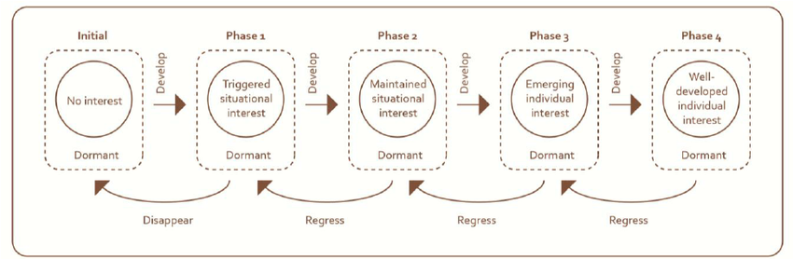
Interest (Hidi & Renninger, 2006)
Diagram from Beh (2015)

Slide 44
Questions? Comments?

Slide 45
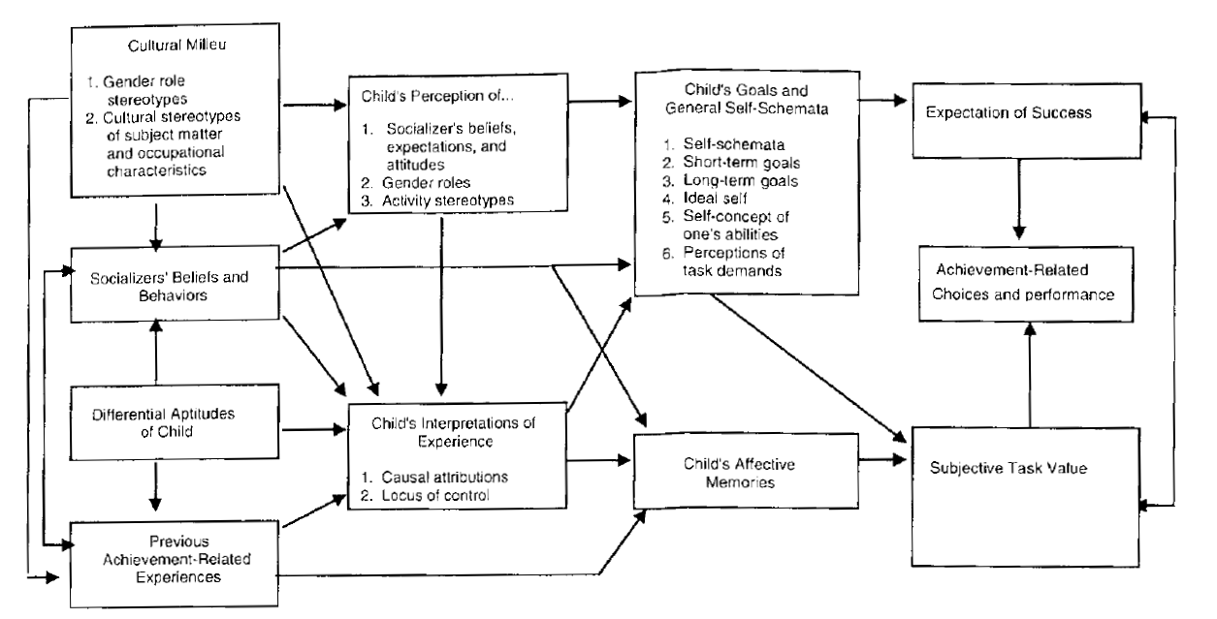
Expectancy-Value Theory

Slide 46
Questions? Comments?

Slide 47
Overall
Questions? Comments?

Slide 48
Upcoming Classes
11/24: (Special Day) Constructionism
12/3: Effective Learning Strategies
12/10: Emotions and Learning
12/17: Social Factors that Mediate Learning
12/20: Final Paper due

Slide 49
Activity in the unlikely event we have time

Slide 50
6 groups: you are developing
Training for sales people trying to convince local mini-marts to stock a new type of ice cream
A new charter high school for disadvantaged students
An intake program for undergraduates at a low-tier rural university
An intake program for undergraduates from very low HDI countries at Penn
A support group for PhD students at a top-ranked engineering graduate school with high dropout rates
A training program for aspiring childrens’ chess champions

Slide 51
Your task
Take 15 minutes and come up with an intervention to promote successful and appropriate grit
  E.g. neither wheel-spinning due to poor strategy or choosing an inappropriate goal
No artifact required, but have a plan

Slide 52
Please share your plans with the room

