Slide 1
Foundations of
Teaching and Learning
September 3, 2021

Slide 2
Welcome to
EDUC 616:
Foundations of Teaching and Learning
Seminar-style course where we’ll discuss several perspectives on what learning and teaching are and should be
Connecting these perspectives to philosophy and theory on the nature of design and inquiry
I hope you’ll come away from this class with an appreciation for what each of these perspectives brings to the discussion and broader field

Slide 3
Format
Blended reading/lecture/discussion
Discussion in class and on discussion forum

Slide 4
Do the readings
I know there’s a lot of readings
You will get a lot less out of this class, if you skip the readings
You also won’t do as well on the assignments

Slide 5
Course times
Friday 630am-820am
Early for some, late for others

Slide 6
Course Prerequisite
None

Slide 7
Assignments
Reflection on your own learning 15%
  Already posted on course website
  Due September 13
Learning Theory Matrix 10%
  Due October 4
Applying Theory to a Contemporary Educational Problem 25%
  Prospectus Due October 18
  Paper Due November 15
Analysis and Revision of Learning System 25%
  Due December 20
Participation 25%
  In-Class Participation 10%
  Discussion Forum Participation 15%

Slide 8
Required Books
Vygotsky, L. S. (1978). Mind in society: The development of higher psychological processes.
  Needed for class September 24
Dewey, J. (1938/1963). Experience and education.

Slide 9
Other Readings
Available at LINK

Slide 10
Questions about Syllabus?

Slide 11
Extensions?
In this class, we will be engaged in an ongoing discussion about assignments
Therefore extensions for the assignments will only be available in case of instructor error or extreme circumstances (assignments in other classes, research studies, and so on do not count as extreme circumstances; serious injury, illness, COVID quarantine, or death in the family do count as extreme circumstances). Outside of these circumstances, late hand-ins will not be accepted (e.g. zero credit will be given).

Slide 12
Where to find stuff
Course discussion forum
piazza.com/upenn/fall2021/educ616
Course website
https://www.upenn.edu/learninganalytics/ryanbaker/FTL2021

Slide 13
Discussion Forum
Will be incorporated into participation grade, along with class participation
  Just showing up to class and sitting silently does not count as class participation
If you have a question for me that is not completely specific (e.g. why did I get a B?), please post it to the forum
  I get hundreds of real emails a day, I will read the forum first

Slide 14
Discussion Groups
You will be placed in a Piazza discussion group, after today’s class
  I wanted to see who would actually come to the first class
Each week you will be provided several prompts related to the readings. Once you have completed the readings, you will write a short, informal response to one of the prompts (1 to 2 paragraphs)
Your initial post is due 24 hours before your class session
Please respond to the posts by your group members before class time
In preparation for the class meetings, you should read the responses posted by others in your discussion group

Slide 15
Ways to get in touch with me
Post to the forum
  Strongly preferred for all questions that could be of interest to other students
Come to office hours, 4pm-5pm Wednesday (at bluejeans)
Set up a meeting penn.learninganalytics@gmail.com
Questions on grades, being late, or missing class ryanshaunbaker@gmail.com
Use the right approach, get a much faster response

Slide 16
Introductions
Everyone please
Say your name
Say what program you’re studying in
Say what your current job is (if you have one)
Say why you’re interested in the material in this class (if you are)
Say what you hope to be doing in 5 years

Slide 17
What we will study this semester
Exploration of major theories of learning, theorists that introduced them, and their implications for practice
Examine several pedagogical frameworks and perspectives and their implications for educational practice
How emerging technologies shape modern learning
Social factors and phenomena that influence and moderate learning in context.

Slide 18
What we will study this semester
To the syllabus!

Slide 19
Questions? Comments?

Slide 20
Where do different theories come from?
Different theories conceptualize learning differently
They also come from different philosophical assumptions about how to construct theory itself
  The difference phenomena we choose to study are dependent in part on the way we look at meaning itself

Slide 21
Buchanan and McKeon’s Framework
“Ways to design”
“The cross of pane”

Slide 22
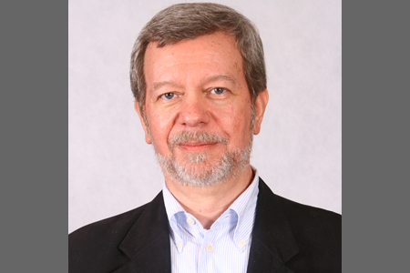
Dick Buchanan
Founder of journal Design Issues
Inventor of term “wicked problem”
Key theoretician of design in the 1990s and the first decade of the 2000s

Slide 23

Richard McKeon
Key 20th century philosopher
Referred to as the “Evil Professor” by Robert Pirsig in Zen and the Art of Motorcycle Maintanance

Slide 24
Buchanan and McKeon’s Framework
HOLISTIC
EXISTENTIALIST
ESSENTIALIST
ENTITATIVE

Slide 25
Buchanan and McKeon’s Framework
HOLISTIC
EXISTENTIALIST
ESSENTIALIST
ENTITATIVE

Slide 26
Buchanan and McKeon’s Framework
HOLISTIC
EXISTENTIALIST
ESSENTIALIST
Includes both “Cognitivism” and “Behaviorism”
ENTITATIVE

Slide 27
Buchanan and McKeon’s Framework
HOLISTIC
EXISTENTIALIST
ESSENTIALIST
You can understand things “in themselves”
ENTITATIVE

Slide 28
Buchanan and McKeon’s Framework
HOLISTIC
EXISTENTIALIST
ESSENTIALIST
You can understand things separately from their contexts
ENTITATIVE

Slide 29
Buchanan and McKeon’s Framework
HOLISTIC
EXISTENTIALIST
ESSENTIALIST
Individuals learn skills and concepts
ENTITATIVE

Slide 30
Buchanan and McKeon’s Framework
HOLISTIC
EXISTENTIALIST
ESSENTIALIST
Key method: REDUCTIONISM
ENTITATIVE

Slide 31
What is reductionism?

Slide 32
Buchanan and McKeon’s Framework
HOLISTIC
EXISTENTIALIST
ESSENTIALIST
We can understand complex phenomena by understanding their parts and how those parts interact
ENTITATIVE

Slide 33
Buchanan and McKeon’s Framework
HOLISTIC
EXISTENTIALIST
ESSENTIALIST
Emergent phenomena can be understood by first understanding the motivating factors and processes
ENTITATIVE

Slide 34
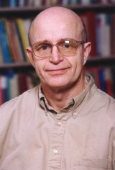
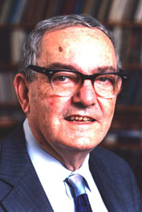
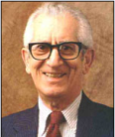
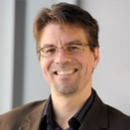
Entitative Thinkers
HOLISTIC
EXISTENTIALIST
ESSENTIALIST
Anderson
Simon
Bloom
Koedinger
ENTITATIVE

Slide 35
Buchanan and McKeon’s Framework
HOLISTIC
EXISTENTIALIST
ESSENTIALIST
ENTITATIVE

Slide 36
Buchanan and McKeon’s Framework
HOLISTIC
Called “the ontological approach” by Buchanan, and Gestalt by others
EXISTENTIALIST
ESSENTIALIST
ENTITATIVE

Slide 37
Buchanan and McKeon’s Framework
HOLISTIC
In education, called “Situationalism” or “Activity Theory” or “Social Cognitivism” by its friends
EXISTENTIALIST
ESSENTIALIST
ENTITATIVE

Slide 38
Buchanan and McKeon’s Framework
HOLISTIC
Things can only be understood by understanding the systems they operate in
EXISTENTIALIST
ESSENTIALIST
ENTITATIVE

Slide 39
Buchanan and McKeon’s Framework
Learners are enculturated into practices that communities agree are correct
HOLISTIC
EXISTENTIALIST
ESSENTIALIST
ENTITATIVE

Slide 40
Buchanan and McKeon’s Framework
HOLISTIC
Complex phenomena must be
understood as wholes; they can not be
understood in terms of their
component parts
EXISTENTIALIST
ESSENTIALIST
ENTITATIVE

Slide 41
Buchanan and McKeon’s Framework
HOLISTIC
Emergent phenomena must be understood in themselves
EXISTENTIALIST
ESSENTIALIST
ENTITATIVE

Slide 42
Buchanan and McKeon’s Framework
HOLISTIC
Key method: DIALECTIC
EXISTENTIALIST
ESSENTIALIST
ENTITATIVE

Slide 43
What is dialectic?

Slide 44
Buchanan and McKeon’s Framework
HOLISTIC
Truth is found through the struggle of opposing hypotheses and their eventual unification in a richer synthesis (Hegelian-Kantian dialectic)
EXISTENTIALIST
ESSENTIALIST
ENTITATIVE

Slide 45
Buchanan and McKeon’s Framework
HOLISTIC
Truth is found through positing overly abstract hypotheses, finding evidence that negates them, and coming to a newer concrete theory (Hegelian dialectic)
EXISTENTIALIST
ESSENTIALIST
ENTITATIVE

Slide 46
Buchanan and McKeon’s Framework
HOLISTIC
Change is governed by historical properties (historicism) where contradictions and states repeat themselves but in continual refinement (material dialectic)
EXISTENTIALIST
ESSENTIALIST
ENTITATIVE

Slide 47
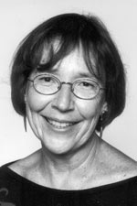
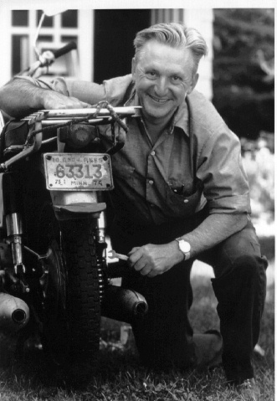
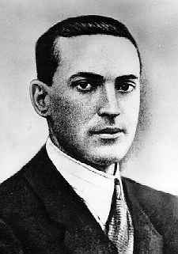
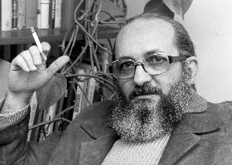
Dialectical Thinkers
HOLISTIC
Lave
Pirsig
Vygotsky Freire
EXISTENTIALIST
ESSENTIALIST
ENTITATIVE

Slide 48
Another key dimension
Is there a reality out there that we want students to learn about?
Are we just teaching cultural practices, or are we teaching real things?

Slide 49
Buchanan and McKeon’s Framework
HOLISTIC
EXISTENTIALIST
ESSENTIALIST
ENTITATIVE

Slide 50
Buchanan and McKeon’s Framework
HOLISTIC
Doesn’t really have a name that its friends call it, in education
EXISTENTIALIST
ESSENTIALIST
ENTITATIVE

Slide 51
Buchanan and McKeon’s Framework
HOLISTIC
Doesn’t really have a name that its friends call it, in education
EXISTENTIALIST
ESSENTIALIST
Despite being probably the most popular approach!
ENTITATIVE

Slide 52
Buchanan and McKeon’s Framework
HOLISTIC
Maybe one could call it “The Curricular Approach”
EXISTENTIALIST
ESSENTIALIST
ENTITATIVE

Slide 53
Buchanan and McKeon’s Framework
HOLISTIC
Its enemies used to call it “Instructionism”
(cf. Papert, 1981)
EXISTENTIALIST
ESSENTIALIST
ENTITATIVE

Slide 54
Buchanan and McKeon’s Framework
HOLISTIC
EXISTENTIALIST
ESSENTIALIST
There is a real fundamental reality to the universe that students can learn about
ENTITATIVE

Slide 55
Buchanan and McKeon’s Framework
HOLISTIC
EXISTENTIALIST
ESSENTIALIST
Or, in the “Pragmatic Essentialism” form, there are beliefs, skills, and practices that are so core to a specific culture and context as to be real for all practical purposes
ENTITATIVE

Slide 56
Buchanan and McKeon’s Framework
HOLISTIC
EXISTENTIALIST
ESSENTIALIST
Essentialism is implicit in the focus on mathematical skills, scientific skills, and literacy, and the “Common Core”
ENTITATIVE

Slide 57
Buchanan and McKeon’s Framework
HOLISTIC
Knowledge can be measured and compared, because there’s some real reference that two students can be compared according to
EXISTENTIALIST
ESSENTIALIST
ENTITATIVE

Slide 58
Buchanan and McKeon’s Framework
HOLISTIC
EXISTENTIALIST
ESSENTIALIST
If you use the Common Core, PSSA, or other standardized exams, you’re an essentialist in practice
ENTITATIVE

Slide 59
Buchanan and McKeon’s Framework
HOLISTIC
EXISTENTIALIST
ESSENTIALIST
If you think standardized exams are worthless because they don’t measure real math/science skill/knowledge, you’re still an essentialist
ENTITATIVE

Slide 60

Buchanan and McKeon’s Framework
HOLISTIC
EXISTENTIALIST
ESSENTIALIST
Gagne
ENTITATIVE

Slide 61
Buchanan and McKeon’s Framework
HOLISTIC
EXISTENTIALIST
ESSENTIALIST
ENTITATIVE

Slide 62
Buchanan and McKeon’s Framework
HOLISTIC
In education, called “Constructionism” by its friends
EXISTENTIALIST
ESSENTIALIST
ENTITATIVE

Slide 63
Buchanan and McKeon’s Framework
HOLISTIC
“Constructionism” is not the same thing as “Constructivism”
EXISTENTIALIST
ESSENTIALIST
ENTITATIVE

Slide 64
Buchanan and McKeon’s Framework
“Constructivism” (a la Piaget) argues that students learn actively rather than passively, and learn best by doing. It’s pretty much orthogonal to the dimensions shown below.
HOLISTIC
EXISTENTIALIST
ESSENTIALIST
ENTITATIVE

Slide 65
Buchanan and McKeon’s Framework
HOLISTIC
EXISTENTIALIST
ESSENTIALIST
Everyone defines their own reality in their own individual way
ENTITATIVE

Slide 66
Buchanan and McKeon’s Framework
HOLISTIC
EXISTENTIALIST
ESSENTIALIST
Agreed-upon conventions are simply agreed-upon conventions and reflect no fundamental reality
ENTITATIVE

Slide 67
Buchanan and McKeon’s Framework
HOLISTIC
EXISTENTIALIST
ESSENTIALIST
0, 1, and 42 are social constructions; blue and red are social constructions
ENTITATIVE

Slide 68
Buchanan and McKeon’s Framework
HOLISTIC
And they’re actually not even the same thing in different peoples’ heads
EXISTENTIALIST
ESSENTIALIST
ENTITATIVE

Slide 69
Buchanan and McKeon’s Framework
HOLISTIC
So when you and I think of “42” we’re thinking of different things
EXISTENTIALIST
ESSENTIALIST
ENTITATIVE

Slide 70
Buchanan and McKeon’s Framework
Because of this, measuring learning is fundamentally misguided – there is no real commonality to compare – even if we manifest the same behavior, the cognitive reality is unreduceable
HOLISTIC
EXISTENTIALIST
ESSENTIALIST
ENTITATIVE

Slide 71
Buchanan and McKeon’s Framework
HOLISTIC
EXISTENTIALIST
ESSENTIALIST
If you think that standardized exams are junk, and never can be improved in any way, because tests cannot measure anything that matters, you’re an existentialist in practice
ENTITATIVE

Slide 72
Buchanan and McKeon’s Framework
HOLISTIC
EXISTENTIALIST
ESSENTIALIST
School should not focus on math or literacy skills, it should focus on “learning how to learn” and generating passion for learning, because everyone will be passionate and skilled at different things
ENTITATIVE

Slide 73
Buchanan and McKeon’s Framework
HOLISTIC
EXISTENTIALIST
ESSENTIALIST
So if you want to measure something, measure passion or measure the great things a student can do and the surprising connections they make
ENTITATIVE

Slide 74
Buchanan and McKeon’s Framework
HOLISTIC
EXISTENTIALIST
ESSENTIALIST
And help learners to make connections across their lives, helping them develop their own individual journey
ENTITATIVE

Slide 75
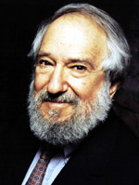
Buchanan and McKeon’s Framework
HOLISTIC
Papert
EXISTENTIALIST
ESSENTIALIST
ENTITATIVE

Slide 76
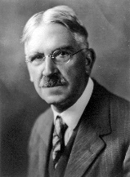
Buchanan and McKeon’s Framework
HOLISTIC
Papert
EXISTENTIALIST
ESSENTIALIST
Dewey wasn’t a constructionist, but you’ll notice some echoes when we read Dewey
ENTITATIVE

Slide 77
Questions, Comments about this?

Slide 78
Crossing the Center
Many researchers are at the diagonals of this graph rather than the ends
Some researchers do not fit neatly in these categories
  e.g. they use both holistic and entitative methods when they seem useful
That said… Buchanan claims that most researchers and designers have a strong preference, and I have generally found that to be true
  I *definitely* have preferences
  And the only major education theorist I’ve ever seen who wrote in both holistic and entitative ways effectively was Vygotsky

Slide 79
Methods
Most education research methods are tightly identified with one (or at most two, at a diagonal) of these philosophical positions
Analytics/data mining seems to be an exception, as it can be used in ways compatible with each of these perspectives
  A fuller discussion of this is outside of the scope of this class

Slide 80
At the extreme
Researchers who are strongly identified with one position tend to find research drawing on the opposite set of assumptions
  incomprehensible, outdated, acting in bad faith,
  or even evil
Example: Greeno-Reder/Anderson/Simon debate
Example: Papert, “Perestroika and Epistemological Politics”

Slide 81
Papert and Perestroika
(If we have time)

Slide 82
Papert and Perestroika
“I believe in consensus. But I have been driven to look at educational decisions with a confrontational eye. This does not mean giving up the ideal of consensual thinking, rather it means changing the community within which to seek the consensus. There is no chance that all educators will come together on the same side of the intellectual front I am trying to demarcate here.”

Slide 83
Papert and Perestroika
“It would be cozier to think that the large issues of educational policy could be settled consensually throughout the education world by the persuasive power of normal science – by the accumulation of incremental scientific knowledge about the ‘best’ conditions for learning. But I am now convinced that, at the very least, something more akin to a Kuhnian revolution is needed. New paradigms are emerging and one cannot expect the established order of the new paradigms to give up their positions... But perhaps even the concept of a Kuhnian revolution unduly limits the scope of what is necessary to bring about real change in education.”

Slide 84
Papert and Perestroika
“No experts predicted the fall of the Berlin Wall or the newly found freedom of speech and religion in the Soviet Union. Institutions that seemed firmly anchored have fallen, giving heart to those of us who have hoped for significant change in education… I look at the events in these places [South Africa, Chile, Eastern Europe] as a source of insight into the nature of our own fight for change in education.”

Slide 85
Papert and Perestroika
“What is our fight really about? My reference to the Soviet Union comes from recognizing events there… as one whose central issues are closely related to those that will dominate any deep change in education. What has happened in the Soviet Union is the collapse of a political and economic structure that invites descriptions like hierarchical, centralized, depersonalized. The confrontation in epistemology invites similar description as hierarchical-centralized-distanced vs. heterarchical-decentralized-personal conceptions of knowledge. The confrontation in education reflects both the political/social and the epistemeological confrontations in the battle between curriculum-centered, teacher-driven forms of instruction, and student-centered developmental approaches to intellectual growth.”

Slide 86
I’m a big believer that
We can all learn from each other

Slide 87
Where do you fit on this diagram?
HOLISTIC
EXISTENTIALIST
ESSENTIALIST
ENTITATIVE

Slide 88
Upcoming Classes
9/10: Behaviorism (Skinner)
9/17: Classic Constructivism (Piaget)
9/24: Sociocultural Theories (Vygotsky)

