Slide 1
Foundations of
Teaching and Learning
October 1, 2021

Slide 2
Learning Theory Matrix
Any questions or comments?

Slide 3
Instructionism
Hard to define
The central paradigm of contemporary schooling in the USA and many other countries
And yet “instructionism” is primarily defined by people who disagree with it

Slide 4
Instructionism
Papert’s Instructionism
Dewey’s Traditional Schools (next week!)
Freire’s Banking Education (October 22!)

Slide 5
Instructionism
Instruction is at the center of the learning experience
Instruction has a pre-defined goal for what we want the student to learn
Instruction is something that is designed (whether expertly or poorly)
Instruction is something that is led by the teacher (or a computer system) instead of the student

Slide 6
Direct Instruction
You might think this is a little easier to define
But even there, Rosenshine (2008) finds five distinct definitions in the literature

Slide 7
Two of Rosenshine (2008)’s defintions
1. Academic instruction that is led by a teacher
5. Settings where the teacher lectures and the students sit passively

Slide 8
The key disjunction
People who favor this kind of approach think in terms of instruction as something that is
  designed by someone (often a teacher, could be an instructional designer)
  Implemented by someone (usually a teacher, could be a computer)
People who are negative to this approach think in terms of passive lecture

Slide 9
Key to the Instructionist Paradigm
Principles, Processes, and Practices for instruction
Resulting in good designs and good implementation of those designs of instruction
Resulting in good learning

Slide 10
Questions so far?
We’ll get more concrete in a minute

Slide 11
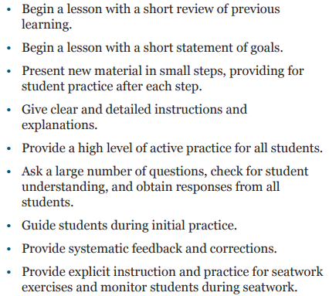
An example
Rosenshine & Stevens (1986) pattern

Slide 12
Key Instructionist Thinkers
Often highly influential on modern schools in the USA
And
Generally unknown by the people who use the practices they developed

Slide 13
Key Instructionist Thinkers
Often highly influential on modern schools in the USA
And
Generally unknown by the people who use the practices they developed

Slide 14
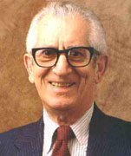
Benjamin Bloom
Tried to assemble the first attempt towards a “grand unified theory” of education and learning

Slide 15
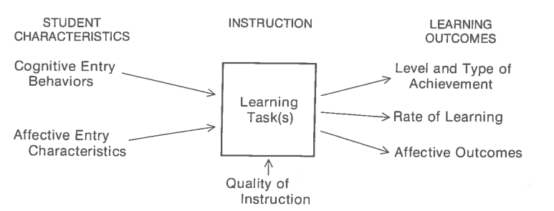
Bloom’s Model of School Learning
We put the right inputs in
We get the right outputs out

Slide 16
But what goes in the box and arrow in the middle?
That’s the core question of instructionism

Slide 17
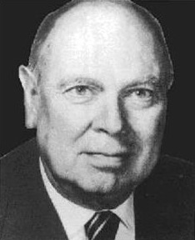
Robert Gagne

Slide 18
Key focus
Understand and formally model the instructional objectives
Understand and structure the content to be taught
Determine proper order of content
  Pre-requisite structure
Plan proper procedure for teaching

Slide 19
Knowledge graphs in adaptive learning
They come from Gagne’s work in defining prerequisite structures in content!

Slide 20
Nine events of instruction
(Gagne, 1974)
Gain attention
Tell the learners the learning objective
Stimulate recall of prior learning
Present the stimulus (content)
Provide learning guidance
Elicit performance
Provide feedback
Assess performance
Enhance retention and transfer

Slide 21
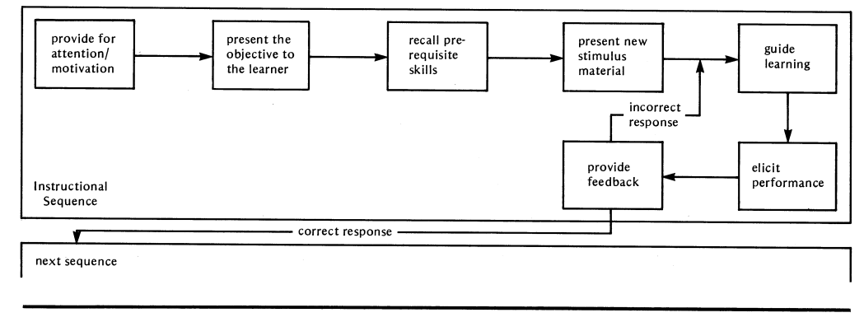
Procedure for computer-aided instruction (Gagne et al., 1981)
Simplification of his model for teachers

Slide 22
Comments? Questions? Concerns?

Slide 23
You probably think this is all too simple…
And so did Gagne’s junior colleague and occasional debate rival

Slide 24
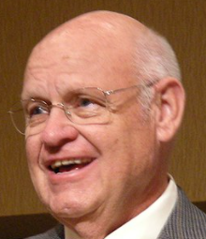
M. David Merrill

Slide 25
Merrill’s article
Jam-packed with interesting ideas and practices for good instruction
Survey of multiple models of instruction and claim that they all involve the same first principles of instruction
  Including models from both cognitive and constructivist perspectives!

Slide 26
Merrill’s four phases of learning (instruction?)
(a) activation of prior experience
(b) demonstration of skills
(c) application of skills
(d) integration of these skills into real-world activities

Slide 27
Merrill’s (2002) five instructional principles
1. Learning is promoted when learners are engaged in solving real-world problems.
2. Learning is promoted when existing knowledge is activated as a foundation for new knowledge.
3. Learning is promoted when new knowledge is demonstrated to the learner.
4. Learning is promoted when new knowledge is applied by the learner.
5. Learning is promoted when new knowledge is integrated into the learner’s world.

Slide 28
Merrill’s critique of most instruction
“Much instructional practice concentrates primarily on the demonstration phase and ignores the other phases in this cycle of learning.”

Slide 29
Merrill’s critique of most instruction
“Much instructional practice concentrates primarily on the demonstration phase and ignores the other phases in this cycle of learning.”
But do note – in Merrill, demonstration (by the teacher or other instructional materials) is a key part of the learning process

Slide 30
Comments? Questions?

Slide 31
What did Merrill mean by problem-centered instruction?
“I use the word problem to include a wide range of activities, with the most critical characteristics being that the activity is some whole task rather than only components of a task and that the task is representative of those the learner will encounter in the world following instruction. Problem-centered instruction is contrasted with topic-centered instruction where components of the task are taught in isolation (e.g., “You won’t understand this now but later it will really be important to you”) before introducing the real world task to the students.”

Slide 32
What did Merrill mean by problem-centered instruction?
“I use the word problem to include a wide range of activities, with the most critical characteristics being that the activity is some whole task rather than only components of a task and that the task is representative of those the learner will encounter in the world following instruction. Problem-centered instruction is contrasted with topic-centered instruction where components of the task are taught in isolation (e.g., “You won’t understand this now but later it will really be important to you”) before introducing the real world task to the students.”
What
what?

Slide 33
Problem-centered instruction
“Learning to complete a whole task involves four levels of instruction:
(a) the problem
(b) the tasks required to solve the problem
(c) the operations that comprise the tasks
(d) the actions that comprise the operations.
Effective instruction should engage students in all four levels of performance.

Slide 34
Problem-centered instruction
“To master a complex problem students must first start with a less complex problem. When the first problem is mastered, students are then given a more complex problem. Through a progression of increasingly complex problems, the students’ skills gradually improve until they are able to solve complex problems.”

Slide 35
Different structures of instruction
Learn each of the component skills, based on prerequisite order, before thinking about solving a complex problem
Solve increasingly complex problems, but focused on the overall problem from the start
That’s more like it
No this is better

Slide 36
Note the kind of debates we can have within this paradigm
The core assumptions are set: it’s the teacher structuring the experiences with the goal of teaching something
The question is on the tactics

Slide 37
Questions? Comments?

Slide 38
BTW, if you liked this article, check out
Other work by Merrill
Component Display Theory – a really detailed model for how to present information; used today by many instructional designers
Instructional Transactional Theory – an extension of CDT and Gagne’s ideas, used for the design of computer-aided instruction

Slide 39
Back to Benjamin Bloom

Slide 40
Shift from whole-class instruction to mastery learning
What is mastery learning?

Slide 41
Mastery Learning
In its simplest articulation:
You keep working until you get it

Slide 42
Mastery Learning
In Bloom’s work
1. Receive learning experience
2. Take a test
3a. If test mastered, MOVE ON
3b. If test not mastered, get feedback and return to #1 (possibly with other activity on same material)

Slide 43
Mastery learning works
Tons of evidence in live classrooms in the 1970s and 1980s
  Meta-analysis in Kulik, Kulik, & Bangert-Drowns (1990)
Basis of most of the successful adaptive learning platforms

Slide 44
But…
As we discussed on the forum…
It’s uncommon in non-technology mediated platforms
And despite its effectiveness, it is often one of the least popular parts of adaptive learning platforms, for teachers

Slide 45
Expert tutoring
The 2-sigma effect
  Very influential jargon
  It’s actually more like a 0.79-sigma effect (VanLehn, 2011)

Slide 46
Sigma effect size
2 Sigma
  A student who would normally perform at the 50th percentile now performs at the 98th percentile
0.79 Sigma
  A student who would normally perform at the 50th percentile now performs at the 78th percentile
Still pretty cool but not quite so absurdly high
When you see a report of a huge effect size in education, someone probably played games with their study design, or there was luck going on

Slide 47
Incidentally, the latest numbers
Expert tutoring: 0.79 Sigma
Intelligent tutoring system (computerized): 0.76 Sigma
Mastery learning: 0.5 Sigma
General computer-assisted learning: 0.33 Sigma

Slide 48
Trade-offs
What are the relative trade-offs between using expert tutoring, intelligent tutoring systems, and traditional instruction?

Slide 49
Bloom’s Taxonomy
What are the classes of Bloom’s Taxonomy?

Slide 50
Bloom’s Taxonomy
Knowledge
Comprehension
Application
Analysis
Synthesis
Evaluation

Slide 51
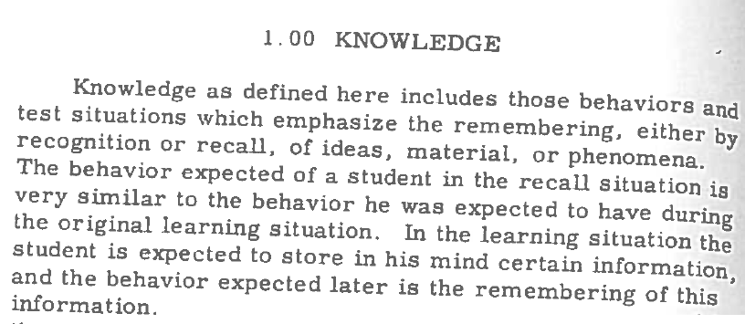
Knowledge

Slide 52
Comprehension
“… when students are confronted with a communication, they are expected to know what is being communicated and to be able to make some use of the material or ideas contained in it… Here we are using the term ‘comprehension’ to include those objectives, behaviors, or responses which represent an understanding of the literal message contained in a communication.”

Slide 53
What is the difference between knowledge and comprehension?

Slide 54
Can you give an example…
Of how a student might be asked to demonstrate knowledge in a school setting?

Slide 55
Can you give an example…
Of how a student might be asked to demonstrate comprehension in a school setting?

Slide 56
What are Bloom’s three types of comprehension?

Slide 57
What are Bloom’s three types of comprehension?
Translation – Converting content into other terms or another form of communication
Interpretation – Reordering ideas into new configurations; inferences, generalizations, or summarizations
Extrapolation

Slide 58
Application
“A problem in the comprehension category requires the student to know an abstraction well enough that he can correctly demonstrate its use when specifically asked to do so. ‘Application’, however, requires a step beyond this. Given a problem new to the student, he will apply the appropriate abstraction without having to be prompted as to which abstraction is correct or without having to be shown how to use it in that situation”

Slide 59
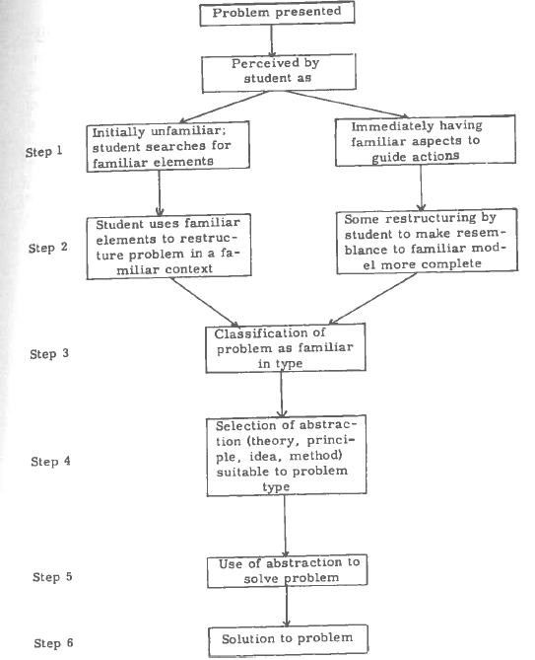
Application
Comprehension

Slide 60
Note
Informal understanding of Bloom’s Taxonomy often classifies all use of knowledge as Application
That’s not quite what Bloom’s Taxonomy is

Slide 61
Can you give an example…
Of how a student might be asked to demonstrate application in a school setting?

Slide 62
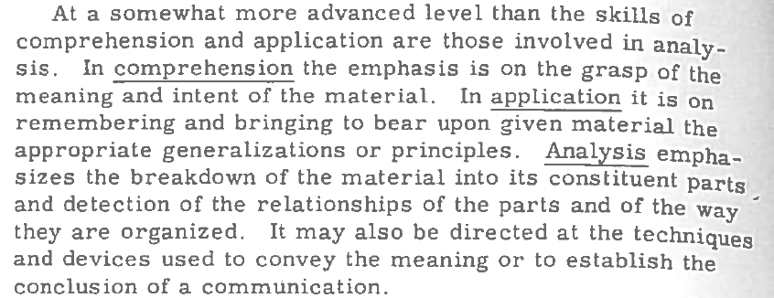
Analysis

Slide 63
What are Bloom’s three levels of analysis?
Break down material into constituent parts, to identify the elements
Make the relationships among the elements explicit
Recognize the organizational principles, the arrangement and structure, which hold together the idea as a whole

Slide 64
Can you give an example…
Of how a student might be asked to demonstrate analysis in a school setting?

Slide 65
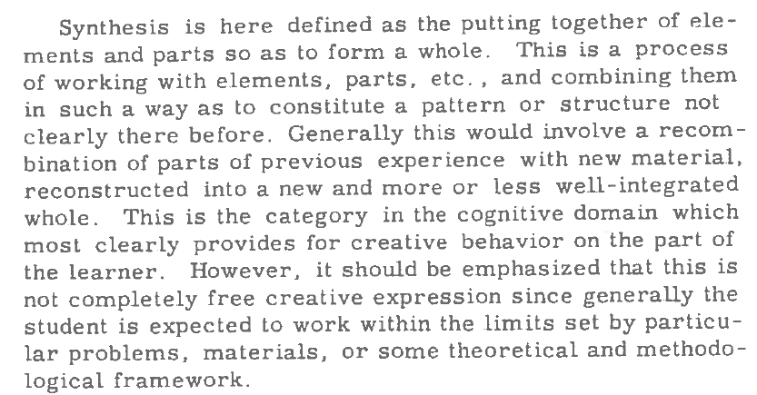
Synthesis

Slide 66
Can you give an example…
Of how a student might be asked to demonstrate synthesis in a school setting?

Slide 67
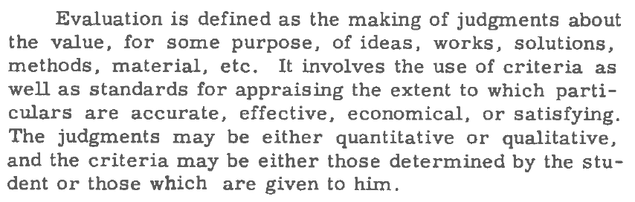
Evaluation

Slide 68
Can you give an example…
Of how a student might be asked to demonstrate evaluation in a school setting?

Slide 69
When did we use each level of the taxonomy in class today? (Did we?)
Knowledge
Comprehension
Application
Analysis
Synthesis
Evaluation

Slide 70
How would one use
Bloom’s Taxonomy?
As a teacher or curriculum developer?

Slide 71
Modern thinking on Bloom’s Taxonomy
Anderson & Krathwohl (2001) recommend some revisions to Bloom’s Taxonomy

Slide 72
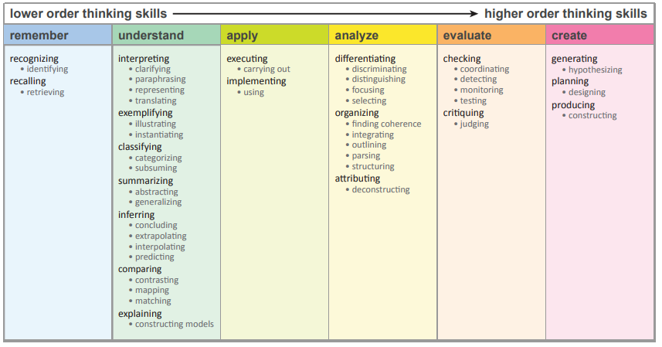
Anderson & Krathwohl (2001)
Diagram from (IA State, 2015)

Slide 73
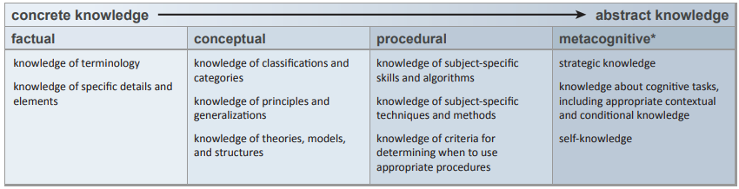
Anderson & Krathwohl (2001)
Diagram from (IA State, 2015)

Slide 74
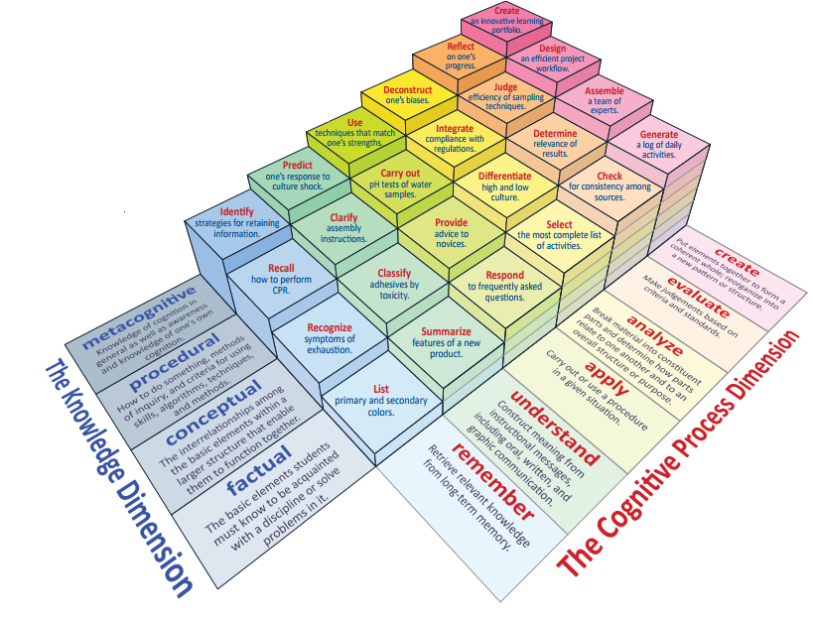
Heer (2012)
Diagram from (IA State, 2015)

Slide 75
Final thoughts or questions?

Slide 76
Upcoming Classes
10/4: Learning Theory Matrix Due
10/8: Dewey (you need the book)
10/15: Socio-Cultural
10/18: Theoretical Paper Prospectus Due (Don’t panic! We will discuss it in the next class!)
10/22: Freire

