Slide 1
Foundations of
Teaching and Learning
October 29, 2021

Slide 2
Any questions about essay due Nov 15?

Slide 3
Adaptive Learning
What is an adaptive learning system?

Slide 4
Intelligent Tutoring System
What is an intelligent tutoring system?

Slide 5
An overly-brief history of intelligent tutoring systems
Programmed instruction machines, 1924
PLATO, 1959
SCHOLAR, 1970
Book by Wenger, 1987
  The same Wenger!
AI Winter hits Intelligent Tutors, late 1980s
Intelligent Tutoring Goes to School in the Big City, 1997
Wide-spread scaling, 2000-2021

Slide 6
AI Winter
A period when the AI methods of the 1970s and early 1980s were largely agreed to have failed
  Based on formal logic and formal reasoning
Replaced by more statistical, bottom-up approaches
  Aka machine learning

Slide 7
AI Winter in Adaptive Learning
Field almost entirely disappeared in USA
  Remnant laboratories in Pittsburgh, Amherst
  Wenger’s book on ITS was
    written before AI winter
    published in the middle of AI winter
    mocked CMU researchers (the first group that scaled!) for using cognitive psychology instead of proper computer science
Field almost entirely survived in UK

Slide 8
Scaling Adaptive Learning
Koedinger, K. R., Anderson, J. R., Hadley, W. H., & Mark, M. A. (1997). Intelligent tutoring goes to school in the big city. International Journal of Artificial Intelligence in Education, 8(1), 30-43.
Landmark paper reporting quasi-experiment evaluating full-year ITS use in urban schools

Slide 9
Scaling Adaptive Learning
Cognitive Tutor quickly scaled to hundreds of thousands of students in USA
Joined in scale-up by ALEKS, and then several other systems
Today: many adaptive learning systems used by hundreds of thousands of students (or more)

Slide 10
Curious Fact
The country where ITS survived AI Winter and continued much the same as it had been – UK
Is a country where ITS has scaled up relatively little in the years since

Slide 11
What characterizes these systems?

Slide 12

Kurt Van Lehn
One of the few “survivors” of AI Winter
Designed several influential intelligent tutoring systems
Key theoretician of intelligent tutoring systems

Slide 13
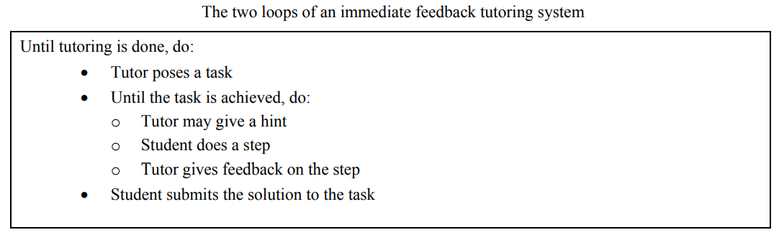
Outer and Inner Loops
(VanLehn, 2006)
OUTER LOOP
INNER LOOP

Slide 14
Outer and Inner Loops
(VanLehn, 2006)
OUTER LOOP (COMPUTER-ASSISTED INSTRUCTION)
INNER LOOP (INTELLIGENT-TUTORING SYSTEM)

Slide 15
A lot of possibilities buried in this model
A lot of ways to hint
A lot of ways to adjust items and content
A lot of ways to select items

Slide 16
Going even deeper
(VanLehn, 2011)
Answer-based tutoring
  Student only gives final answers
Step-based tutoring
  Lets students express steps towards solving problem
  Can give hints or feedback on steps
Substep-based tutoring
  Dives into reasoning underlying steps
  Can shift problem based on wrong answer on step
  Can scaffold process involved in a step

Slide 17
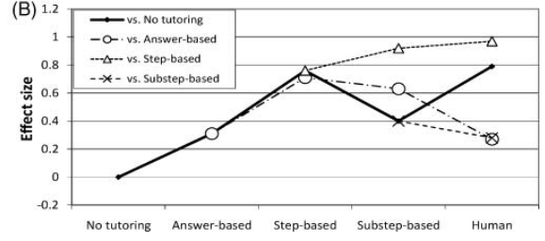
Average Effectiveness?
(VanLehn, 2011)
Only look at the solid line

Slide 18
Let’s categorize the systems in the readings
How would VanLehn classify each system?
Outer loop/inner loop adaptation
Answer-based/step-based/substep-based

Slide 19
Let’s categorize some systems from the readings
Yixue (Feng et al)
Alef (Baker et al)
Mindspark (Muralidharan et al)
Math Garden (Brinkhuis et al)
Steve (VanLehn appendix)
Algebra Cognitive Tutor (VanLehn appendix)
Andes (VanLehn appendix)
Sherlock (VanLehn appendix)
AutoTutor (VanLehn appendix)
SQL-Tutor (VanLehn appendix)
Outer loop/inner loop adaptation
Answer-based/step-based/substep-based

Slide 20
Questions? Comments?

Slide 21
How did context affect the design or use of these systems?
Yixue (Feng et al)
Alef (Baker et al)
Mindspark (Muralidharan et al)
Math Garden (Brinkhuis et al)
RoboTutor (McReynolds et al)
Any of the US-based systems discussed by VanLehn or Baker

Slide 22
What is the role of the teacher in using adaptive learning technologies?

Slide 23
What strategies can/should teachers use when using these technologies?

Slide 24
Guide classroom discussion of homework
“Teachers… use the information in the reports to facilitate their daily homework review time in the classroom including focusing attention on the homework problems that students had the most difficulty with, reviewing correct solution procedures for those problems as well as the common wrong answers to address underlying misunderstandings.”
(Murphy et al., 2020)

Slide 25
Make instructional decisions in real-time
Students using adaptive learning in class
Teacher uses real-time data on student performance to select students for proactive remediation, individually or in small groups
While rest of class keeps working
(Miller et al., 2015)

Slide 26
Make instructional interventions faster
Intervening with a student who is struggling or disengaged earlier than otherwise possible
(Wise & Jung, 2019)

Slide 27
Identify inactive students
Identify which students aren’t actually working on an activity (Dickler et al., 2021)
Not always easy to tell from across the room

Slide 28
Revise homework materials and activities
Identify specific questions or parts of activities that are harder than expected
Fix them for next time
“It tells us we might need to look at a question again. For example, ‘is this written well?’ or ‘do we need to change the question?’” (Wise & Jung, 2019)

Slide 29
Thoughts? Comments?

Slide 30
Intelligent Tutoring Systems versus Stupid Tutoring Systems
Stupid Tutoring Systems = “Tutors that do not, themselves, behave very intelligently. But tutors that are designed intelligently, and that leverage human intelligence”

Slide 31
Disadvantages of Automated Intervention (Baker, 2016)
Time-consuming to create
Brittle – system usually can’t realize when it’s failing or unexpected student response
Students change over time, so designs need to change

Slide 32
Thoughts? Comments?

Slide 33

Ken Koedinger
Co-developer of Cognitive Tutor (now Mathia)
Co-developer of KLI Framework

Slide 34
KLI Framework’s Goal
Understand how to design computer-based learning for different types of learning
Promote robust learning:
Learning that leads to
  Transfer
  PFL/AFL
  Retention

Slide 35
Goals
identify mechanisms of student learning that lead to instructional principles
(b) communicate instructional principles that are general over contexts and provide guidance to instructional designers

Slide 36
KLI is a framework

Slide 37
What is a framework?
“Frameworks are composed of the bold, general claims … They are sets of constructs that define important aspects of [interest] … Frameworks, however, are insufficiently specified to enable predictions to be derived from them, but they can be elaborated, by the addition of assumptions, to make them into theories, and it is these theories that generate predictions. A single framework can be elaborated into many different theories. (Anderson, 1993)”
“The propositions within the KLI framework can help generate research questions within specific domains and instructional situations that, with further work, yield precise and falsifiable predictions. However, our main goal here is to identify the broad constructs and claims that serve more specific instantiations.” (Koedinger et al., 2006)

Slide 38
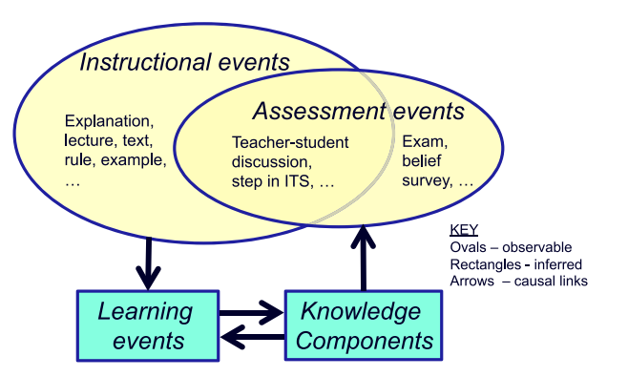
Koedinger, Corbett, Perfetti 2012

Slide 39
Key Types of Learning Processes
(Koedinger et al., 2012)
Memory and Fluency-Building
Induction and Refinement Processes
Understanding and Sense-Making

Slide 40
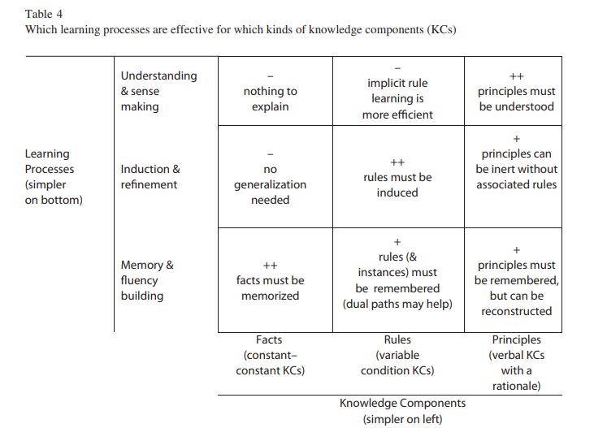

Slide 41
Applying this model
Which learning process should be used for:
  Learning vocabulary in a second language
  Learning when to use grammatical forms in a first language
  Learning when to use different politeness forms in a second language

Slide 42
Applying this model
Which learning process should be used for:
  Learning how to multiply
  Learning multiplication tables
  Understanding what it means to multiply a fraction

Slide 43
What are other examples of
Memory and Fluency-Building
Induction and Refinement Processes
Understanding and Sense-Making

Slide 44
Which learning process do each of these instructional principles match?
(Define then match)
LEARNING PROCESS
Memory and Fluency-Building
Induction and Refinement Processes
Understanding and Sense-Making
INSTRUCTIONAL PRINCIPLE
Accountable talk
Feature focusing
Spacing and testing
Timely feedback
Optimized scheduling
Worked examples
Prompted self-explanation

Slide 45
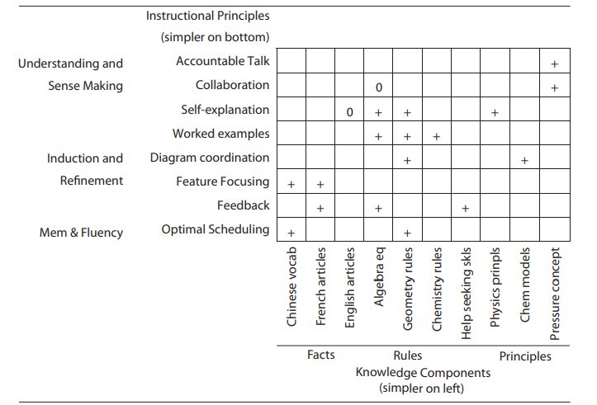
Attempt to match instructional principles to learning domains (incomplete)

Slide 46
Why incomplete?
The center grant ended
A lot of people have used the ideas in this paper
But no one has really tried to continue or take forward the framework
Why?

Slide 47
Koedinger’s claim
“Theories are like tooth brushes – no one wants to use someone else’s” -- Koedinger

Slide 48
Is a framework like KLI useful for instructional design?
Your thoughts?

Slide 49
Final thoughts/comments?

Slide 50
Thanksgiving Wednesday class

Slide 51
Upcoming Classes
11/5: Learning in a Digitally Connected World
11/12: Identity and Culture
11/15: Essay due
11/19: Motivation and Engagement

