Slide 1
Core Methods in
Educational Data Mining
EDUC6191
Fall 2024

Slide 2
Hello
From a better internet connection!
Sorry again about last week

Slide 3
CA2
Any questions or comments about CA2?

Slide 4
Your process for feature engineering
How do you decide what features to create?

Slide 5
What tools have you used to create features?

Slide 6
Does it seem to be working?
Has it made models perform better for you?

Slide 7
Any other comments about your process/results in CA2?

Slide 8
Feature Engineering Reprised

Slide 9
What’s a good feature?
A feature that is potentially meaningfully linked to the construct you want to identify
You can tell a “just so” story about it
A hypothesized (perhaps unjustified) causal account

Slide 10
What’s a good feature?
A feature that is potentially meaningfully linked to the construct you want to identify
You can tell a “just so” story about it
“School suspensions can predict high school dropout because they can reinforce alienation from the educational environment.”
“Slow actions can be used to infer off-task behavior because they can indicate that the student has stopped using the software.”

Slide 11
Feature Engineering Continued

Slide 12
SMOTE for Class Imbalance
Any questions?

Slide 13
Synthetic Data Generation/Augmentation with LLMs
Including Cochran et al. paper
Comments? Questions?

Slide 14
Hyperparameter Tuning
Any questions?

Slide 15
Knowledge Engineering
What is knowledge engineering?

Slide 16
Knowledge Engineering
What is the difference between knowledge engineering and EDM?

Slide 17
Knowledge Engineering
What is the difference between good knowledge engineering and bad knowledge engineering?

Slide 18
Knowledge Engineering
What is the difference between (good) knowledge engineering and EDM?
What are the advantages and disadvantages of each?

Slide 19
How can they be integrated?

Slide 20
Any last questions?
Feature Engineering
Knowledge Engineering

Slide 21
Network Analysis

Slide 22
Four types of centrality
What were they again?

Slide 23
Four types of centrality
Degree centrality
Closeness centrality
Betweeness centrality
Eigenvector centrality

Slide 24
What does each one mean conceptually?
Degree centrality
Closeness centrality
Betweeness centrality
Eigenvector centrality

Slide 25
In the video, I described several types of nodes
In a graph of classroom interactions, there could be several different types of nodes
  Teacher
  TA
  Student
  Project Leader
  Project Scribe

Slide 26
In the video, I described several types of links
In a graph of classroom interactions, there could be several types of links
  Leadership role (X leads Y)
  Working on same learning resource
  Helping act
  Criticism act
  Insult
  Note that links can be directed or undirected

Slide 27
Questions or comments?

Slide 28
Network Analysis
The most common use of network analysis is for social networks
Where else might it apply?

Slide 29
Let’s list examples
What are some types of networks one might encounter in education/learning?
  Special cases of social networks with different nodes or links are fine

Slide 30
Let’s break into groups
Each group takes a type of network
  One group per network type
  I will number them right now
Define what the meaning in this network would be (or could be) for
  Node types, links, link types, link strength
  Density
  Reachability, Geodesic Distance, Flow
  Centrality (in its four forms)
  Other measures that might be particularly relevant for your type of network

Slide 31
Now reconvene
Who wants to share
  What their network type is
  Node types, links, link types, link strength
  Anything else that’s interesting

Slide 32
Questions or comments?

Slide 33
Epistemic Network Analysis
Is anyone here familiar with ENA?
What is it?

Slide 34
Epistemic Network Analysis
Is anyone here familiar with ENA?
What is it?
Studying relationships between elements in coded data

Slide 35
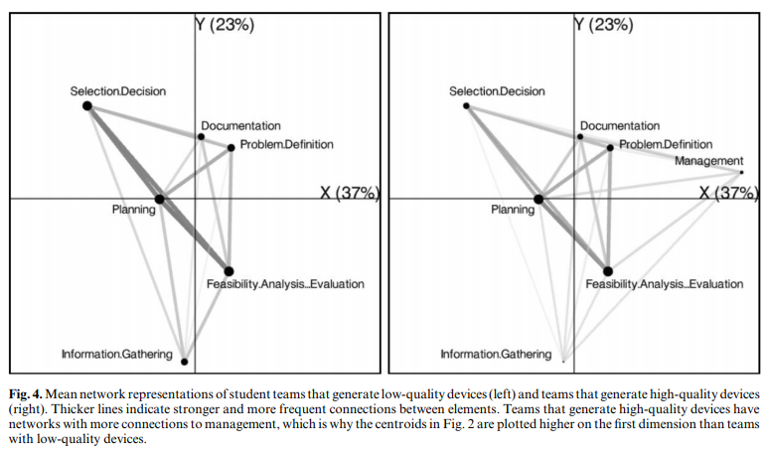
Studying Process of Successful and Unsuccessful Teams
(Arastoopour et al., 2016)

Slide 36
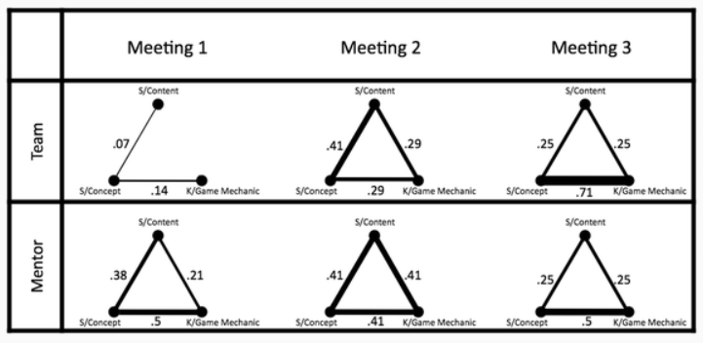
Studying connections between topics in meetings over time
(Nash & Shaffer, 2013)

Slide 37
Questions? Comments?

Slide 38
Has anyone here…
… conducted an ENA?
If so, please tell us about it

Slide 39
Gasevic reading
Questions? Comments?

Slide 40
Pantic reading
Questions? Comments?

Slide 41
Karimi reading
Questions? Comments?

Slide 42
Key theme across papers
Social network analyses are much more interesting when they are connected to other data as well
Correlations between social networks and GPA outcomes
Connections between social networks and epistemic networks (on self-reports of agency and implementation)
Topics and websites used associated with high values on social network

Slide 43
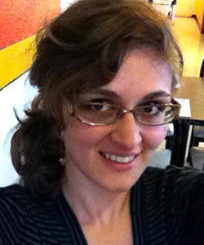
To learn more about ENA
EDUC5100 Quantitative Ethnography
Dr. Amanda Barany

Slide 44

To learn more about SNA
EDUC5100 Social Network Analysis
Professor Bodong Chen

Slide 45
Final questions or comments?

Slide 46
The End

