Slide 1
Core Methods in
Educational Data Mining
EDUC6191
Fall 2023

Slide 2
CA2
Any questions or comments about CA2?

Slide 3
Your process for feature engineering
How do you decide what features to create?

Slide 4
What tools have you used to create features?

Slide 5
Does it seem to be working?
Has it made models perform better for you?

Slide 6
Any other comments about your process/results in CA2?

Slide 7
Network Analysis

Slide 8
Four types of centrality
What were they again?

Slide 9
Four types of centrality
Degree centrality
Closeness centrality
Betweeness centrality
Eigenvector centrality

Slide 10
What does each one mean conceptually?
Degree centrality
Closeness centrality
Betweeness centrality
Eigenvector centrality

Slide 11
In the video, I described several types of nodes
In a graph of classroom interactions, there could be several different types of nodes
  Teacher
  TA
  Student
  Project Leader
  Project Scribe

Slide 12
In the video, I described several types of links
In a graph of classroom interactions, there could be several types of links
  Leadership role (X leads Y)
  Working on same learning resource
  Helping act
  Criticism act
  Insult
  Note that links can be directed or undirected

Slide 13
Questions or comments?

Slide 14
Network Analysis
The most common use of network analysis is for social networks
Where else might it apply?

Slide 15
Let’s list examples
What are some types of networks one might encounter in education/learning?
  Special cases of social networks with different nodes or links are fine

Slide 16
Let’s break into groups
Each group takes a type of network
  One group per network type
Define what the meaning in this network would be (or could be) for
  Node types, links, link types, link strength
  Density
  Reachability, Geodesic Distance, Flow
  Centrality (in its four forms)
  Other measures that might be particularly relevant for your type of network

Slide 17
Now reconvene
Who wants to share
  What their network type is
  Node types, links, link types, link strength
  Anything else that’s interesting

Slide 18
Questions or comments?

Slide 19
Epistemic Network Analysis
Is anyone here familiar with ENA?
What is it?

Slide 20
Epistemic Network Analysis
Is anyone here familiar with ENA?
What is it?
Studying relationships between elements in coded data

Slide 21
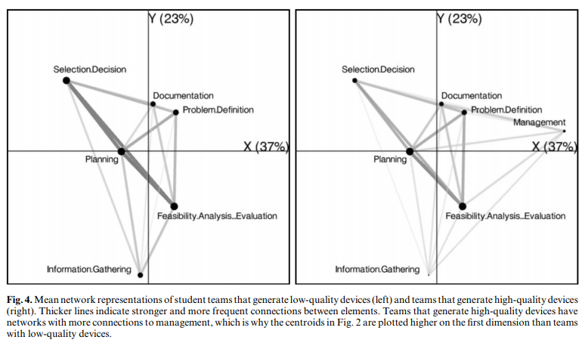
Studying Process of Successful and Unsuccessful Teams
(Arastoopour et al., 2016)

Slide 22
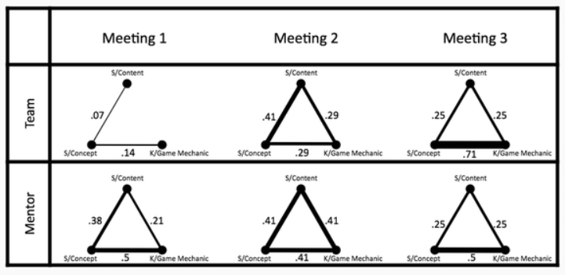
Studying connections between topics in meetings over time
(Nash & Shaffer, 2013)

Slide 23
Questions? Comments?

Slide 24
Has anyone here…
… conducted an ENA?
If so, please tell us about it

Slide 25
Gasevic reading
Questions? Comments?

Slide 26
Pantic reading
Questions? Comments?

Slide 27
Karimi reading
Questions? Comments?

Slide 28
Key theme across papers
Social network analyses are much more interesting when they are connected to other data as well
Correlations between social networks and GPA outcomes
Connections between social networks and epistemic networks (on self-reports of agency and implementation)
Topics and websites used associated with high values on social network

Slide 29

To learn more about ENA
EDUC5100 Quantitative Ethnography
Dr. Amanda Barany

Slide 30

To learn more about SNA
EDUC5100 Social Network Analysis
Professor Bodong Chen

Slide 31
Final questions or comments?

Slide 32
Next classes
October 12 & 17
Guest lecturer Oct 12: Joyce Zhang
Bayesian Knowledge Tracing
  Basic: SNA Due October 16
October 19 & 24
Everything at its normal time and place
Logistic Knowledge Tracing
  Basic: BKT Due October 23
October 26 & 31
Everything at its normal time and place
Deep Knowledge Tracing
  Basic: PFA Due October 30

Slide 33
The End

