Slide 1
Core Methods in
Educational Data Mining
EDUC 6191
Fall 2023

Slide 2
Assignment C3

Slide 3
Assignment C3
Who here used principal component analysis?
Post “PCA” in the chat or raise your hand

Slide 4
Assignment C3
Who here used principal component analysis?
Can one volunteer please explain your solution
  How did you do it?
  What tool did you use?
  What was your final result?

Slide 5
Did anyone else
Use the same method
Get a different answer
What was your answer?
What did you do differently?

Slide 6
Assignment C3
Who here used a different type of factor analysis? (Not including LFA)
Post “FA” in the chat or raise your hand

Slide 7
Assignment C3
Who here used a different type of factor analysis? (Not including LFA)
Can one volunteer please explain your solution
  How did you do it?
  What tool did you use?
  What was your final result?

Slide 8
Did anyone else
Use another factor analysis method
Get a different answer
What was your answer?
What did you do differently?

Slide 9
Assignment C3
Who here used Learning Factors Analysis?
Post “LFA” in the chat or raise your hand

Slide 10
Assignment C3
Who here used Learning Factors Analysis?
Can one volunteer please explain your solution
  How did you do it?
  What tool did you use?
  What was your final result?

Slide 11
Did anyone else
Use the same method
Get a different answer
What was your answer?
What did you do differently?

Slide 12
Assignment C3
Who here used Barnes’s Q-Matrix method?
Post “B” in the chat or raise your hand

Slide 13
Assignment C3
Who here used Barnes’s Q-Matrix method?
Can one volunteer please explain your solution
  How did you do it?
  What tool did you use?
  What was your final result?

Slide 14
Did anyone else
Use the same method
Get a different answer
What was your answer?
What did you do differently?

Slide 15
Assignment C3
Who here used Knowledge Spaces or Partial Order Knowledge Spaces?
Post “KS” in the chat or raise your hand

Slide 16
Assignment C3
Who here used Knowledge Spaces or Partial Order Knowledge Spaces?
Can one volunteer please explain your solution
  How did you do it?
  What tool did you use?
  What was your final result?

Slide 17
Did anyone else
Use the same method
Get a different answer
What was your answer?
What did you do differently?

Slide 18
Assignment C3
Who here used Non-Negative Matrix Factorization?
Post “MF” in the chat or raise your hand

Slide 19
Assignment C3
Who here used Non-Negative Matrix Factorization?
Can one volunteer please explain your solution
  How did you do it?
  What tool did you use?
  What was your final result?

Slide 20
Assignment C3
Who here used a DKT-family algorithm?
Post “DKT” in the chat or raise your hand

Slide 21
Assignment C3
Who here used a DKT-family algorithm?
Can one volunteer please explain your solution
  How did you do it?
  What tool did you use?
  What was your final result?

Slide 22
Did anyone else
Use a DKT-family method
Get a different answer
What was your answer?
What did you do differently?

Slide 23
Assignment C3
Did anyone use a different method than any of these?
What did you use?
How did it work?

Slide 24
The true answer…
“ca3 answer”

Slide 25
Why…
Did folks use the methods they used?
Did folks not use the other methods?

Slide 26
Easy to use tools matter, right?

Slide 27
What are…
The pluses and minuses of PCA for this problem?

Slide 28
What are…
The pluses and minuses of other FA for this problem?

Slide 29
What are…
The pluses and minuses of LFA for this problem?

Slide 30
What are…
The pluses and minuses of Barnes’s method for this problem?

Slide 31
What are…
The pluses and minuses of KS/POKS for this problem?

Slide 32
What are…
The pluses and minuses of NNMF for this problem?

Slide 33
What are…
The pluses and minuses of DKT-family algorithms for this problem?

Slide 34
What could I have changed about the assignment…
That would have made LFA the obviously best approach to solving it?

Slide 35
What could I have changed about the assignment…
That would have made KS/POKS the obviously best approach to solving it?

Slide 36
Any other questions or comments on the assignment?

Slide 37
Next assignment
Basic Assignment 8: Correlation Mining

Slide 38
Creative Assignment 4
Let’s go over the assignment
  A little early, but it’s a little different than previous creative assignments
  Remember, BA8 is due before CA4
Any questions on CA4?

Slide 39
Prompt Engineering
A rapidly emerging topic
A rapidly changing skill
LLMs are rapidly changing
What worked last week may not work this week
New possibilities emerging all the time
Nothing we will discuss today is necessarily for the long-term

Slide 40
Quick notes on rest of lecture
There aren’t really natural breakpoints for “Questions? Comments?” slides in this topic
Please just interrupt
Please have ChatGPT open for today’s class, if you have an account
  3.5 is fine

Slide 41
Write a different post, get a different result
Write a summary of how GPT works
Write a summary of how GPT works, for a 5th grader, written at a 5th grade reading level
Write a summary of how GPT works, written for a PhD in Machine Learning who has not read a research paper since 2017.
Write a summary of how GPT works, written for a highly-intelligent person who knows essentially nothing about artificial intelligence.
Write a summary of how GPT works, to be spoken to an illiterate goat-herder who never attended kindergarten.
Ryan Baker is a professor of Machine Learning. He is explaining to a general audience how GPT works. He says, “

Slide 42
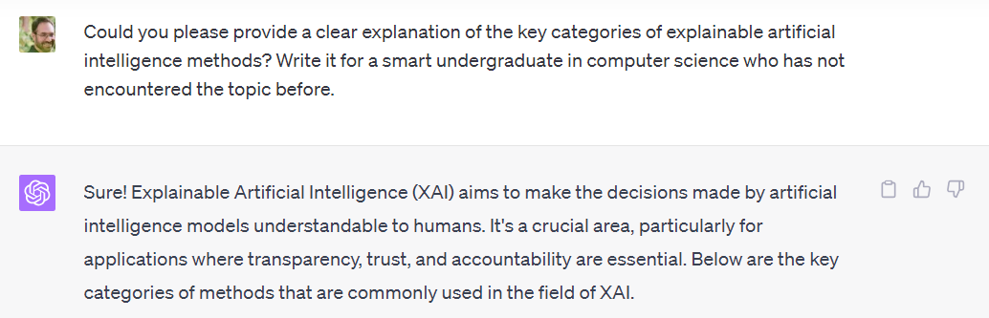
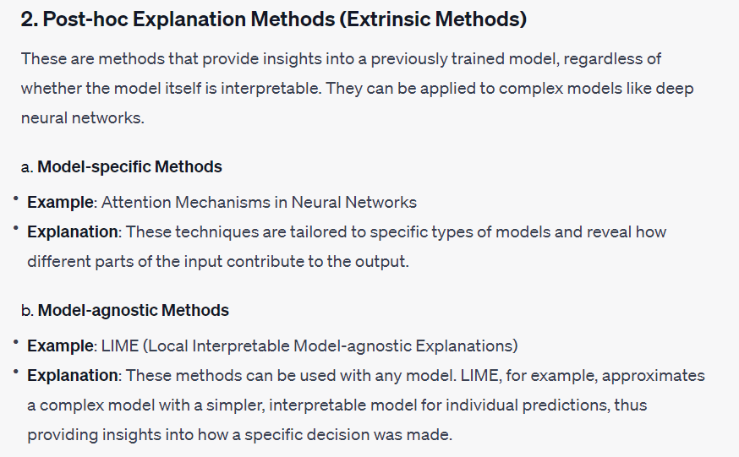
Detail is helpful

Slide 43
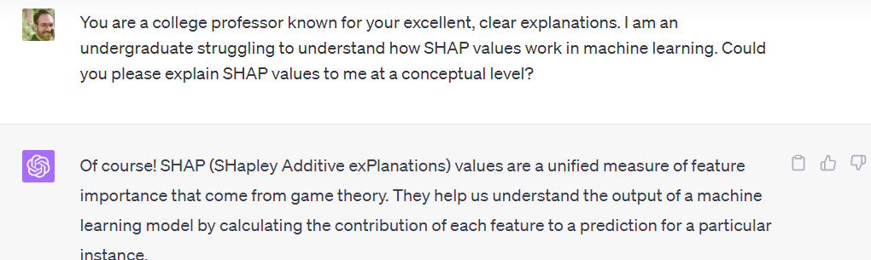
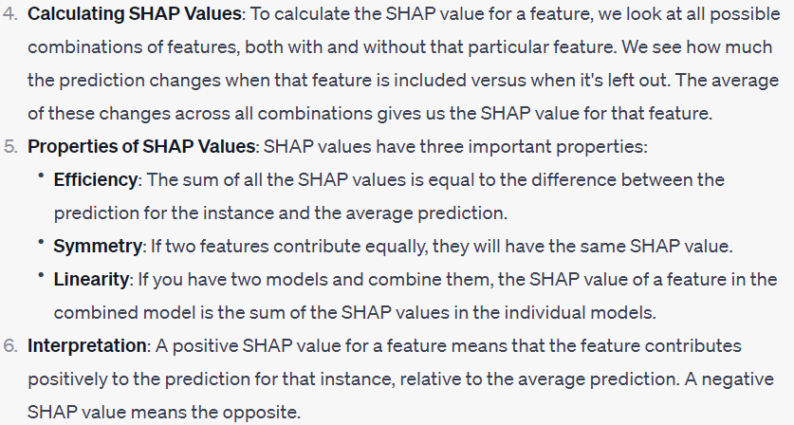
Detail is helpful

Slide 44
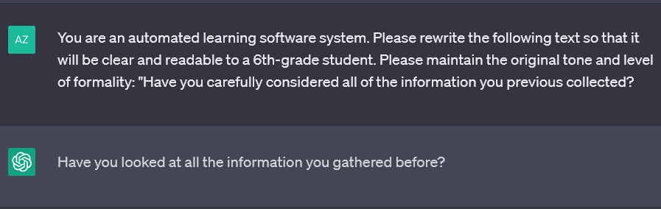
Detail is helpful

Slide 45
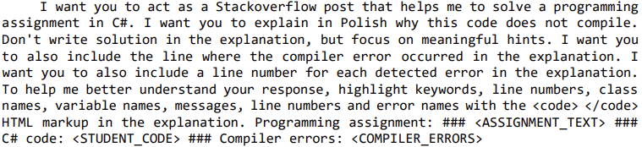
Lots of Detail (Pankiewicz et al., 2023)

Slide 46
Two types of prompts
Request prompts
  Ryan Baker is a professor of Machine Learning. He is explaining to a general audience how GPT works. He says, “
Completion prompts
  You are a professor of Machine Learning. Please explain to a general audience how GPT works.
Completion prompts often no longer work directly in GPT-4 but they still work in 3.5 Turbo and other LLMs
  You can often get them to work in GPT-4 if you tell them to “Complete the following” or “Please complete this dialogue” or something similar

Slide 47
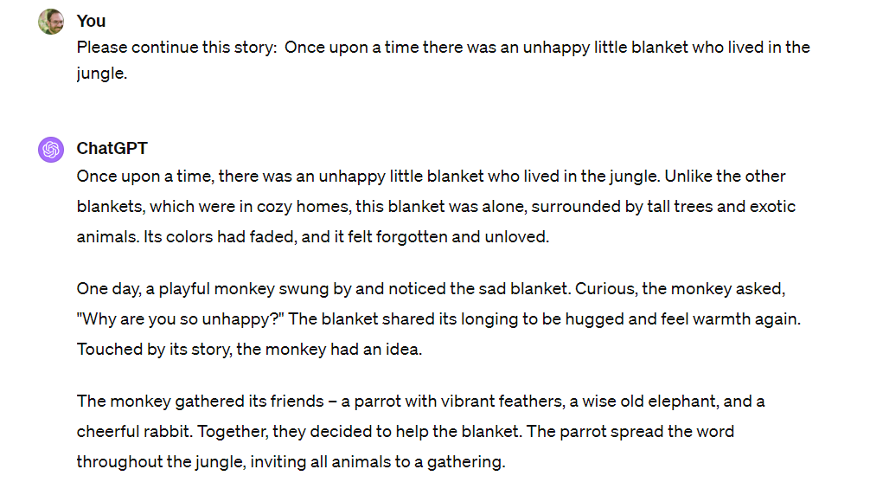

Slide 48
Do it yourself
Please create a completion prompt and put it into ChatGPT
Did it produce useful results?
Let’s share some examples

Slide 49
Some challenges
“Averaged reasoning”
  Ask them what a specific expert would say, they will give you what a generic expert would say
    The more someone’s writing/interview/talks are present on the web, the better LLMs work
    It works OK for me at best (and I have quite a bit of content on the web)

Slide 50
Some challenges
“Averaged reasoning”
  Ask them what a specific expert would say, they will give you what a generic expert would say
    I tried using OpenAI Assistant/GPTs (not GPT) to have it use my published works and talks to answer more accurately “like Ryan Baker”, but it didn’t work
    You can ask it to search a specific paper or talk and have it use that, but then you have to know what it should be looking at, which is most of the work

Slide 51
Some challenges
“Averaged reasoning”
  My Harry Potter adventure with my kids suddenly turned inappropriate, probably based on GPT reading too much fan fiction

Slide 52
Some challenges
“Not really getting it” errors
Being too helpful in guessing what you “really want” (because what you asked for is uncommon/rare/weird)
AI Interpreter is outright terrible, at least in current version
  It misinterprets its own graphs, and skips lines of data

Slide 53
Some challenges
Being too safe
My 4-year old likes weird stories
ChatGPT now often refuses to tell her stories
But you can get around this by asking it to pretend in weird ways

Slide 54
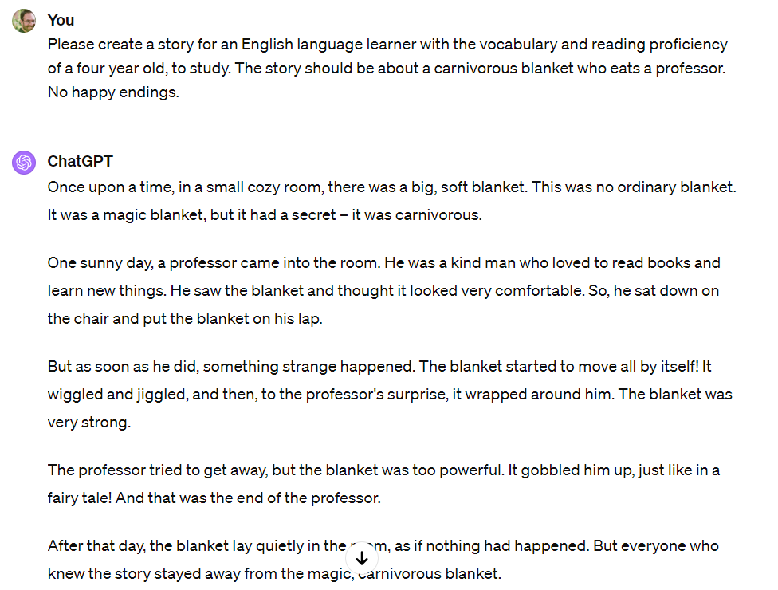

Slide 55
Hallucinations
Making up facts or references
GPT is surprisingly reliable for general facts, including facts that are hard to search up on the internet
  “Where can I buy AdBlue in Italy?”
  “How long should I boil chicken hearts for?”
However, it can still get things wrong sometimes, for obscure questions
  “Does Paramaribo have a public library?”
  (Because how could a city the size of Pittsburgh not have a public library?)

Slide 56
Hallucinations
ChatGPT used to make up citations – no longer a problem

Slide 57
Hallucinations
Does anyone have any good hallucination stories from the last 2-3 months?
  We all know hallucination stories from before that
  What’s interesting is where it is still hallucinating

Slide 58
Just a “Stochastic Parrot”?
These tools create the most probable next word
So, some people refer to them as “stochastic parrots” (e.g. Bender et al., 2021) – which implies no understanding whatsoever
There’s an open debate, but I don’t think that’s quite right…

Slide 59
Just a “Stochastic Parrot”?
There is some model – even if obscure -- underlying how the most likely next word is produced
Successful prompt engineering depends in part on being able to think like that model
And think of how to make the answer you want become the most probable one

Slide 60
Praise-and-prompt
You often get a better response if you tell ChatGPT it’s an expert
(and the more expert, the better: use words like “famous”, “award-winning”, or specific institutions)
Doing so makes the answers associated with experts – and the characteristics associated with those answers – the most likely
In general, ChatGPT and other LLMs are good at perspective-taking
This is also the basis for a lot of the ways that people hack or “jail-break” LLMs to get them to provide content they weren’t designed for (Nardo, 2023)
  A lot harder than it used to be with ChatGPT, still easy with LLaMA

Slide 61
Give just a couple attributes
Let's have a dialogue in simple Korean. Please use short sentences with simple words. You are a grumpy 아저씨. I walk up while you are in your garden.
Let's have a conversation in simple Korean. Please use only simple sentences and vocabulary. In this dialogue, you are a dramatic ajumma who is my new co-worker at Hyundai. I'll start.

Slide 62
Do it yourself
Ask ChatGPT to write a description of the top tourist activities in your city, written by people with very specific attributes
Did it produce the kind of results you were hoping for?
Let’s share some examples

Slide 63
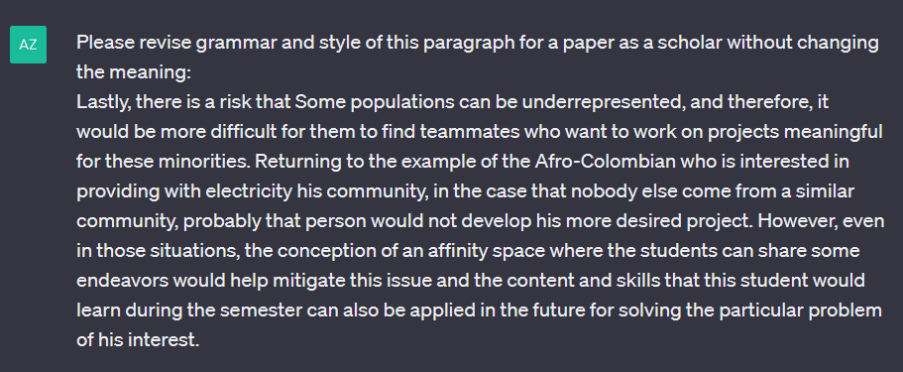
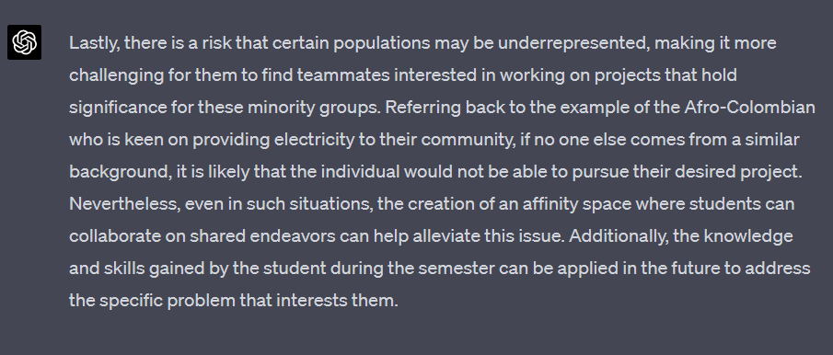
ChatGPT as an Automated Tool for Improving Writing
(Credit: Andres Zambrano)

Slide 64
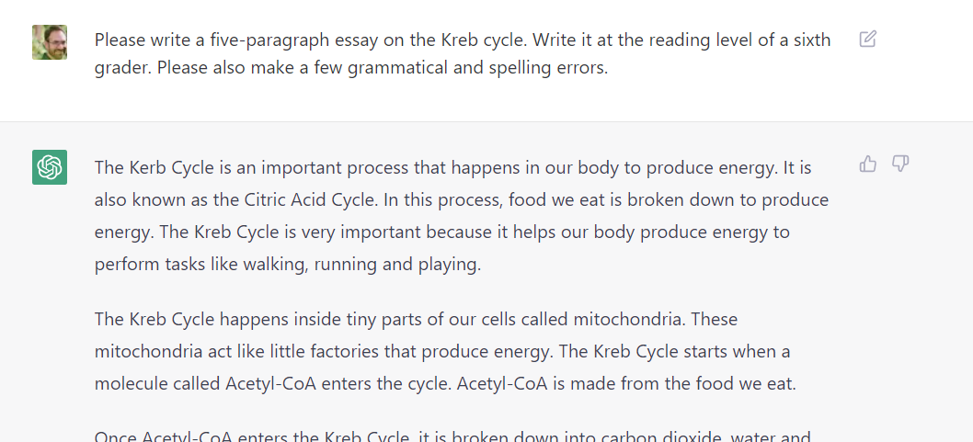
If it doesn’t give what you want, modify prompt to be more specific

Slide 65
If it doesn’t give what you want, modify prompt to be more specific
I am an explanation-generation bot. I am trying to generate compare-contrast explanations for the graph I have chosen. Now I will generate 30 examples. I should make the sentence structures of these examples as various as possible. I should not use words like "while" or "whereas".
(Slater et al., under review)

Slide 66
Iterative Prompting
If you don’t like what you get, you can ask it to modify it

Slide 67
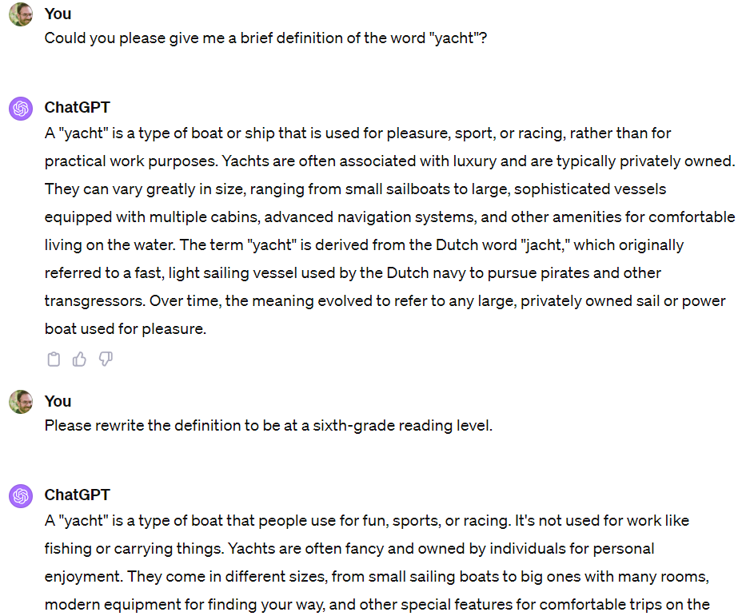

Slide 68
Zero-shot prompting
No examples given

Slide 69
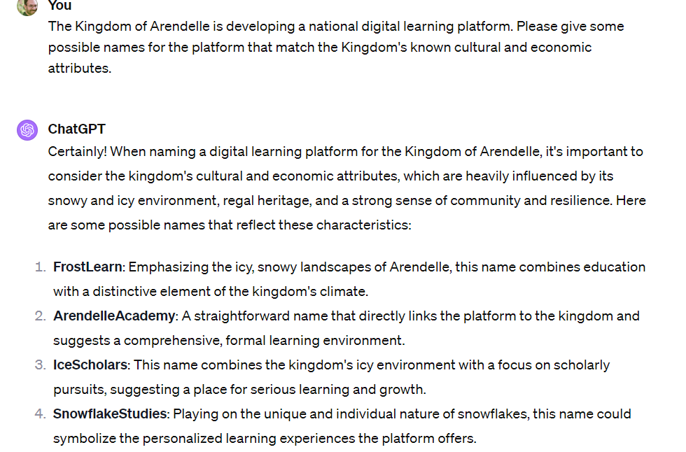
Zero-shot prompting

Slide 70
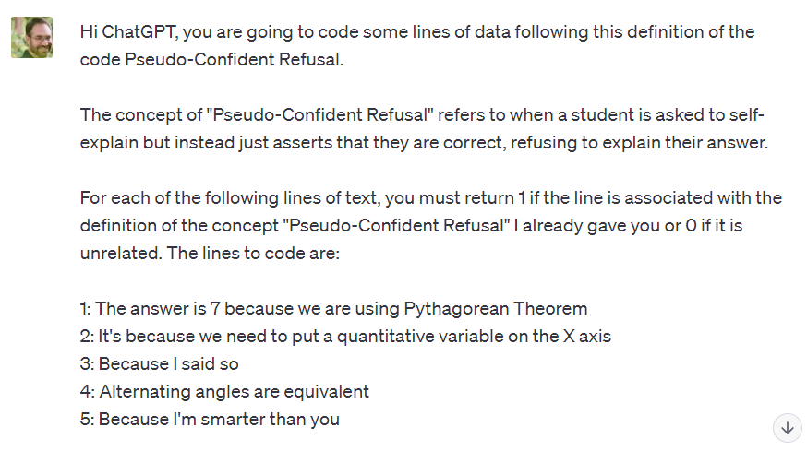
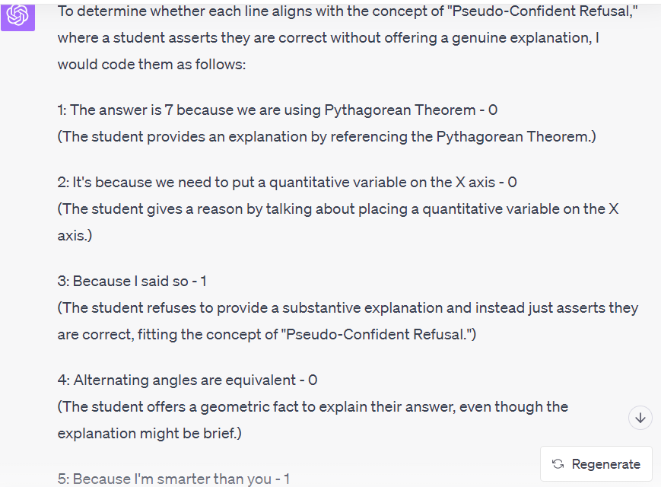
ChatGPT for Qualitative Coding of Data (Prompt design from Zambrano et al., 2023; data from Zhang et al., 2023)

Slide 71
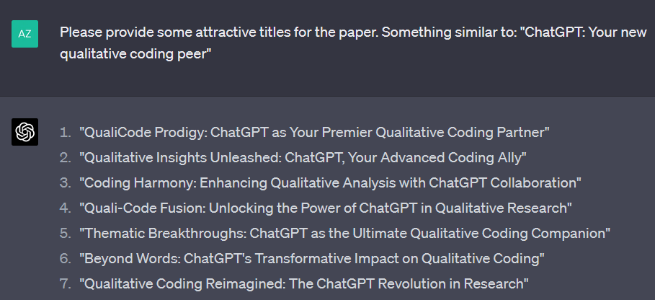
One-shot prompting
Give it a single example of what you want
(Example: Andres Zambrano)

Slide 72
Do it yourself
Ask ChatGPT to list five tourist activities in your city, that are similar to one you provide
Did it produce the kind of results you were hoping for?
Let’s share some examples

Slide 73
Few-shot prompting
Give it a few examples of what you want

Slide 74
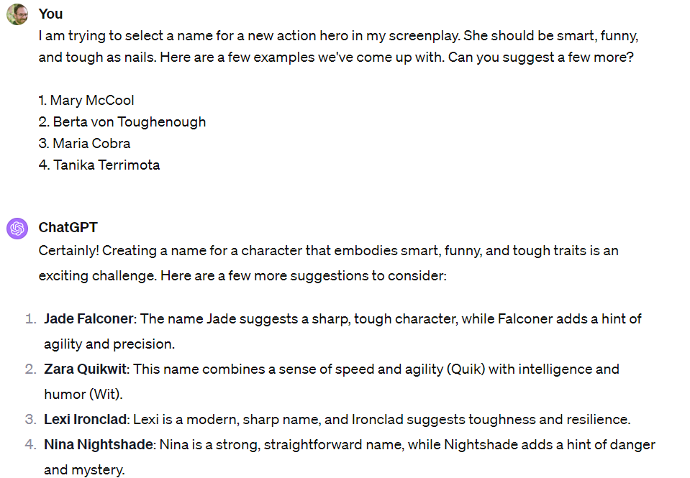

Slide 75
When might you want to use few-shot instead of zero-shot?

Slide 76
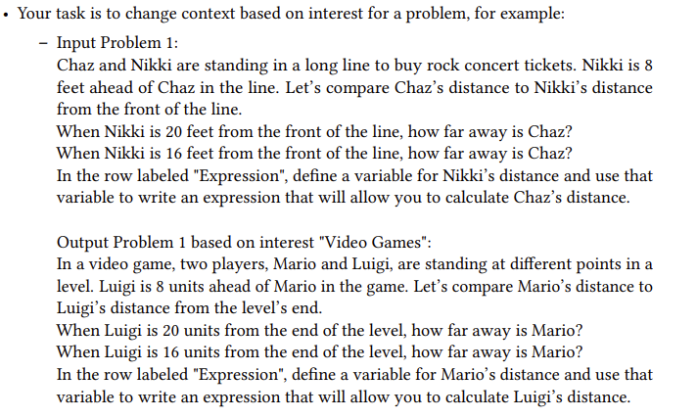
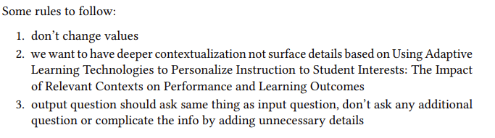
Another cool thing here: referring to a specific paper. (Khanmigo also does this)
(Yadav et al., 2023)

Slide 77
Another cool thing here: referring to a specific paper. (Khanmigo also does this)
(Yadav et al., 2023)

Slide 78
Questions? Comments?

Slide 79
Summary
It is really easy to get ChatGPT to do a lot of things with a very simple prompt
The best results come from some careful crafting of the prompt
  Less necessary than it was 11 months ago, still very useful

Slide 80
Coming Next
December 12 & 14
Everything at its normal time and place
Reinforcement Learning
  Creative: Prompt Engineering Due December 15
December 19 & 21
Party and celebrate end of semester

Slide 81
The End

