Slide 1
Core Methods in
Educational Data Mining
EDUC 6191
Fall 2023

Slide 2
Any questions about the assignment?

Slide 3
Knowledge Structure Discovery

Slide 4
Knowledge Structure Discovery
From generic structure discovery (clustering, factor analysis) to specific structure discovery (knowledge structures)

Slide 5
Any lingering questions about clustering or factor analysis?

Slide 6
Q-Matrix
(Tatsuoka, 1983; Barnes, 2005)
 | Skill1 | Skill2 | Skill3 | Skill4
Item1 | 1 | 0 | 0 | 0
Item2 | 1 | 1 | 0 | 0
Item3 | 1 | 0 | 1 | 0
Item4 | 0 | 0 | 0 | 1
Item5 | 0 | 0 | 1 | 1
Item6 | 0 | 1 | 0 | 0

Slide 7
Example
 | Add | Subtract | Multiply | Divide
7 + 3 + 2 | 1 | 0 | 0 | 0
7 + 3 - 2 | 1 | 1 | 0 | 0
(7 + 3) * 2 | 1 | 0 | 1 | 0
7 / 3 / 2 | 0 | 0 | 0 | 1
7 * 3 / 2 | 0 | 0 | 1 | 1
7 - 3 - 2 | 0 | 1 | 0 | 0

Slide 8
Get into groups of 3
Create a q-matrix for the following tasks from an English intensive course
Listen to this conversation at the registrar’s office and answer questions about it
Read this passage about the history of the university and summarize it
Fill in the blanks in this sentence with correct grammar
Write a short essay on your experience taking the bus in Philadelphia
Identify the synonyms and antonyms in this list
Listen to this news report on the mayoral election and identify the main ideas
Read and interpret this graph on the composition of the US congress
Complete this sentence with appropriate vocabulary words
Just 15 minutes for this task

Slide 9
First group
Please present your list of skills

Slide 10
Other groups
How did your list of skills differ?

Slide 11
Each group
What was your count of skills?
Please average your skills per item – what was the average number of skills per item?

Slide 12
Such different q-matrices
How would we decide which one was best?

Slide 13
Questions? Comments?

Slide 14
Partial Order Knowledge Spaces
(Desmarais et al., 1996, 2006)
Postulate relationships between items
Mastery of one item
is prerequisite to
mastery of another item

Slide 15
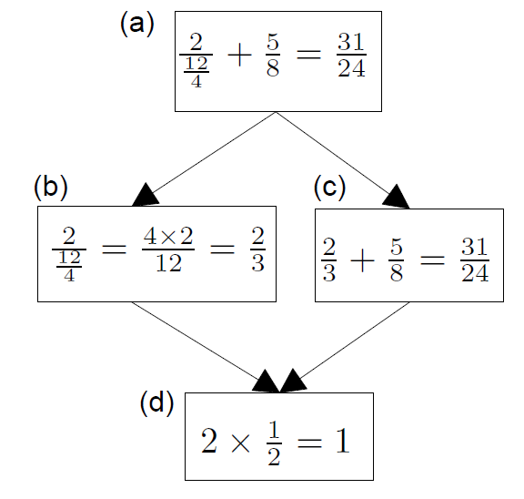
Example
(Desmarais et al., 2006)
B does not inform us about C
If student succeeds at C, they will succeed at D;
D is prerequisite to C

Slide 16
Extension to skills
POKS can be extended rather easily to use skills (interchangeable items) rather than items

Slide 17
Questions about POKS?

Slide 18
What are the relative benefits of using a q-matrix versus a knowledge space?

Slide 19
Bayesian Networks
Less restricted set of models that also infer relationships between skills and items, and between skills
Can infer more complicated relationships between material than the very restricted set of relationships modeled in POKS
  Can infer {skill-skill, item-item, skill-item} relationships at the same time
  Can integrate very diverse types of information
That extra flexibility can lead to over-fitting (cf. Desmarais et al., 2006)

Slide 20
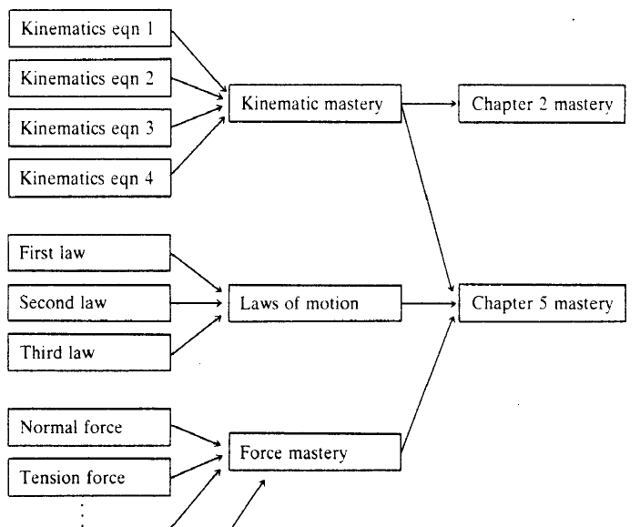
Martin & VanLehn (1995)

Slide 21
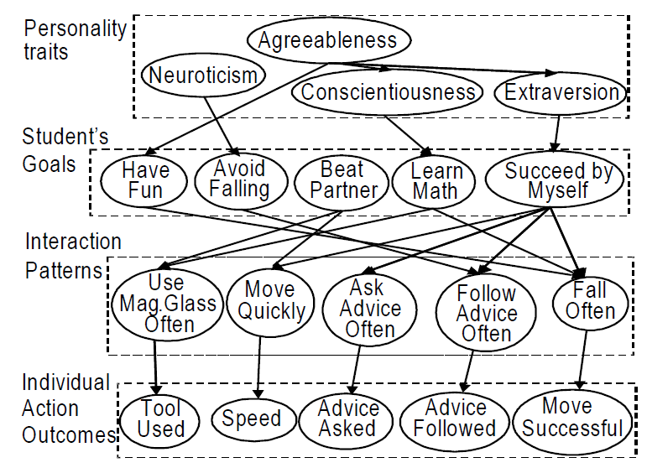
Conati et al., 2009

Slide 22
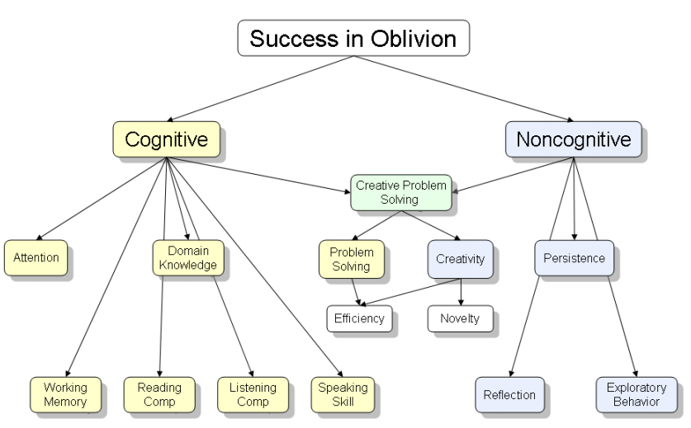
Shute et al., 2009

Slide 23
What are the trade-offs
Between Knowledge Spaces
And Bayes Nets
?

Slide 24
Comments? Questions?

Slide 25
What are the consequences of getting a knowledge mapping wrong?

Slide 26
Knowledge Structure Discovery
Why would someone want to discover the knowledge structure automatically, rather than doing it by hand?

Slide 27
Automated model discovery
(from scratch)
What are some ways to do this?

Slide 28
Automated model discovery
(from scratch)
What are some ways to do this?
  PCA/Factor Analysis
  Barnes’s method
  NNMF
  DKVMN/KQN
What situation does each apply in?

Slide 29
Automated model discovery
(from scratch)
What are the advantages and disadvantages of those approaches?

Slide 30
Hand development and refinement
What are the advantages and disadvantages of this type of approach?

Slide 31
Hybrid approach:
Learning Factors Analysis
Does anyone remember this from the lecture?

Slide 32
Hybrid approach: LFA
What are the advantages and disadvantages?

Slide 33
What does a spike in a learning curve mean?

Slide 35
Questions or comments?

Slide 36
KnowEdu paper
Uses NN on text to extract concepts from curriculum standards
Uses association rules on performance data to find candidate prerequisite structure between them
Comments? Questions?

Slide 37
Last comments or questions for today?

Slide 38
Next Classes
NO CLASS THANKSGIVING – VIRTUAL AND IN-PERSON SECTIONS FLIP ORDER
November 28 & 30
Everything at its normal time and place
Correlation Mining
  Creative: Knowledge Structure Due December 1
December 5 & 7
Everything at its normal time and place
Prompt Engineering
  Basic: Correlation Mining Due December 8
December 12 & 14
Everything at its normal time and place
Reinforcement Learning
  Creative: Prompt Engineering Due December 15

Slide 39
The End

