Slide 1
Core Methods in
Educational Data Mining
EDUC545
Spring 2017

Slide 2
What is the
Goal of Knowledge Inference?

Slide 3
What is the
Goal of Knowledge Inference?
Measuring what a student knows at a specific time
Measuring what relevant knowledge components a student knows at a specific time

Slide 4
Why is it useful to measure student knowledge?

Slide 5
Key assumptions of BKT
Assess a student’s knowledge of skill/KC X
Based on a sequence of items that are scored between 0 and 1
  Classically 0 or 1, but there are variants that relax this
Where each item corresponds to a single skill
Where the student can learn on each item, due to help, feedback, scaffolding, etc.

Slide 6
Key assumptions of BKT
Each skill has four parameters
From these parameters, and the pattern of successes and failures the student has had on each relevant skill so far
We can compute
  Latent knowledge P(Ln)
  The probability P(CORR) that the learner will get the item correct

Slide 7
Key assumptions of BKT
Two-state learning model
  Each skill is either learned or unlearned
In problem-solving, the student can learn a skill at each opportunity to apply the skill
A student does not forget a skill, once he or she knows it

Slide 8
Model Performance Assumptions
If the student knows a skill, there is still some chance the student will slip and make a mistake.
If the student does not know a skill, there is still some chance the student will guess correctly.

Slide 9
Classical BKT
Not learned
p(T)
Learned
p(L₀)
p(G)
1-p(S)
correct
correct
Two Learning Parameters
p(L₀) Probability the skill is already known before the first opportunity to use the skill in problem solving.
p(T) Probability the skill will be learned at each opportunity to use the skill.
Two Performance Parameters
p(G) Probability the student will guess correctly if the skill is not known.
p(S) Probability the student will slip (make a mistake) if the skill is known.

Slide 10
Assignment B5
Let’s go through the assignment together

Slide 11
Filter out all actions from (a copy of) the data set, until you only have actions for KC “VALUING-CAT-FEATURES”. How many rows of data remain?

Slide 12
Filter out all actions from (a copy of) the data set, until you only have actions for KC “VALUING-CAT-FEATURES”. How many rows of data remain?
Correct answer: 2473
Other known answer: 2474 (“Almost. You have also included the header row. What is the total when you eliminate that?”)
Other known answer: 124370 or 124371 (“You haven’t removed anything.”)
Other known answer: 121897 or 121898 (“Oops! You deleted VALUING-CAT-FEATURES instead of keeping that.”)

Slide 13
We need to delete some rows, based on the assumptions of Bayesian Knowledge Tracing. With reference to the firstattempt column, which rows do we need to delete?
Firstattempt = 1
Firstattempt = 0
No rows
All rows

Slide 14
We need to delete some rows, based on the assumptions of Bayesian Knowledge Tracing. With reference to the firstattempt column, which rows do we need to delete?
Firstattempt = 1
Firstattempt = 0
No rows
All rows

Slide 15
Go ahead and delete the rows you indicated in question 2. How many rows of data remain?
Correct answer: 1791

Slide 16
We’re going to create a Bayesian Knowledge Tracing model for VALUING-CAT-FEATURES. Create variable columns P(Ln-1) (cell I1), P(Ln-1|RESULT) (cell J1), and P(Ln) (cell K1), and leave the columns below them empty for now. (If you’re not sure what these represent, re-watch the lecture). To the right of this, type into four cells, (cell M2) L0, (M3) T, (M4) S, and (M5) G. Now type 0.3, 0.1, 0.2, and 0.25 to the right of (respectively) L0, T, S, and G (e.g. cells N2, N3, N4, N5). What is your slip parameter?

Slide 17
We’re going to create a Bayesian Knowledge Tracing model for VALUING-CAT-FEATURES. Create variable columns P(Ln-1) (cell I1), P(Ln-1|RESULT) (cell J1), and P(Ln) (cell K1), and leave the columns below them empty for now. (If you’re not sure what these represent, re-watch the lecture). To the right of this, type into four cells, (cell M2) L0, (M3) T, (M4) S, and (M5) G. Now type 0.3, 0.1, 0.2, and 0.25 to the right of (respectively) L0, T, S, and G (e.g. cells N2, N3, N4, N5). What is your slip parameter?
Correct answer: 0.2

Slide 18
Just temporarily, set K3 to have = I2+0.1, and propagate that formula all the way down (using copy-and-paste, for example), so that K4 has = I3+0.1, and so on (this pretends that the student always gets 10% better each time, even going over 100%, which is clearly wrong… we’ll fix it later). What should the formula be for Column I, P(Ln-1)? If you’re not sure which of these is right, try them each in Excel. Now, what should the formula for cell I2 be?

Slide 19
Propagate the correct formula for column I all the way down (using copy-and-paste). Just temporarily, set J2 to have =I2, and propagate that formula all the way down (this eliminates Bayesian updating, which is not correct within BKT… we’ll fix it later). Now, what should the formula for cell K2 be, to correctly represent learning based on the P(T) parameter?

Slide 20
What should the formula for cell K2 be?

Slide 21
If a student starts the tutor and then gets 3 problems right in a row for the skill, what is his/her final P(Ln) after these three problems?

Slide 22
If a student starts the tutor and then gets 3 problems wrong in a row for the skill, what is his/her final P(Ln)?

Slide 23
Assignment B5
Any questions?

Slide 24
Parameter Fitting
Picking the parameters that best predict future performance
Any questions or comments on this?

Slide 25
Overparameterization
BKT is thought to be overparameterized (Beck et al., 2008)
Which means there are multiple sets of parameters that can fit any data

Slide 26
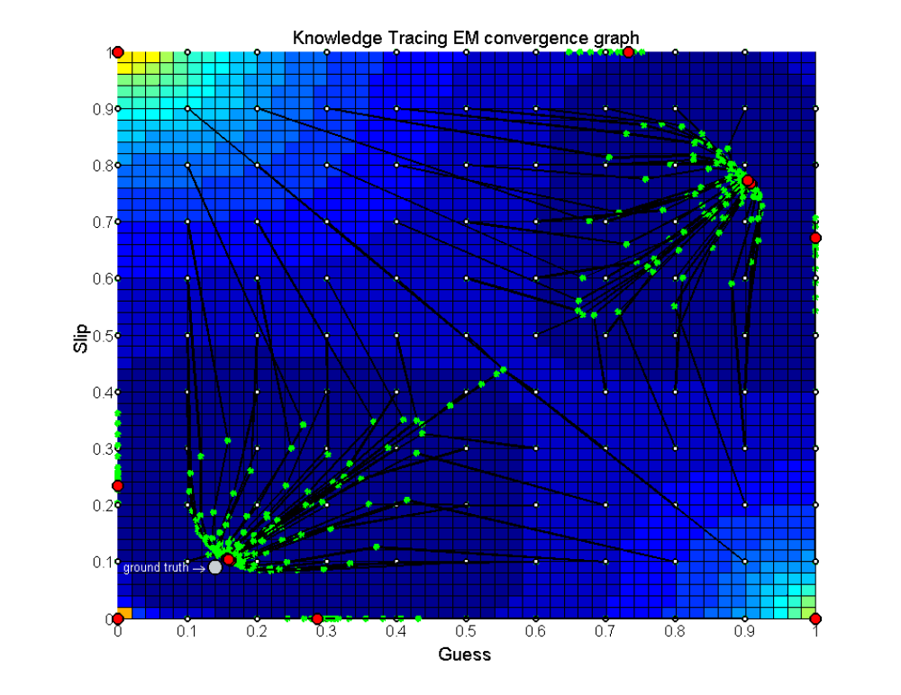
Degenerate Space
(Pardos et al., 2010)

Slide 27
Parameter Constraints Proposed
Beck
  P(G)+P(S)<1.0
Baker, Corbett, & Aleven (2008):
  P(G)<0.5, P(S)<0.5
Corbett & Anderson (1995):
  P(G)<0.3, P(S)<0.1
Your thoughts?

Slide 28
Does it matter what algorithm you use to select parameters?
EM better than CGD
  Chang et al., 2006 ΔA’= 0.05
CGD better than EM
  Baker et al., 2008 ΔA’= 0.01
EM better than BF
  Pavlik et al., 2009 ΔA’= 0.003, ΔA’= 0.01
  Gong et al., 2010 ΔA’= 0.005
  Pardos et al., 2011 Δ RMSE= 0.005
  Gowda et al., 2011 ΔA’= 0.02
BF better than EM
  Pavlik et al., 2009 ΔA’= 0.01, ΔA’= 0.005
  Baker et al., 2011 ΔA’= 0.001
BF better than CGD
  Baker et al., 2010 ΔA’= 0.02

Slide 29
Other questions, comments, concerns about BKT?

Slide 30
Next Assignment
Basic assignment 6

Slide 31
Final Projects
Let’s discuss final projects
Final project presentations
5/2 9am-11am

Slide 32
Next Class
Wednesday, April 5
B6: Performance Factors Assessment and Deep Knowledge Tracing
Baker, R.S. (2015) Big Data and Education. Ch. 4, V3.
Pavlik, P.I., Cen, H., Koedinger, K.R. (2009) Performance Factors Analysis -- A New Alternative to Knowledge Tracing. Proceedings of AIED2009.
Pavlik, P.I., Cen, H., Koedinger, K.R. (2009) Learning Factors Transfer Analysis: Using Learning Curve Analysis to Automatically Generate Domain Models. Proceedings of the 2nd International Conference on Educational Data Mining.
Khajah, M., Lindsey, R. V., & Mozer, M. C. (2016) How Deep is Knowledge Tracing? Proceedings of the International Conference on Educational Data Mining.

Slide 33
The End

