Slide 1
Core Methods in
Educational Data Mining
EDUC 545
Spring 2017

Slide 2
Questions about the HW?

Slide 3
Correlation Mining
The simplest form of relationship mining

Slide 4
What is a post-hoc control, and why do we need it?

Slide 5
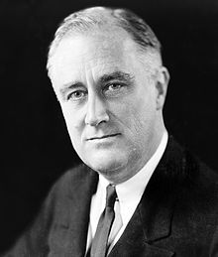
Questions about FDR vs FWER?

Slide 6
Questions about Bonferroni?

Slide 7
Questions about
Stigler’s Law of Eponomy?

Slide 8
Questions about p versus q?

Slide 9
Questions about p versus q?
p = probability that the results could have occurred if there were only random events going on
q = probability that the current test is a false discovery, given the post-hoc adjustment

Slide 10
Other questions about post-hoc controls?

Slide 11
Questions about ideas behind causal data mining?

Slide 12
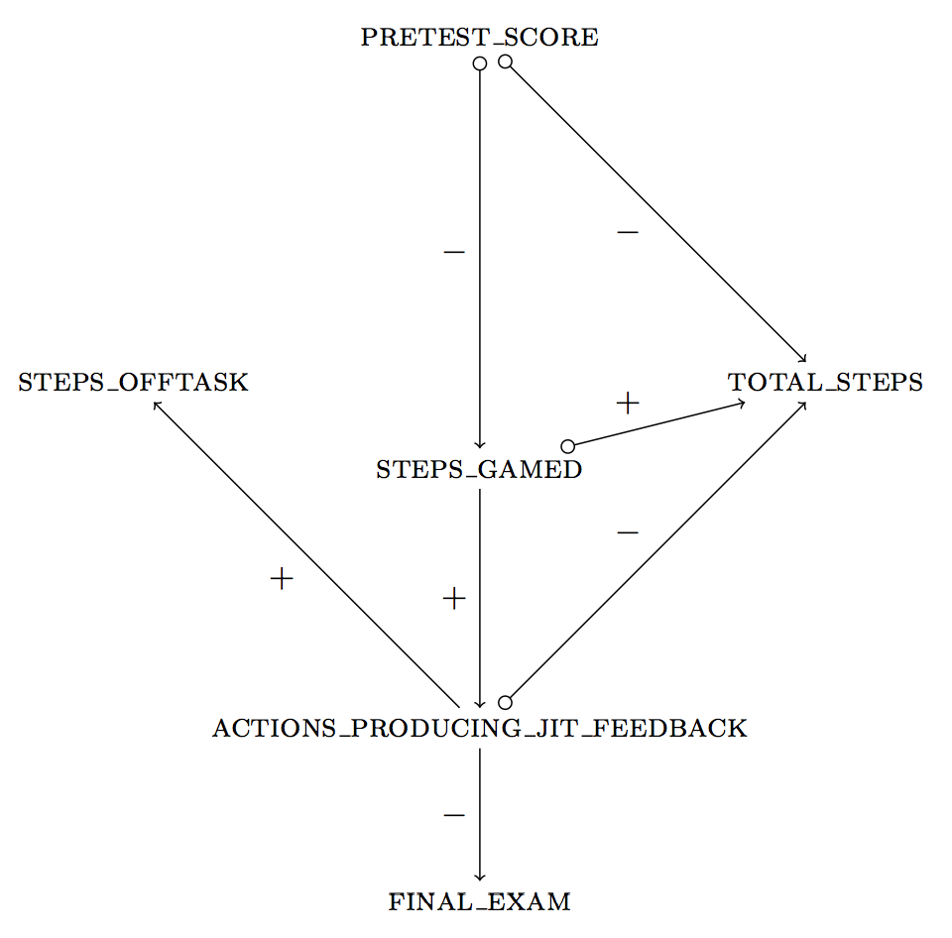
Fancsali (2013) Example
This example uses an algorithm that allows for
unmeasured common causes of measured
variables.
pretest_score → total_steps can signify
(1) pretest_score is a cause of total_steps;
(2) pretest_score & total_steps share a
common cause;
(3) both!

Slide 13
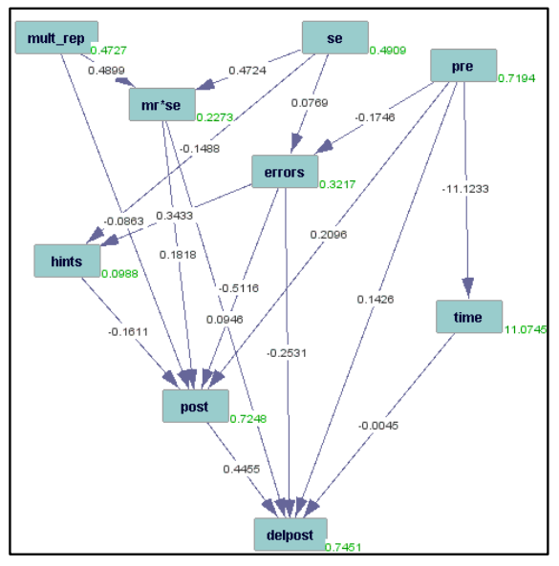
Rau & Scheines (2012)

Slide 14
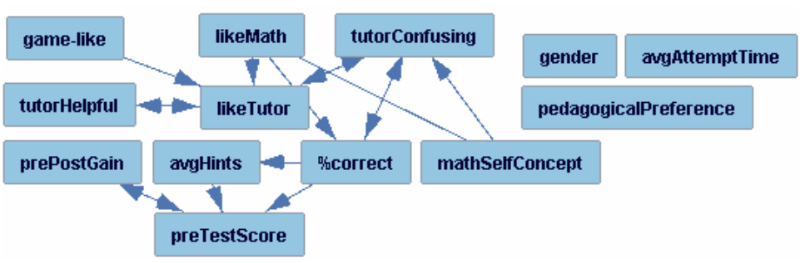
Rai et al. (2011)

Slide 15
Rai et al. (2011)
What’s wrong with this graph?

Slide 16
Rai et al. (2011)
What’s wrong with this graph?

Slide 17
Solution
Use domain knowledge to constrain search.
The future can’t cause the past.

Slide 18
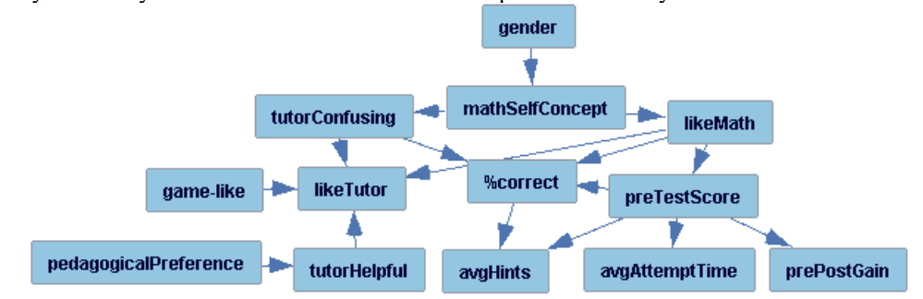
Result

Slide 19
Does this seem OK?

Slide 20
Does this seem OK?
Or does it call the whole method into question?
If we can get future->past relationships,
why should we trust any causal arrows tetrad produces?

Slide 21
Other questions or comments?

Slide 22
“Extra Slides”

Slide 23
Questions about Final Presentations?

Slide 24
Next Class
Wednesday, April 26
Baker, R.S. (2015) Big Data and Education. Ch. 5, V5. Ch. 8, V2.
Haythornthwaite, C. (2001) Exploring Multiplexity: Social Network Structures in a Computer-Supported Distance Learning Class. The Information Society: An International Journal, 17 (3), 211-226
Dawson, S. (2008) A study of the relationship between student social networks and sense of community. Educational Technology & Society, 11(3), 224-238.
Gasevic, D., Zouaq, A., & Janzen, R. (2013). "Choose Your Classmates, Your GPA Is at Stake!": The Association of Cross-Class Social Ties and Academic Performance. American Behavioral Scientist

Slide 25
The End

