Slide 1
Core Methods in
Educational Data Mining
HUDK4050
Fall 2015

Slide 2
Final Project Presentations
Part 2 of 3

Slide 3
Final Projects
Presentations of ideas for how educational data mining can be used to positively impact the world
Some of you may decide to carry out these project ideas in Feature Engineering Studio, or as your capstone projects

Slide 4
Timing
Remember: you have 5 minutes to present
There will be 2 minutes for questions between presentations

Slide 5
Presenters
#1 Irene
#2 Xue
#3 Shan
#4 Youngju
#5 Yunjia
#6 Huipu

Slide 6
Which of these ideas has the highest potential for impact on the world?
Impacting Practice OR
Impacting Scientific Understanding
#1 Irene
#2 Xue
#3 Shan
#4 Youngju
#5 Yunjia
#6 Huipu

Slide 7
Visualization assignments

Slide 8
John Saul

Slide 9
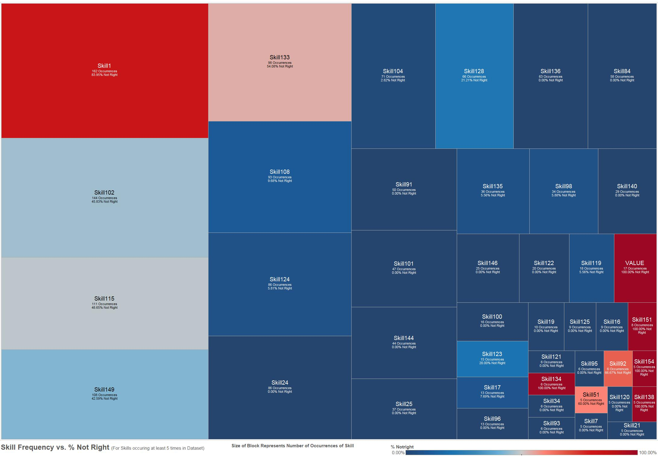

Slide 10
Sunmin Lee

Slide 11
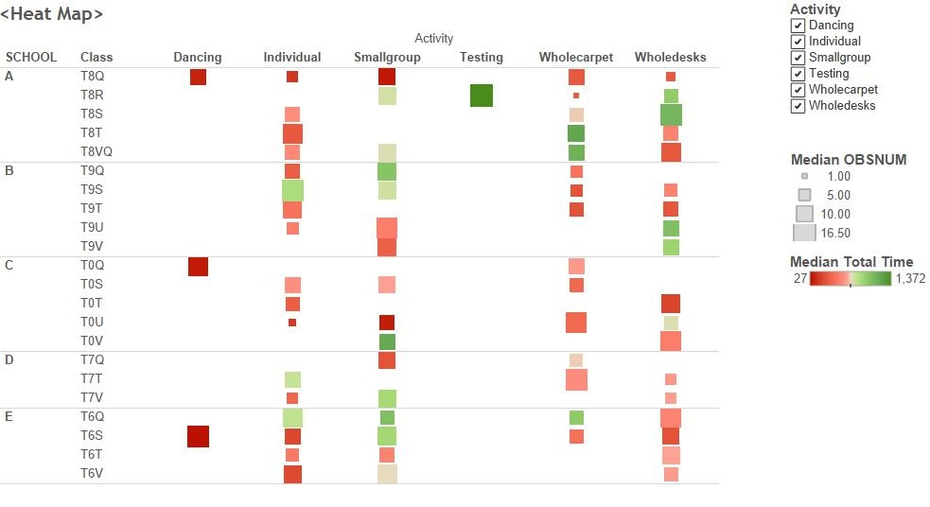

Slide 12
Matt Cirigliano

Slide 13
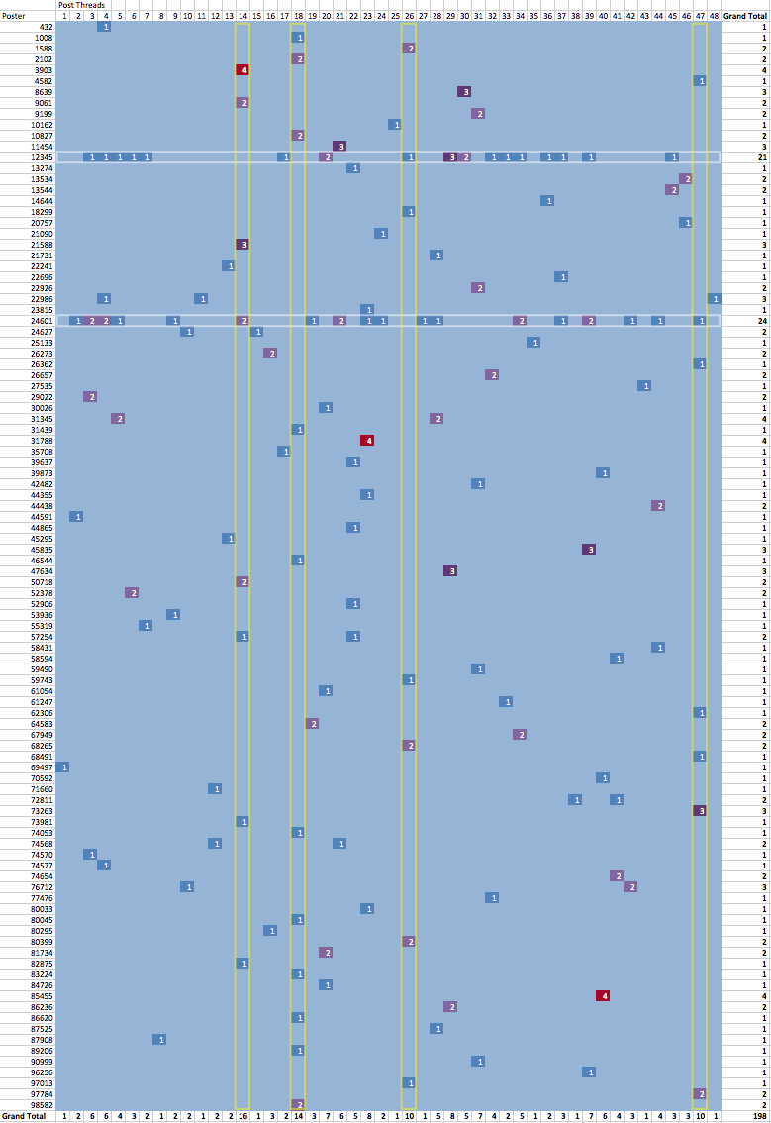

Slide 14
Meghan Wenzel

Slide 15
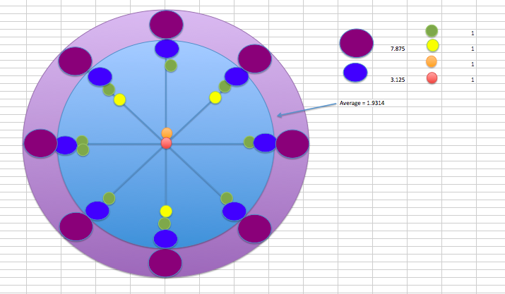

Slide 16
Tiantian Jin

Slide 17
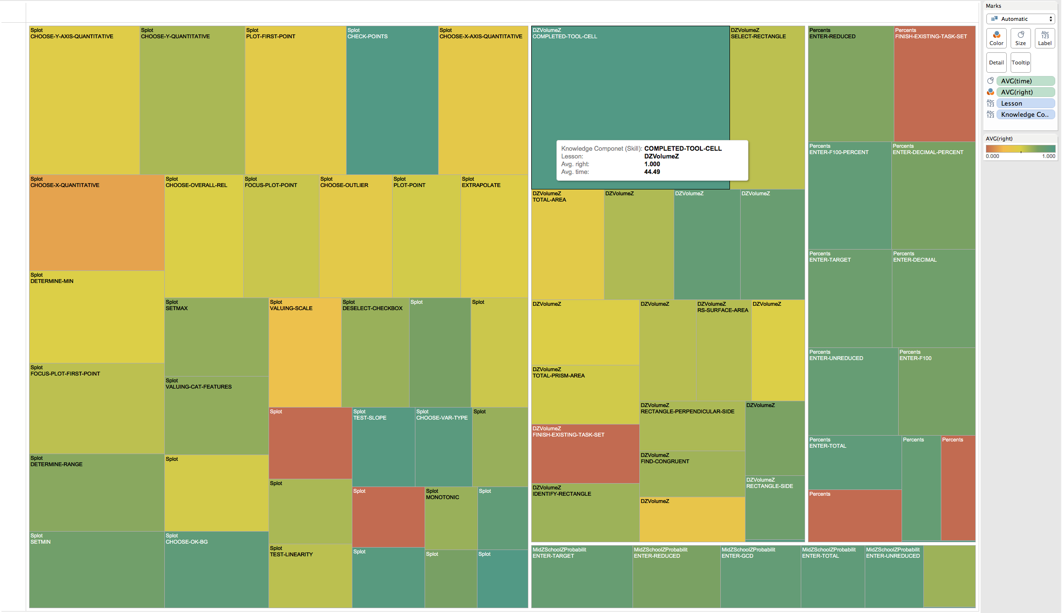

Slide 18
Yi Zhang

Slide 19
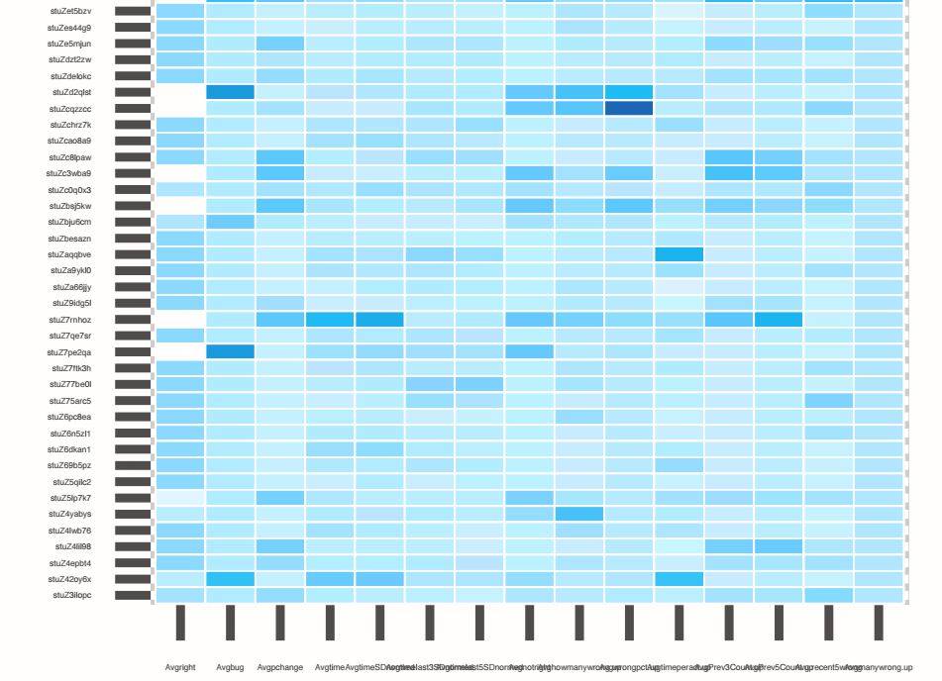

Slide 20
Yidan Wang

Slide 21
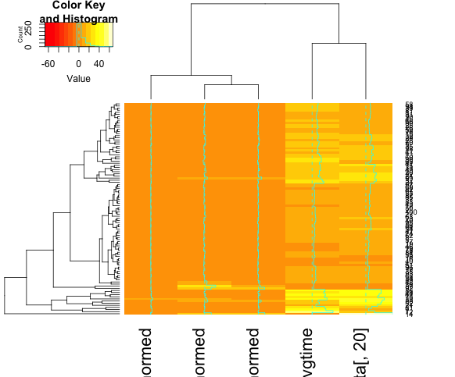

Slide 22
Xiang Sun

Slide 23
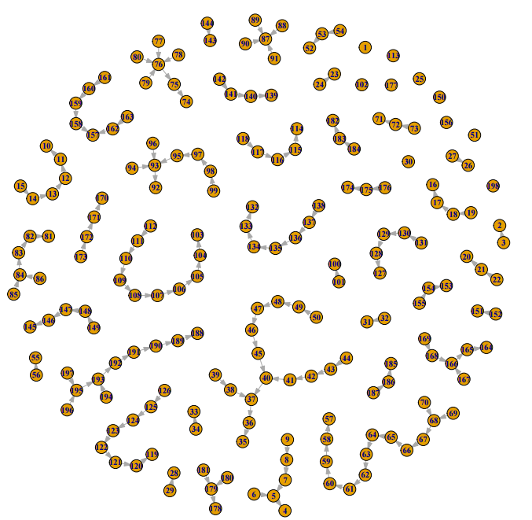

Slide 24
Yan Xu

Slide 25
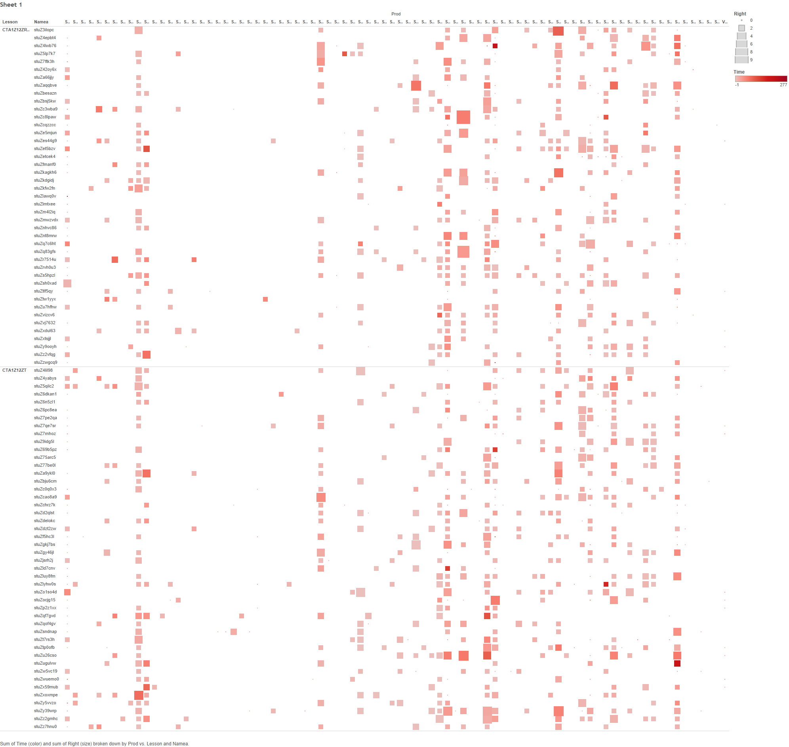

Slide 26
Karina Diaz

Slide 27
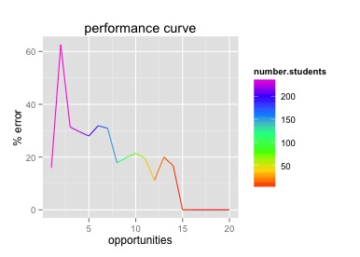

Slide 28
Shiyue Zheng

Slide 29
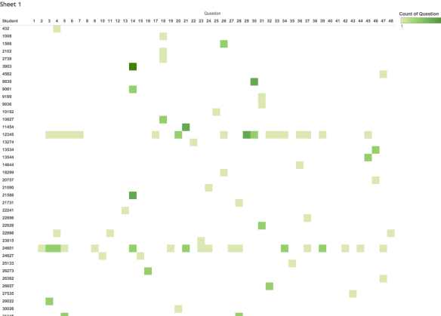

Slide 30
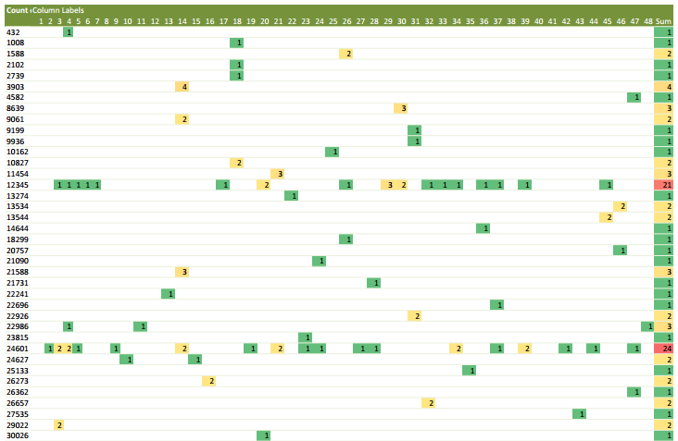

Slide 31
Kayhan Sanyal

Slide 32
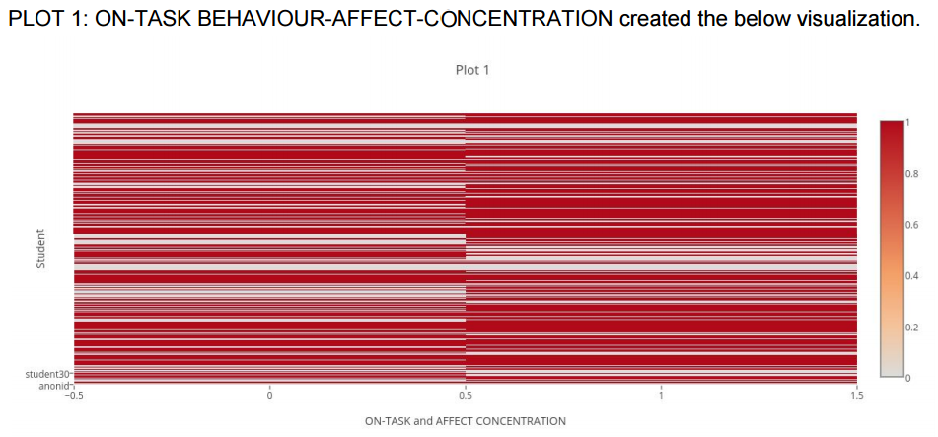

Slide 33
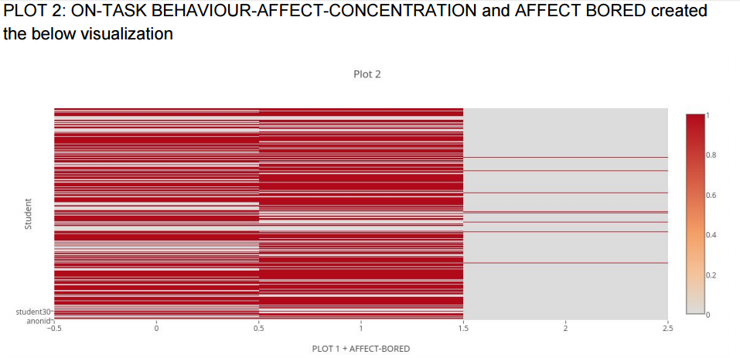

Slide 34
Anyone else?

Slide 35
General comments or thoughts on visualizations?
Beyond the fact that lots of folks used reeeeeeeealllllly small fonts

Slide 36
Hidden Markov Models

Slide 37
What is an HMM?
What does the “hidden” stand for?

Slide 38
What is an HMM?
What is the Markov assumption and what is it useful for?

Slide 39
Hidden Markov Models
Any questions about Hidden Markov Models?

Slide 40
What could you use HMMs for?

Slide 41
The End

