Slide 1
Core Methods in
Educational Data Mining
HUDK4050
Fall 2015

Slide 2
Final Project Presentations
Part 1 of 3

Slide 3
Final Projects
Presentations of ideas for how educational data mining can be used to positively impact the world
Some of you may decide to carry out these project ideas in Feature Engineering Studio, or as your capstone projects

Slide 4
Timing
Remember: you have 5 minutes to present
There will be 2 minutes for questions between presentations

Slide 5
Presenters
#1 Nishant
#2 Miggy
#3 Xiang
#4 Yang
#5 Nathaniel
#6 Sonam
#7 John Saul

Slide 6
Which of these ideas has the highest potential for impact on the world?
Impacting Practice OR
Impacting Scientific Understanding
#1 Nishant
#2 Miggy
#3 Xiang
#4 Yang
#5 Nathaniel
#6 Sonam
#7 John Saul

Slide 7
Visualization

Slide 8
Visualization
Displaying information in a meaningful fashion

Slide 9
Visualization Should…
(Tufte, 1983)
Show the data
Induce the viewer to think about the substance
Avoid distorting what the data have to say
Make large data sets coherent
Encourage the eye to compare different pieces of data
Reveal the data at several levels
(And other stuff too)

Slide 10
Learning Curve
What does a learning curve (typically) show?

Slide 11
Learning Curve
What do the following curves mean?

Slide 12
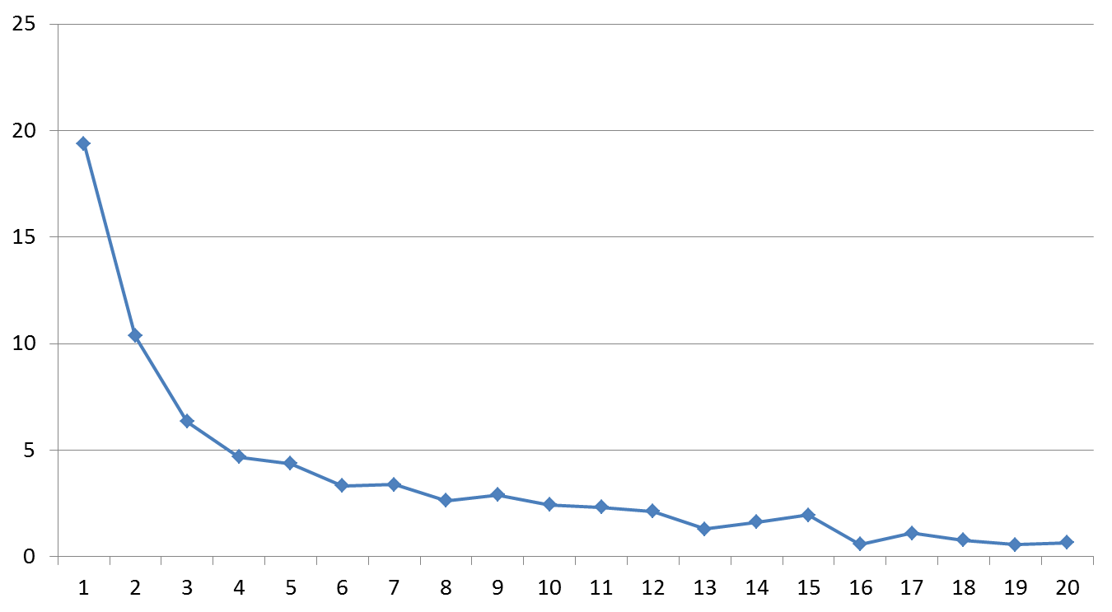

Slide 13
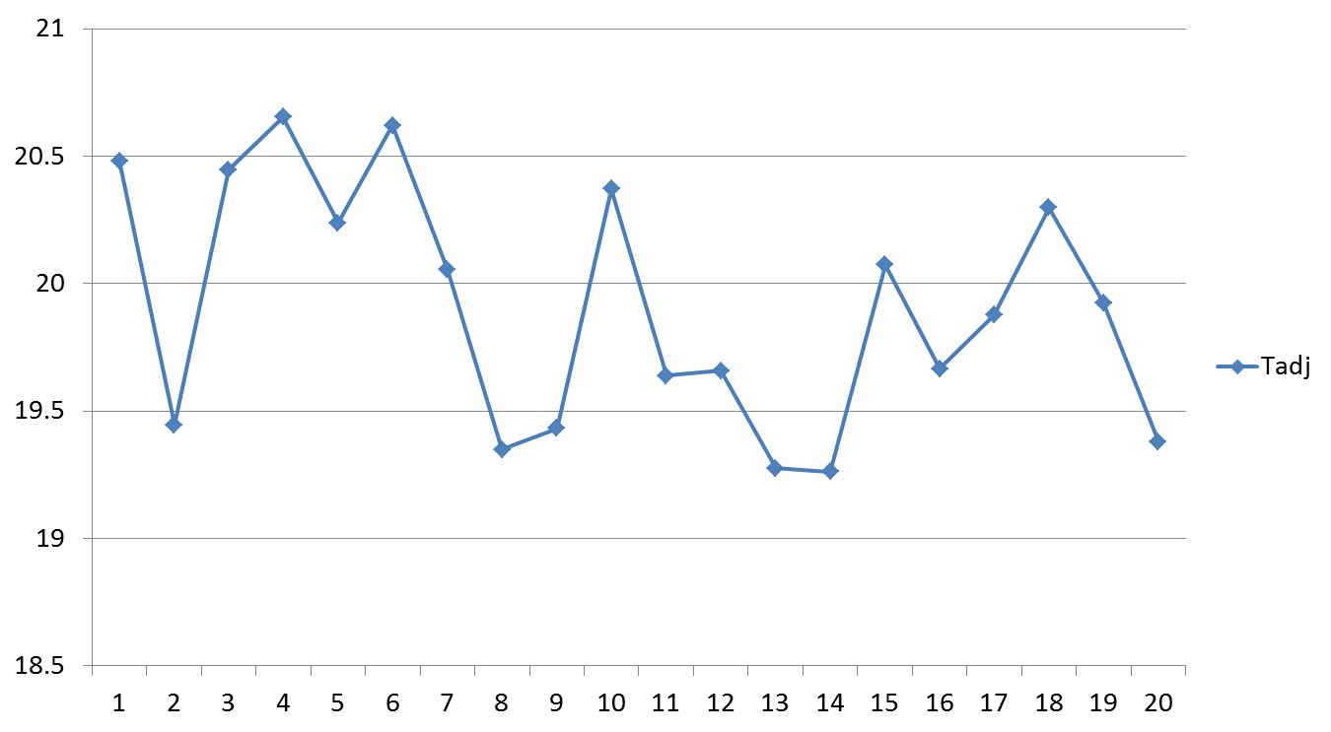

Slide 17
What are learning curves used for?

Slide 18
What is the difference between
Learning curves?
Moment-by-moment learning graphs?

Slide 19

Scatterplots and Heat Maps

Slide 20
Scatterplots and Heat Maps
What are the advantages of scatterplots relative to heat maps?
What are the advantages of heat maps relative to scatterplots?

Slide 21
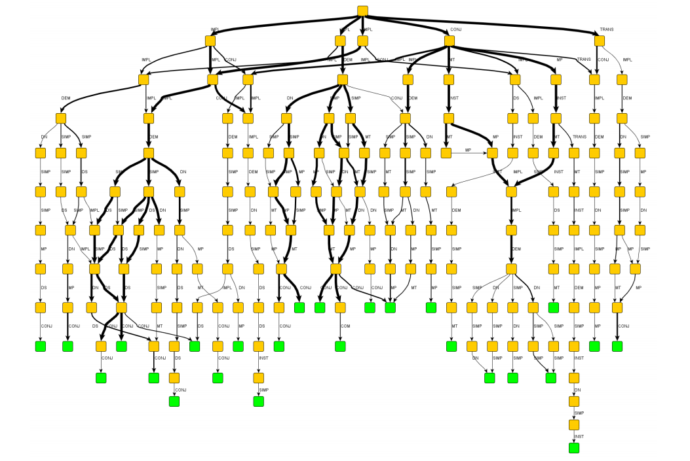
State Space Graphs

Slide 22
State Space Graphs
What are they used for?

Slide 23
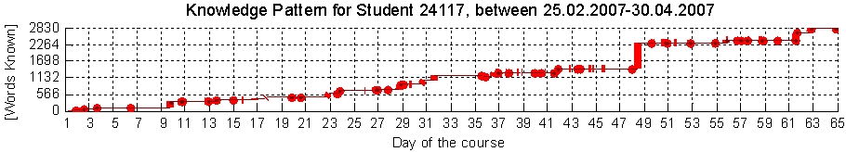


Learnograms:
What are they good for?
(Hershkovitz & Nachmias, 2009)

Slide 24
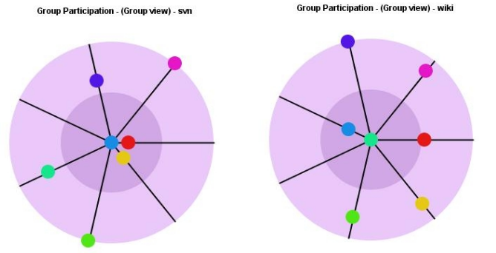



Activity Radar:
What are they good for?
(Kay, Maisonneuve, Yacef, & Reimann, 2006)

Slide 25
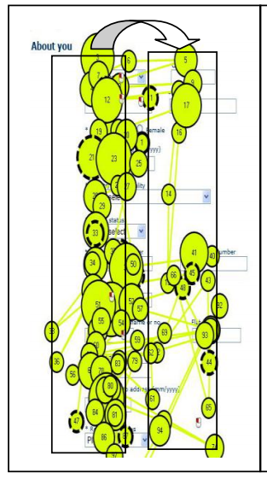
Gaze Plots:
What are they good for?
(Das, McEwan, & Douglas,
2008)

Slide 26
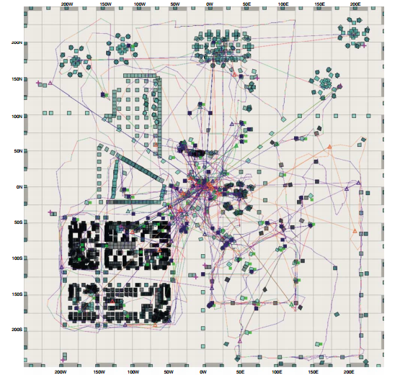
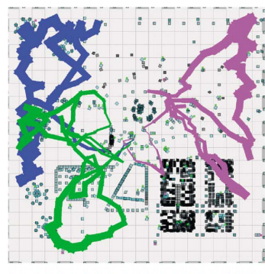
Spatial Usage Maps:
What are they good for?
(Borner & Penumarthy, 2003)

Slide 27
Pie Charts: Are they as bad as some folks say?

Slide 28
What’s wrong with this visualization?

Slide 29
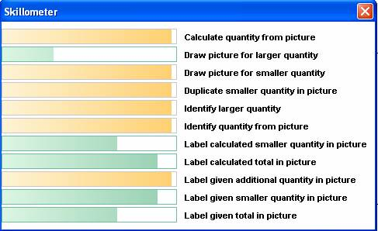

Visualizations don’t have to be fancy to be effective

Slide 30
Other visualizations you like?

Slide 31
Other comments or questions on visualizations?

Slide 32
Assignment C5
Visualization
  Due Tuesday
Questions?
Email me your visualizations

Slide 33
The End

