Slide 1
Core Methods in
Educational Data Mining
HUDK4050
Fall 2015

Slide 2
Hi!

Slide 3
PFA Assignment
General questions?

Slide 4
PFA Assignment
What is SSR?
Do you want a higher or lower SSR?

Slide 5
PFA Assignment
Were you able to get the Excel Equation Solver to work?

Slide 6
PFA Assignment
Other PFA questions?

Slide 7
Advanced BKT
But first…

Slide 8
Any questions about Classical BKT?
(Corbett & Anderson, 1995)
P(G)
P(S)
Unknown
P(T)
Known
P(~L_{n})
P(L_{n})

Slide 9
In the video lecture,
I discussed four ways of extending BKT

Slide 10
Advanced BKT: Lecture
Beck’s Help Model
Individualization of L_{o}
Contextual Guess and Slip
Moment by Moment Learning

Slide 11
Advanced BKT
Beck’s Help Model
  Relaxes assumption of one P(T) in all contexts

Slide 12
Beck et al.’s (2008) Help Model
p(T|H)
Not learned
p(T|~H)
Learned
p(L₀|H),
p(L₀|~H)
p(G|~H), p(G|H)
1-p(S|~H)
1-p(S|H)
correct
correct

Slide 13
Note
Did not lead to better prediction of student performance
How might it still be useful?

Slide 14
Questions? Comments?

Slide 15
Advanced BKT
Moment by Moment Learning
  Relaxes assumption of one P(T) in all contexts
  More general than Help model
  Can adjust P(T) in several ways
  Switches from P(T) to P(J)

Slide 16
Moment-By-Moment Learning Model
(Baker, Goldstein, & Heffernan, 2010)
Probability you Just Learned
p(J)
Not learned
p(T)
Learned
p(L₀)
p(G)
1-p(S)
correct
correct

Slide 17
P(J)
P(T) = chance you will learn if you didn’t know it
  P(T) = P(L_{n+1} | ~L_{n} )
P(J) = probability you JustLearned
  P(J) = P(~L_{n} ^ T)
  P(J) = P(~L_{n} ^ L_{n+1} )

Slide 18
P(J) is distinct from P(T)
For example:
P(L_{n}) = 0.1
P(T) = 0.6
P(J) = 0.54
P(L_{n}) = 0.96
P(T) = 0.6
P(J) = 0.02
Learning!
Little Learning

Slide 19
Do people want to go through the calculation process?
Up to you…

Slide 20
Alternative way of computing P(J)
(van de Sande, 2013; Pardos & Yudelson, 2013)
Assume learning occurs exactly once in sequence (at most)
Compute probability for each of the possible points, in the light of the entire sequence
May be more precise
Needs all the data to compute
Can’t account for cases where there is improvement twice

Slide 21
Using P(J)
Model can be used to create
Moment-by-Moment Learning Graphs
(Baker et al., 2013)

Slide 22
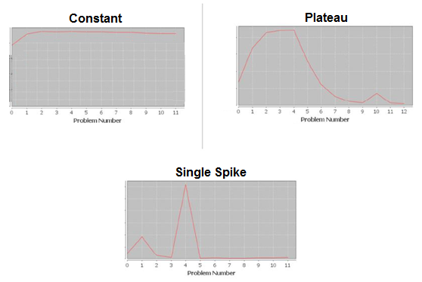

Slide 23
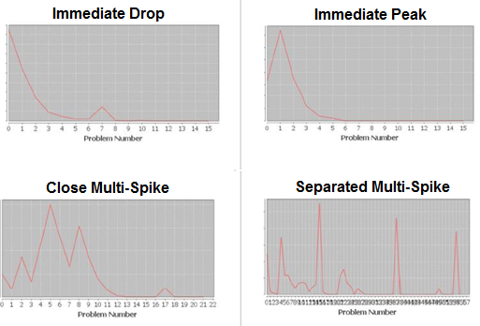

Slide 24
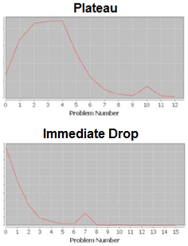
Can predict Preparation for Future Learning
(Baker et al., 2013)
Patterns correlate to PFL!
r = -0.27, q<0.05
r = 0.29, q<0.05

Slide 25

Data-Mined Combination of Features
Can predict student PFL very effectively
(Hershkovitz et al., 2013)
Better than BKT or metacognitive features

Slide 26

Work to study
What student behavior precedes eureka moments
  Moments with top 1% of P(J)
Moore et al. (2015)

Slide 27
Predicting Eureka Moments: Top Feature
Number of attempts during problem step
  A’ = 0.735
  1% Mean = 3.7 (SD = 4.6)
  99% Mean = 1.9 (SD = 2.6)

Slide 28
Predicting Eureka Moments: #2 Feature
Asking for help (regardless of what you do afterwards)
  A’ = 0.677
  1% Mean = 0.38 (SD = 0.33)
  99% Mean = 0.16 (SD = 0.29)

Slide 29
Predicting Eureka Moments: #3 Feature
Time > 10 Seconds and Previous Action Help or Bug
  A’ = 0.635
  1% Mean = 0.23 (SD = 0.30)
  99% Mean = 0.10 (SD = 0.25)

Slide 30
Not so predictive
Receiving a Bug Message
  A’ = 0.584
Help Avoidance
  A’ = 0.570
Number of Prob. Steps Completed So Far on Current Skill
  A’ = 0.502

Slide 31
Questions? Comments?

Slide 32
Advanced BKT
Individualization of L_{o}
  Relaxes assumption of one P(L_{o}) for all students

Slide 33
BKT-Prior Per Student
p(L₀) = Student’s average correctness on all prior problem sets
Not learned
p(T)
Learned
p(G)
1-p(S)
correct
correct

Slide 34
BKT-Prior Per Student
Much better on
  ASSISTments (Pardos & Heffernan, 2010)
  Cognitive Tutor for genetics (Baker et al., 2011)
Much worse on
  ASSISTments (Pardos et al., 2011)

Slide 35
Advanced BKT
Contextual Guess and Slip
  Relaxes assumption of one P(G), P(S) in all contexts

Slide 36
Contextual Guess and Slip model
Not learned
p(T)
Learned
p(L₀)
p(G)
1-p(S)
correct
correct

Slide 37
Do people want to go through the calculation process?
Up to you…

Slide 38
Contextual Guess and Slip model
Effect on future prediction: very inconsistent
Much better on Cognitive Tutors for middle school, algebra, geometry (Baker, Corbett, & Aleven, 2008a, 2008b)
Much worse on Cognitive Tutor for genetics (Baker et al., 2010, 2011) and ASSISTments (Gowda et al., 2011)

Slide 39
But predictive of longer-term outcomes
Average contextual P(S) predicts post-test (Baker et al., 2010)
Average contextual P(S) predicts shallow learners (Baker, Gowda, Corbett, & Ocumpaugh, 2012)
Average contextual P(S) predicts college attendance, selective college attendance, college major (San Pedro et al., 2013, 2014, in preparation)

Slide 40
Other Advanced BKT

Slide 41
Advanced BKT
Relaxing assumption of binary performance
  Turns out to be trivial to accommodate in existing BKT paradigm
  (Sao Pedro et al., 2013)

Slide 42
Advanced BKT
Relaxing assumption of no forgetting
  There are variants of BKT that incorporate forgetting (e.g. Chang et al., 2008)
    General probability P(F) of going from learned to unlearned, in all situations
  But typically handled with memory decay models rather than BKT (e.g. Pavlik & Anderson, 2008)
    No reason memory decay algorithms couldn’t be integrated into contextual P(F)
    But no one has done it yet

Slide 43
Advanced BKT
Relaxing assumption of one skill per item
  Compensatory Model (Pardos et al., 2008)
  Conjunctive Model (Pardos et al., 2008)
    Like DINA model in Psychometrics!
  PFA

Slide 44
Advanced BKT
What other assumptions could be relaxed?

Slide 45
Other questions or comments?

Slide 46
Assignment C3
Any questions?

Slide 47
Next Class
Tuesday, October 27
Assignment C3 due
Baker, R.S. (2014) Big Data and Education. Ch. 7, V6, V7.
Desmarais, M.C., Meshkinfam, P., Gagnon, M. (2006) Learned Student Models with Item to Item Knowledge Structures. User Modeling and User-Adapted Interaction, 16, 5, 403-434.
Barnes, T. (2005) The Q-matrix Method: Mining Student Response Data for Knowledge. Proceedings of the Workshop on Educational Data Mining at the Annual Meeting of the American Association for Artificial Intelligence.
Cen, H., Koedinger, K., Junker, B. (2006) Learning Factors Analysis - A General Method for Cognitive Model Evaluation and Improvement. Proceedings of the International Conference on Intelligent Tutoring Systems, 164-175.
Koedinger, K.R., McLaughlin, E.A., Stamper, J.C. (2012) Automated Student Modeling Improvement. Proceedings of the 5th International Conference on Educational Data Mining, 17-24.

Slide 48
The End

