Slide 1
Core Methods in
Educational Data Mining
HUDK4050
Fall 2014

Slide 2
What is the
Goal of Knowledge Inference?

Slide 3
What is the
Goal of Knowledge Inference?
Measuring what a student knows at a specific time
Measuring what relevant knowledge components a student knows at a specific time

Slide 4
Why is it useful to measure student knowledge?

Slide 5
Key assumptions of BKT
Assess a student’s knowledge of skill/KC X
Based on a sequence of items that are scored between 0 and 1
  Classically 0 or 1, but there are variants that relax this
Where each item corresponds to a single skill
Where the student can learn on each item, due to help, feedback, scaffolding, etc.

Slide 6
Key assumptions of BKT
Each skill has four parameters
From these parameters, and the pattern of successes and failures the student has had on each relevant skill so far
We can compute
  Latent knowledge P(Ln)
  The probability P(CORR) that the learner will get the item correct

Slide 7
Key assumptions of BKT
Two-state learning model
  Each skill is either learned or unlearned
In problem-solving, the student can learn a skill at each opportunity to apply the skill
A student does not forget a skill, once he or she knows it

Slide 8
Model Performance Assumptions
If the student knows a skill, there is still some chance the student will slip and make a mistake.
If the student does not know a skill, there is still some chance the student will guess correctly.

Slide 9
Classical BKT
Not learned
p(T)
Learned
p(L₀)
p(G)
1-p(S)
correct
correct
Two Learning Parameters
p(L₀) Probability the skill is already known before the first opportunity to use the skill in problem solving.
p(T) Probability the skill will be learned at each opportunity to use the skill.
Two Performance Parameters
p(G) Probability the student will guess correctly if the skill is not known.
p(S) Probability the student will slip (make a mistake) if the skill is known.

Slide 10
Assignment 3B
Let’s go through the assignment together

Slide 11
Assignment 3B
Any questions?

Slide 12
Parameter Fitting
Picking the parameters that best predict future performance
Any questions or comments on this?

Slide 13
Overparameterization
BKT is overparameterized (Beck et al., 2008)
Which means there are multiple sets of parameters that can fit any data

Slide 14
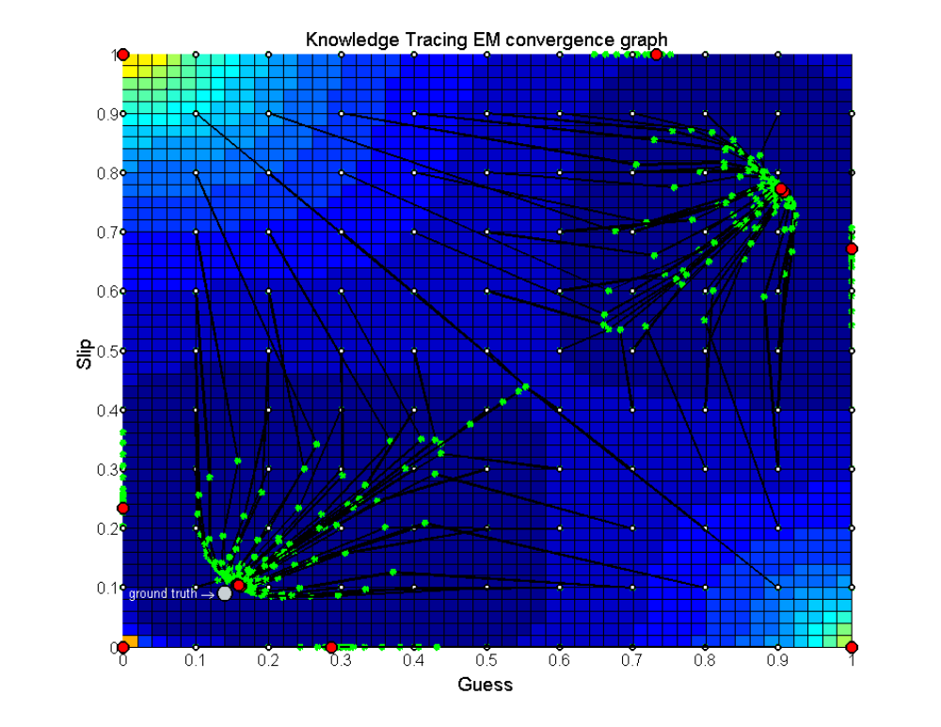
Degenerate Space
(Pardos et al., 2010)

Slide 15
Parameter Constraints Proposed
Beck
  P(G)+P(S)<1.0
Baker, Corbett, & Aleven (2008):
  P(G)<0.5, P(S)<0.5
Corbett & Anderson (1995):
  P(G)<0.3, P(S)<0.1
Your thoughts?

Slide 16
Does it matter what algorithm you use to select parameters?
EM better than CGD
  Chang et al., 2006 ΔA’= 0.05
CGD better than EM
  Baker et al., 2008 ΔA’= 0.01
EM better than BF
  Pavlik et al., 2009 ΔA’= 0.003, ΔA’= 0.01
  Gong et al., 2010 ΔA’= 0.005
  Pardos et al., 2011 Δ RMSE= 0.005
  Gowda et al., 2011 ΔA’= 0.02
BF better than EM
  Pavlik et al., 2009 ΔA’= 0.01, ΔA’= 0.005
  Baker et al., 2011 ΔA’= 0.001
BF better than CGD
  Baker et al., 2010 ΔA’= 0.02

Slide 17
Other questions, comments, concerns about BKT?

Slide 18
Assignment B4
Any questions?

Slide 19
Next Class
Wednesday, October 15
B3: Bayesian Knowledge Tracing
Baker, R.S. (2014) Big Data and Education. Ch. 4, V1, V2.
Corbett, A.T., Anderson, J.R. (1995) Knowledge Tracing: Modeling the Acquisition of Procedural Knowledge. User Modeling and User-Adapted Interaction, 4, 253-278.

Slide 20
The End

