Slide 1
Core Methods in
Educational Data Mining
HUDK4050
Fall 2014

Slide 2
The Homework
Let’s go over the homework

Slide 3
Was it harder or easier than basic homework 1?

Slide 4
What was the answer to Q1?
What tool(s) did you use to compute it?

Slide 5
What was the answer to Q2?
What tool(s) did you use to compute it?

Slide 6
What was the answer to Q3?
What tool(s) did you use to compute it?

Slide 7
What was the answer to Q4?
What tool(s) did you use to compute it?

Slide 8
What was the answer to Q5?
What tool(s) did you use to compute it?

Slide 9
What was the answer to Q6?
What tool(s) did you use to compute it?

Slide 10
What was the answer to Q7?
What tool(s) did you use to compute it?

Slide 11
What was the answer to Q8?
What tool(s) did you use to compute it?

Slide 12
What was the answer to Q9?
What tool(s) did you use to compute it?

Slide 13
What was the answer to Q10?

Slide 14
Who did Q11?
Challenges?

Slide 15
Questions? Comments? Concerns?

Slide 16
Textbook/Readings

Slide 17
Detector Confidence
Any questions about detector confidence?

Slide 18
Detector Confidence
What are the pluses and minuses of making sharp distinctions at 50% confidence?

Slide 19
Detector Confidence
Is it any better to have two cut-offs?

Slide 20
Detector Confidence
How would you determine where to place the two cut-offs?

Slide 21
Cost-Benefit Analysis
Why don’t more people do cost-benefit analysis of automated detectors?

Slide 22
Detector Confidence
Is there any way around having intervention cut-offs somewhere?

Slide 23
Goodness Metrics

Slide 24
Exercise
 | Detector Academic Suspension | Detector No Academic Suspension
Data Suspension | 2 | 3
Data No Suspension | 5 | 140
What is accuracy?

Slide 25
Exercise
 | Detector Academic Suspension | Detector No Academic Suspension
Data Suspension | 2 | 3
Data No Suspension | 5 | 140
What is kappa?

Slide 26
Accuracy
Why is it bad?

Slide 27
Kappa
What are its pluses and minuses?

Slide 28
ROC Curve

Slide 29
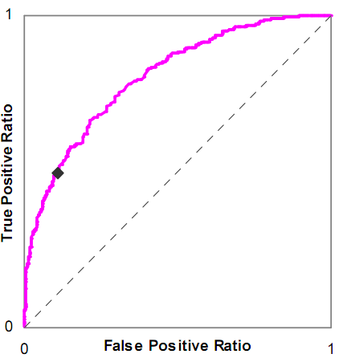
Is this a good model or a bad model?

Slide 30
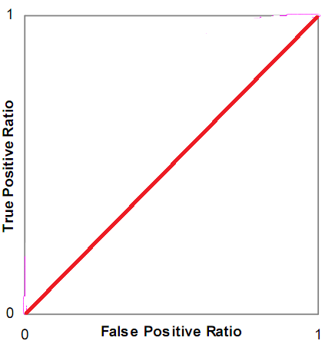
Is this a good model or a bad model?

Slide 31
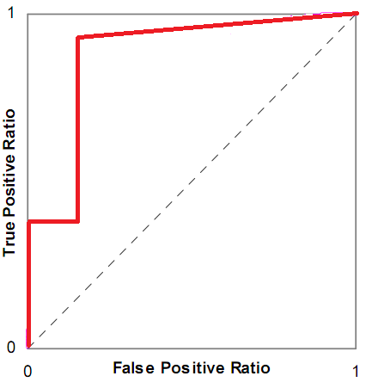
Is this a good model or a bad model?

Slide 32
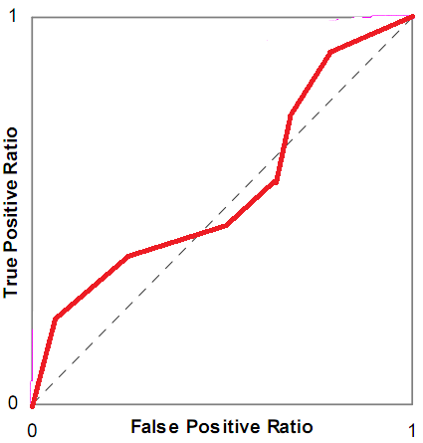
Is this a good model or a bad model?

Slide 33
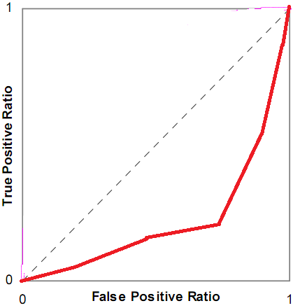
Is this a good model or a bad model?

Slide 34
ROC Curve
What are its pluses and minuses?

Slide 35
A’
What are its pluses and minuses?

Slide 36
Any questions about A’?

Slide 37
Precision and Recall
Precision = TP
  TP + FP
Recall = TP
  TP + FN

Slide 38
Precision and Recall
What do they mean?

Slide 39
What do these mean?
Precision = The probability that a data point classified as true is actually true
Recall = The probability that a data point that is actually true is classified as true

Slide 40
Precision and Recall
What are their pluses and minuses?

Slide 41
Correlation vs RMSE
What is the difference between correlation and RMSE?
What are their relative merits?

Slide 42
What does it mean?
High correlation, low RMSE
Low correlation, high RMSE
High correlation, high RMSE
Low correlation, low RMSE

Slide 43
RMSE vs MAE

Slide 44

RMSE vs MAE
Radek Pelanek argues that MAE is inferior to RMSE
(and notes this opinion is held by many others)

Slide 45
Radek’s Example
Take a student who makes correct responses 70% of the time
And two models
  Model A predicts 70% correctness
  Model B predicts 100% correctness

Slide 46
In other words
70% of the time the student gets it right
  Response = 1
30% of the time the student gets it wrong
  Response = 0
Model A Prediction = 0.7
Model B Prediction = 0.3

Slide 47
MAE
70% of the time the student gets it right
  Response = 1
  Model A (0.7) Absolute Error = 0.3
  Model B (1.0) Absolute Error = 0
30% of the time the student gets it wrong
  Response = 0
  Model A (0.7) Absolute Error = 0.7
  Model B (1.0) Absolute Error = 1

Slide 48
MAE
Model A
  (0.7)(0.3)+(0.3)(0.7)
  0.21+0.21
  0.42
Model B
  (0.7)(0)+(0.3)(1)
  0+0.3
  0.3

Slide 49
MAE
Model A
  (0.7)(0.3)+(0.3)(0.7)
  0.21+0.21
  0.42
Model B is better.
  (0.7)(0)+(0.3)(1)
  0+0.3
  0.3

Slide 50
MAE
Model A
  (0.7)(0.3)+(0.3)(0.7)
  0.21+0.21
  0.42
Model B is better. Do you buy that?
  (0.7)(0)+(0.3)(1)
  0+0.3
  0.3

Slide 51
RMSE
70% of the time the student gets it right
  Response = 1
  Model A (0.7) Squared Error = 0.09
  Model B (1.0) Squared Error = 0
30% of the time the student gets it wrong
  Response = 0
  Model A (0.7) Squared Error = 0.49
  Model B (1.0) Squared Error = 1

Slide 52
RMSE
Model A
  (0.7)(0.09)+(0.3)(0.49)
  0.063+0.147
  0.21
Model B
  (0.7)(0)+(0.3)(1)
  0+0.3
  0.3

Slide 53
RMSE
Model A is better.
  (0.7)(0.09)+(0.3)(0.49)
  0.063+0.147
  0.21
Model B
  (0.7)(0)+(0.3)(1)
  0+0.3
  0.3

Slide 54
RMSE
Model A is better.
Does this seem more reasonable?
  (0.7)(0.09)+(0.3)(0.49)
  0.063+0.147
  0.21
Model B
  (0.7)(0)+(0.3)(1)
  0+0.3
  0.3

Slide 55
AIC/BIC vs Cross-Validation
AIC is asymptotically equivalent to LOOCV
BIC is asymptotically equivalent to k-fold cv
Why might you still want to use cross-validation instead of AIC/BIC?
Why might you still want to use AIC/BIC instead of cross-validation?

Slide 56
AIC vs BIC
Any comments or questions?

Slide 57
LOOCV vs k-fold CV
Any comments or questions?

Slide 58
Other questions, comments, concerns about textbook?

Slide 59
Creative HW 2

Slide 60
Creative HW 2
Due October *8*

Slide 61
Creative HW 2
Yes, you get to breathe for a few days

Slide 62
Creative HW 2
Yes, you get to breathe for a few days
(Sorry about assignment timing; my getting sick the second week of class threw off the class timeline a little)

Slide 63
Questions about Creative HW 2?

Slide 64
Other questions or comments?

Slide 65
No Class Next Week

Slide 66
Next Class
Monday, October 6
Feature Engineering -- What
Baker, R.S. (2014) Big Data and Education. Ch. 3, V3
Sao Pedro, M., Baker, R.S.J.d., Gobert, J. (2012) Improving Construct Validity Yields Better Models of Systematic Inquiry, Even with Less Information. Proceedings of the 20th International Conference on User Modeling, Adaptation and Personalization (UMAP 2012),249-260.

Slide 67
The End

