Slide 1
Core Methods in
Educational Data Mining
HUDK4050
Fall 2014

Slide 2
Correlation Mining
The simplest form of relationship mining

Slide 3
Assignment B6
Let’s go over each answer

Slide 4
Questions about why post-hoc controls are needed?

Slide 5
Questions about Bonferroni?

Slide 6
Questions about
Stigler’s Law of Eponomy?

Slide 7
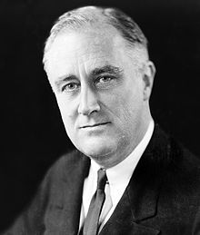
Questions about FDR vs FWER?

Slide 8
Questions about p versus q?

Slide 9
Questions about p versus q?
p = probability that the results could have occurred if there were only random events going on
q = probability that the current test is a false discovery, given the post-hoc adjustment

Slide 10
Other questions about post-hoc controls?

Slide 11
Questions about ideas behind causal data mining?

Slide 12
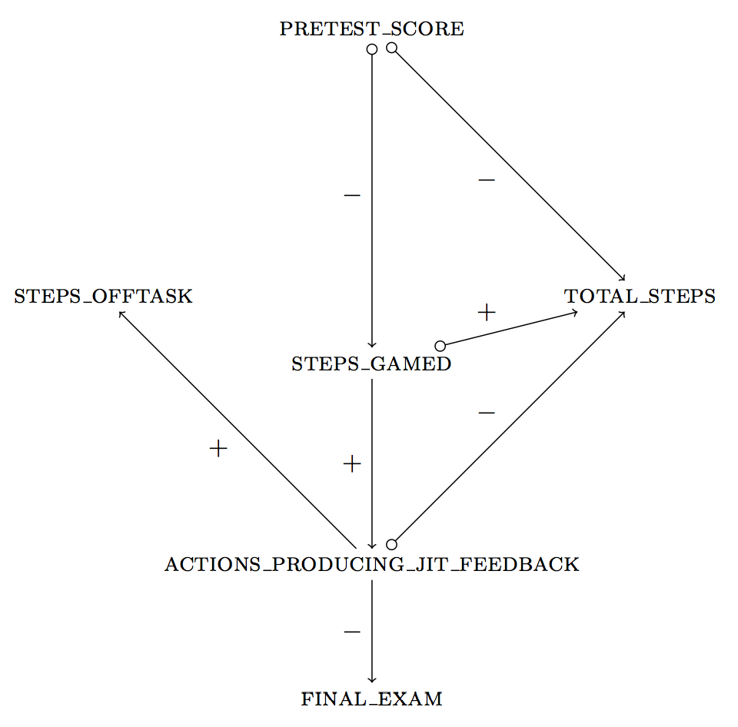
Fancsali (2013) Example
This example uses an algorithm that allows for
unmeasured common causes of measured
variables.
pretest_score → total_steps can signify
(1) pretest_score is a cause of total_steps;
(2) pretest_score & total_steps share a
common cause;
(3) both!

Slide 13
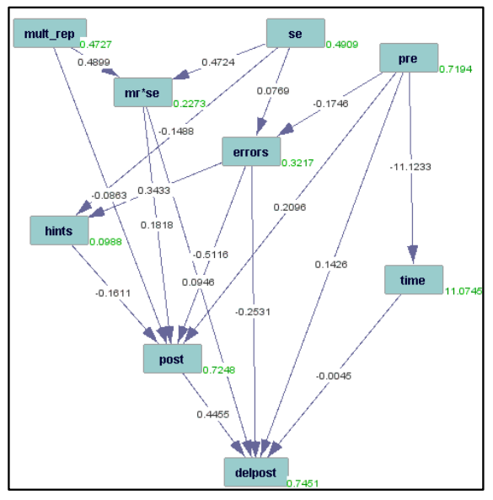
Rau & Scheines (2012)

Slide 14
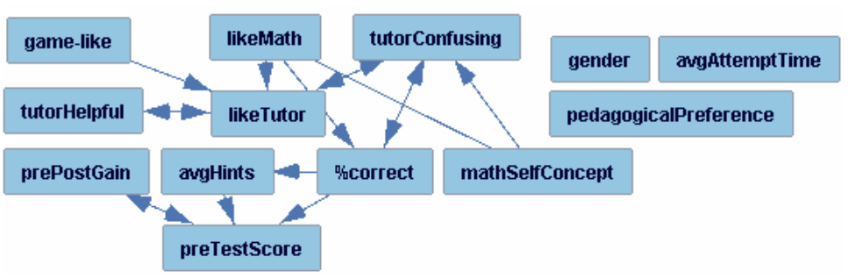
Rai et al. (2011)

Slide 15
Rai et al. (2011)
What’s wrong with this graph?

Slide 16
Rai et al. (2011)
What’s wrong with this graph?

Slide 17
Solution
Use domain knowledge to constrain search.
The future can’t cause the past.

Slide 18
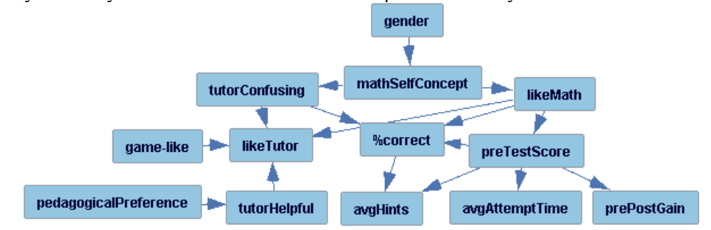
Result

Slide 19
Does this seem OK?

Slide 20
Does this seem OK?
Or does it call the whole method into question?
If we can get future->past relationships,
why should we trust any causal arrows tetrad produces?

Slide 21
Any other questions or comments?

Slide 22
Assignment B7
Clustering

Slide 23
Next Class
No class next week

Slide 24
Next Class
Monday, November 24
Baker, R.S. (2014) Big Data and Education. Ch. 8, V1, V2.
Pardos, Z.A., Baker, R.S., San Pedro, M.O.C.Z., Gowda, S.M., Gowda, S.M. (2014) Affective states and state tests: Investigating how affect and engagement during the school year predict end of year learning outcomes. Journal of Learning Analytics, 1 (1), 107-128.
Hershkovitz, A., Baker, R.S.J.d., Gobert, J., Wixon, M., Sao Pedro, M. (2013) Discovery with Models: A Case Study on Carelessness in Computer-based Science Inquiry. American Behavioral Scientist, 57 (10), 1479-1498.

Slide 25
The End

