Slide 1
Core Methods in
Educational Data Mining
HUDK4050
Fall 2014

Slide 2
Wow
Welcome!
There’s a lot of you
  It’s great to see so much continuing interest in EDM at TC

Slide 3
Administrative Stuff
Is everyone signed up for class?
If not, and you want to receive credit, please talk to me after class

Slide 4
Class Schedule

Slide 5
Class Schedule
Updated versions will be available on the course webpage
Readings will be made available in a course Dropbox or gdrive

Slide 6
Class Schedule
More content than a usual TC class
But also a somewhat more irregular schedule than a usual TC class
I travel a lot for grant commitments
Online schedule will be kept up-to-date

Slide 7
Required Texts
Baker, R.S. (2013) Big Data and Education
http:/www.columbia.edu/~rsb2162/
bigdataeducation.html

Slide 8
Readings
This is a graduate class
I expect you to decide what is crucial for you
And what you should skim to be prepared for class discussion and for when you need to know it in 8 years

Slide 9
Readings
That said

Slide 10
Readings and Participation
It is expected that you come to class, unless you have a very good reason not to
It is expected that you watch Big Data and Education videos before class, so we can discuss them rather than me repeating them
It is expected that you be prepared for class by skimming the readings to the point where you can participate effectively in class discussion
This is your education, make the most of it!

Slide 11
Readings
https://drive.google.com/folderview?id=0B3e6NaCpKireVGdOQ0VPN29qMVE&usp=sharing

Slide 12
Course Goals
This course covers methods from the emerging area of educational data mining.
You will learn how to execute these methods in standard software packages
And the limitations of existing implementations of these methods.
Equally importantly, you will learn when and why to use these methods.

Slide 13
Course Goals
Discussion of how EDM differs from more traditional statistical and psychometric approaches will be a key part of this course
In particular, we will study how many of the same statistical and mathematical approaches are used in different ways in these research communities.

Slide 14
Assignments
There will be 8 basic homeworks
You choose 6 of them to complete
  3 from the first 4 (e.g. BHW 1-4)
  3 from the second 4 (e.g. BHW 5-8)

Slide 15
Basic homeworks
Basic homeworks will be due before the class session where their topic is discussed

Slide 16
Why?
These are not your usual homeworks
Most homework is assigned after the topic is discussed in class, to reinforce what is learned
This homework is due before the topic is discussed in class, to enable us to talk more concretely about the topic in class

Slide 17
These homeworks
These homeworks will not require flawless, perfect execution
They will require personal discovery and learning from text and video resources
Giving you a base to learn more from class discussion

Slide 18
Assignments
There will be 6 creative homeworks
You choose 4 of them to complete
  2 from the first 3 (e.g. CHW 1-3)
  2 from the second 3 (e.g. CHW 4-6)

Slide 19
Creative homeworks
Creative homeworks will be due after the class session where their topic is discussed

Slide 20
Why?
These homeworks will involve creative application of the methods discussed in class, going beyond what we discuss in class

Slide 21
These homeworks
These homeworks will not require flawless, perfect execution
They will require personal discovery and learning from text and video resources
Giving you a base to learn more from class discussion

Slide 22
Assignments
Homeworks will be due at least 3 hours before the beginning of class (e.g. noon) on the due date
Since you have a choice of homeworks, extensions will only be granted for instructor error or extreme circumstances
  Outside of these situations, late = 0 credit

Slide 23
Because of that
You must be prepared to discuss your work in class
You do not need to create slides
But be prepared
  to have your assignment projected
  to discuss aspects of your assignment in class

Slide 24
A lot of work?
I’m told by some students in the class that this course has gotten a reputation as being a lot of work

Slide 25
A lot of work?
I’m told by some students in the class that this course has gotten a reputation as being a lot of work
And that is true

Slide 26
A lot of work?
I’m told by some students in the class that this course has gotten a reputation as being a lot of work
And that is true
But the grading is not particularly harsh, and I have not failed a student at TC yet (in any of my courses)

Slide 27
The Goal
Learn a suite of new methods that aren’t taught elsewhere at TC, except in passing
There is a lot to learn in this course
And that’s why there is a lot of work

Slide 28
If you’re worried
Come talk to me
I try to find a way to accommodate every student

Slide 29
Homework
All assignments for this class are individual assignments
  You must turn in your own work
  It cannot be identical to another student’s work
  The goal is to get diverse solutions we can discuss in class
However, you are welcome to discuss the readings or technical details of the assignments with each other
  Including on the class discussion forums

Slide 30
Examples
Buford can’t figure out the UI for the software tool. Alpharetta helps him with the UI.
  OK!
Deanna is struggling to understand the item parameter in PFA to set up the mathematical model. Carlito explains it to her.
  OK!

Slide 31
Examples
Fernando and Evie do the assignment together from beginning to end, but write it up separately.
  Not OK
Giorgio and Hannah do the assignment separately, but discuss their (fairly different) approaches over lunch
  OK!

Slide 32
Plagiarism and Cheating:
Boilerplate Slide
Don’t do it
If you have any questions about what it is, talk to me before you turn in an assignment that involves either of these
University regulations will be followed to the letter
That said, I am not really worried about this problem in this class

Slide 33
Grading
6 of 8 Basic Assignments
  6% each (up to a maximum of 36%)
4 of 8 Creative Assignments
  10% each (up to a maximum of 40%)
Class participation 24%
PLUS: For every homework, there will be a special bonus of 20% for the best hand‐in. “Best” will be defined in each assignment.

Slide 34
Examinations
None

Slide 35
Accommodations for Students with Disabilities
See syllabus and then see me

Slide 36
Finding me
Best way to reach me is email
I am happy to set up meetings with you
Better to set up a meeting with me than to just show up at my office

Slide 37
Finding me
If you have a question about course material you are probably better off posting to the Moodle forum than emailing me directly
  I will check the forum regularly
  And your classmates may give you an answer before I can

Slide 38
Questions
Any questions on the syllabus, schedule, or administrative topics?

Slide 39
Who are you
And why are you here?
What kind of methods do you use in your research/work?
What kind of methods do you see yourself wanting to use in the future?

Slide 40
This Class

Slide 41

“the measurement, collection, analysis and reporting of data about learners and their contexts, for purposes of understanding and optimizing learning and the environments in which it occurs.”
(www.solaresearch.org/mission/about)
Notes:
To quote the Society for Learning Analytics Research…
EDM and learning analytics methods have some similarities with traditional data mining methods, but as with the other areas where data mining methods have been common: bioinformatics, medical informatics, business analytics, data analysis methods in physics, and so on, the unique features of the domain of education leads to the development of unique methods.

Slide 42
Goals
Joint goal of exploring the “big data” now available on learners and learning
To promote
  New scientific discoveries & to advance science of learning
  Better assessment of learners along multiple dimensions
    Social, cognitive, emotional, meta-cognitive, etc.
    Individual, group, institutional, etc.
  Better real-time support for learners

Slide 43
The explosion in data is supporting a revolution in the science of learning
Large-scale studies have always been possible…
But it was hard to be large-scale
and fine-grained
And it was expensive

Slide 44

EDM is…
“… escalating the speed of research on many problems in education.”
“Not only can you look at unique learning trajectories of individuals, but the sophistication of the models of learning goes up enormously.”
Arthur Graesser, Outgoing Editor,
Journal of Educational Psychology

Slide 45
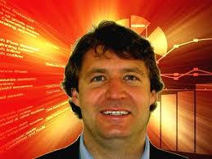

Types of EDM/LA Method
(Baker & Siemens, in press; building off of Baker & Yacef, 2009)
Prediction
  Classification
  Regression
  Latent Knowledge Estimation
Structure Discovery
  Clustering
  Factor Analysis
  Domain Structure Discovery
  Network Analysis
Relationship mining
  Association rule mining
  Correlation mining
  Sequential pattern mining
  Causal data mining
Distillation of data for human judgment
Discovery with models

Slide 46
Prediction
Develop a model which can infer a single aspect of the data (predicted variable) from some combination of other aspects of the data (predictor variables)
Which students are bored?
Which students will fail the class?

Slide 47
Structure Discovery
Find structure and patterns in the data that emerge “naturally”
No specific target or predictor variable
What problems map to the same skills?
Are there groups of students who approach the same curriculum differently?
Which students develop more social relationships in MOOCs?

Slide 48
Structure Discovery
Different kinds of structure discovery algorithms find…

Slide 49
Structure Discovery
Different kinds of structure discovery algorithms find… different kinds of structure
  Clustering: commonalities between data points
  Factor analysis: commonalities between variables
  Domain structure discovery: structural relationships between data points (typically items)
  Network analysis: network relationships between data points (typically people)

Slide 50
Relationship Mining
Discover relationships between variables in a data set with many variables
  Association rule mining
  Correlation mining
  Sequential pattern mining
  Causal data mining

Slide 51
Relationship Mining
Discover relationships between variables in a data set with many variables
Are there trajectories through a curriculum that are more or less effective?
Which aspects of the design of educational software have implications for student engagement?

Slide 52
Discovery with Models
Pre-existing model (developed with EDM prediction methods… or clustering… or knowledge engineering)
Applied to data and used as a component in another analysis

Slide 53
Distillation of Data for Human Judgment
Making complex data understandable by humans to leverage their judgment

Slide 54
Why now?
Just plain more data available
Education can start to catch up to research in Physics and Biology…

Slide 55
Why now?
Just plain more data available
Education can start to catch up to research in Physics and Biology… from the year 1985

Slide 56
Why now?
In particular, the amount of data available in education is orders of magnitude more than was available just a decade ago

Slide 57
Data Used to Be
Dispersed
Hard to Collect
Small-Scale
Collecting sizable amounts of data required heroic efforts

Slide 58
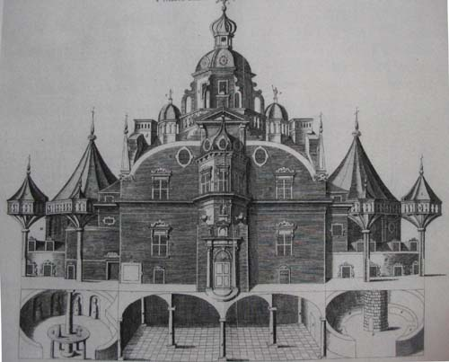
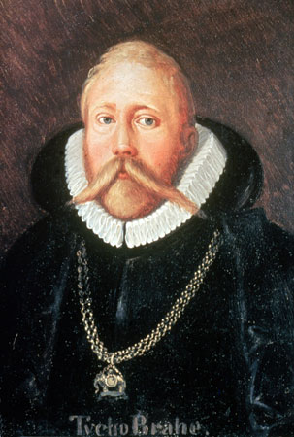
Tycho Brahe
Spent 24 years observing the sky from a custom-built castle on the island of Hven

Slide 59

Johannes Kepler
Had to take a job with Brahe to get Brahe’s data

Slide 60
Johannes Kepler
Had to take a job with Brahe to get Brahe’s data
Only got unrestricted access to data…

Slide 61
Johannes Kepler
Had to take a job with Brahe to get Brahe’s data
Only got unrestricted access to data…
when Brahe died

Slide 62
Johannes Kepler
Had to take a job with Brahe to get Brahe’s data
Only got unrestricted access to data…
when Brahe died
and Kepler stole the data and
fled to Germany

Slide 63

Alex Bowers
Teachers College, Columbia University
“For my dissertation I wanted to collect all of the data for all of the assessments (tests and grades and discipline reports, and attendance, etc.) for all of the students in entire cohorts from a school district for all grade levels, K-12. To get the data, the schools had it as the students' "permanent record", stored in the vault of the high school next to the boiler, ignored and unused. The districts would set me up in the nurse's office with my laptop and I'd trudge up and down the stairs into the basement to pull
3-5 files at a time and I'd hand enter the data into SPSS. Eventually I got fast enough to do about 10 a day, max.”

Slide 64

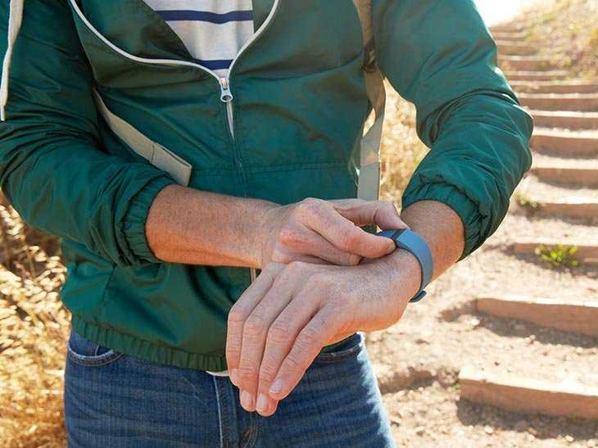

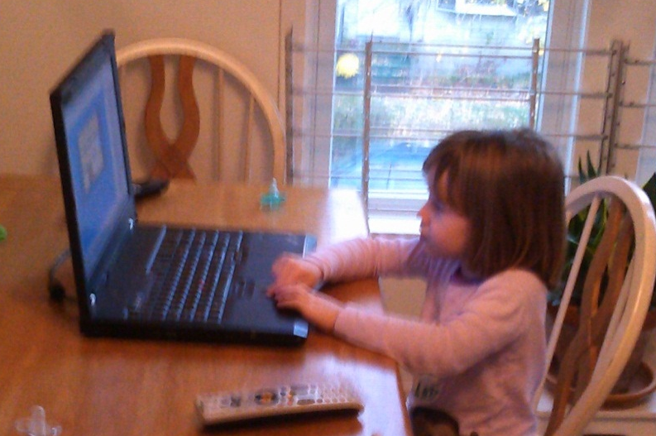
Data Today
Notes:
Every day, every one of us generates lots of data, with almost everything we do.

Slide 65
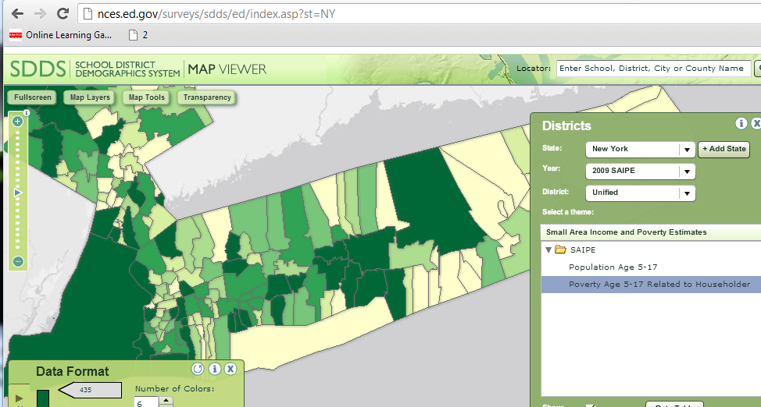
Data Today

Slide 66

Data Today

Slide 67
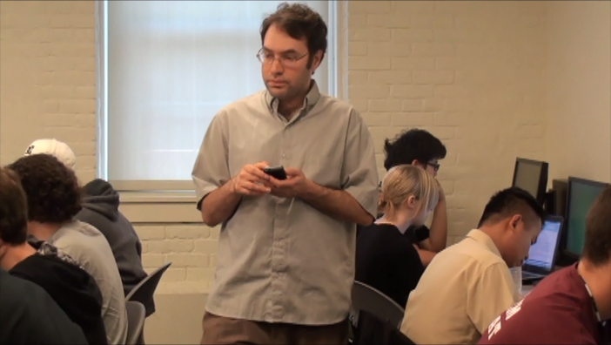
Data Today

Slide 68
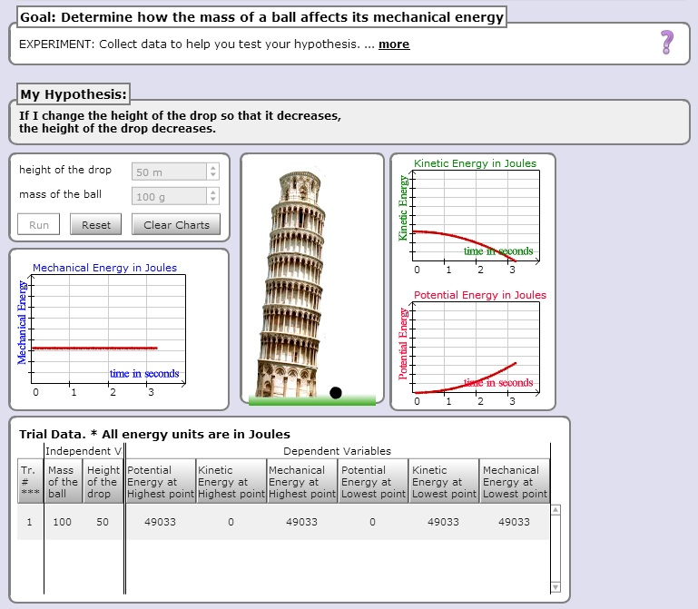
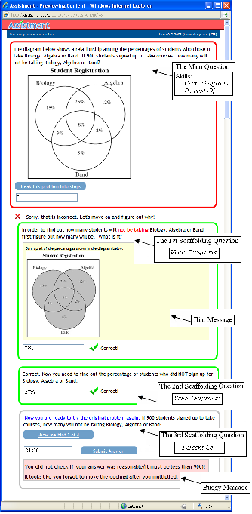
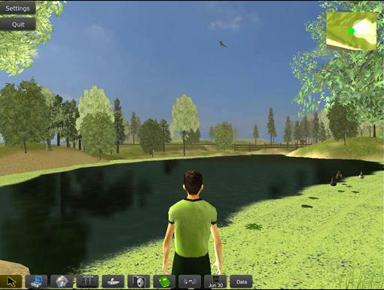
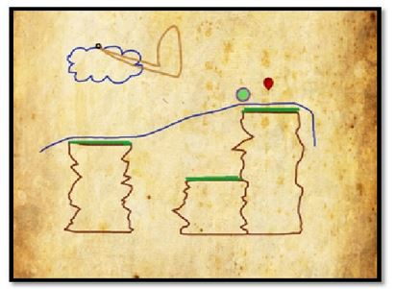
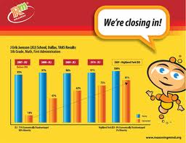
Data Today
Notes:
As more learning takes place within educational software and online learning environments of various types, it becomes much easier to gather very rich data on individual students’ learning and engagement within specific subjects. For example, a student might use a science simulation like the Inq-ITS, to learn science content and inquiry skills. Or they might learn scientific inquiry skill and content within a virtual environment like EcoMUVE. They might learn math skill in an action game like Zombie Division – the student has a set of weapons with numbers associated with them, a 2 for a sword, or a 5 for a gauntlet, and they can divide a skeleton if the weapon divides the number on the skeleton’s chest. Or they might learn math in a conceptual story-based learning environment like Reasoning Mind… or by doing math problems in a workbook-like environment like ASSISTments. All of these environments generate rich data streams that have been used in EDM analyses. And this kind of software in becoming more widespread every day. Systems like the Cognitive Tutor, or ASSISTments, or Reasoning Mind, are used by tens or hundreds of thousands of students, one or two days a week.

Slide 69
Student Log Data
*000:22:297 READY
.
*000:25:875 APPLY-ACTION
WINDOW; LISP-TRANSLATOR::AUTHORINGTOOL-TRANSLATOR,
CONTEXT; 3FACTOR-CROSS-XPL-4,
SELECTIONS; (GROUP3_CLASS_UNDER_XPL),
ACTION; UPDATECOMBOBOX,
INPUT; "Two crossover events are very rare.",
.
*000:25:890 GOOD-PATH
.
*000:25:890 HISTORY
P-1; (COMBOBOX-XPL-TRACE SIMBIOSYS),
.
*000:25:890 READY
.
*000:29:281 APPLY-ACTION
WINDOW; LISP-TRANSLATOR::AUTHORINGTOOL-TRANSLATOR,
CONTEXT; 3FACTOR-CROSS-XPL-4,
SELECTIONS; (GROUP4_CLASS_UNDER_XPL),
ACTION; UPDATECOMBOBOX,
INPUT; "The largest group is parental since crossovers are uncommon.",
.
*000:29:281 GOOD-PATH
.
*000:29:281 HISTORY
P-1; (COMBOBOX-XPL-TRACE SIMBIOSYS),
.
*000:29:281 READY
.
*001:20:733 APPLY-ACTION
WINDOW; LISP-TRANSLATOR::AUTHORINGTOOL-TRANSLATOR,
CONTEXT; 3FACTOR-CROSS-XPL-4,
SELECTIONS; (ORDER_GENES_OBS_XPL),
ACTION; UPDATECOMBOBOX,
INPUT; "The Q and q alleles have interchanged between the parental and SCO genotypes.",
.
*001:20:733 SWITCHED-TO-EDITOR
.
*001:20:748 NO-CONFLICT-SET
.
*001:20:748 READY
.
*001:32:498 APPLY-ACTION
WINDOW; LISP-TRANSLATOR::AUTHORINGTOOL-TRANSLATOR,
CONTEXT; 3FACTOR-CROSS-XPL-4,
SELECTIONS; (ORDER_GENES_OBS_XPL),
ACTION; UPDATECOMBOBOX,
INPUT; "The Q and q alleles have interchanged between the parental and DCO genotypes.",
.
*001:32:498 GOOD-PATH
.
*001:32:498 HISTORY
P-1; (COMBOBOX-XPL-TRACE SIMBIOSYS),
.
*001:32:498 READY
.
*001:37:857 APPLY-ACTION
WINDOW; LISP-TRANSLATOR::AUTHORINGTOOL-TRANSLATOR,
CONTEXT; 3FACTOR-CROSS-XPL-4,
SELECTIONS; (ORDER_GENES_UNDER_XPL),
ACTION; UPDATECOMBOBOX,
INPUT; "In the DCO group BOTH outer genes cross over so the interchanged gene is the middle one.",
.
*001:37:857 GOOD-PATH
Notes:
For example, as a student uses one of these interactive learning environments, the student will make hundreds of meaningful actions each hour – pausing and thinking before making an incorrect answer, asking for help, rapidly changing settings on a simulation, running away from a skeleton. When the data is logged, these behaviors provide us with incredibly rich detail about learning and engagement, that we can analyze.

Slide 70
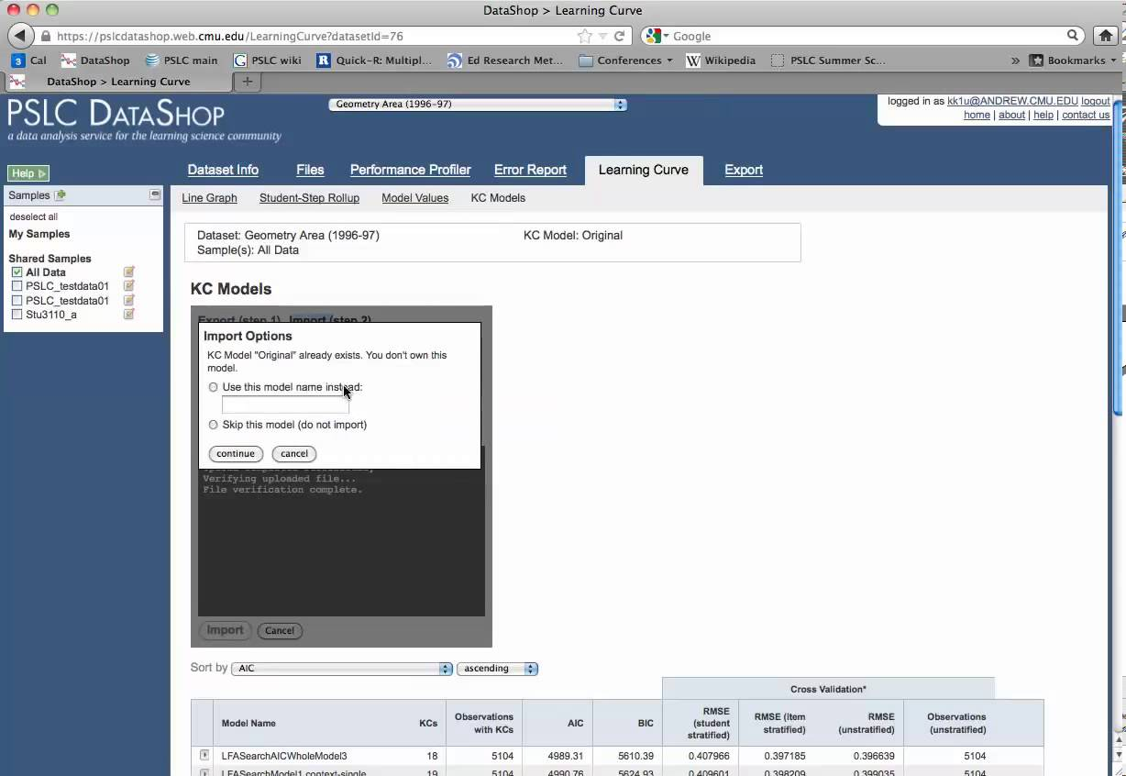


PSLC DataShop
(Koedinger et al, 2008, 2010)
>250,000 hours of students using educational software within LearnLabs and other settings
>30 million student actions, responses & annotations

Slide 71
How much data is big data?

Slide 72
2004 and 2014
2004: I reported a data set with 31,450 data points. People were impressed.

Slide 73
2004 and 2014
2004: I reported a data set with 31,450 data points. People were impressed.
2014: A reviewer in an education journal criticized me for referring to 817,485 data points as “big data”.

Slide 74
What’s does it mean to call data
“big data”?
Any thoughts?

Slide 75
Some definitions
“Big data” is data big enough that traditional statistical significance testing becomes useless
“Big data” is data too big to input into a traditional relational database
“Big data” is data too big to work with on a single machine

Slide 76
What do you do when you have big data?

Slide 77
Analytics/Data Mining

Slide 78
Learning Analytics
EDM and LA are closely related communities

Slide 79
Two communities
Society for Learning Analytics Research
  First conference: LAK2011
  Published JLA since 2014
International Educational Data Mining Society
  First event: EDM workshop in 2005 (at AAAI)
  First conference: EDM2008
  Publishing JEDM since 2009

Slide 80

Key Distinctions
(Siemens & Baker, 2012)

Slide 81
Key Distinctions:
Origins
LAK
  Semantic web, intelligent curriculum, social networks, outcome prediction, and systemic interventions
EDM
  Educational software, student modeling, course outcomes

Slide 82
Key Distinctions:
Modes of Discovery
LAK
  Leveraging and supporting human judgment is key; automated discovery is a tool to accomplish this goal
  Information distilled and presented to human decision-maker
EDM
  Automated discovery is key; leveraging human judgment is a tool to accomplish this goal
  Humans provide labels which are used in classifiers

Slide 83
Key Distinctions:
Guiding Philosophy
LAK
  Stronger emphasis on understanding systems as wholes, in their full complexity
  “Holistic” approach
EDM
  Stronger emphasis on reducing to components and analyzing individual components and relationships between them

Slide 84
Key Distinctions:
Adaptation and Personalization
LAK
  Greater focus on informing and empowering instructors and learners and influencing the design of the education system
EDM
  Greater focus on automated adaption (e.g. by the computer with no human in the loop) and influencing the design of interactions

Slide 85
To Learn More About LA versus EDM
Take HUDK4051:
Learning Analytics: Process and Theory

Slide 86
Questions? Comments?

Slide 87
Tools
There are a bunch of tools you can use in this class
  I don’t have strong requirements about which tools you choose to use
We’ll talk about them throughout the semester
You may want to think about downloading or setting up accounts for
  RapidMiner (I prefer 5.3. 6.0 is fine, I just will not be able to give as much tech support)
  SAS OnDemand for Academics
  Weka
  Microsoft Excel
  Java
  Matlab
No hurry, but keep it in mind…

Slide 88
Learning Analytics Seminar Series
We have a semi-regular seminar series on learning analytics here at TC
Upcoming speakers include
  Jay Verkuilen (CUNY)
  Yoav Bergner (ETS)
  Blair Lehman (ETS)
  Tiffany Barnes (NC State)
  Dragan Gasevic (Edinburgh)
  Shane Dawson (Adelaide)

Slide 89
Learning Analytics Seminar Series
To join the mailing list, please email me
Also, you may want to meet with some of our speakers

Slide 90
Basic HW 1
Due in one week
Note that this assignment requires the use of RapidMiner
We will learn how to set up and use RapidMiner in the next class session this Wednesday
  So please install RapidMiner 5.3 on your laptop if possible before then
  And bring your laptop to class

Slide 91
Let’s go over Basic HW 1

Slide 92
Questions? Concerns?

Slide 93
Background in Statistics
This is not a statistics class
But I will compare EDM methods to statistics throughout the class
Most years, I offer a special session
“An Inappropriately Brief Introduction to Frequentist Statistics”
Would folks like me to schedule this?

Slide 94
Other questions or comments?

Slide 95
Next Class
Wednesday, September 10
Regression and Prediction
Baker, R.S. (2014) Big Data and Education. Ch. 1, V2.
Witten, I.H., Frank, E. (2011) Data Mining: Practical Machine Learning Tools and Techniques. Sections 4.6, 6.5.
No Assignments Due

Slide 96
The End

