Slide 1


DataShop: An Educational Data Mining Platform for the Learning Science Community
John Stamper
Pittsburgh Science of Learning Center
Human-Computer Interaction Institute
Carnegie Mellon University
Notes:
Why is data important to improving student learning
If we knew everything about students’ learning challenges, we would not need data
But, there is a lot we do not know ….

Slide 2
About me.

Slide 3
EDM Data
What kinds of data can we collect?
What levels?
What is the right size for EDM discovery?

Slide 4
Data Granularity
Finest – Transaction
Steps
Problems
Units
Tests
Class Grades
Class Avgs
Schools
Coarsest - ….
We are mostly here
Policy is being made here

Slide 5
LearnLab
Pittsburgh Science of Learning Center (PSLC)
Created to bridge the Chasm between science & practice
  Low success rate (<10%) of randomized field trials
LearnLab = a socio-technical bridge between lab psychology & schools
  E-science of learning & education
  Social processes for research-practice engagement
Purpose: Leverage cognitive theory and computational modeling to identify the conditions that cause robust student learning
Notes:
The vision for the PSLC starts with the broad goals of understanding human learning and using that understanding to improve education. More specifically, we are working to fill the chasm that currently exists between learning science research and educational practice. A key indicator is the low hit rate of costly large-scale randomized control trials . It appears the science behind many of these trials may not have been sound and reliable enough (we believe in RFTs, but we need more science to build up to them).
2) Toward this end, we have created LearnLab …
Goals are to: Do rigorous science at scale. Create a two-way street. Have problems from practioners guide psychological research goals.
3) In general, our purpose is to “leverage cognitive … learning”.

Slide 6
DataShop
Central Repository
  Secure place to store & access research data
  Supports various kinds of research
    Primary analysis of study data
    Exploratory analysis of course data
    Secondary analysis of any data set
Analysis & Reporting Tools
  Focus on student-tutor interaction data
  Data Export
    Tab delimited tables you can open with your favorite spreadsheet program or statistical package
    Web services for direct access
6
Notes:
6
So, what exactly is DataShop?
Well, first it is a central repository for all of the data generated by PSLC studies and courses. The goal is to eventually have all of the data from learnlab studies and courses safely tucked away in DataShop for safe keeping.
Once data is in, users can conduct primary, secondary and exploratory analysis of datasets.
Second, DataShop provides analysis and reporting tools. It’s a place where researchers can jumpstart analyses – perhaps by drilling down on student performance data through the Performance Profiler or viewing learning trends through the Learning Curve tool.
You can also get data out through various export options.

Slide 7
Repository
Allows for full data management
Controlled access for collaboration
File attachments
Paper attachments
Great for secondary analyses
How much data does DataShop have?

Slide 8
How big is DataShop?
Domain | Files | Papers | Datasets | Student Actions | Students | Student Hours
Language | 64 | 11 | 76 | 6,185,358 | 6,401 | 6,820
Math | 217 | 50 | 174 | 65,566,816 | 31,774 | 144,152
Science | 91 | 19 | 90 | 12,776,806 | 15,793 | 42,813
Other | 18 | 12 | 43 | 6,826,989 | 11,691 | 24,676
Total | 390 | 92 | 383 | 91,355,969 | 65,659 | 218,463
As of January 2013

Slide 9
What kinds of data?
By domain based on studies from the Learn Labs
Data from intelligent tutors
Data from online instruction
Data from games
The data is fine grained at a transaction level!

Slide 10
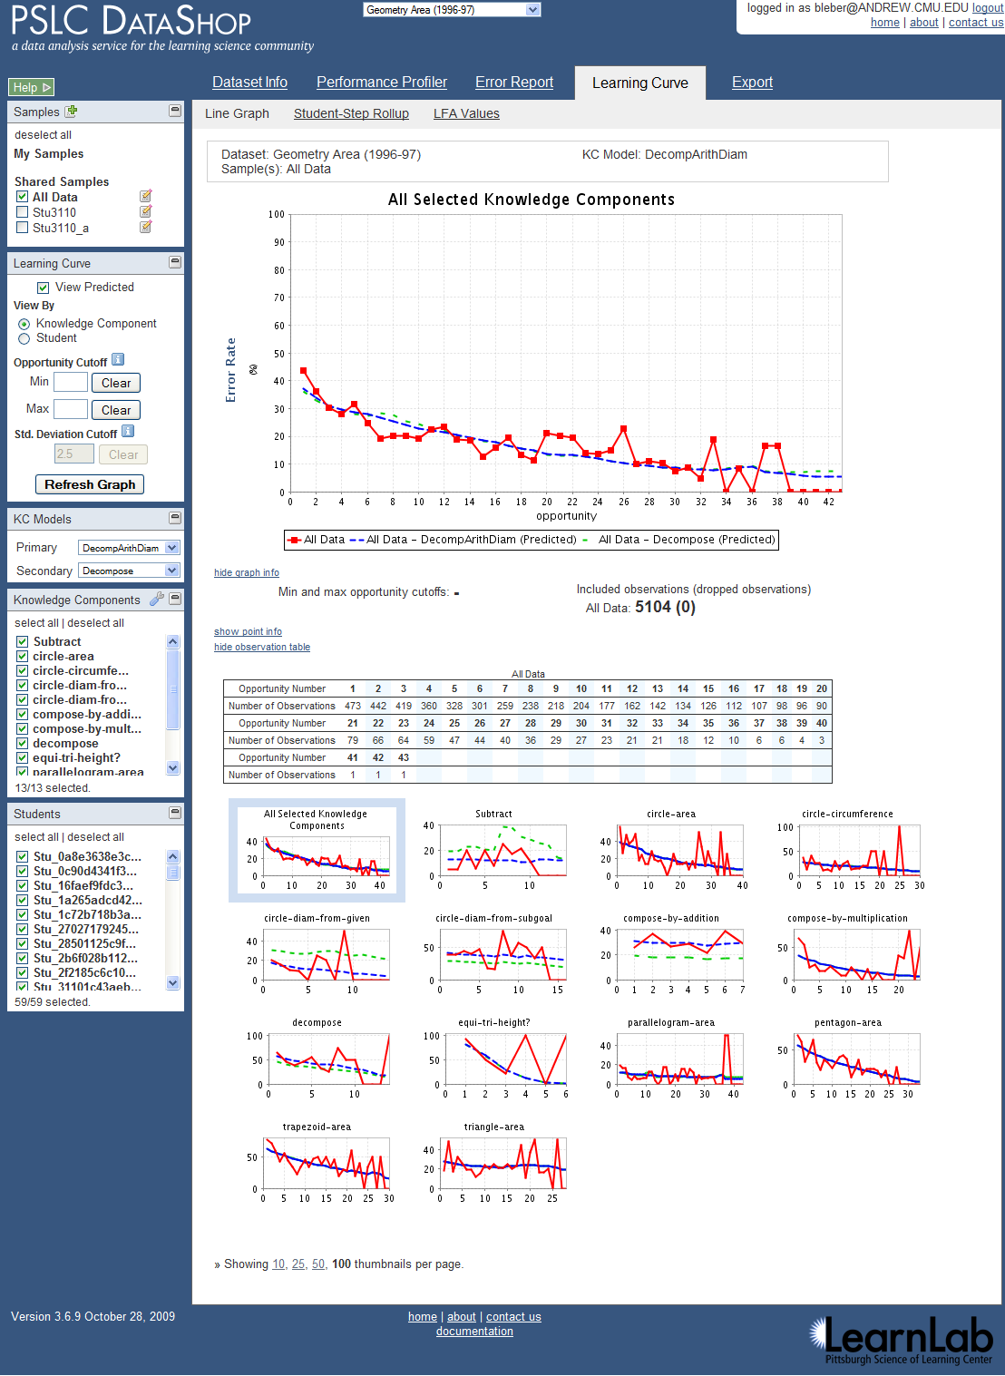
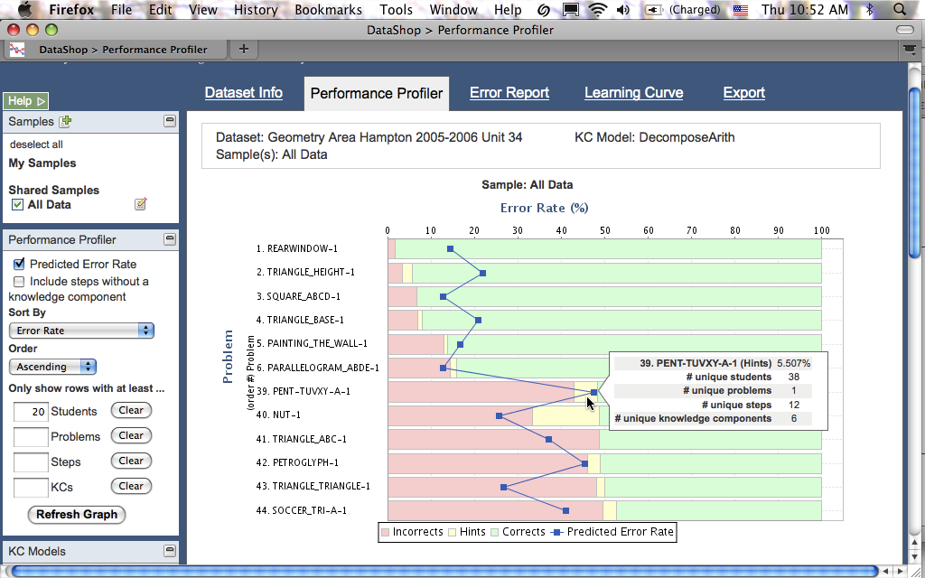
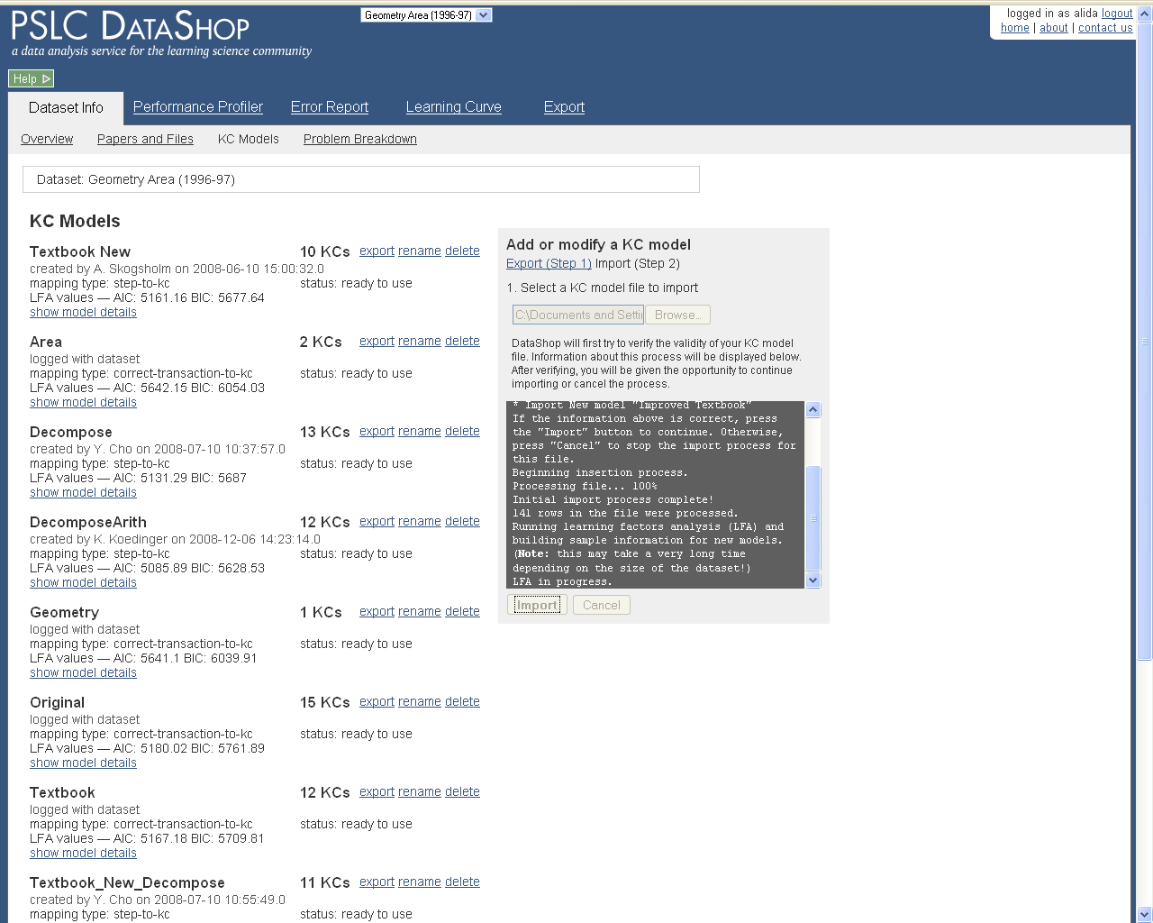
Web Application

Slide 11
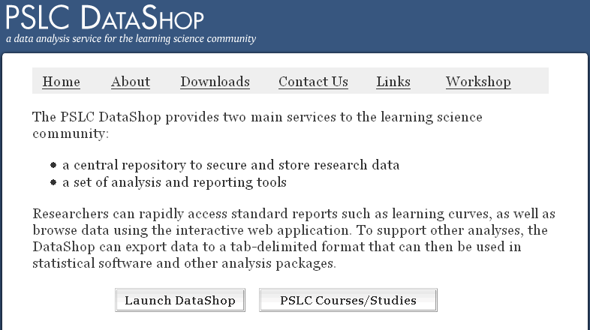
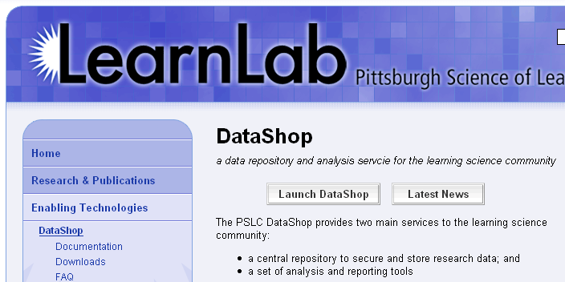
Getting to DataShop
Explore data through the DataShop tools
Where is DataShop?
  http://pslcdatashop.org
  Linked from DataShop homepage and learnlab.org
    http://pslcdatashop.web.cmu.edu/about/
    http://learnlab.org/technologies/datashop/index.php
11
Notes:
11
OK, so your data is now in DS – what do you do with it now?
This is where the analysis tools come in handy.
To play around with the tools, you can log into DS. This slide shows you two ways of doing that – launching via our homepage or from the learnlab.org site.

Slide 12
Creating an account
On DataShop's home page, click
"Sign up now". Complete the form to create your DataShop account.
If you’re a CMU student/staff/faculty, click “Log in with WebISO” to create your account.
12

Slide 13
Getting access to datasets
By default, you will have access to the public datasets.
For access to other datasets, you can request access from dataset
13

Slide 14
DataShop Terminology
Problem: a task for a student to perform that typically involves multiple steps
Step: an observable part of the solution to a problem
Transaction: an interaction between the student and the tutoring system.

Slide 15
DataShop Terminology
Observation: a group of transactions for a particular student working on a particular step.
Attempt: transaction; an attempt toward a step
Opportunity: a chance for a student to demonstrate whether he or she has learned a given knowledge component. An opportunity exists each time a step is present with the associated knowledge component.
Notes:
If one transaction, it’s still an observation.

Slide 16
DataShop Terminology
KC: Knowledge component
  also known as a skill/concept/fact
  a piece of information that can be used to accomplish tasks
  tagged at the step level
KC Model:
  also known as a cognitive model or skill model
  a mapping between correct steps and knowledge components

Slide 17
Example

Slide 18
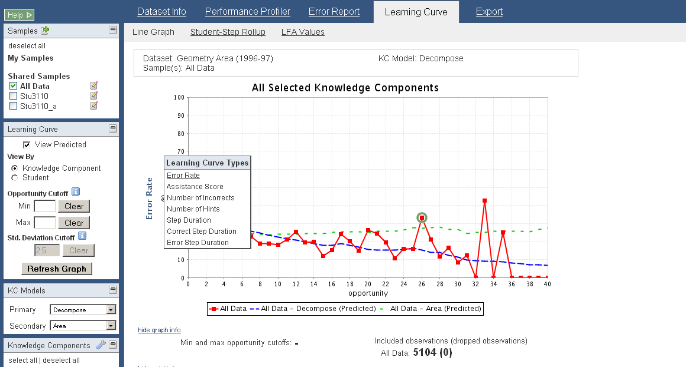
Learning Curves
Visualizes changes in student performance over time
Hover the y-axis to change the type of Learning Curve.
Types include:
Error Rate
Assistance Score
Number of Incorrects
Number of Hints
Step Duration
Correct Step Duration
Error Step Duration
Time is represented on the x-axis as ‘opportunity’, or the # of times a student (or students) had an opportunity to demonstrate a KC
Notes:
To select a curve type you simply hover the y-axis

Slide 19
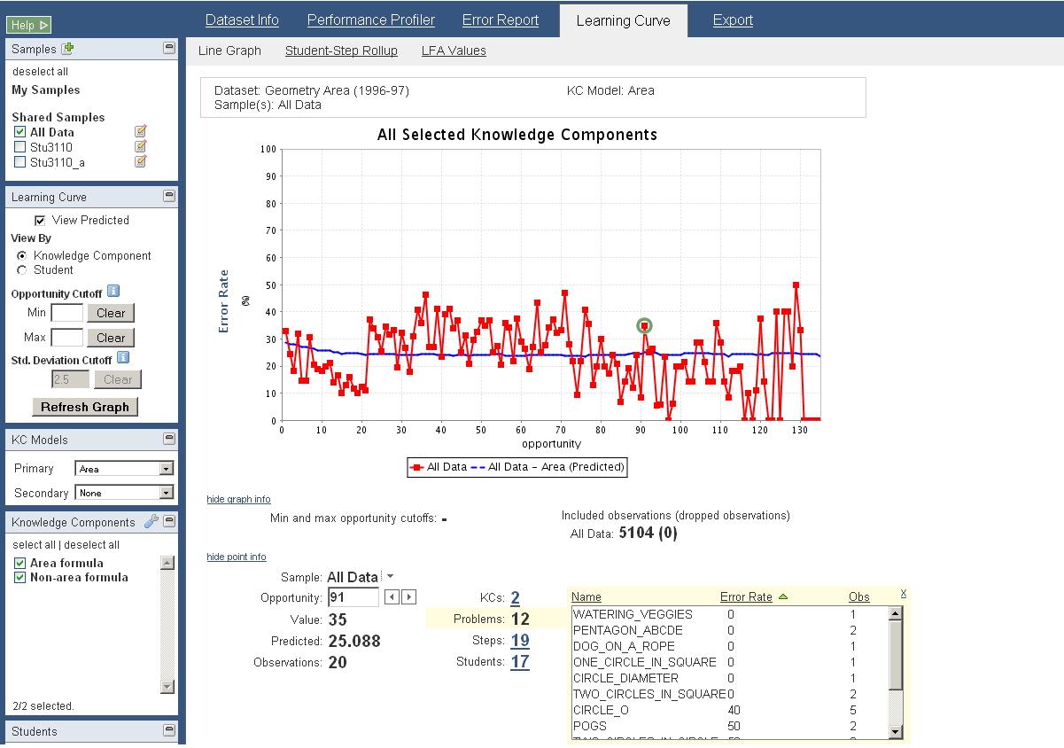
Learning Curves: Drill Down
Click on a data point to view point information
Click on the number link to view details of a particular drill down information.
Details include:
Name
Value
Number of Observations
Four types of information for a data point:
KCs
Problems
Steps
Students

Slide 20
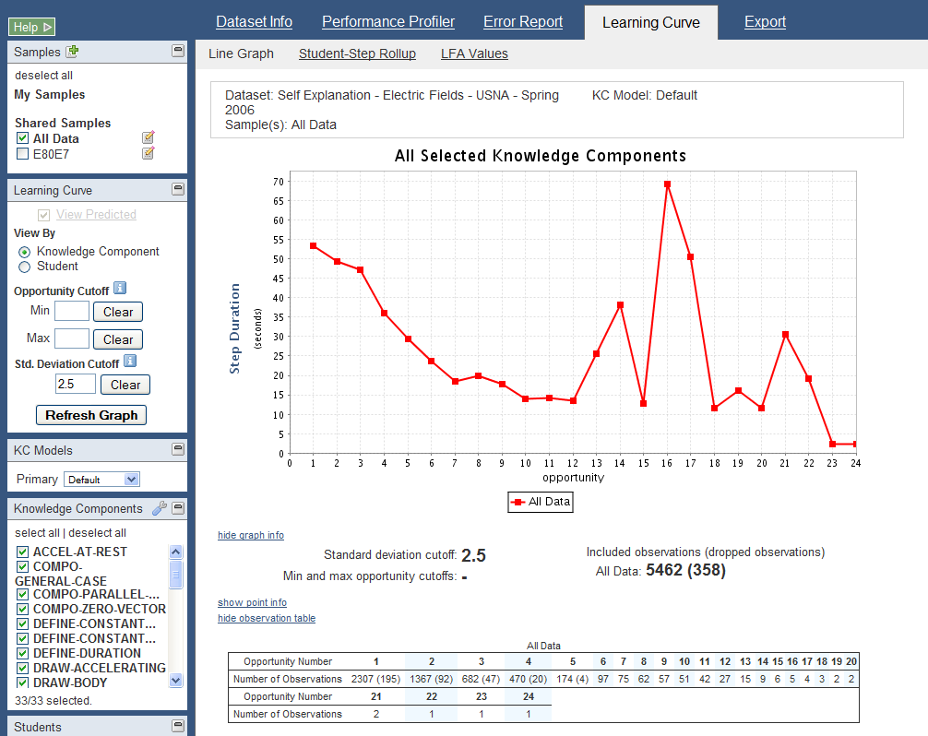
Learning Curve: Latency Curves
For latency curves, a standard deviation cutoff of 2.5 is applied by default.
The number of included and dropped observations due to the cutoff is shown in the observation table.
Step Duration = the total length of time spent on a step. It is calculated by adding all of the durations for transactions that were attributed to a given step.
Error Step Duration = step duration when first attempt is an error
Correct Step Duration = step duration when the first attempt is correct
Notes:
To customize your latency curve you can apply a standard deviation cutoff. Std deviation cutoff is useful in the context of latency curves for eliminating outliers that affect the graph.
On first load, DataShop applies a cutoff of 2.5 by default. To change that, simply enter the cutoff of your choice and click the refresh graph button.
You’ll notice the observation table now includes the number of dropped observations in parenthesis.
<ANY QUESTIONS??>

Slide 21
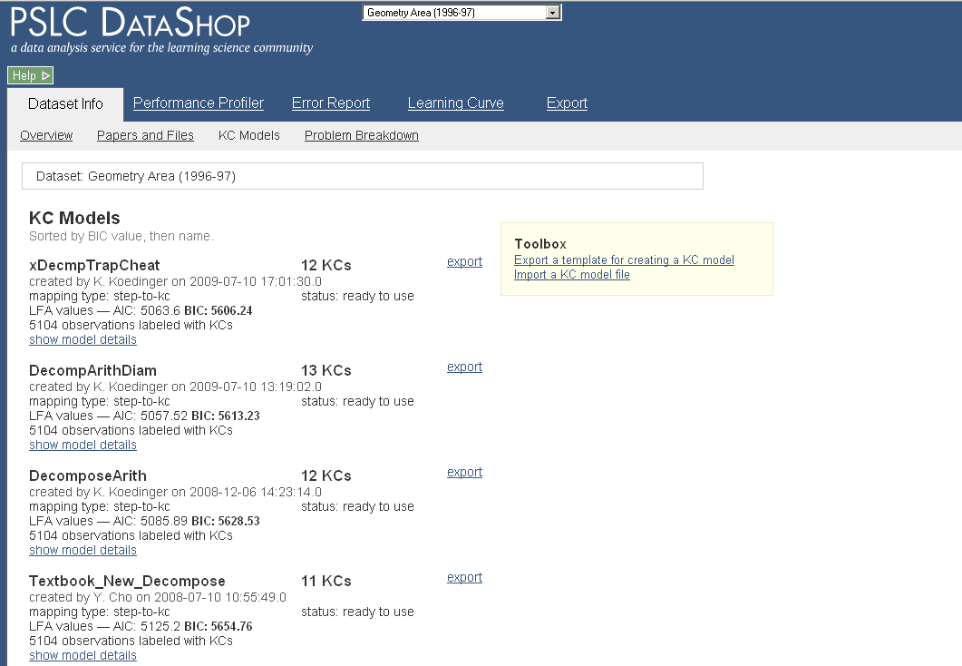
Dataset Info: KC Models
Toolbox allows you
to export one or more KC models, work with them, then reimport into the
Dataset.
Handy information displayed for each KC Model:
Name
# of KCs in the model
Created By
Mapping Type
AIC & BIC Values
DataShop generates two
KC models for free:
Single-KC
Unique-step
These provide upper and lower bounds for AIC/BIC.
Click to view
the list of KCs
for this model.

Slide 22
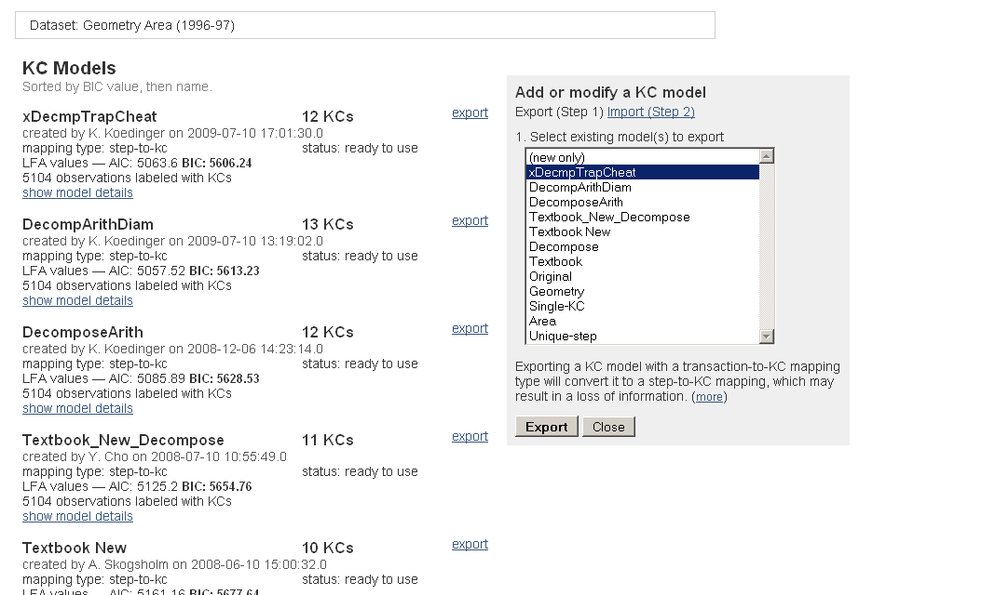
Dataset Info: Export a KC Model
Select the models you wish
to export and click the
“Export” button.
Model information as well as
other useful information is
provided in a tab-delimited
Text file.
Selecting the “export”
option next to a KC Model
will auto-select the model
for you in the export
toolbox.
Export multiple models at once.
Notes:
To select a model or models to export, you can either click on “export” next to the model’s name, or select them from the export toolbox.
The exported file will not only contain the models you have chosen to export, but will also have additional information that should make your kc modelling task easier. Finally, the exported file provides you data in a format that allows your to re-import the kc model (or a new model).
Note, you cannot import a tx_export, well you can try, but you will not be successful ☺
<should demo export a KC model here>
<go through the various columns to show what information is available to help with modeling task>

Slide 23
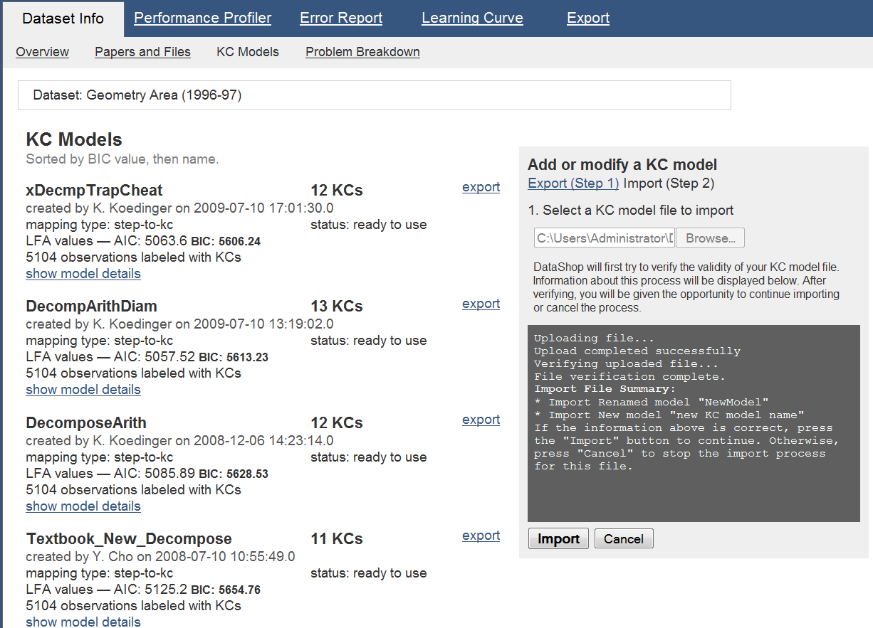
Dataset Info: Import a KC Model
When you are ready to import,
upload your file to DataShop for
verification.
Once verification is successful,
click the “Import” button.
Your new or updated model will
be available shortly (depending
on the size of the dataset).
Notes:
Once you are ready to test your new and or improved models, simply return to the KC model toolbox and select the “Import” option.
Here you will be able to chose your KC model file, upload it to the system and have it verified for correctness. If there are problems encountered during file verification the system will alert you, via the toolbox console.
If your file is perfect in every way, the “Import” button will become active. Clicking it will start the import process for your KCM file.
If you are overwriting an existing model that you own, you will be prompted to confirm this by the system. If you decide you don’t want to do this, you can rename the new model, or you can skip it.
If a model name in your import file matches an existing model within the dataset, but you do not own it, then you must rename the model or skip it.
<JUMP TO WEB APP>
Ken has graciously offered to provide an in depth KC import/export demonstration.

Slide 24
Getting the KC Model Right!
The KC model drives instruction in adaptive learning
  Problem and topic sequence
  Instructional messages
  Tracking student knowledge

Slide 25
What makes a good Cognitive Model?
A correct expert model is one that is consistent with student behavior.
Predicts task difficulty
Predicts transfer between instruction and test
The model should fit the data!

Slide 26
Good Cognitive Model => Good Learning Curve
An empirical basis for determining when a cognitive model is good
Accurate predictions of student task performance & learning transfer
  Repeated practice on tasks involving the same skill should reduce the error rate on those tasks
  => A declining learning curve should emerge

Slide 27
How do we make KC Models?

Slide 28
Traditionally CTA has been used
  But Cognitive Task Analysis has some issues…
  Extremely human driven
  It is highly subjective
  Leading to differing results from different analysts
  And these human discovered models are usually wrong!

Slide 29
If Human centered CTA is not the answer
  How should student models be designed?
  They shouldn’t!
  Student models should be discovered not designed!

Slide 30
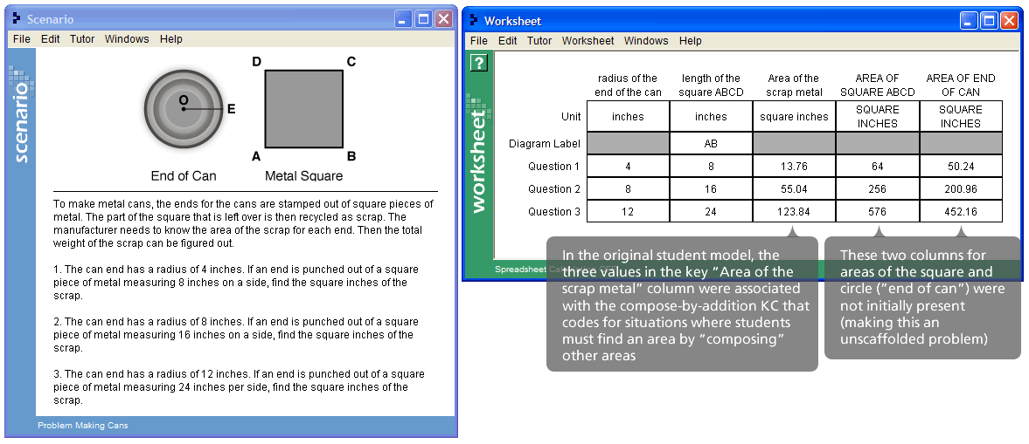
Solution – Use computers
  Today we have lots of log data from tutors
  We can harness this data to validate and improve existing student models

Slide 31
Human-Machine Student Model Discovery
  DataShop provides easy interface to add and modify student models and ranks the models using AFM

Slide 32
Human-Machine Student Model Discovery
  3 strategies for discovering improvements to the student model
  Smooth learning curves
  No apparent learning
  Problems with unexpected error rates

Slide 33
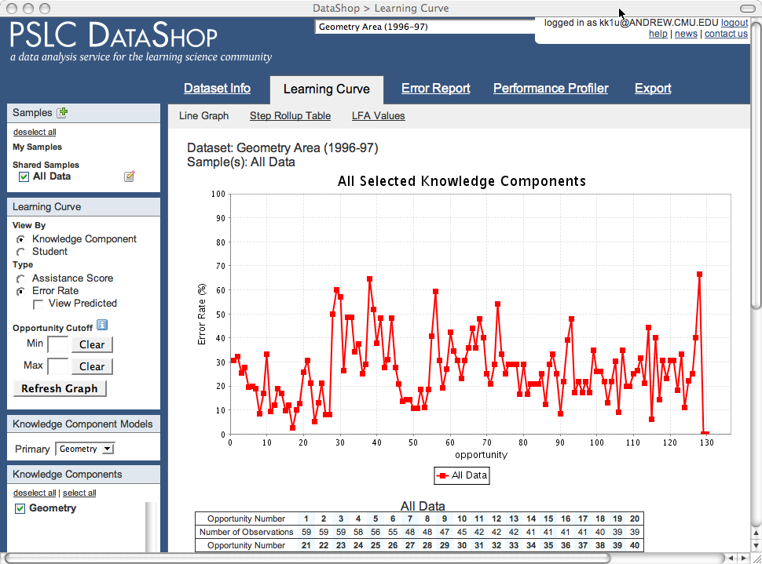
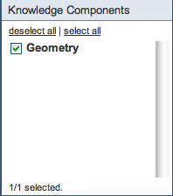
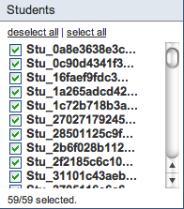
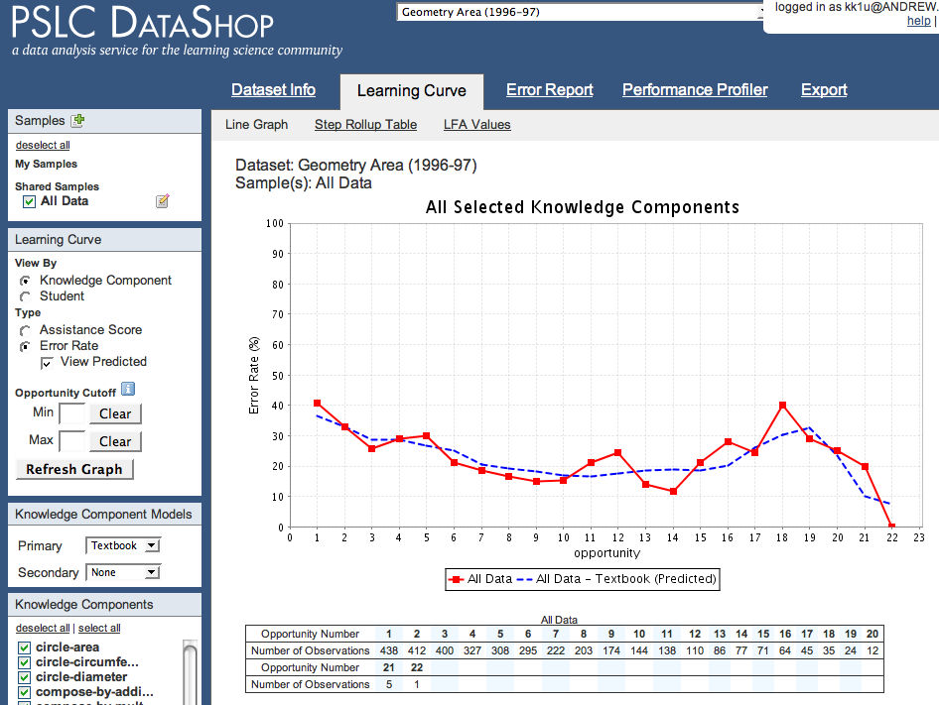
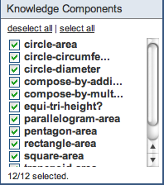
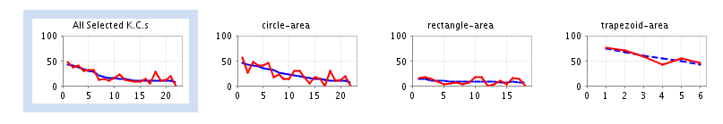
A good cognitive model produces a learning curve
Without decomposition, using just a single “Geometry” skill,
no smooth learning curve.
But with decomposition,
12 skills for area,
(Rise in error rate because poorer students get assigned more problems)
a smooth learning curve.
Is this the correct or “best” cognitive model?
Notes:
Good Cognitive Model => Good Learning Curve
An empirical basis for determining when a cognitive model is good
Accurate predictions of student task performance & learning transfer
Repeated practice on tasks involving the same skill should reduce the error rate on those tasks
=> A declining learning curve should emerge

Slide 34
Inspect curves for individual knowledge components (KCs)
Many curves show a reasonable decline
Some do not =>
Opportunity to improve model!

Slide 35
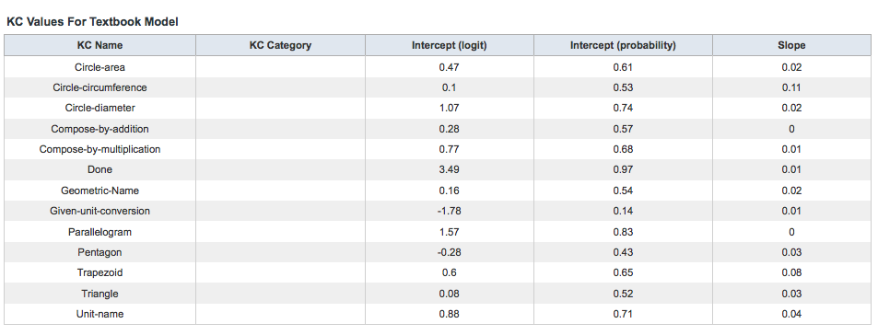
No apparent Learning

Slide 36
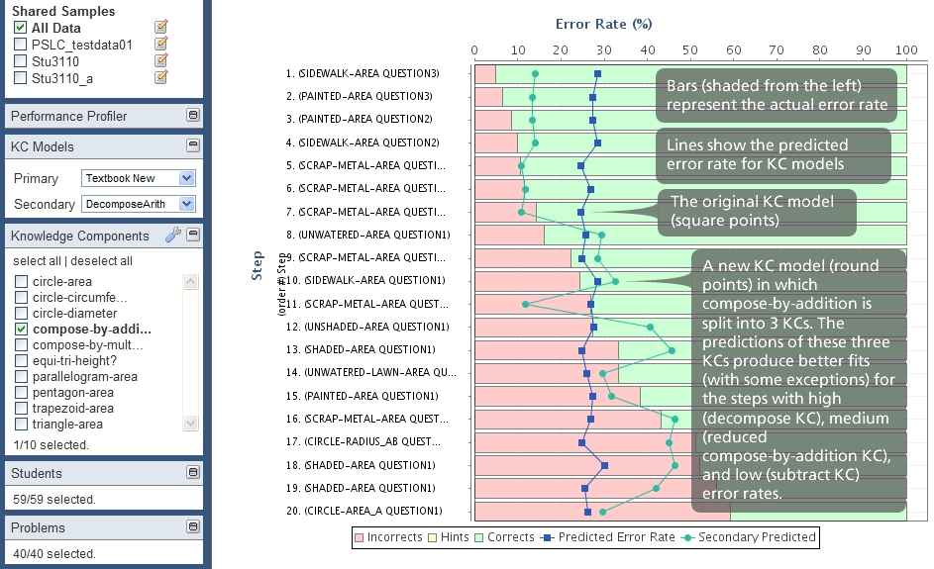
Problems with Unexpected Error Rates

Slide 37
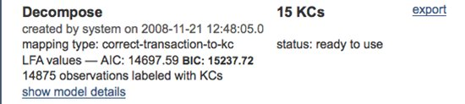
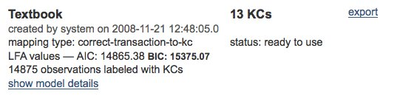
These strategies suggest an improvement
  Hypothesized there were additional skills involved in some of the compose by addition problems
  A new student model (better BIC value) suggests the splitting the skill.

Slide 38
Redesign based on Discovered Model
  Our discovery suggested changes needed to be made to the tutor
  Resequencing – put problems requiring fewer skills first
  Knowledge Tracing – adding new skills
  Creating new tasks – new problems
  Changing instructional messages, feedback or hints

Slide 39
Discovering cognitive models from data
Abstract from a computational symbolic cognitive model to a statistical cognitive model
For each task label the knowledge components that are required:
Original “Q matrix”
Other possible “learning factors”
Item | Skill | Add | Sub | Mul
2*8 | 0 | 0 | 1
2*8 – 3 | 0 | 1 | 1
2*8 - 30 | 0 | 1 | 1
3+2*8 | 1 | 0 | 1
Item | Skill | Deal with negative | Order of Ops | …
2*8 | 0 | 0
2*8 – 3 | 0 | 0
2*8 - 30 | 1 | 0
3+2*8 | 0 | 1

Slide 40
Can a data-driven process be automated & brought to scale?
Yes!
Combine Cognitive Science, Psychometrics, Machine Learning …
Collect a rich body of data
Develop new model discovery algorithms, visualizations, & on-line collaboration support

Slide 41
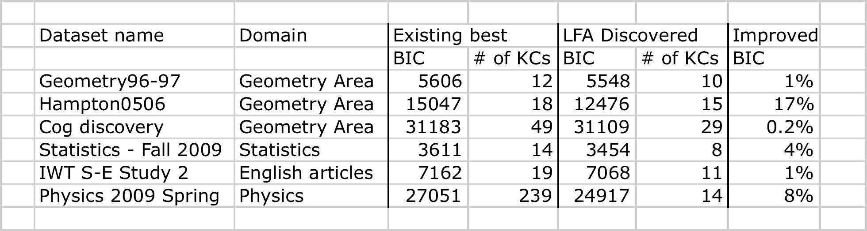
Discovery of new cognitive models: Strategy & Results
“Mixed initiative” human & machine discovery
  Visualizations to aid human discovery
  AI search for statistically better models
Better models discovered in Geometry, Statistics, English, Physics
Stamper, J., Koedinger, K.R. (2011) Human-machine Student Model Discovery and Improvement Using DataShop.
Notes:
These are recent (and preliminary) results and we are just beginning discussions with the domain-specialists (in Geometry, Statistics, English, Physics) about how to interpret discoveries for course redesign

Slide 42
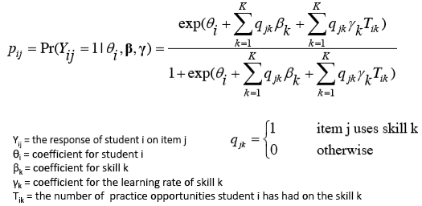
Logistic Regression Model of Student
Performance & Learning
“Additive Factor Model” (AFM) (cf., Draney, Pirolli, Wilson, 1995)
Evaluate with BIC, AIC, cross validation to reduce over-fit
Notes:
42

Slide 43
LFA –Model Search Process
Search algorithm guided by a heuristic: BIC
Start from an existing cog model (Q matrix)
Automates the process of hypothesizing alternative cognitive models & testing them against data
Notes:
43

Slide 44
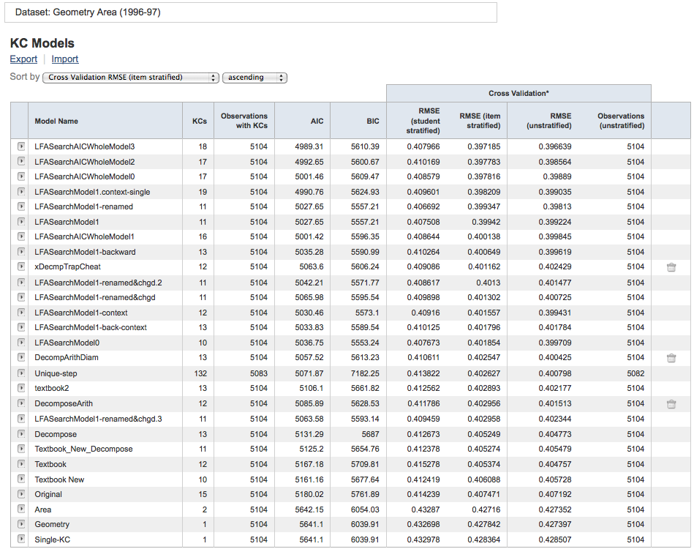
Cognitive Model Leaderboard for Geometry Area Data Set
Some models are machine generated (based on human-generated learning factors)
Some models are human generated

Slide 45
Crowdsourcing EDM
Allowing human generated models to work with machine generated models is a form of crowd sourcing.
Another way is through competitions.

Slide 46
2010 KDD Cup Competition
Knowledge Discovery and Data Mining (KDD) is the most prestigious conference in the data mining and machine learning fields
KDD Cup is the premier data mining challenge
2010 KDD Cup called “Educational Data Mining Challenge”
Ran from April 2010 through June 2010

Slide 47
KDD Cup Competition
Competition goal is to predict student responses given tutor data provided by Carnegie Learning
Dataset | Students | Steps | File size
Algebra I 2008-2009 | 3,310 | 9,426,966 | 3 GB
Bridge to Algebra 2008-2009 | 6,043 | 20,768,884 | 5.43 GB

Slide 48
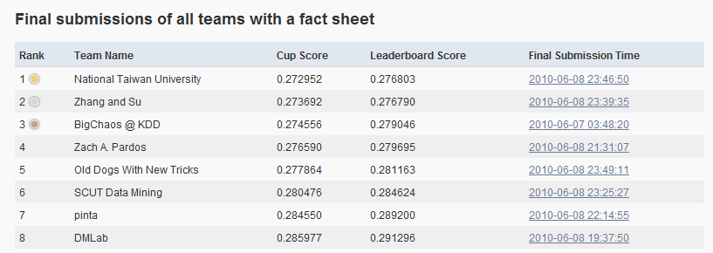
KDD Cup Competition
  655 registered participants
  130 participants who submitted predictions
  3,400 submissions

Slide 49
KDD Cup Competition
Advances in prediction and cognitive modeling
Excitement in the KDD Community
The datasets are now in the “wild” and showing up in non KDD conferences
New competitions have been done and are in the works

Slide 50
http://pslcdatashop.org
Questions?
john@stamper.org
datashop-help@lists.andrew.cmu.edu

