Slide 1
Special Topics in Educational Data Mining
HUDK5199
Spring term, 2013
January 28, 2013

Slide 2
Please Ask Questions
After class, three separate people asked me “what is an algorithm?”
It’s a recipe
Please ask questions if I use terms that are unfamiliar to you
  You’re not the only one

Slide 3
Basic stats
Who here is unfamiliar with the technical meaning of the following terms
  P value
  T test
  Correlation
  Z score

Slide 4
Would you be interested in…
If you want, I could give a lecture I’ve given in the past, called
“An Inappropriately Brief Introduction to Frequentist Statistics ”
Who would be interested in this as an optional additional activity?

Slide 5
Today’s Class
Bayesian Knowledge Tracing

Slide 6
What is the key goal of BKT?

Slide 7
What is the key goal of BKT?
Measuring how well a student knows a specific skill/knowledge component at a specific time
What are some examples of skills/knowledge components from the papers you read?

Slide 8
Skills should be tightly defined
Unlike approaches such as Item Response Theory (see other courses in this department)
The goal is not to measure overall skill for a broadly-defined construct
  Such as arithmetic
But to measure a specific skill or knowledge component
  Such as addition of two-digit numbers where no carrying is needed

Slide 9
What is the typical use of BKT?
Assess a student’s knowledge of skill/KC X
Based on a sequence of items that are dichotomously scored
  E.g. the student can get a score of 0 or 1 on each item
Where each item corresponds to a single skill
Where the student can learn on each item, due to help, feedback, scaffolding, etc.

Slide 10
Key assumptions
Each item must involve a single latent trait or skill
  Different from PFA, which we’ll talk about next week
Each skill has four parameters
From these parameters, and the pattern of successes and failures the student has had on each relevant skill so far, we can compute latent knowledge P(Ln) and the probability P(CORR) that the learner will get the item correct

Slide 11
Key Assumptions
Two-state learning model
  Each skill is either learned or unlearned
In problem-solving, the student can learn a skill at each opportunity to apply the skill
A student does not forget a skill, once he or she knows it

Slide 12
Model Performance Assumptions
If the student knows a skill, there is still some chance the student will slip and make a mistake.
If the student does not know a skill, there is still some chance the student will guess correctly.

Slide 13
Corbett and Anderson’s Model
Not learned
p(T)
Learned
p(L₀)
p(G)
1-p(S)
correct
correct
Two Learning Parameters
p(L₀) Probability the skill is already known before the first opportunity to use the skill in problem solving.
p(T) Probability the skill will be learned at each opportunity to use the skill.
Two Performance Parameters
p(G) Probability the student will guess correctly if the skill is not known.
p(S) Probability the student will slip (make a mistake) if the skill is known.

Slide 14
Bayesian Knowledge Tracing
Whenever the student has an opportunity to use a skill, the probability that the student knows the skill is updated using formulas derived from Bayes’ Theorem.

Slide 15


Formulas

Slide 16
BKT
Only uses first problem attempt on each item
What are the advantages and disadvantages?
Note that several variants to BKT break this assumption at least in part – more on that on February 11th

Slide 17
Knowledge Tracing
How do we know if a knowledge tracing model is any good?
Our primary goal is to predict knowledge

Slide 18
Knowledge Tracing
How do we know if a knowledge tracing model is any good?
Our primary goal is to predict knowledge
But knowledge is a latent trait

Slide 19
Knowledge Tracing
How do we know if a knowledge tracing model is any good?
Our primary goal is to predict knowledge
But knowledge is a latent trait
So we instead check our knowledge predictions by checking how well the model predicts performance

Slide 20
Fitting a Knowledge-Tracing Model
In principle, any set of four parameters can be used by knowledge-tracing
But parameters that predict student performance better are preferred

Slide 21
Knowledge Tracing
So, we pick the knowledge tracing parameters that best predict performance
Defined as whether a student’s action will be correct or wrong at a given time

Slide 22
Fit Methods
Hill-Climbing
Hill-Climbing (Randomized Restart)
Iterative Gradient Descent (and variants)
Expectation Maximization (and variants)
Brute Force/Grid Search

Slide 23
Hill-Climbing
The simplest space search algorithm
Start from some choice of parameter values
Try moving some parameter value in either direction by some amount
  If the model gets better, keep moving in the same direction by the same amount until it stops getting better
    Then you can try moving by a smaller amount
  If the model gets worse, try the opposite direction

Slide 24
Hill-Climbing
Vulnerable to Local Minima
  a point in the data space where no move makes your model better
  but there is some other point in the data space that *is* better
Unclear if this is a problem for BKT
  IGD (which is a variant on hill-climbing) typically does worse than Brute Force (Baker et al., 2008)
  Pardos et al. (2010) did not find evidence for local minima (but he used simulated data)

Slide 25
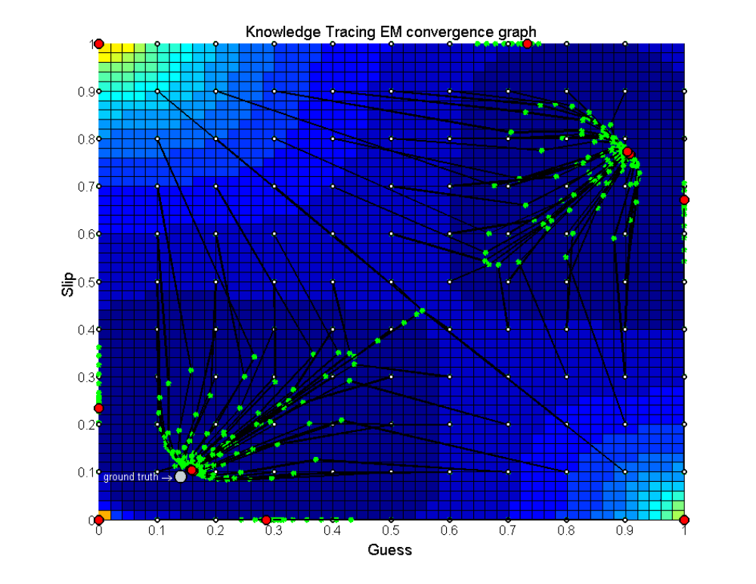
Pardos et al., 2010

Slide 26
Let’s try Hill-Climbing
On a small data set
For one skill
Let’s use 0.1 as the starting point for all four parameters

Slide 27
Hill-Climbing with Randomized Restart
One way of addressing local minima is to run the algorithms with randomly selected different initial parameter values

Slide 28
Let’s try Hill-Climbing
On same data set
For one skill
Let’s run four times with different randomly selected parameters

Slide 29
Iterative Gradient Descent
Find which set of parameters and step size (may be different for different parameters) leads to the best improvement
Use that set of parameters and step size
Repeat

Slide 30
Conjugate Gradient Descent
Variant of Iterative Gradient Descent (used by Albert Corbett and Excel)
Rather complex to explain
“I assume that you have taken a ﬁrst course in linear algebra, and that you have a solid understanding of matrix multiplication and linear independence” – J.G. Shewchuk, An Introduction to the Conjugate Gradient Method Without the Agonizing Pain. (p. 5 of 58)

Slide 31
Expectation Maximization
Starts with initial values for L0, T, G, S
Estimates student knowledge P(Ln) at each problem step
Estimates L0, T, G, S using student knowledge estimates
If goodness is substantially different from last time it was estimated, and max iterations has not been reached, go to step 2

Slide 32
Expectation Maximization
EM is vulnerable to local minima just like hill-climbing and gradient descent
Randomized restart typically used
Used in BNT-SM: Bayes Net Toolkit – Student Modeling (Chang et al., 2006)

Slide 33
Brute Force/Grid Search
Try all combination of values at a 0.01 grain-size:
L0=0, T=0, G= 0, S=0
L0=0.01, T=0, G= 0, S=0
L0=0.02, T=0, G= 0, S=0
…
L0=1,T=0,G=0,S=0
…
L0=0, T=0.01, G=0, S=0
…
L0=1,T=1,G=0.3,S=0.3
I’ll explain this soon

Slide 34
Which is best?
EM better than CGD
  Chang et al., 2006 ΔA’= 0.05
CGD better than EM
  Baker et al., 2008 ΔA’= 0.01
EM better than BF
  Pavlik et al., 2009 ΔA’= 0.003, ΔA’= 0.01
  Gong et al., 2010 ΔA’= 0.005
  Pardos et al., 2011 Δ RMSE= 0.005
  Gowda et al., 2011 ΔA’= 0.02
BF better than EM
  Pavlik et al., 2009 ΔA’= 0.01, ΔA’= 0.005
  Baker et al., 2011 ΔA’= 0.001
BF better than CGD
  Baker et al., 2010 ΔA’= 0.02

Slide 35
Maybe a slight advantage for EM
The differences are tiny

Slide 36
Model Degeneracy

Slide 37
Conceptual Idea Behind Knowledge Tracing
Knowing a skill generally leads to correct performance
Correct performance implies that a student knows the relevant skill
Hence, by looking at whether a student’s performance is correct, we can infer whether they know the skill

Slide 38
Essentially
A knowledge model is degenerate when it violates this idea
When knowing a skill leads to worse performance
When getting a skill wrong means you know it

Slide 39
Theoretical Degeneracy
(Baker, Corbett, & Aleven, 2008)
P(S)>0.5
  A student who knows a skill is more likely to get a wrong answer than a correct answer
P(G)>0.5
  A student who does not know a skill is more likely to get a correct answer than a wrong answer

Slide 40
Empirical Degeneracy
(Baker, Corbett, & Aleven, 2008)
Actual behavior by a model that violates the link between knowledge and performance

Slide 41
Empirical Degeneracy: Test 1
(Concrete Version)
(Abstract version given in paper)
If a student’s first 3 actions in the tutor are correct
The model’s estimated probability that the student knows the skill
Should be higher than before these 3 actions.

Slide 42
Test 1 Passed
P(L₀)= 0.2
Bob gets his first three actions right
P(L₃)= 0.4

Slide 43
Test 1 Failed
P(L₀)= 0.2
Maria gets her first three actions right
P(L₃)= 0.1

Slide 44
Empirical Degeneracy: Test 2
(Concrete Version)
(Abstract version in paper)
If the student makes 10 correct responses in a row
The model should assess that the student has mastered the skill

Slide 45
Test 2 Passed
P(L₀)= 0.2
Teresa gets her first seven actions right
P(L₇)= 0.98
The system assesses mastery and moves Teresa on to new material

Slide 46
Test 2 Failed
P(L₀)= 0.2
Ido gets his first ten actions right
P(L₁₀)= 0.44
Over-practice for Ido

Slide 47
Test 2 Really Failed
P(L₀)= 0.2
Elmo gets his first ten actions right
P(L₁₀)= 0.42
Elmo gets his next 300 actions right
P(L₃₁₀)= 0.42

Slide 48
Test 2 Really Failed
P(L₀)= 0.2
Elmo gets his first ten actions right
P(L₁₀)= 0.42
Elmo gets his next 300 actions right
P(L₃₁₀)= 0.42
Elmo’s school quits using the tutor

Slide 49
Model Degeneracy
Joe Beck has told me in personal communication that he has an alternate definition of Model Degeneracy that he prefers
P(G)+P(S)>1.0
Why might this definition make sense?

Slide 50
Extensions
There have been many extensions to BKT
We will discuss some of the most important ones in class on February 11

Slide 51
BKT
Questions?
Comments?

Slide 52
Next Class
Wednesday, January 30
3pm-4:40pm
Special Guest Lecturer: John Stamper, Carnegie Mellon University
Educational Databases
Koedinger, K.R., Baker, R.S.J.d., Cunningham, K., Skogsholm, A., Leber, B., Stamper, J. (2010) A Data Repository for the EDM community: The PSLC DataShop. Handbook of Educational Data Mining. Boca Raton, FL: CRC Press, pp. 43-56.

Slide 53
The End

