Slide 1
Special Topics in Educational Data Mining
HUDK5199
Spring term, 2013
March 27, 2013

Slide 2
Today’s Class
Correlation Mining
Causal Data Mining

Slide 3
The Situation
You have 100 variables, and you want to know how each one correlates to a variable of interest
  Not quite the same as building a prediction model
You have 100 variables, and you want to know how they correlate to each other

Slide 4
When…
When might you want to do this?
  Examples from this week’s readings
  Other examples

Slide 5
The Problem
You run 100 correlations (or 10,000 correlations)
9 of them come up statistically significant
Which ones can you “trust”?

Slide 6
Let’s run a simulation
With 1000 random variables
One target variable
100 data points
How many statistically significant correlations are obtained?

Slide 7
The Problem
Comes from the paradigm of conducting a single statistical significance test

Slide 8
The Solution
Adjust for the probability that your results are due to chance, using a post-hoc control

Slide 9
Two paradigms
FWER – Familywise Error Rate
  Control for the probability that any of your tests are falsely claimed to be significant (Type I Error)
FDR – False Discovery Rate
  Control for the overall rate of false discoveries

Slide 10
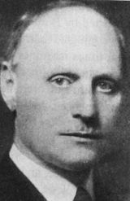
Bonferroni Correction
Who here has heard of the Bonferroni Correction?

Slide 11
Bonferroni Correction
Who here has heard of the Bonferroni Correction?
Who here has used it?

Slide 12

Bonferroni Correction
Who here has heard of the Bonferroni Correction?
Who here has used it?
Who has had a statistics professor
who actually recommended it?

Slide 13
Bonferroni Correction
Ironically, derived by Miller rather than Bonferroni

Slide 14
Bonferroni Correction
Ironically, derived by Miller rather than Bonferroni
Also ironically, there appear to be no pictures of Miller on the internet

Slide 15

Bonferroni Correction
A classic example of Stigler’s Law of Eponomy
  “No scientific discovery is named after its original discoverer”

Slide 16
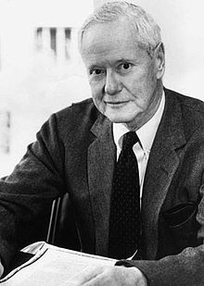
Bonferroni Correction
A classic example of Stigler’s Law of Eponomy
  “No scientific discovery is named after its original discoverer”
  Stigler’s Law of Eponomy was proposed by
  Robert Merton

Slide 17
Bonferroni Correction
If you are conducting n different statistical tests on the same data set
Adjust your significance criterion α to be
  α / n
E.g. For 4 statistical tests, use statistical significance criterion of 0.0125 rather than 0.05

Slide 18
Bonferroni Correction
  Sometimes instead expressed by multiplying p * n, and keeping statistical significance criterion α = 0.05
  Mathematically equivalent…
    As long as you don’t try to treat p like a probability afterwards… or meta-analyze it… etc., etc.
    For one thing, can produce p values over 1, which doesn’t really make sense

Slide 19
Bonferroni Correction: Example
Five tests
  p=0.04, p=0.12, p=0.18, p=0.33, p=0.55
Five corrections
  All p compared to α= 0.01
  None significant anymore
  p=0.04 seen as being due to chance

Slide 20
Bonferroni Correction: Example
Five tests
  p=0.04, p=0.12, p=0.18, p=0.33, p=0.55
Five corrections
  All p compared to α= 0.01
  None significant anymore
  p=0.04 seen as being due to chance
  Does this seem right?

Slide 21
Bonferroni Correction: Example
Five tests
  p=0.001, p=0.011, p=0.02, p=0.03, p=0.04
Five corrections
  All p compared to α= 0.01
  Only p=0.001 still significant

Slide 22
Bonferroni Correction: Example
Five tests
  p=0.001, p=0.011, p=0.02, p=0.03, p=0.04
Five corrections
  All p compared to α= 0.01
  Only p=0.001 still significant
  Does this seem right?

Slide 23
Bonferroni Correction
  Advantages
  Disadvantages

Slide 24
Bonferroni Correction
  Advantages
    You can be “certain” that an effect is real if it makes it through this correction
    Does not assume tests are independent
      In our “100 correlations with the same variable” case, they aren’t!
  Disadvantages
    Massively over-conservative
    Throws out everything if you run a lot of correlations

Slide 25
Often attacked these days
Arguments for rejecting the sequential Bonferroni in ecological studies. MD Moran - Oikos, 2003 - JSTOR
Beyond Bonferroni: less conservative analyses for conservation genetics. SR Narum - Conservation Genetics, 2006 – Springer
What's wrong with Bonferroni adjustments. TV Perneger - Bmj, 1998 - bmj.com
p Value fetishism and use of the Bonferroni adjustment. JF Morgan - Evidence Based Mental Health, 2007

Slide 26
There are some corrections that are a little less conservative…
Holm Correction/Holm’s Step-Down (Toothaker, 1991)
Tukey’s HSD (Honestly Significant Difference)
Sidak Correction
Still generally very conservative
Lead to discarding results that probably should not be discarded

Slide 27
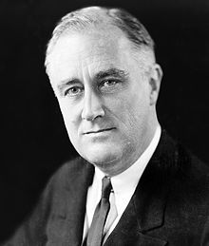
FDR Correction
(Benjamini & Hochberg, 1991)

Slide 28
FDR Correction
Different paradigm, probably a better match to the original conception of statistical significance

Slide 29
Comparison of Paradigms

Slide 30
Statistical significance
p<0.05
A test is treated as rejecting the null hypothesis if there is a probability of under 5% that the results could have occurred if there were only random events going on
This paradigm accepts from the beginning that we will accept junk (e.g. Type I error) 5% of the time

Slide 31
FWER Correction
p<0.05
Each test is treated as rejecting the null hypothesis if there is a probability of under 5% divided by N that the results could have occurred if there were only random events going on
This paradigm accepts junk far less than 5% of the time

Slide 32
FDR Correction
p<0.05
Across tests, we will attempt to accept junk exactly 5% of the time
  Same degree of conservatism as the original conception of statistical significance

Slide 33
Example
Twenty tests, all p=0.04
Bonferroni rejects all of them as non-significant
FDR notes that we should have had 1 fake significant, and 20 significant results is a lot more than 1

Slide 34
FDR Procedure
(Benjamini & Hochberg, 1991)
Order your n tests from most significant (lowest p) to least significant (highest p)
  Test your first test according to significance criterion α∗1 / n
  Test your second test according to significance criterion α∗2 / n
  Test your third test according to significance criterion α∗3 / n
  Quit as soon as a test is not significant

Slide 35
FDR Correction: Example
Five tests
  p=0.001, p=0.011, p=0.02, p=0.03, p=0.04

Slide 36
FDR Correction: Example
Five tests
  p=0.001, p=0.011, p=0.02, p=0.03, p=0.04
First correction
  p = 0.001 compared to α= 0.01
  Still significant!

Slide 37
FDR Correction: Example
Five tests
  p=0.001, p=0.011, p=0.02, p=0.03, p=0.04
Second correction
  p = 0.011 compared to α= 0.02
  Still significant!

Slide 38
FDR Correction: Example
Five tests
  p=0.001, p=0.011, p=0.02, p=0.03, p=0.04
Third correction
  p = 0.02 compared to α= 0.03
  Still significant!

Slide 39
FDR Correction: Example
Five tests
  p=0.001, p=0.011, p=0.02, p=0.03, p=0.04
Fourth correction
  p = 0.03 compared to α= 0.04
  Still significant!

Slide 40
FDR Correction: Example
Five tests
  p=0.001, p=0.011, p=0.02, p=0.03, p=0.04
Fifth correction
  p = 0.04 compared to α= 0.05
  Still significant!

Slide 41
FDR Correction: Example
Five tests
  p=0.04, p=0.12, p=0.18, p=0.33, p=0.55

Slide 42
FDR Correction: Example
Five tests
  p=0.04, p=0.12, p=0.18, p=0.33, p=0.55
First correction
  p = 0.04 compared to α= 0.01
  Not significant; stop

Slide 43
How do these results compare
To Bonferroni Correction
To just accepting p<0.05, no matter how many tests are run

Slide 44
q value extension in FDR
(Storey, 2002)
Remember how Bonferroni Adjustments could either be made by adjusting α or adjusting p?
There is a similar approach in FDR
  where p values are transformed to q values
Unlike in Bonferroni, q values can be interpreted the same way as p values

Slide 45
q value extension in FDR
(Storey, 2002)
p = probability that the results could have occurred if there were only random events going on
q = probability that the current test is a false discovery, given the post-hoc adjustment

Slide 46
q value extension in FDR
(Storey, 2002)
q can actually be lower than p
In the relatively unusual case where there are many statistically significant results

Slide 47
Questions? Comments?

Slide 48
Causal Data Mining

Slide 49


Causal Data Mining:
Here Be Dragons
YE OLDE SEA OF DATA

Slide 50
Causal Data Mining
Distinct from prediction
The goal is not to figure out what predicts X
But instead…

Slide 51
Causal Data Mining
Find causal relationships in data
Examples from Scheines (2007)
  What feature of student behavior causes learning
  What will happen when we make everyone take a reading quiz before each class
  What will happen when we program our tutor to intervene to give hints after an error

Slide 52
Causal Data Mining
TETRAD is a key software package used to study this
http://www.phil.cmu.edu/projects/tetrad/

Slide 53
TETRAD
Implements multiple algorithms for finding causal structure in data

Slide 54
Causal Data Mining Explicitly Attempts to infer if A causes B

Slide 55
Finding causal structure
For any two correlated variables a and b
It is possible that
  a causes b
  b causes a
  Some other variable c causes a and b
  Some combination of these

Slide 56
Finding causal structure
Easy to determine if you manipulate a
But can you determine this from purely correlational data?
  Glymour, Scheines, and Sprites say yes!

Slide 57
Big idea
Try to infer likelihood of data, assuming
  a causes b
  b causes a
  Some other variable c causes a and b
  Some combination of these
In context of full pattern of correlation across variables

Slide 58
Full Math
See
(Scheines et al., 1998)
(Glymour, 2001)

Slide 59
Examples in EDM

Slide 60
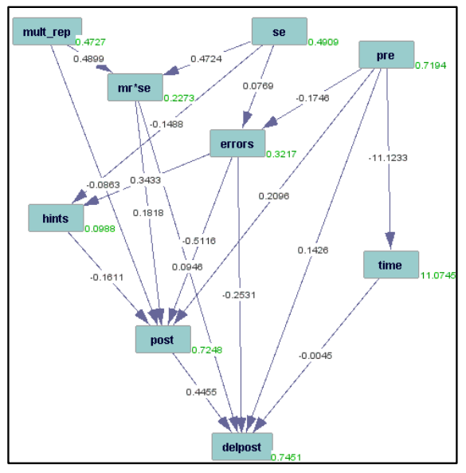
Rau et al., 2012

Slide 61
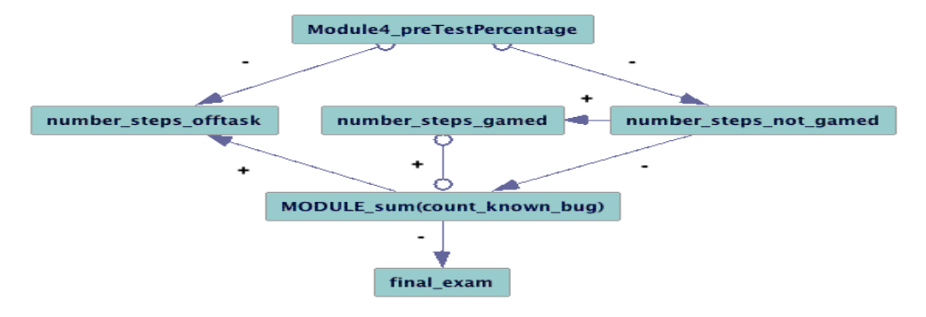
Fancsali, 2012

Slide 62
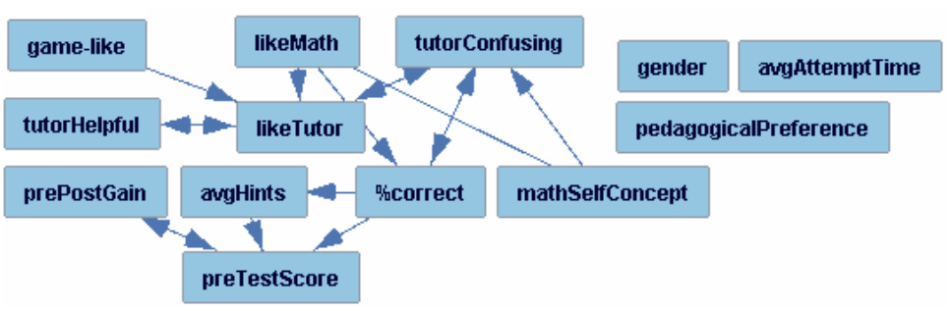
Rai et al. (2011)

Slide 63
Wait, what?

Slide 64
Solution
Explicitly build domain knowledge into model
The future can’t cause the past

Slide 65
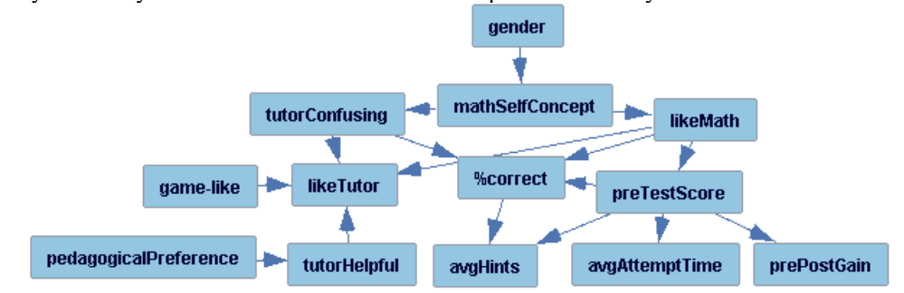
Result

Slide 66
Well, that’s better… right?

Slide 67
Here’s the issue
The future can’t cause the past
If the algorithm can produce that result more than very rarely
Then there is something seriously wacky with the algorithm, and it shouldn’t be trusted

Slide 68
Here’s the issue
I repeatedly hear informally about causal modeling algorithms producing bizarre results like this
  When domain knowledge isn’t built in to prevent it
It seldom gets published
Rai et al. (2011) is the only published example I know about
Data mining lore ☹

Slide 69
To be clear
I’m not saying, never use causal modeling
But know what you’re doing…
And be really careful!

Slide 70
Questions? Comments?

Slide 71
Causal Data Mining:
Here Be Dragons
YE OLDE SEA OF DATA

Slide 72
Asgn. 8
Questions?
Comments?

Slide 73
Next Class
Monday, April 1
Discovery with Models
Readings
Pardos, Z.A., Baker, R.S.J.d., San Pedro, M.O.C.Z., Gowda, S.M., Gowda, S.M. (in press) Affective states and state tests: Investigating how affect throughout the school year predicts end of year learning outcomes. To appear in Proceedings of the 3rd International Conference on Learning Analytics and Knowledge.
Hershkovitz, A., Baker, R.S.J.d., Gobert, J., Wixon, M., Sao Pedro, M. (in press) Discovery with Models: A Case Study on Carelessness in Computer-based Science Inquiry. To appear in American Behavioral Scientist.
Assignments Due: None

Slide 74
The End

