Slide 1
Special Topics in
Educational Data Mining
HUDK5199
Spring 2013
March 25, 2012

Slide 2
Today’s Class
Social Network Analysis

Slide 3
General Principles of
Social Network Analysis

Slide 4

General Principles of
Social Network Analysis

Slide 5
General Postulates of
Social Network Analysis

Slide 6
General Postulates of
Social Network Analysis
There are many entities, referred to as nodes or vertices
Nodes have connections to other notes, referred to as ties or links
Nodes can have different types or identities
Links can have different types or identities
Links can have different strengths

Slide 7
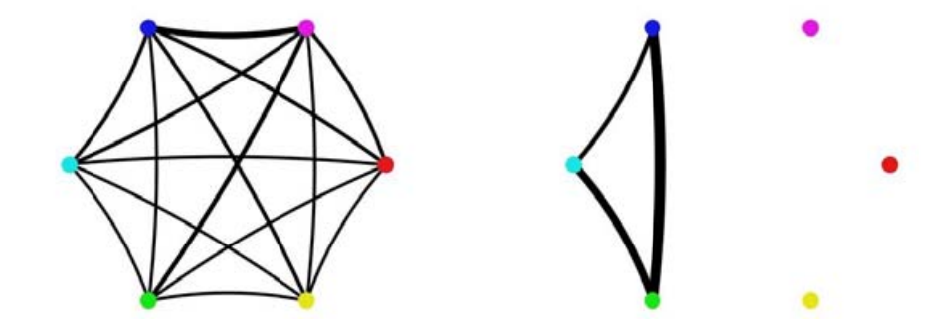
Example
(Student work groups – Kay et al., 2006)

Slide 8
Example
(Student work groups – Kay et al., 2006)
nodes

Slide 9
Example
(Student work groups – Kay et al., 2006)
ties

Slide 10
Example
(Student work groups – Kay et al., 2006)
Strong ties
Weak ties

Slide 11
Which student group works together better?

Slide 12
Which is the most collaborative pair?

Slide 13
Who is the most collaborative student?

Slide 14
Types
In a graph of classroom interactions, what different types of nodes could there be?

Slide 15
Types
In a graph of classroom interactions, what different types of nodes could there be?
  Teacher
  TA
  Student
  Project Leader
  Project Scribe

Slide 16
Types
In a graph of classroom interactions, what different types of links could there be?

Slide 17
Types
In a graph of classroom interactions, what different types of links could there be?
  Leadership role (X leads Y)
  Working on same learning resource
  Helping act
  Criticism act
  Insult
  Note that links can be directed or undirected

Slide 18
Strength
In a graph of classroom interactions, what would make links stronger or weaker?

Slide 19
Strength
In a graph of classroom interactions, what would make links stronger or weaker?
  Intensity of act (Examples?)
  Frequency of act (Examples?)

Slide 20
Examples
What might be some types of social networks that would be studied in the learning sciences?
What might be some relevant research questions?

Slide 21
Social Network Analysis
Use social network graphs to study the patterns and regularities of the relationships between the nodes

Slide 22
Density
Proportion of possible lines that are actually present in graph
What is the density of these graphs?

Slide 23
Reachability
A node is “reachable” if a path goes from any other node to it
Which nodes are reachable and unreachable?

Slide 24
Geodesic Distance
The number of nodes between one node N and another node M

Slide 25
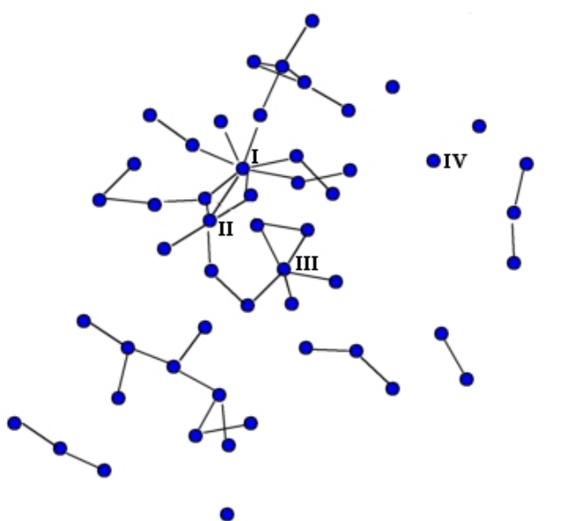
Example
(Dawson, 2008)

Slide 26
What is the geodesic distance?

Slide 27
What is the geodesic distance?

Slide 28
What is the geodesic distance?

Slide 29
Geodesic Distance
What might be a use for geodesic distance in educational research?

Slide 30
Flow
How many possible paths are there between node N and node M?

Slide 31
What is the flow?

Slide 32
Flow
What might be a use for flow in educational research?

Slide 33
Centrality
How important is a node within the graph?

Slide 34
Centrality
Four common measures
  Degree centrality
  Closeness centrality
  Betweeness centrality
  Eigenvector centrality

Slide 35
Nodal Degree
Number of lines that connect to a node

Slide 36
Which node has the highest nodal degree?

Slide 37
Nodal Degree
Indegree: number of lines that come into a node
  How might this be interpreted for some link types you might see in educational data?
Outdegree: number of lines that come out of a node
  How might this be interpreted for some link types you might see in educational data?

Slide 38
Closeness
A node N’s closeness is defined as the sum of its distance to other nodes
The most central node in terms of closeness is the node with the lowest value for this metric
Note that strengths can be used as a distance measure for calculating closeness
  Higher strength = closer nodes

Slide 39
Which node has highest closeness? (looking solely at number of steps)

Slide 40
Which node has highest closeness? (looking at link strengths)

Slide 41
Betweenness
Betweeness centrality for node N is computed as:
The percent of cases where
For each pair of nodes M and P (which are not N)
  The shortest path from M to P passes through N

Slide 42
What is this node’s betweenness

Slide 43
What is this node’s betweenness

Slide 44
What is this node’s betweenness

Slide 45
Betweenness
How might this be interpreted for some link types you might see in educational data?

Slide 46
Eigenvector Centrality
Complex math, but assigns centrality to nodes through recursive process where
More and stronger connections are positive
Connections to nodes with higher eigenvector centrality contribute more than connections to nodes with lower eigenvector centrality

Slide 47
Eigenvector Centrality
What type of applications might this have?

Slide 48
How do these measures differ in meaning?

Slide 49
Reciprocity
What percentage of ties are bi-directional?
  Can be computed as number of bi-directional ties over total number of connected pairs

Slide 50
What is the reciprocity?

Slide 51
What could reciprocity tell you?
For educational data

Slide 52
Clique
Sub-set of a network for which all nodes are connected to each other
  If there is any node which is connected to all nodes in the clique
  Then it is also part of the clique

Slide 53
What are the cliques?

Slide 54
Clique
What could cliques tell you in educational research problems?

Slide 55
N-Clique
Sub-set of a network for which all nodes are connected to each other with a path of geodesic distance of N or less

Slide 56
What are the 2-cliques?

Slide 57
K-plex
Sub-set of a network, of size N, for which all nodes are connected to at least N-K other members of the K-plex

Slide 58
What are the 1-plexes?

Slide 59
Connections between cliques
Can represent key conduits for information
Example from Haythornthwaite (1998)

Slide 60
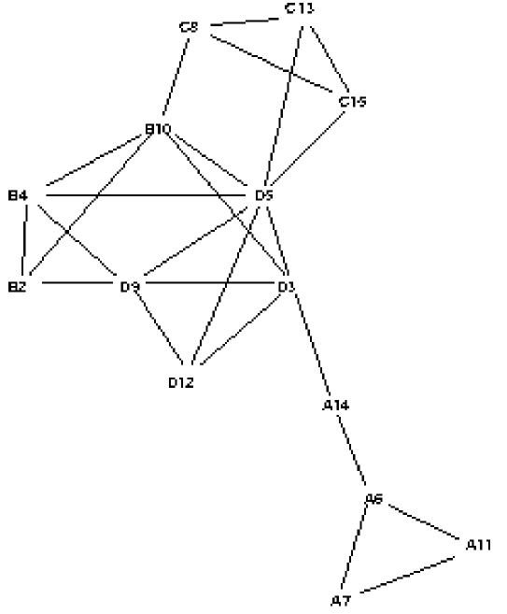
Communication in a class
(letters indicate groups)

Slide 61
Comments? Questions?

Slide 62
Case Studies in Uses of
Social Network Analysis
(Haythornthwaite, 2001)
(Dawson, 2008)

Slide 63
How?
How did Haythornthwaite and Dawson use social network analysis to learn about collaborative learning?

Slide 64
Haythornthwaite
Analyzed data from four groups from same class over time
Analyzed students’ communication behaviors
  Collaborative Work
  Exchanging Advice
  Socializing
  Emotional Support
Analyzing students’ use of communication technologies
  Webboard
  IRC
  Email
  NetMeeting
  Telephone
  Face-to-Face

Slide 65
Dawson
Analyzed student perception of being part of a social community and a learning community, in relation to their centrality (multiple measures)

Slide 66
Other uses?
What are some other uses of social network analysis for learning beyond those we’ve discussed today?

Slide 67
Comments? Questions?

Slide 68
Assignment 6
Solutions

Slide 69
Assignment 7

Slide 70
Next Class
Wednesday, March 27
Correlation Mining and Causal Mining
Readings
Arroyo, I., Woolf, B. (2005) Inferring learning and attitudes from a Bayesian Network of log file data. Proceedings of the 12th International Conference on Artificial Intelligence in Education, 33-40.
Rai, D., Beck, J.E. (2011) Exploring user data from a game-like math tutor: a case study in causal modeling. Proceedings of the 4th International Conference on Educational Data Mining, 307-313.
Rau, M. A., & Scheines, R. (2012) Searching for Variables and Models to Investigate Mediators of Learning from Multiple Representations. Proceedings of the 5th International Conference on Educational Data Mining, 110-117.
Assignments Due: None

Slide 71
The End

