Slide 1
Special Topics in
Educational Data Mining
HUDK5199
Spring term, 2013
March 6, 2013

Slide 2
Today’s Class
Advanced Detector Validation and Evaluation

Slide 3
Calculating Statistical Significance for EDM models
Up to this point, we’ve discussed cross-validation mostly
Tests generalizability
Relatively mathematically easy

Slide 4
But it’s possible to calculate statistical significance for some metrics
A’ specifically
The next few slides will be review…

Slide 5
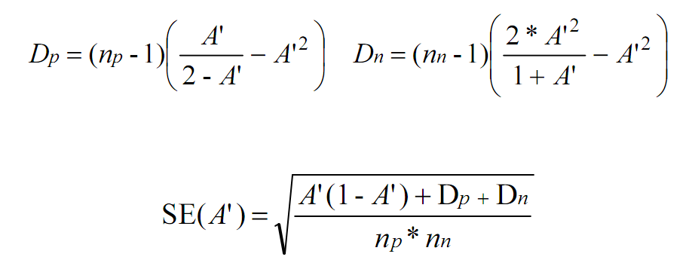
Review

Slide 6
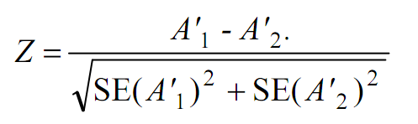
Comparing Two Models
(Review)

Slide 7
Comparing Model to Chance
(Review)
0.5
0

Slide 8
Complication
This test assumes independence
If you have multiple data points per student
Then this assumption is not only wrong, it’s dangerous
  Biases in the direction of statistical significance

Slide 9
What can we do?
We can borrow a technique from the meta-analysis literature

Slide 10
Meta-Analysis
What is it?
What is it usually used for?

Slide 11
Special Warning
When publishing using this techniques, it is probably wise to cite the appropriate paper but not mention the words meta-analysis
Some reviewers just can’t deal with the idea that one can use meta-analytic statistical techniques in cases other than meta-analysis

Slide 12
Combining Statistical Significance
Stouffer’s Z
Z
sqrt(K)

Slide 13
Let’s consider an example
Is a model better than chance?

Slide 14
Data
Student 1 A’ = 0.69, Np = 12, Nn = 13
Student 2 A’ = 0.65, Np = 14, Nn = 20
Student 3 A’ = 0.72, Np = 16, Nn = 25
Student 4 A’ = 0.83, Np = 70, Nn = 55
Student 5 A’ = 0.86, Np = 80, Nn = 60
Overall A’ = 0.80, Np = 192, Nn = 173

Slide 15
Compute
Student 1 A’ = 0.69, Np = 12, Nn = 13
Student 2 A’ = 0.65, Np = 14, Nn = 20
Student 3 A’ = 0.72, Np = 16, Nn = 25
Student 4 A’ = 0.83, Np = 70, Nn = 55
Student 5 A’ = 0.86, Np = 80, Nn = 60
Overall A’ = 0.80, Np = 192, Nn = 173

Slide 16
Compute
Student 1 A’ = 0.69, Np = 12, Nn = 13
Student 2 A’ = 0.65, Np = 14, Nn = 20
Student 3 A’ = 0.72, Np = 16, Nn = 25
Student 4 A’ = 0.83, Np = 70, Nn = 55
Student 5 A’ = 0.86, Np = 80, Nn = 60
Overall A’ = 0.80, Np = 192, Nn = 173

Slide 17
Comparing models
Same methods can be used to compare between A’ for different models

Slide 18
Are the models significantly different?

Slide 19
Data
A’a = 0.69, A’b = 0.72, Np = 12, Nn = 13
A’a = 0.65, A’b = 0.64, Np = 14, Nn = 20
A’a = 0.72, A’b = 0.75, Np = 16, Nn = 25
A’a = 0.83, A’b = 0.86, Np = 70, Nn = 55
A’a = 0.86, A’b = 0.92, Np = 80, Nn = 60

Slide 20
Other use of meta-analytic methods in detector validation
Studying whether a detector generalizes
  Population
  Demographic group
Compare A’ in original context to A’ in new context

Slide 21
More complicated case
What if populations of students are overlapping but non-identical for two contexts?
  E.g. 4 schools used software A and software B, but two additional schools used software B
  E.g. A lot of kids were absent due to a school assembly
You could just drop the non-overlapping kids
  Not always practical
Alternative: use Strube’s Adjusted Z
  Deals with the partial non-independence of student performance within two different tutor lessons
  Explicitly incorporates correlation between a student’s performance in the two tutor lessons, treating non-overlapping students as having a correlation of 0

Slide 22
Advanced Thoughts about Validation
There are a lot of frameworks for thinking about validity of models, coming from decades of thought in the world of statistics
We’ve discussed a few types of validity this semester so far
I’ll mention a few here
  Not an exhaustive list!

Slide 23
Generalizability
Does your model remain predictive when used in a new data set?
Underlies the cross-validation paradigm that is common in data mining
Knowing the context the model will be used in drives what kinds of generalization you should study

Slide 24
Ecological Validity
Do your findings apply to real-life situations outside of research settings?
For example, if you build a detector of student behavior in lab settings, will it work in real classrooms?

Slide 25
Construct Validity
Does your model actually measure what it was intended to measure?

Slide 26
Construct Validity
Does your model actually measure what it was intended to measure?
One interpretation: does your model fit the training data?

Slide 27
Construct Validity
Another interpretation: do your model features plausibly measure what you are trying to detect?
If they don’t, you might be over-fitting
(Or your conception of the domain might be wrong!)
See Sao Pedro paper from earlier in the semester for evidence that attention to this can improve model generalizability

Slide 28
Predictive Validity
Does your model predict not just the present, but the future as well?

Slide 29
Substantive Validity
Do your results matter?
Are you modeling a construct that matters?
If you model X, what kind of scientific findings or impacts on practice will this model drive?
Can be demonstrated by predicting future things that matter

Slide 30
Substantive Validity
For example, we know that boredom correlates strongly with
  Disengagement
  Learning Outcomes
  Standardized Exam Scores
  Attending College Years Later
By comparsion, whether someone prefers visual or verbal learning materials doesn’t even seem to predict very reliably whether they learn better from visual or verbal learning materials
(See lit review in Pashler et al., 2008)

Slide 31
Content Validity
From testing; does the test cover the full domain it is meant to cover?
For behavior modeling, an analogy would be, does the model cover the full range of behavior it’s intended to?
  A model of gaming the system that only captured systematic guessing but not hint abuse (cf. Baker et al, 2004; my first model of this)
  would have lower content validity than a model which captured both (cf. Baker et al., 2008)

Slide 32
Conclusion Validity
Are your conclusions justified based on the evidence?

Slide 33
Other validity concerns?

Slide 34
Relative Importance?
Which of these do you want to optimize?
Which of these do you want to satisfice?
Can any be safely ignored completely? (at least in some cases)

Slide 35
Exercise
In groups of 3
Write the abstract of the worst behavior detector paper ever

Slide 36
Any group want to share?

Slide 37
Exercise #2
In different groups of 3
Now write the abstract of the best behavior detector paper ever

Slide 38
Any group want to share?

Slide 39
Asgn. 6
Any questions?

Slide 40
Next Class
Monday, March 11
Regression in Prediction
Readings
Witten, I.H., Frank, E. (2011) Data Mining: Practical Machine Learning Tools and Techniques. Sections 4.6, 6.5.
Assignments Due: 6. Regression

Slide 41
The End

