Slide 1
Big Data, Education, and Society
February 22, 2024

Slide 2
Thank you for your assignment 1 handins
Great assignments
Great feedback to each other on the forums – thank you!
I am processing your assignments, and will get you feedback ASAP
Some groups may get feedback from me earlier than others – don’t worry if you get:
  Feedback before or after others (there’s no specific order)
  Relatively brief feedback from me (I might just agree with JeepyTA)

Slide 3
Assignment 2:
Needs Assessment
Let’s go over it together
Any questions?

Slide 4
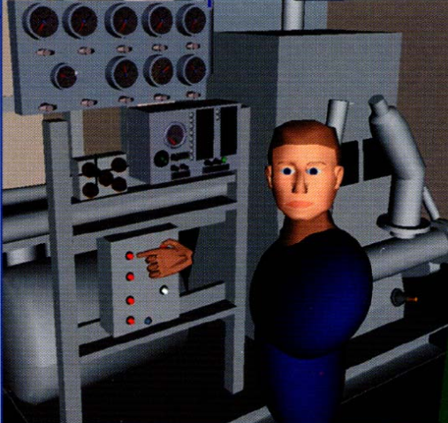


Automated Intervention

Slide 5
Examples of Use (at scale)
Cognitive Tutor/MATHia – automated detectors of student knowledge used to drive mastery learning
Middle school and high school and college math, USA

Slide 6
Examples of Use (at scale)
Alef NextGen – automated detectors of student knowledge used to select what material to give student next and provide reports to instructors
Entire (all subject) middle school curriculum, United Arab Emirates

Slide 7
Examples of Use (at scale)
ALEKS – Models of prerequisite structure and knowledge used to select material for students
High school and college math and science, USA

Slide 8
Examples of Use (at scale)
Project LISTEN/Amira – data mining used to determine which strategies work for which students, and to help select which stories to give students to read
Elementary school reading, USA

Slide 9
Examples of Use (at scale)
Duolingo – automated detectors of student memory used to determine when a student needs to review something they already learned
Foreign language vocabulary, worldwide

Slide 10
Examples of Use
(formerly at scale)
Learnta – Models of prerequisite structure and knowledge used to select material for students, automated detectors of student knowledge used to drive mastery learning
English as a second language and math, China

Slide 11
Examples of Use (at scale)
InqITS – automated detectors of student inquiry skill embedded in an automated agent that helps students learn how to conduct effective inquiry
Leading to inquiry skill that transfers to new scientific domains
Middle school science, USA, formerly China

Slide 12
Comments? Questions?

Slide 13
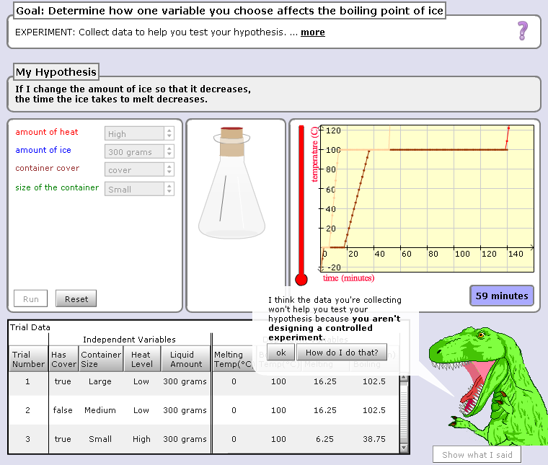

Slide 14
Hey, are you just playing with the buttons? Take your learning seriously or I will eat you!!!

Slide 15
Comments? Questions?

Slide 16
Scooter video
ldcwdmcmscm

Slide 17
Comments? Questions?

Slide 18
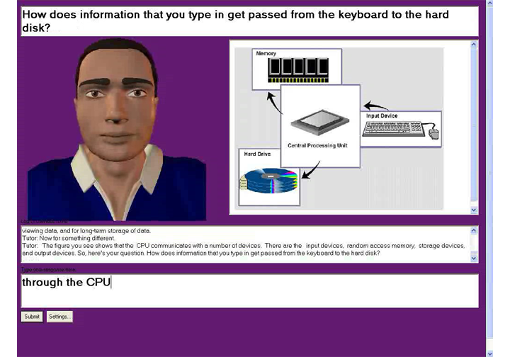
AutoTutor

Slide 19
AutoTutor
Engages in knowledge-construction dialogues with learner
Adapts based on student emotion as well as student knowledge
  Supportive versus shake-up dialogues

Slide 20
AutoTutor
https://www.youtube.com/watch?v=aPcoZPjL2G8
https://www.youtube.com/watch?v=jDNXG09vFqo

Slide 21
Comments? Questions?

Slide 22
Those of you who have learned from a system doing automated intervention
What system was it
What did it do
What was your reaction

Slide 23
Those of you who have taught using a system doing automated intervention
What system was it
What did it do
What was your reaction

Slide 24
Is anyone here familiar with any other examples?

Slide 25
What are some situations when a system could intervene?

Slide 26
What are the properties of a good automated intervention?

Slide 27
What are some things to avoid in an automated intervention?

Slide 28
What is the difference in benefits/risks
Obvious interventions
Stealth interventions

Slide 29
Further comments/discussion?

Slide 30
Upcoming sessions
Feb 26 VIVI-SD 3 Due
Feb 29 Validity
Mar 7 NO CLASS SPRING BREAK
Mar 14 Rational Modeling and Model Validity
Mar 15 Project Assignment 2 first draft due
Mar 21 Generalizability
  Both Sections Virtual, 9a (45min early) and 7p (1 hr late)
Mar 22 Project Assignment 2 final version due
Mar 28 Discrimination and the Perpetuation of Bias
  Both Sections Virtual, 9a (45min early) and 7p (1 hr late)

