Slide 1
Big Data, Education, and Society
October 22, 2021

Slide 2
Needs Assessment
Any questions?

Slide 3
Rational Modeling
Where your model is created by a smart human being, rather than an exhaustive computer

Slide 4
Also called
Knowledge engineering
Cognitive modeling

Slide 5
Knowledge Engineering at its best
Knowledge engineering is the art of a human being
  Becoming deeply familiar with the target construct
  Carefully studying the data, including possibly process data (such as think-alouds)
  Understanding the relevant theory and how it applies
  Thoughtfully crafting an excellent model

Slide 6
Knowledge Engineering at its best
In its classical version
  A knowledge engineer and a domain expert work together to model the construct
  Through an iterative process
  Where the knowledge engineer interviews the expert, creates models, goes through the model and its implications with the expert, gets feedback, enhances the models, and repeats the process
  Until both the knowledge engineer and domain expert believe the model has fully captured the expert’s reasoning

Slide 7

An Example of This
Paquette et al. (2014)
AKA this week’s reading

Slide 8
Paquette paper
Questions?
Thoughts?

Slide 9
Knowledge Engineering at its best
Achieves higher construct validity than data mining
Achieves comparable performance in data
And can transfer better to new data in some cases, by capturing more general aspects of the construct
(Paquette et al., 2014, 2015, 2019)

Slide 10
Knowledge Engineering at its best
Tests a model’s sensitivity to variations in how the construct is specified
(e.g. Kovanovic et al., 2015 investigating what “time on task” means)

Slide 11
Questions? Comments?

Slide 12




Another example of excellent knowledge engineering
Aleven et al.’s (2004, 2006) help-seeking model

Slide 13
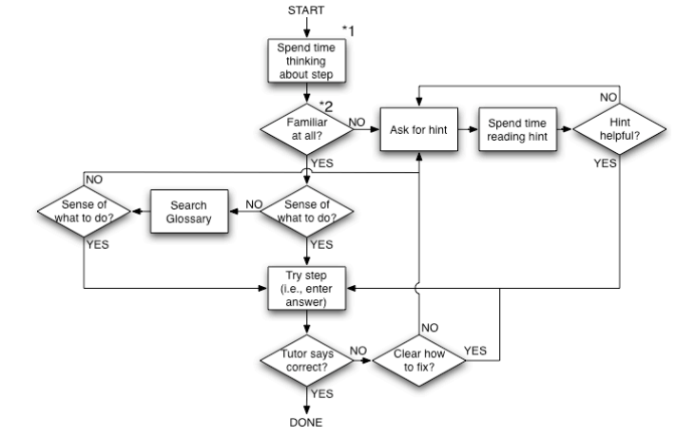
A prescriptive model of good help-seeking behavior in an online tutor

Slide 14
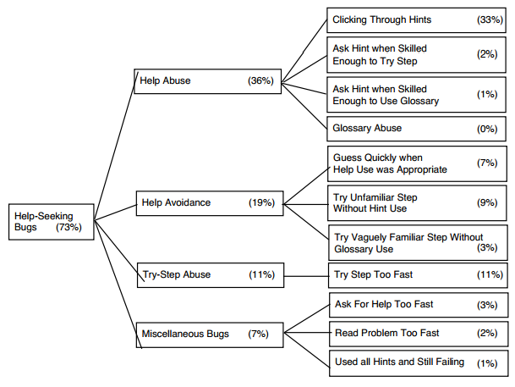
With a taxonomy of errors in student help-seeking

Slide 15
Developed based on
Thorough study of dozens of scientific articles
Years of experience in designing online learning environments
Intensive study of log files of student interaction with learning system
Plus experience watching kids use educational software in real classrooms

Slide 16
Resultant models
Predictive of student learning (Aleven et al., 2004, 2006) and preparation for future learning (Baker et al., 2011)
Specific aspects of model correlate to data-mined detectors of same constructs, and improve data-mined models if added to them (Roll et al., 2005)

Slide 17
Questions? Comments?

Slide 18
Knowledge Engineering at its worst
Knowledge engineering (and the other terms) are sometimes used to refer to
  Someone making up a simple model very quickly
  And then calling the resultant construct by a well-known name
  And not testing on data in any way
  And asserting that their model is the construct, despite having no evidence

Slide 19
Knowledge Engineering at its worst
Achieves poorer construct validity than data mining
Predicts desired constructs poorly, sometimes even worse than chance
  Due to over-simplifying a complex construct
  Or even failing to match it
Can slow scientific progress by introducing false results
Can hurt student outcomes by intervening at the wrong times

Slide 20
How can you tell if knowledge engineering is bad
If a data mining model is bad
  It’s usually relatively easy to identify, from the features, the validation procedure, or the goodness metrics
Telling top-notch knowledge engineering from junk is a little harder
The hard work is in the researcher’s brain, and the process is usually invisible
But… look for very simple models of complex constructs

Slide 21
Questions? Comments?

Slide 22
Whether You Use Knowledge Engineering or Data Mining…
You should be testing your models on data in some fashion
Even if you can’t get a direct measure (training labels)
You can usually get some kind of indirect measure (predicting student learning, for example)

Slide 23
Questions? Comments?

Slide 24
It’s not an either-or…
Some research has used knowledge engineering to discover what basic operators domain experts think in terms of
And then re-combine those operators in a broader range of ways
(Paquette et al., 2014b)

Slide 25
It’s not an either-or…
Knowledge-engineered models sometimes depend on cut-offs or numerical parameters that are hard to determine rationally
These parameters can be empirically fit using data
Some variants of Aleven et al.’s model do this, for example

Slide 26
Let’s discuss the Muldner article
Is this good knowledge engineering or bad knowledge engineering?
Are the conclusions drawn using this model warranted?

Slide 27
The Chicago Model
Who here is familiar with “The Chicago Model”? (If you have to say “Which Chicago Model”, then you aren’t)
Does anyone want to tell folks about it?

Slide 28
The Chicago Model
Good knowledge engineering?
Bad knowledge engineering?
Good knowledge engineering followed by bad application?

Slide 29
Questions? Comments?

