Slide 1
Big Data, Education, and Society
December 10, 2021

Slide 2
Assignment 4
Any questions about assignment 4?
Reminder: sign up for a presentation slot at
https://docs.google.com/spreadsheets/d/1tR9sGXpCwslWqH_FMzeknmuJWbSj4R6bkocek73GUJA/edit#gid=0

Slide 3
Today
Big Data
Big Science
Longitudinal Follow-up

Slide 4
Two big directions
Making learning platforms available for A/B tests proposed by outside researchers
Making data sets available for outside use
Often the same platforms do both
Very few platforms do either

Slide 5
One large platform that does both

Slide 6

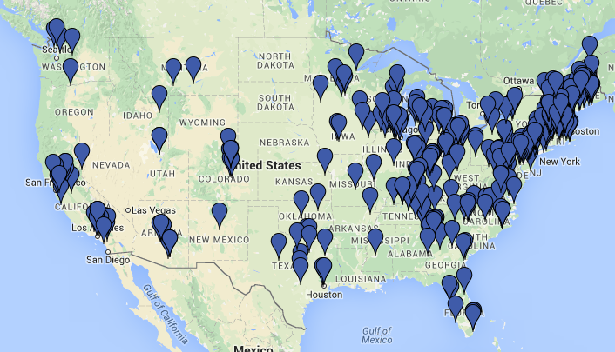
Over half a million student users in 2020-2021 school year
Blended-learning model
(mostly) Middle school
Development of procedural fluency in math
Notes:
Mastery-learning paradigm (cycles of feedback until mastery)
Blended learning model-technology integrated into instruction
Focus on development of procedural fluency
Focus on middle school

Slide 7
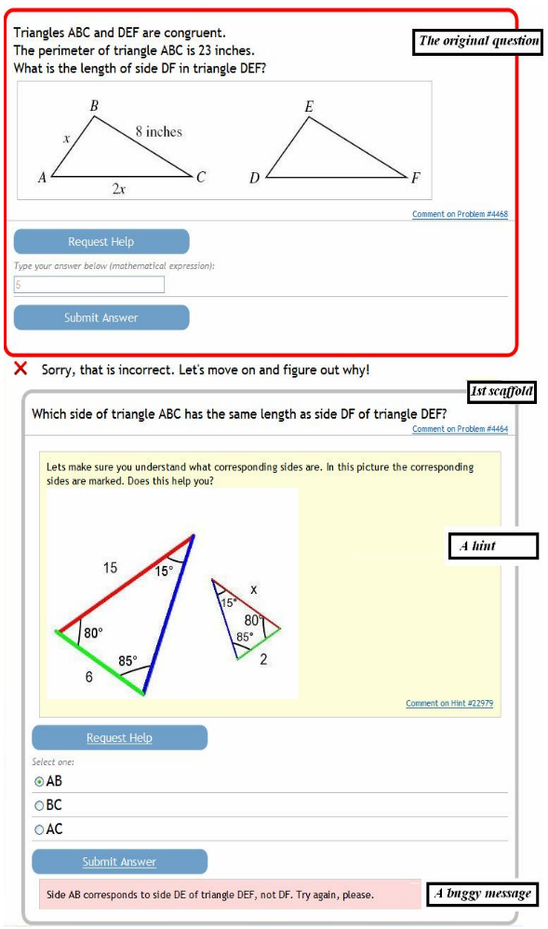

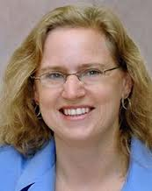
Gives student mathematics questions
Offers multi-step hints to struggling student
If student makes error, student is given scaffolding that breaks the original questions down into sub-steps

Slide 8
E-TRIALS
https://www.etrialstestbed.org/
https://www.etrialstestbed.org/resources/featured-studies

Slide 9
ASSISTments Data Sharing
https://sites.google.com/site/assistmentsdata/

Slide 10
ASSISTments Data Competitions
https://sites.google.com/view/assistmentsdatamining
https://sites.google.com/view/edm-longitudinal-workshop/home

Slide 11
A previous large platform

Slide 12
LearnLab
https://learnlab.org/
https://learnlab.org/wiki/index.php?title=Main_Page

Slide 13
Still offers

Slide 14
PSLC DataShop
https://pslcdatashop.web.cmu.edu/
https://pslcdatashop.web.cmu.edu/help
Hundreds of published papers using DataShop data

Slide 15
PSLC DS KDD Cup
https://pslcdatashop.web.cmu.edu/KDDCup/

Slide 16
Other platforms support smaller amounts of research
In-house projects
Small numbers of partner academics
Single competitions

Slide 17
Examples
Duolingo
Algebra Nation
Mindspark
Eedi
Riid
BlueJ “Blackbox”
Realizeit

Slide 18
RFP-based model: Algebra Nation
https://lastinger.center.ufl.edu/data-mining-and-learning-analytics/

Slide 19
MORF
https://educational-technology-collective.github.io/morf/

Slide 20
edX RDX
https://edx.readthedocs.io/projects/devdata/en/latest/rdx/

Slide 21
A/B trial support
What are the benefits (for researchers, platforms, students)?
What are the drawbacks (for researchers, platforms, students)?

Slide 22
Fully online A/B versus field research support
i.e. E-TRIALS versus Classic LearnLab
What are the benefits and drawbacks?

Slide 23
ManyClasses Model (Fyfe et al., 2019)
Instructors in disparate contexts set up a study with the same design but locally-specific materials
Run the study and analyze across contexts
What are the benefits and drawbacks?

Slide 24
Data Sharing
What are the benefits (for researchers, platforms, students)?
What are the drawbacks (for researchers, platforms, students)?

Slide 25
Data Sharing: Open Model versus
RFP-Based Model
What are the benefits and drawbacks?

Slide 26
Data Competitions
What are the benefits (for researchers, platforms, students)?
What are the drawbacks (for researchers, platforms, students)?

Slide 27
Longitudinal Data

Slide 28
Engagement and Standardized Exam Score
(Pardos et al., 2013, 2014)
Detectors applied to whole year of data for 1,393 students who used ASSISTments
Gaming the system (r = -0.36)
Engaged concentration (r = +0.36)
Boredom (r = -0.2)
Notes:
We then evaluate the relationship of these measures to student outcomes, such as state exam scores.
Applying applyint the assistments detectors to a whole year of data for aroun 1400 students,
We found out end-of year exam scores to be negatively correlated to boredom and gaming the system, and positively correlated to engaged concentration

Slide 29
Standardized Exam Score data
Hard to obtain
  Involves agreements with school districts, etc.
All or nothing
  If you get any of it, you get it all

Slide 30
College Attendance
(San Pedro, Baker, Bowers, & Heffernan, 2013)
Obtained college attendance data from National Student Clearinghouse

Slide 31
College Attendance
(San Pedro, Baker, Bowers, & Heffernan, 2013)
Apply detectors to data from 2004-2007
The detectors can predict
Whether a student will go to college or not, ~6 years later
  69% of the time for new students

Slide 32
Predict College Attendance
(San Pedro et al., 2013)
Student knowledge, engaged concentration, carelessness associated with going to college
Gaming the system, boredom, confusion associated with not going to college
Overall model A’ = 0.69

Slide 33
Note
Carelessness positively associated with college until you control for student knowledge
Then associated with not going to college
Carelessness is the disengaged behavior of generally successful students (cf. Clements, 1982)

Slide 34
Predict Selective College Attendance
National Student Clearinghouse

Slide 35
Predict Selective College Attendance
Student knowledge, engaged concentration, carelessness associated with going to selective college
Gaming the system, boredom associated with not going to selective college
Overall model A’ = 0.76

Slide 36
Predict STEM Major in college
(San Pedro et al., 2014)
Follow-up survey
Attempted to contact students in several ways
Very time-intensive and difficult

Slide 37
Predict STEM Major in college
(San Pedro et al., 2014)
Student knowledge, carelessness associated with STEM major
Gaming the system associated with non-STEM major (D= 0.573)
Overall model A’ = 0.68

Slide 38
Predict STEM job post-college
(Almeda & Baker, 2020)
Found student profiles on LinkedIn using Premium Account

Slide 39
Predict STEM job post-college
(Almeda & Baker, 2020)
Student knowledge, carelessness associated with STEM job
Gaming the system associated with non-STEM job (D= 0. 330)

Slide 40
Another Example
Student engagement within a MOOC on data science can predict whether the student will eventually submit a scientific paper in the field (Wang et al., 2017)
Forum lurkers are more likely to submit a scientific paper than forum posters!
  Even though forum posters are more likely to complete the course

Slide 41
Student scientific paper submission
Obtained this information through personal connections to conference organizers

Slide 42
Longitudinal Analyses in
Learning Analytics
Rare
Several papers go as far as end-of-year tests (some but not all standardized)
Very few go further than that

Slide 43
Longitudinal Analysis
Is it important?
Is it worth it?

Slide 44
Longitudinal Analysis
What additional variables should we be collecting?
How could we put measures in place to make them easier to collect?

Slide 45
Questions? Comments?
Further Discussion?

Slide 46
Thank you
For a great semester of learning together

