Slide 1
Big Data, Education, and Society
February 12, 2020
Notes:
Intro -- Class brainstorm, 20 min. Pair 2:00 - 2:20
Reading 1 - Assistments -10 2:30
Reading 2 - Lumilo -10 2:40
Reading 3 - Dashboards - 10 2:50
Reading Compare/Contrast - 10 min. -
small group > whole class 3:00
Design Activity - 40 min.
Card Brainstorm 1 - 3 min - solo 3:05
Card Brainstorm 2
(with EDM Methods) - 3 min -solo 3:10
Card Sort - 4 min - solo 3:15
Partner Card Sort - 10 min -pair 3:25
Share Top Card - 15 min -
whole class 3:40

Slide 2
Reports for School Personnel
Aaron Hawn, Ph.D.
Notes:
2pm- 350

Slide 3
Introductions
Notes:
Great to meet all of you!
I recently graduated from TC.
Worked as a teacher and school administrator for over 20 years now.
So, this topic is near and dear to my heart.
I’ve managed information systems for schools and been a teacher trying to make them work for me and my research has focused on how educators use some of these systems.
So, I’m really excited to get into this topic today.
Unfortunately, I’m not going to be able to get everyone’s name today, but I’d like to get a little sense of where everyone’s coming from.
I’m going to just ask a few questions and get a show of hands, so I can understand the experience in the classroom.
Who’s been a classroom teacher? Raise your hand.
Who’s been some variety of school leaders or administrator?
Who’s worked in some other capacity in schools? Specialist? Technology?

Slide 4
Agenda
Our perspectives on Reports for School Personnel
What do the readings have to say (And why do they say it)
Design Activity (Yes. There are notecards)

Slide 5
So. . .
Reports for Educators can mean a lot of things
Notes:
Last week it looks like you covered some pretty high level work on applying predictive analytics at scale.
Today will be more in the weeds around how educators actually use reports.
So…
I’m very curious about the kind of reports you may have used.
I’m going to run through some categories and then get some observations from you about the systems you’ve used.

Slide 6
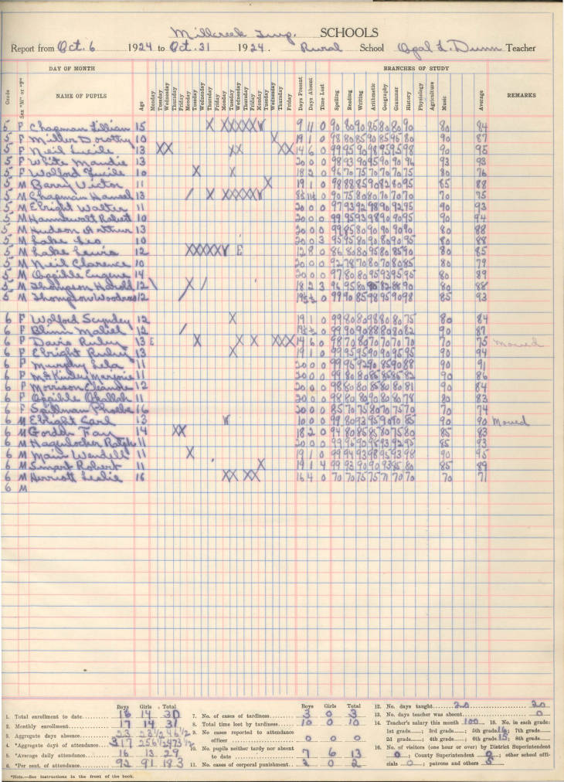
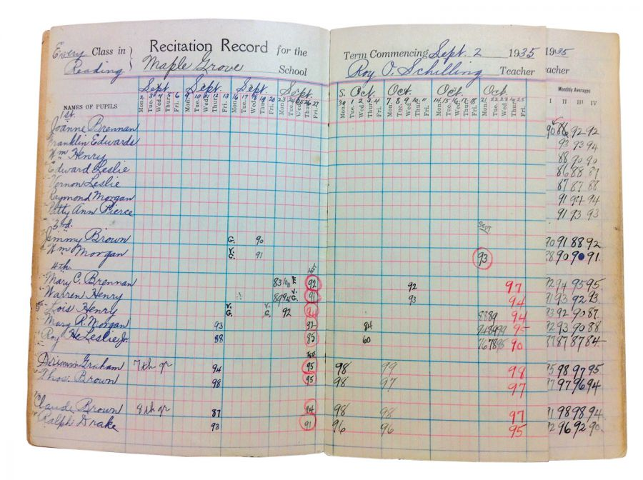
Notes:
Once upon a time school reports
might have meant something like these

Slide 7
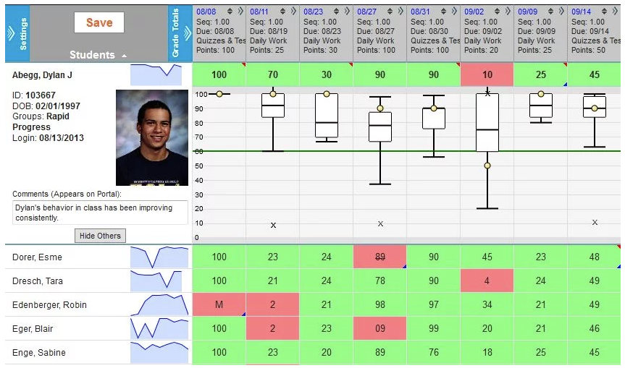
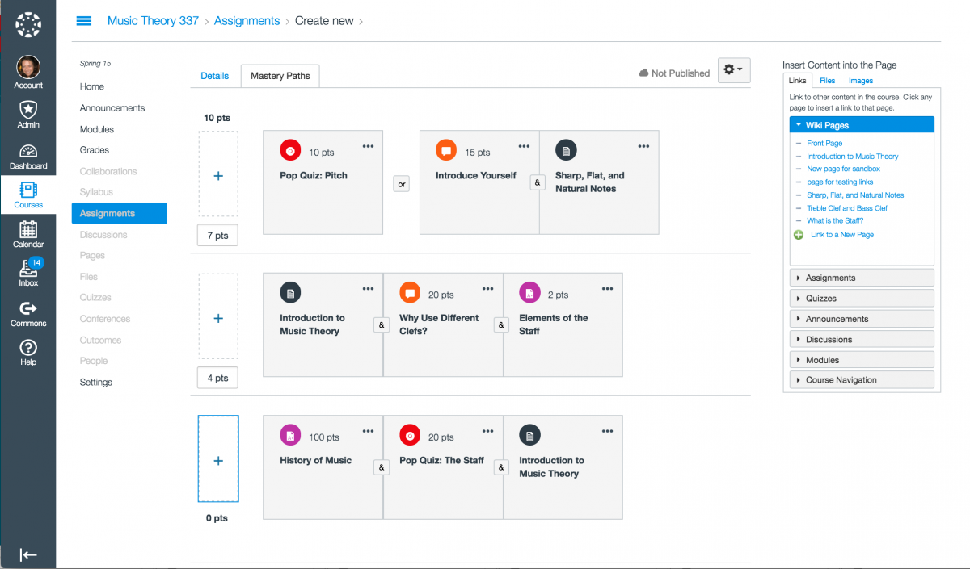
Student Information Systems (SIS) &
Learning Management Systems (LMS)
Notes:
Now they can mean...

Slide 8
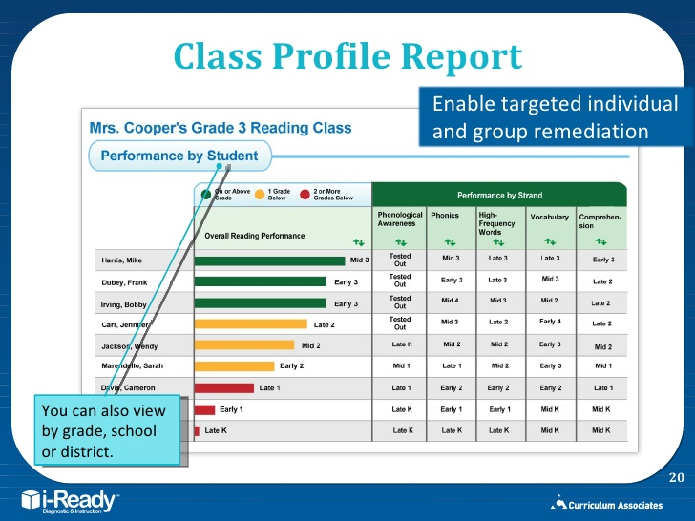
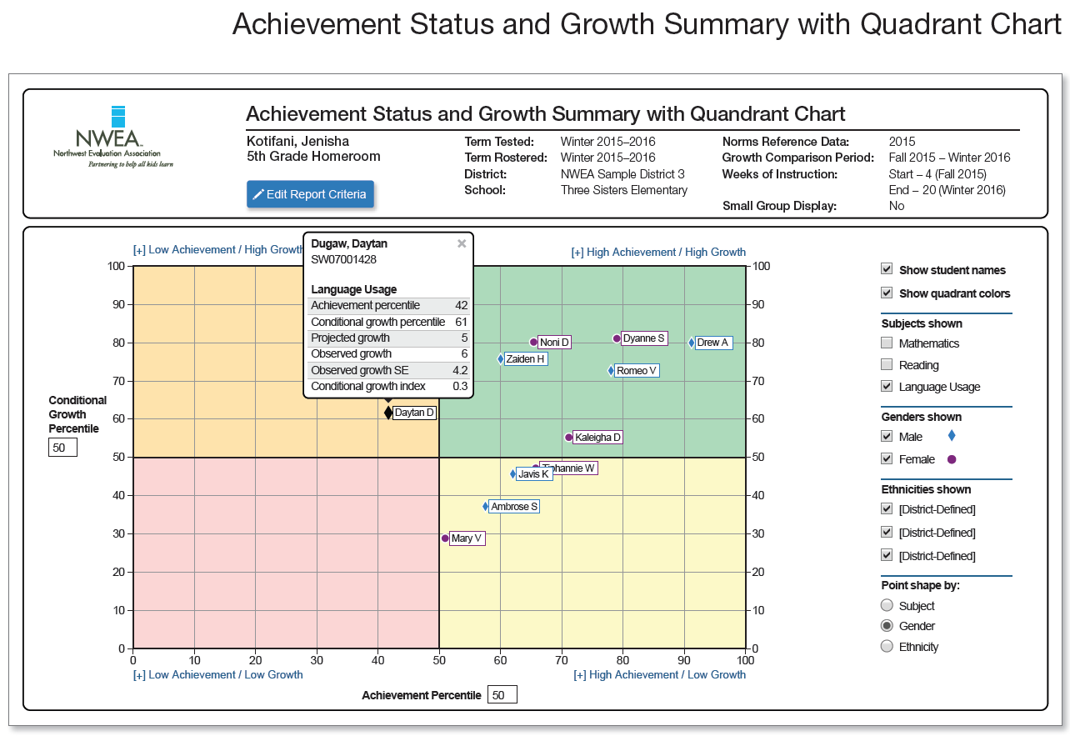
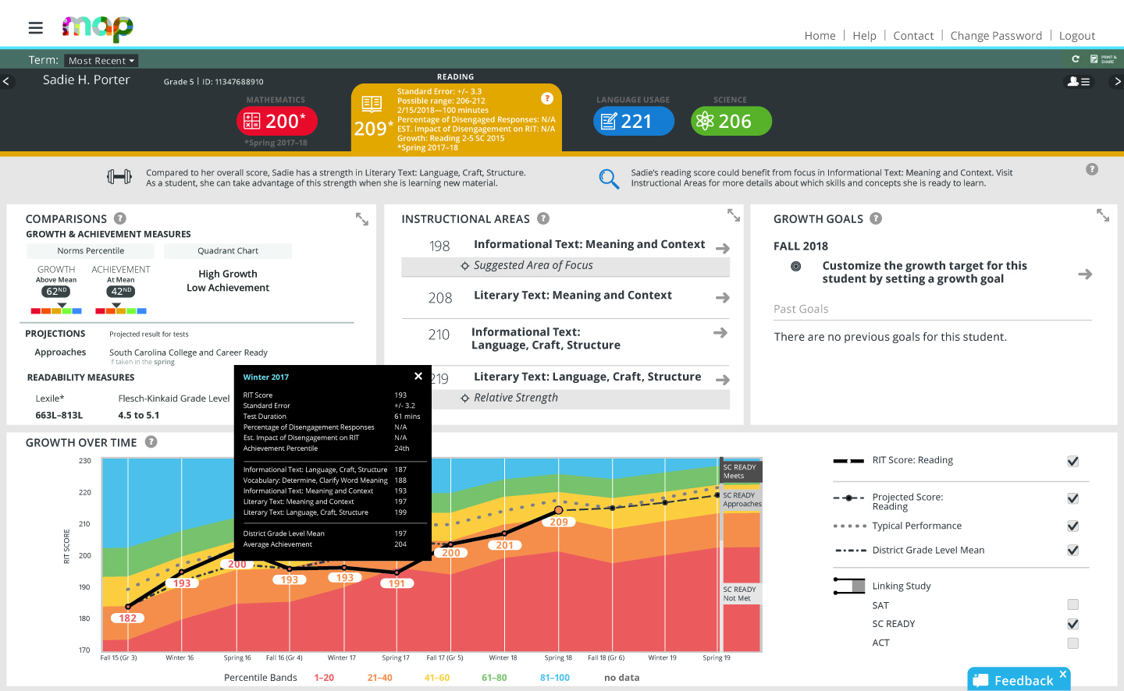
Interim Assessment Systems
Notes:
There is reporting for assessment systems --

Slide 9
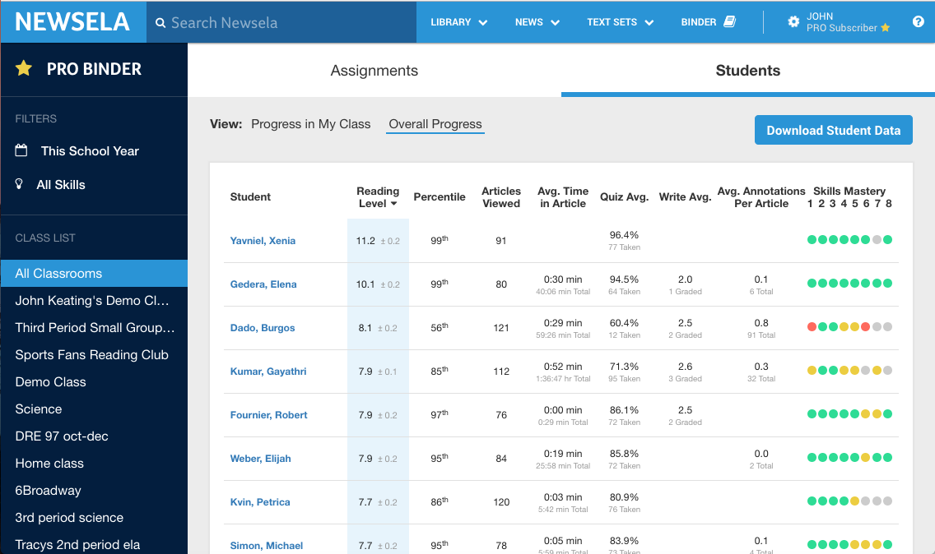
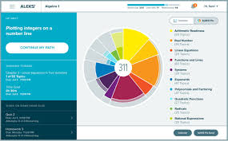
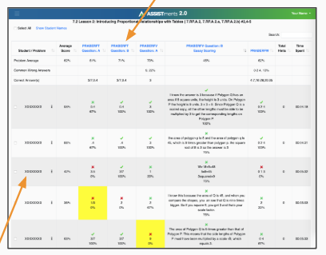
Instructional Technology Reporting
Notes:
Reports for instructors generated from instructional software.

Slide 10
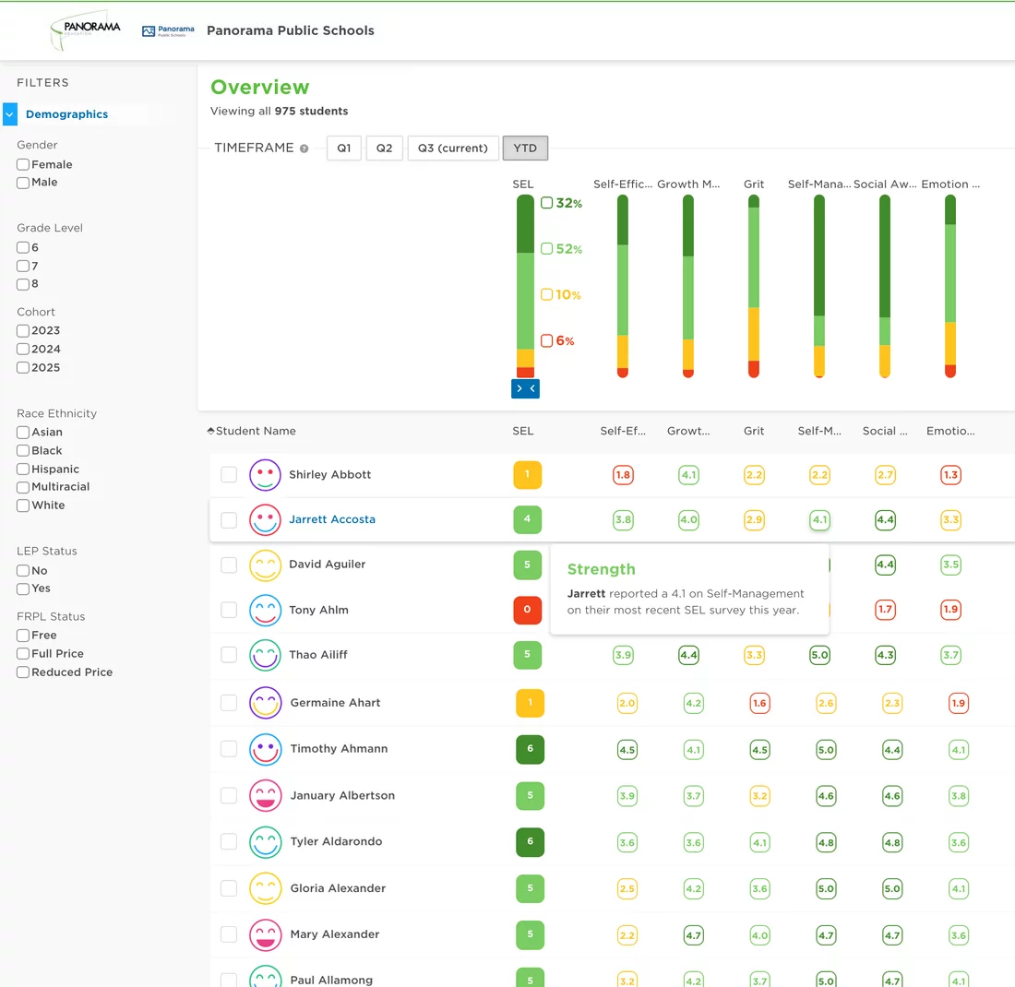
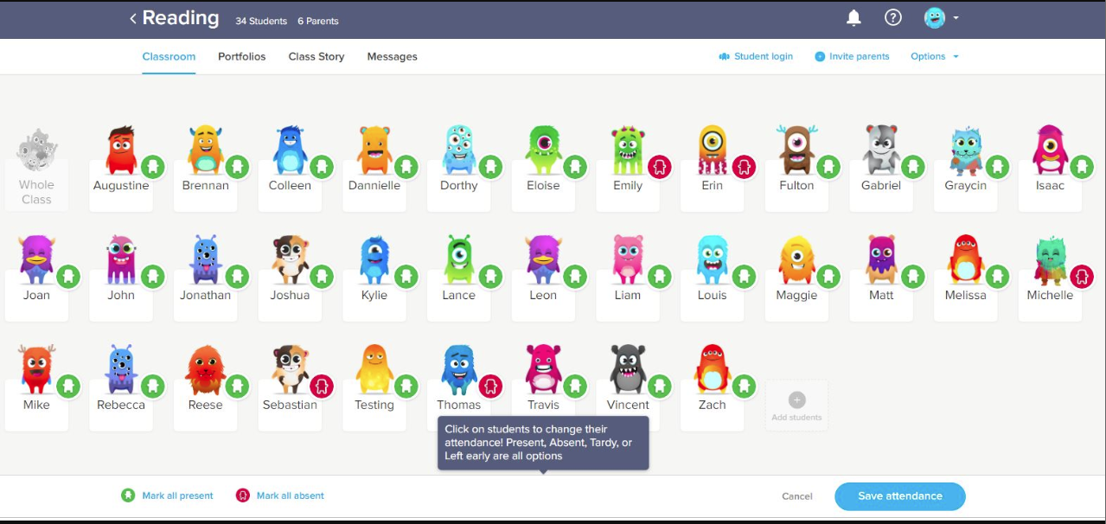
Behavior and Social-Emotional Learning Systems

Slide 11
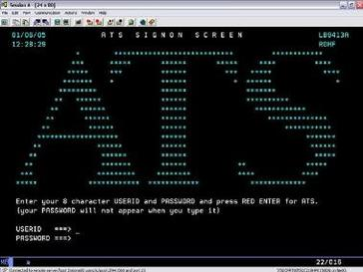
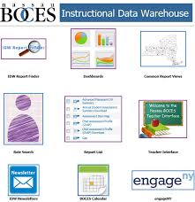
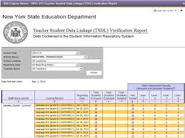
Student Data Warehouses

Slide 12
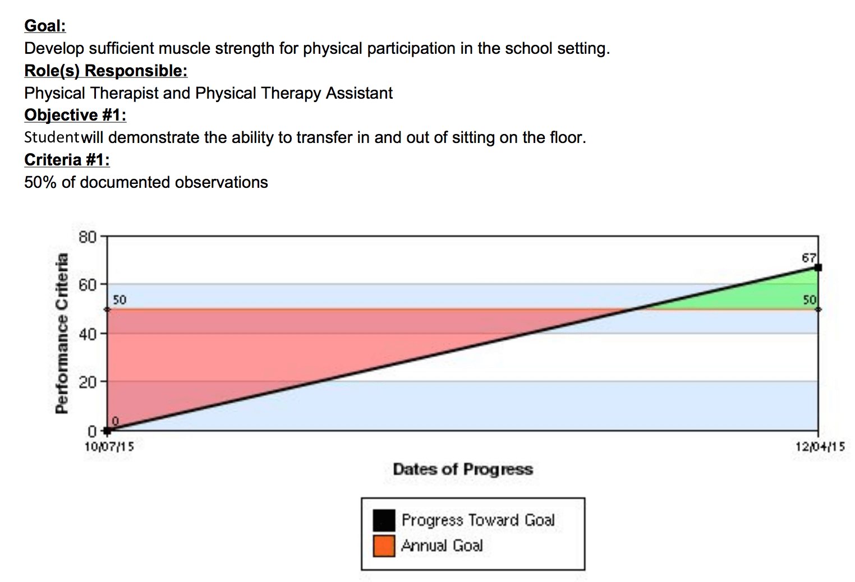
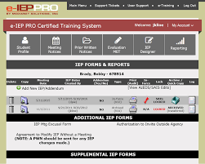
Special Education Reporting

Slide 13
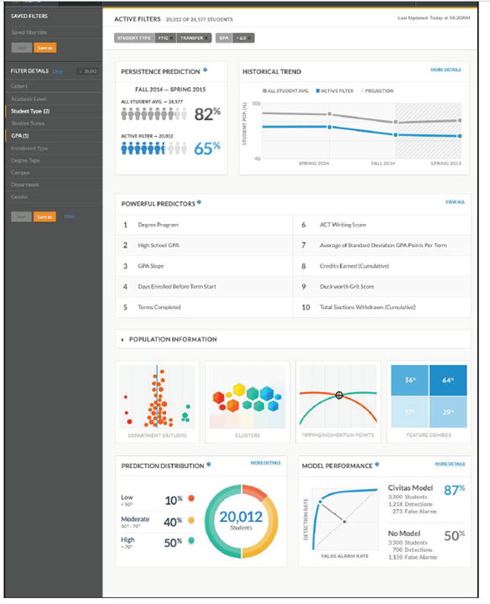
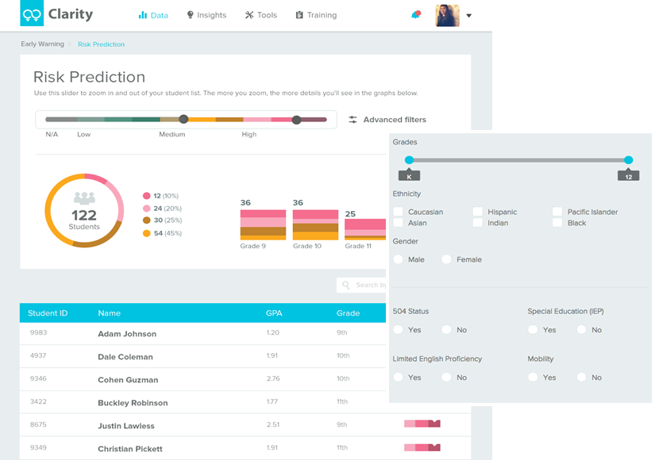
Predictive Analytics on Students
Notes:
And as you all talked about last week, reports for educators that incorporate predictive analytics of student outcomes.
------------

Slide 14
School Accountability Reports
Teacher Observations / Evaluations
Class Observations / Learning Walks
Notes:
Some other categories of reports more directed at teachers and administrators

Slide 15
SIS / LMS
Assessment Systems
Instructional Technology
Behavior and SEL
Student Data Warehouses
Predictive
Analytics
School Accountability
Teacher Observations
Class Observations
Notes:
So those are a few categories?
Any other categories we can think of?
Or systems that you’re not quite sure where they fit?
Quick show of hands --
Who has used reports in some of these kind of systems?

Slide 16
Think for a minute on your own about. . .
Reports in schools that you found useful
Reports that weren’t so useful
What made some reports useful and others not so much?
*if you can’t think of an example as an educator, fine to use an example from another context, e.g. employee, student
Notes:
1 minute brainstorm on your own.
Now, find a partner and compare notes for few minutes
---------------------
What were some examples of useful reporting?
What about not so useful?
Anyone have reports in common?That you both had used?
Any interesting disagreements between partners? One of you thought a system rocked, another didn’t?

Slide 17
Notes

Slide 18


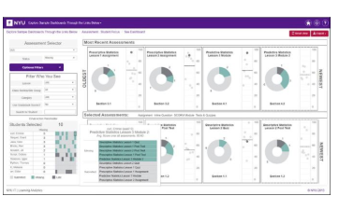
The Readings
Feng & Heffernan, 2006
Holstein, McLaren, & Aleven, 2019
Wise & Jung, 2019
Notes:
So we know a thing or two about these reports from having used them,
but also, in the readings, we looked at a few approaches to reports for educators in the era of big data.
Three approaches to getting information to teachers.
>Assistments is redefining how homework works in the classroom
>And Holstein is bringing AR into the classrooms combined with intelligent tutors
>Wise and Jung (Young?) are doing user-centered work in the trenches with college teachers to see how they use instructional dashboards

Slide 19
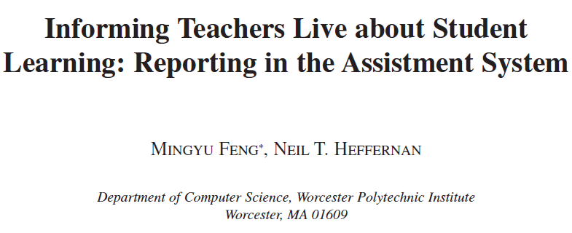


Notes:
So, high level, can someone give us the big picture for this article?

Slide 20
What issues was Assistments trying to address in 2006?
How did it try and solve these problems?
Notes:
Let’s talk for a bit about what was prompting this project?

Slide 21
“The question of tagging items to learning standards is very important because
teachers, principals and superintendents are all being told to be “data-driven”
and use the MCAS reports to inform their instruction and help their students.
As a teacher has said “It does affect reports... because then the state sends
reports that say that your kids got this problem wrong so they’re bad in
geometry-and you have no idea, well you don’t know what it really is- whether it’s algebra, measurement/perimeter, or geometry.”
Notes:
One issue that’s discussed. . .

Slide 22
State Testing / Interim Testing Reporting
Grid graphic of state test reporting
Notes:
Let’s get a clear picture about what some of this work is working against

Slide 23
Some issues Assistments wanted to address. . .
The Frequency problem
  Once a year / Once every nine weeks
The Instructional time problem
  Assisting students (instruction) Vs. Assessing students (assessment)
The Feedback and Knowledge Component Problem
  The grain-size of state standards
The content creation problem
  Teacher-made scaffolds, hints, common wrong answers
Notes:
These are some of the problems that stuck out for me:
The first three are big themes in discussions I’ve had with teachers and administrators.
You all may have been involved in similar discussions
But once you’ve scheduled for interim testing, computer adaptive testing, state test practice testing, unit testing, teachers are justifiably concerned about the impact on instructional time
Article Notes:
Grain-size feedback, p. 3 example
A transfer model [4] is a cognitive model that contains a group of
knowledge components and maps existing questions (original items and
scaffolding questions) to knowledge components. It also indicates the
number of times a particular knowledge component has been applied for a
given question. It is called a “transfer model” since the intent is to predict learning and knowledge transfer. Transfer models are useful in selecting the
next problem. The next section shows that transfer models are important for
quality reporting.
39 > WPI1300 (174) -- unordered list

Slide 24
Some issues Assistments wanted to address. . .
The Frequency problem
  Once a year / Once every nine weeks
The Instructional time problem
  Assisting students (instruction) Vs. Assessing students (assessment)
The Feedback and Knowledge Component Problem
  The grain-size of state standards
The content creation problem
  Teacher-made scaffolds, hints, common wrong answers
Are these problems still around?
Notes:
Not that it was on Assistments to solve these issues, but from your vantage points are schools still struggling with
These issues in 2020?
Or have there been changes

Slide 25
Assistments Reports
Grade Book Report
Student Report
Class Summary Report
Class Progress Report
Item Difficulty Report
Scaffolding Report
Red & Green Distribution Matrix
Anova & T-test report (First to second opportunity)
Notes:
So, if educators weren’t getting what they needed from state testing reports,
Assistments offered them a different set of reports.
Apologies about the visibility of the figures.
From the descriptions, did any of these strike you as surprising?
Did any seem more useful for teachers? Less useful?
How can you picture them being used?
What kind of decisions would they inform?

Slide 26
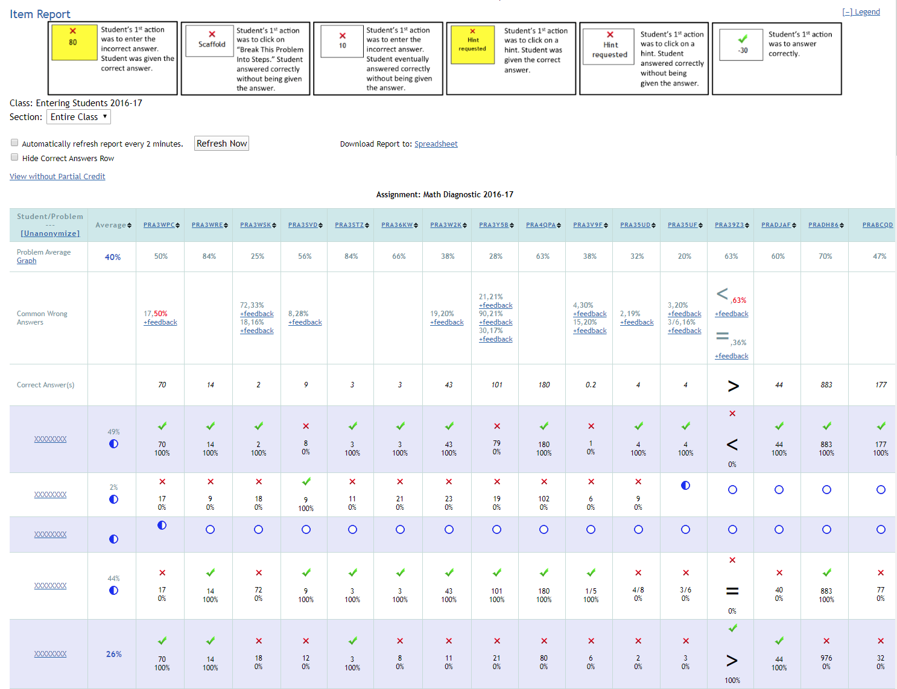
Notes:
This is a more current report in Assistments though not the most current, which interfaces with Google Classroom.
This is a screenshot from when I used Assistments a few years ago, and I have a little sidebar on my experience with the program.
[Story about red “X”s, how reporting can break down at multiple levels, and the fragility of implementation]

Slide 27
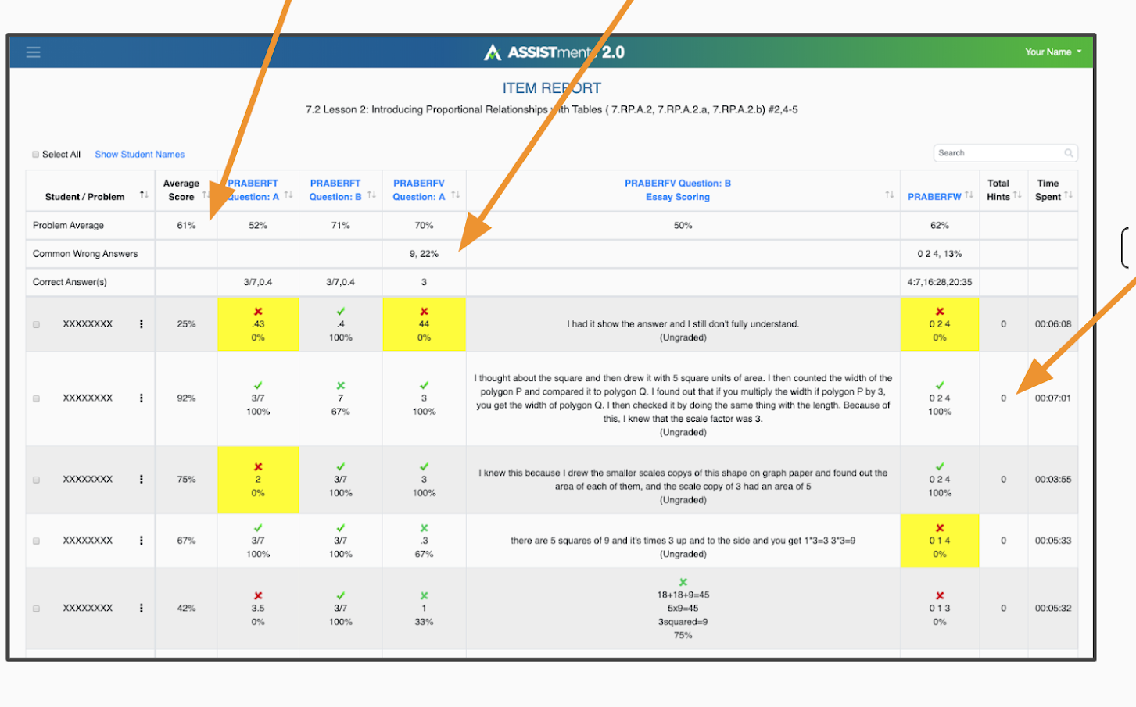

Slide 28

Based on the video, how would you say that Assistments has shifted strategy since 2006?
Notes:
And here is a more recent video highlighted on the Assistments homepage
*More of a focus on Organizational Routines

Slide 29
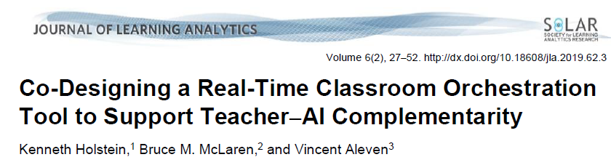



Notes:
In a kind of a related vein, let’s shift to the Holstein article

Slide 30
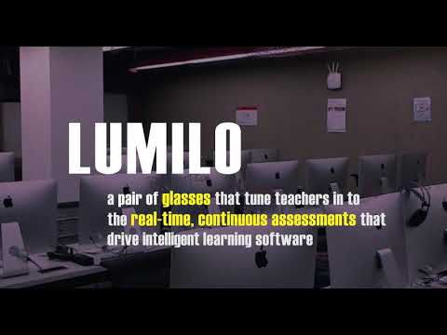
Notes:
Let’s go straight to the video this time

Slide 31
What problem are Holstein et. al. addressing?
What is their critique of previous Learning Analytics Tools?
What is their solution?
Notes:
Actively involving educational practitioners and other stakeholders throughout the design of educational technologies can help ensure their alignment with real-world needs, values, and constraints, and their usefulness and usability in actual educational contexts (Bonsignore, DiSalvo, DiSalvo, & Yip, 2017; Prieto-Alvarez, Martinez-Maldonado, & Anderson, 2018; Schuler & Namioka, 1993).
Yet given the complexity of learning analytics (LA) systems, it can be challenging for stakeholders to meaningfully contribute to their design (cf. Martinez-Maldonado et al., 2016; Mavrikis, Gutierrez-Santos, Geraniou, Noss, & Poulovassilis, 2013; Prieto-Alvarez et al., 2018).
>For example, teachers and students may have limited data literacy or limited understanding of the potentials of state-of-the-art data gathering, processing, or visualization techniques (Martinez-Maldonado et al., 2016; Mavrikis et al., 2013).
Effectively co-designing LA systems with practitioners thus requires generative design techniques and strategies for eliciting end-user desires, needs, values, and constraints, untethered by specific pre-existing technologies or users’ understandings of what is currently possible.
In addition, meaningfully involving non-technical stakeholders throughout the whole design process requires prototyping methods that can aid them in understanding the consequences of particular design choices in complex LA systems (e.g., how particular analytic measures, coupled with specific parameter settings and visualizations, might behave when used for different student populations), so that they can provide informed design feedback.
Also mentioned,
>Teacher feelings of being un- or under-utilized?
> evidence that IT help high achieving students more?

Slide 32
The Solution is the Process
Initial Needs Analysis &
Concept Generation
Card Sorting, Directed Storytelling, Semi-structured Interviews
Iterative low to mid- fidelity Prototyping
Role-playing, Bodystorming, participatory sketching, comicboarding
Initial Concept Validation
Speed Dating
Iterative classroom piloting &
experimental evaluation
Field Observations, pre-post assessments, semi-structured interviews, behavioral mapping
Iterative higher-fidelity Prototyping
Replay-based simulations (REs)
Notes:
So, this seems like a lot of work. Is this overkill? Do LA tools really need more participatory design steps?
Why? Why not?
*Cost-benefit
*complex algorithms
*high stakes of new tech
*high motivational cost of failed implementation for schools (researchers can still have valuable findings, but…)

Slide 33
Outcomes
Lumilo was an “Equalizing force in the classroom”
>Teachers allocated significantly more time to struggling students
>Struggling students learned more and closed achievement gap
Notes:
In particular, a teacher’s use of real-time teacher analytics served as an equalizing force in the classroom. That is, whereas the use of AI tutors in K–12 has sometimes been shown in prior studies to increase achievement gaps — favouring students who are better prepared to learn from these systems (Rau, 2015; Reich & Ito, 2017) — teachers’ use of real-time analytics in the classroom had the effect of narrowing the gap in learning outcomes across students of varying prior domain knowledge (Holstein et al., 2018b). This effect appeared to be mediated by a shift in the way teachers distributed their time across students during a class session. Without Lumilo, teachers distributed their time relatively evenly across students of varying prior domain knowledge. However, when using Lumilo, teachers allocated significantly more time towards students detected as struggling or exhibiting maladaptive learning behaviours — resulting in a dramatic shift of teachers’ time and attention towards students with lower prior domain knowledge.
I was interested that. . .
Teachers thought they tried to spend more time
“Although all participating teachers reported attempting to devote most of their time to students whom they expected would struggle with the material, we found no significant relationships between students’ pre- or post-test scores and teachers’ time allocation across students.”

Slide 34
What an awesome LA tool!
Notes:
Any last thoughts on Lumilo?
Do you think we’ll be getting emails from salespeople selling to schools in the next few years?

Slide 35
What an awesome LA tool!
What could possibly go wrong?

Slide 36
What an awesome LA tool!
What could possibly go wrong?
Districts
Schools
Grades
Content Areas
Teacher
Classroom
Students

Slide 37



Notes:
And another approach, this time with postsecondary teachers
What’s the big picture of this study?

Slide 38
How is this approach similar/different from the one in Holstein et. al.?
How are the context and the information different?
What is the product of this work?
What are some of the key findings?
Notes:
*Focuses on teacher reflection, Process of changing information to action
*Not real-time tool
*Based in Teacher Inquiry Cycles - LA can support. TIC offer framework for making analytics actionable
*Prototype already exists
*Basically one method.
*working across organizational silos
*Detectors - drill down to student work - summary metrics -resource use - icons
*Product is a model to describe instructors’ use of analytics (not a product or a process)
generate a model that offers a set of useful categories for conceptualizing instructors’ analytics use and making recommendations for analytics design and implementation to support actionability and impact.
A semi-structured interview format was used to allow for follow-up of interesting topics emerging throughout the interviews. The protocol began with an initial set of questions about teaching background, technology skills, and expectations for the dashboard. The main part of the interview asked instructors to load the dashboard and then walk through their process of use following a series of prompts that asked them about 1) what they looked at in the analytics, 2) how they made sense of the information provided, 3) any instructional decisions made based on this, and 4) whether they checked the impact of their decisions in the analytics. This process was repeated for each of the views individual instructors had available to them, each time using the relevant visualizations to concretize their responses. A final set of questions elicited overall reflections on their analytics use, including any challenges encountered.
“low frequency and overall levels of usage of an analytics dashboard for an online video and annotation system by 14 instructors given access for the course of a year. Dazo, Stepanek, Chauhan, Dorn (2017)”
“Instructor difficulties in integrating the use of tools into their daily teaching activities”

Slide 39
Emphasis on a Balanced Perspective
“analytics exist as part of a socio-technical system where human decision making and consequent actions are as much a part of any successful analytics solution as the technical components” (van Harmelen & Workman, 2012, p. 4).”
“the process of using data to inform decisions in real-world educational settings is a decidedly non-trivial one in which instructors need to translate system-provided information into locally meaningful knowledge and subsequently use it to guide their pedagogical activity (Kitto, Buckingham Shum, & Gibson, 2018; Wise & Vytasek, 2017).”
Notes:
“study how instructors work with and act on learning analytics in authentic teaching contexts (Wise, Knight, & Ochoa, 2018) and develop robust conceptualizations of these processes.”

Slide 40
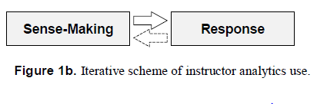
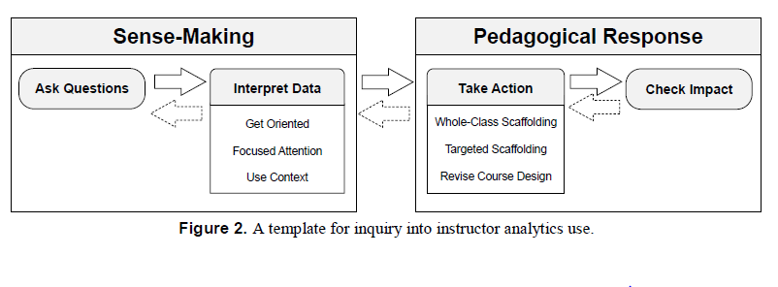
Notes:
The work starts with this basic model for teachers using analytics.
Explicitly based on an inquiry or data use cycle

Slide 41
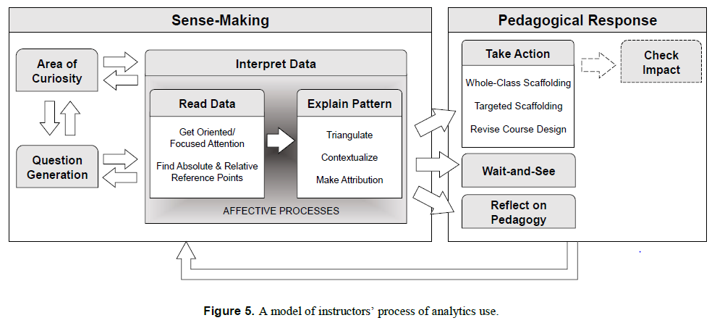
Notes:
And, after analyzing interviews with teachers it ends here:
What were the elaborations or differences that struck you?
RQ1: How Do Instructors Ask Questions of the Analytics?
Come with General curiosity - How much do students use materials?
Develop new questions in viewing data
RQ2: How Do Instructors Interpret the Analytics?
Get oriented
Apply focused attention
Need for reference point (absolute or relative)
Comparisons over time
5.2.2. Explaining Patterns
Triangulating data with other sources of information
Used contextual knowledge of course and students
Inconsistent attribution of cause
5.2.3 affective aspects
Provoked affective response
RQ3: How Do Instructors Respond to the Analytics?
Take action
Whole class scaffolding
Targeted scaffolding
Revising the course elements
Wait and See
Reflect on pedagogy
RQ4: How Do Instructors Check the Impact of Actions Taken in Response to the Analytics?
RQ5: What Are Other Important Aspects of Instructors’ Process of Analytics Use?
Transparency with students
Collaborative interpretation

Slide 42
Three Approaches. All Valuable.
Feng & Heffernan, 2006
Holstein, McLaren, & Aleven, 2019
Wise & Jung, 2019
Notes:
But we live in a world of limited resources.
So, let’s just pretend for a moment that

Slide 43

Who would you fund? Why?
Consider
Impact on Students
Impact on Knowledge
$100,000 for all, some, or none
Notes:
you are a foundation.
You have a 100,000 to fund all, some, or none of these projects
>Make a small group of 3-4 and see what kind of consensus you can reach

Slide 44
Any other common threads across the readings?
Feng & Heffernan, 2006
Holstein, McLaren, & Aleven, 2019
Wise & Jung, 2019

Slide 45
A few ideas
AI vs. IA
Co-design / HCI methods
Integration with Organizational Routines
Student Engagement / Process Data
Maximizing Time (For instruction and During instruction)
Notes:
We can define organizational routines as “a repetitive, recognizable
pattern of interdependent actions, involving multiple actors” (Feldman and
Pentland 2003, 311). Organizational routines structure day-to-day practice in
schools by more or less framing and focusing interactions among school staff
(March and Simon 1958; Nelson and Winter 1982). At the school level, or-
ganizational routines include school improvement planning, teacher hiring,
teacher evaluations, and grade team meetings, among others.

Slide 46
Now, it’s our turn. . .
Notes:
Hand out cards
Pens?

Slide 47

Our turn to be Super Heroes!
Notes:
Holstein et al. used a superpowers prompt with teachers..
So. . .

Slide 48
Our turn to be Super Heroes!
If you could have any REPORTING superpowers you wanted to help you do your job what would they be?

Slide 49
SIS / LMS
Assessment Systems
Instructional Technology
Behavior and SEL
Student Data Warehouses
Predictive
Analytics
School Accountability
Teacher Observations
Class Observations
Notes:
For a this activity, let’s look back to the big picture of reporting in schools. . .

Slide 50
Report User
SIS / LMS
Assessment Systems
Teacher (What Kind?)
Special Education Teacher
Content Specialist
School Leader
Dean
Instructional Coach
Technology Specialist
Network Leadership
Other?
Behavior and SEL
Student Data Warehouses
School Accountability
Teacher Observations
Instructional Technology
Predictive
Analytics
Class Observations
Notes:
Now,

Slide 51
Report User
SIS / LMS
Assessment Systems
Teacher (What Kind?)
Special Education Teacher
Content Specialist
School Leader
Dean
Instructional Coach
Technology Specialist
Network Leadership
Other?
Behavior and SEL
Student Data Warehouses
School Accountability
Teacher Observations
Instructional Technology
Predictive
Analytics
Class Observations
Notes:
Now,
Pick a User

Slide 52
Report User
SIS / LMS
Assessment Systems
Teacher (What Kind?)
Special Education Teacher
Content Specialist
School Leader
Dean
Instructional Coach
Technology Specialist
Network Leadership
Other?
Behavior and SEL
Student Data Warehouses
School Accountability
Teacher Observations
Instructional Technology
Predictive
Analytics
Class Observations
Notes:
Pick a reporting context,

Slide 53
Report User
SIS / LMS
Assessment Systems
Teacher (What Kind?)
Special Education Teacher
Content Specialist
School Leader
Dean
Instructional Coach
Technology Specialist
Network Leadership
Other?
Behavior and SEL
Student Data Warehouses
School Accountability
Teacher Observations
Instructional Technology
Predictive
Analytics
Class Observations
Notes:
heck pick two contexts
And pretend you have Reporting Super Powers!
What would you want to see?
Understand better about students
Just know about students
Visualize easily
What might your understanding look like?
How would you want to see the information?
Take a few minutes to write down some ideas, one idea on each card

Slide 54
SIS / LMS
Assessment Systems
EDM/LA Methods
(Baker & Siemens + Wise)
Prediction
  Classification, Regression, Latent Knowledge
Structure Discovery
  Clustering, Factor Analysis, Latent Class, SEM, Domain Structure
Relationship Mining
  Correlation, Association Rules, Sequential Patterns, Network
Distill Data for Humans/ Visualization
Discovery with Models
Natural Language Processing
Behavior and SEL
Student Data Warehouses
School Accountability
Teacher Observations
Instructional Technology
Predictive
Analytics
Class Observations
Notes:
Now let’s bring back some of the Big Data methods you discussed a couple of weeks ago.
Stick with your same persona
And let’s add a few more idea cards
Now playing with some possibilities of connecting these reporting processes to these core methods?
Could we, for example, picture using. . .

Slide 55
SIS / LMS
Assessment Systems
EDM/LA Methods
(Baker & Siemens + Wise)
Prediction
  Classification, Regression, Latent Knowledge
Structure Discovery
  Clustering, Factor Analysis, Latent Class, SEM, Domain Structure
Relationship Mining
  Correlation, Association Rules, Sequential Patterns, Network
Distill Data for Humans/ Visualization
Discovery with Models
Natural Language Processing
Behavior and SEL
Student Data Warehouses
School Accountability
Teacher Observations
Instructional Technology
Predictive
Analytics
Class Observations
Notes:
. predictive methods for reporting in student data warehouses (as in the BrightBytes presentation last week)
Or. . .

Slide 56
SIS / LMS
Assessment Systems
EDM/LA Methods
(Baker & Siemens + Wise)
Prediction
  Classification, Regression, Latent Knowledge
Structure Discovery
  Clustering, Factor Analysis, Latent Class, SEM, Domain Structure
Relationship Mining
  Correlation, Association Rules, Sequential Patterns, Network
Distill Data for Humans/ Visualization
Discovery with Models
Natural Language Processing
Behavior and SEL
Student Data Warehouses
School Accountability
Teacher Observations
Instructional Technology
Predictive
Analytics
Class Observations
Notes:
develop ways to visualize classroom observation feedback for teachers in a way that motivates changes in practice
Or. . .

Slide 57
SIS / LMS
Assessment Systems
EDM/LA Methods
(Baker & Siemens + Wise)
Prediction
  Classification, Regression, Latent Knowledge
Structure Discovery
  Clustering, Factor Analysis, Latent Class, SEM, Domain Structure
Relationship Mining
  Correlation, Association Rules, Sequential Patterns, Network
Distill Data for Humans/ Visualization
Discovery with Models
Natural Language Processing
Behavior and SEL
Student Data Warehouses
School Accountability
Teacher Observations
Instructional Technology
Predictive
Analytics
Class Observations
Notes:
Connect SEL reporting to gradebook data to look for relationships between student engagement and classroom assignments and attendance
>Take another couple minutes on your own to brainstorm and add a few more cards to your deck

Slide 58
Sort your ideas
Most Important Idea
(On top)
Least Important (on bottom)
Notes:
Now take a minute and sort you cards - most important on top.

Slide 59
Compare with a Partner
Most Important Idea
(On top)
Most Important Idea
(On top)
Least Important (on bottom)
Least Important (on bottom)
Notes:
Now find a partner --
Compare you stacks
Discuss your rankings
Feel free to add new cards to your deck if you have new ideas.
We will share out in about 8 minutes.

Slide 60
Collect Cards with Binder Clips
I will type up these ideas and share back with the class.

Slide 61
Final Questions?

Slide 62
THANK YOU!!

Slide 63
Class Logistics?

Slide 64
Extra Slides

Slide 65
How do we know what’s working?

Slide 66
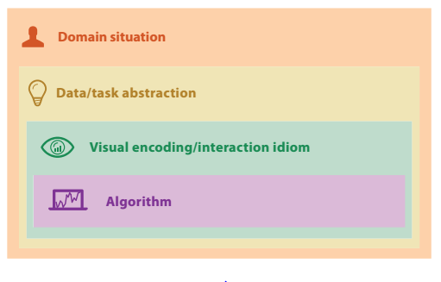
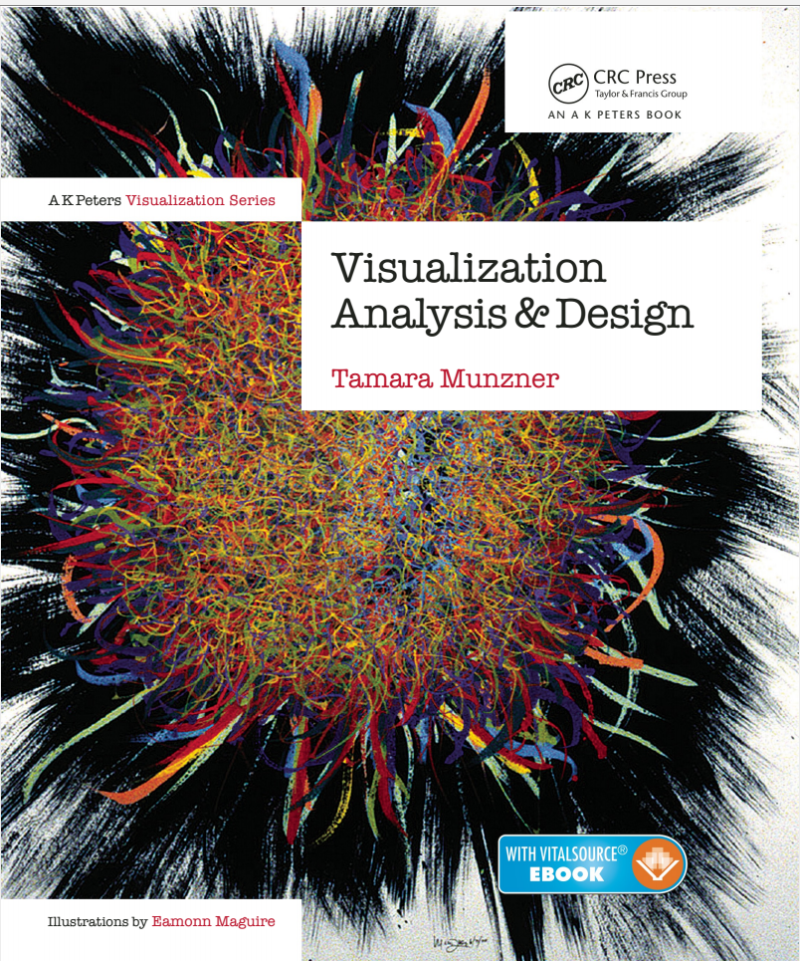
Let’s borrow an info viz framework for validation. . .
Munzner, 2015

Slide 67
Identify Target Users, their needs,
and their data
What kind of data to show?
What kind of task to address?
The way you represent information
Is it correct? Is is efficient?

Slide 68
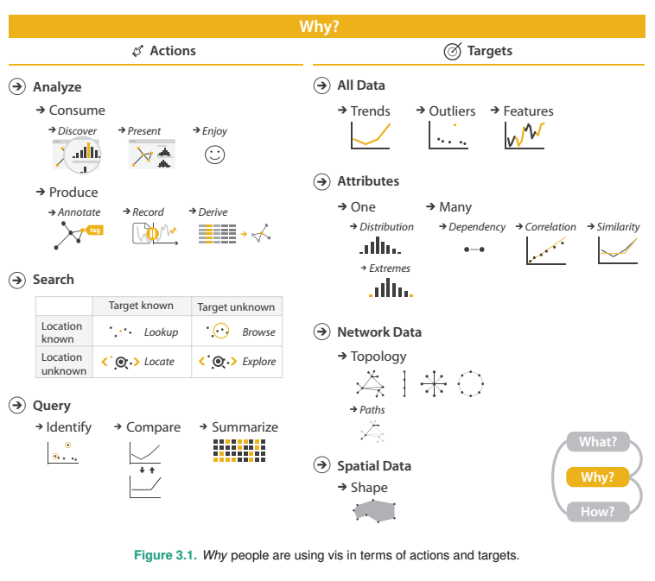

Slide 69
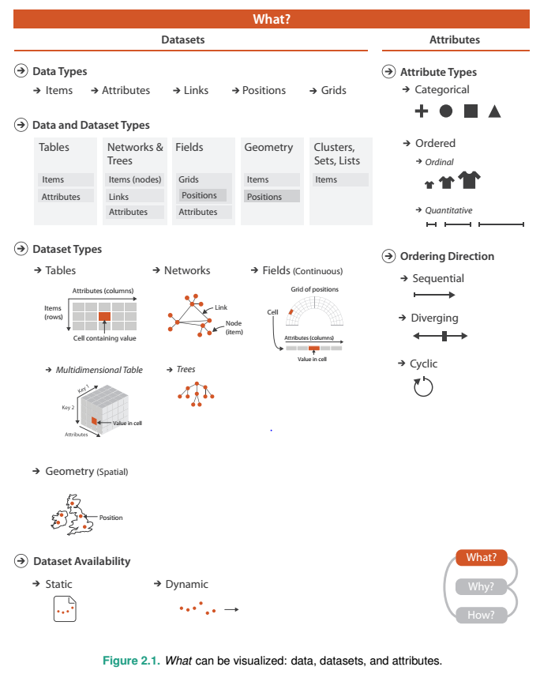

Slide 70
