Slide 1
Big Data, Education, and Society
February 5, 2020

Slide 2
At-Risk Predictions

Slide 3
Examples of Use (at scale)
Civitas, Course Signals, Zogotech – At-risk prediction models used to provide actionable information to instructors and academic advisors
  Who is likely to fail a course or drop out, and why
College

Slide 4
Examples of Use (at scale)
BrightBytes, Clever, Chicago School Consortium – At-risk prediction models used to predict which students will drop out instead of graduate, to inform interventions by teachers and guidance counselors
High School

Slide 5

BrightBytes Clarity slides, courtesy of Rich Allen
Rich Allen
Product Manager
BrightBytes
@richallenbb
rich@brightbytes.net
Notes:
==below, rich to introduce himself===
A little about myself and BB and how we approach these problems. We start with the hardest challenges understand the research that help make good decisions, identify the data needed, and mobilize the data at scale.
10 years working in district
Pretty much every technology role one can carry in that time
Most exciting time
Shift from on-prem disteinct servers to on-prem virtualization to cloud virtualization
Shift from single computer in classrooms and computer labs to every student and teacher with a device
Not just changes in technology, but even more significant changes in teaching and learning
Joined BB about 4 years ago
Started on the research team
Now working on the product team – deliver great products to help my former colleagues solve the challenges that they face each and ever day

Slide 6
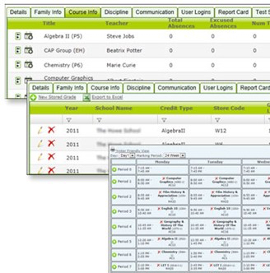
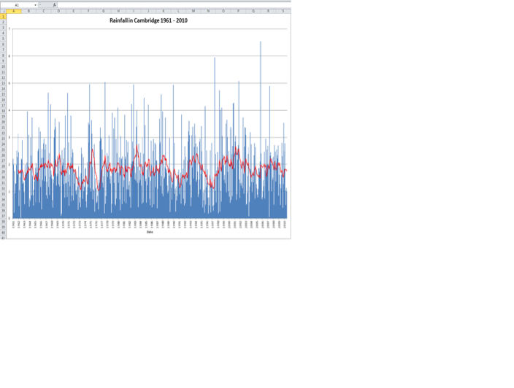
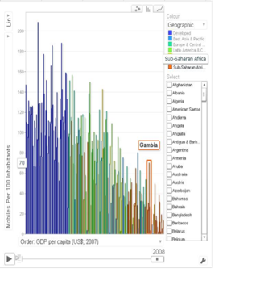
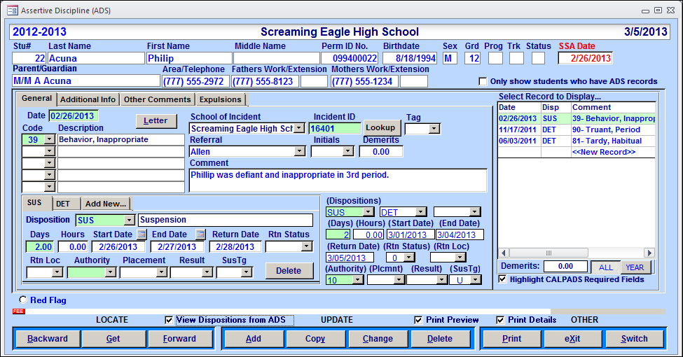
Notes:
”If only we had more data.”
In one of my former roles, I oversaw all of the database systems in my district. You would never have heard me say those words, but I actually heard them often from my colleagues. What I learned was that it was less that we needed more data – it was that we needed more information. We have mountains of data – we just don’t have the ability to easily understand it. If we are not able to understand it, it’s not very effective at all.
And even there, if you start with the data and start to find answers… you can sometimes find yourself answering questions that no one actually asked.
==previous notes===
At BB, we recognize that data is central to every conversation about education and student outcomes.. We also acknowledge that most school districts are sitting on as much data as a Fortune 500 organization, which is a lot to manage and make sense of. Additionally, the tools to manage and understand that data that we usually see can be clunky and cumbersome. For data to be truly mobilized it needs to be easily gathered, analyzed and understood..
We are drowning in DRIP (Data rich, information poor)
That is to say we have so much data, from so many sources, that the meaning gets lost in a sea of spreadsheets, line graphs, and bar charts. If we look at data in silos and narrow views we fail to see the story behind it.
We need to not only collect data, but collect the right data, and use that data to make the right decisions.
There is more than just being able to access data.
We need to know what the data means.
Big data will never change the world if we aren’t using it right.
The data here helps you see where to look, but not why.

Slide 7

9.2M
Students Impacted by Clarity
11B
Individual SIS Data Points
20M
Public Data Points
396M
Survey Responses
2,570
Districts on Clarity
1 in 5
Schools in the U.S
Notes:
Our approach
Rephrase what ryan covered:
DATA - Today we have access to a greater amount of data at greater levels of fidelity
CONTEXT - Data becomes much more powerful when it is contextualized
INFORMATION - Contextualized data leads to information
ACTION - And with information, we can be more confident in the actions we take
- ACTION - Begin with the most difficult decisions educational leaders are faced with
INFORMATION - Identify the information one would need to inform the decision
CONTEXT- Deeply understand the research around that decision
DATA - Locate the existing data and introduce mechanisms to acquire new data where necessary
This allows for us to help educators tackle very diverse challenges while building a growing understanding and research context around a growing known set of data
Allows for us to deliver at scale

Slide 8
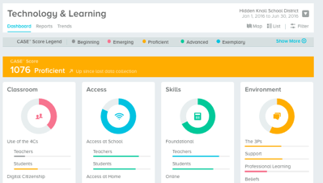
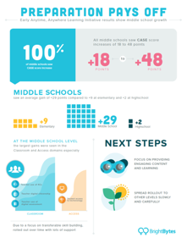

The Clarity Decision Support Platform
Simplified Data
Sharable Reports
Actionable Next Steps
Ongoing Progress
Notes:
This is how and why the BrightBytes Clarity platform was created. To provide education organizations with a solution for gathering and interpreting their data against research-based frameworks and delivering actionable next steps for continuous improvement.
Simplified Data
Sharable Reports
Actionable Next Steps
Ongoing Progress

Slide 9
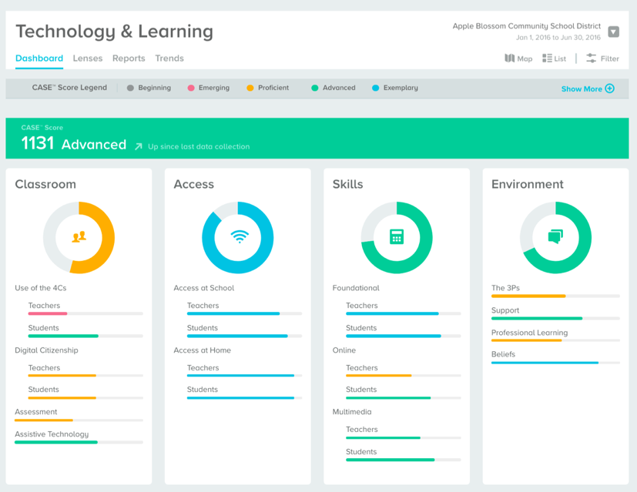
From Data to Information
Notes:
(D.1) Data Finding
See it at a glance

Slide 10
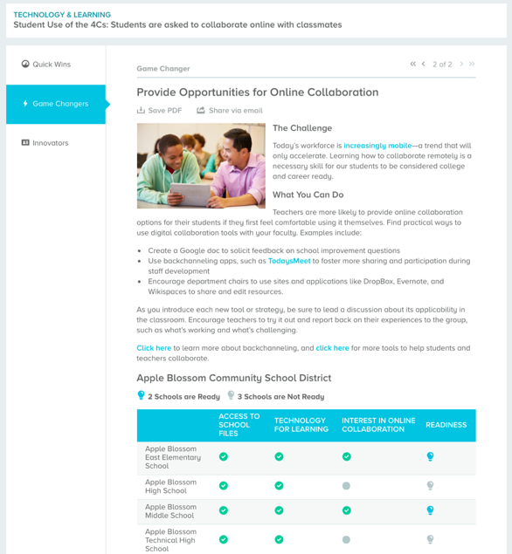
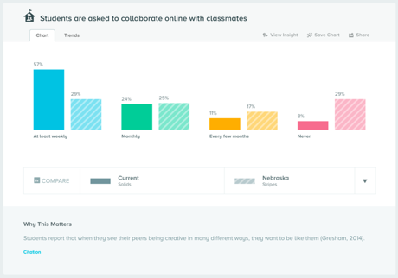
Making Data Informative
Notes:
(D.2) Data Finding
Leveraging a global data set
With T&L, we leverage data at scale beyond your walls… you can easily compare where you are in this migration from 20th century to 21st century teaching and learning to other organizations like you…. Identify areas in which you are a leader and can share with others – as well as areas that may be a gap, and can identify where you can receive help and guidance.
Possible images
Image of a compare
Image of action plan

Slide 11
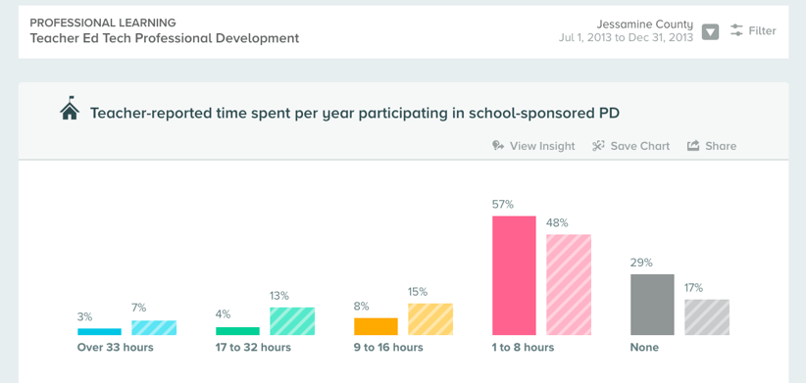
Professional Development
Professional Development
Jessamine County vs. KY state in 2013
Notes:
(D) Outcome
Jessamine county schools in Kentucky is a great example of leveraging data to improve outcomes.
After their initial Technology & Learning data collection, in 2013 the Jessamine County schools noticed that the recent influx of technology had created a need for professional development across the district. They saw that they were a bit behind the state average, and felt that this could be improved with some strategic planning and by replicating the best practices of nearby districts.
Leaders felt it was imperative that teachers truly understood the great capability of technology to support and further their
work. Jessamine’s Director of Technology, Erin Waggoner, and her team began to adjust technology training plans to address any immediate gaps, including improving staff technology skills and training educators to integrate technology into everyday classroom instruction.

Slide 12
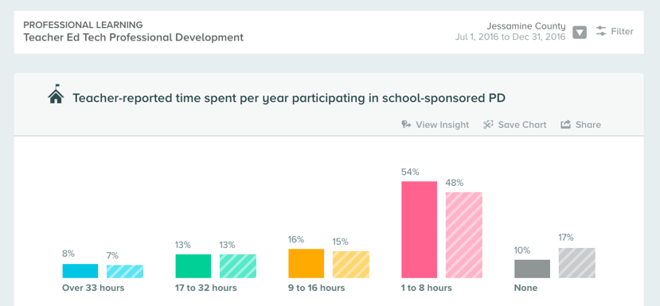
Professional Development
Professional Development
Jessamine County vs. KY state in 2016
Notes:
In order to truly provide a 21st century learning environment, the Jessamine County leadership team decided to include all district staff in their professional development efforts. This gave everyone the opportunity to learn how to use digital tools on a daily basis. The shift in behavior was carefully introduced to ensure staff felt confident with their newly obtained skills. Rather than using professional development sessions to introduce a wide range of new tools all at once, district leaders strategically prioritized key topics for professional learning. To increase the productivity and effectiveness of these training sessions, the content was differentiated to target a wide variety of skills based on the roles of participants in attendance.

Slide 13
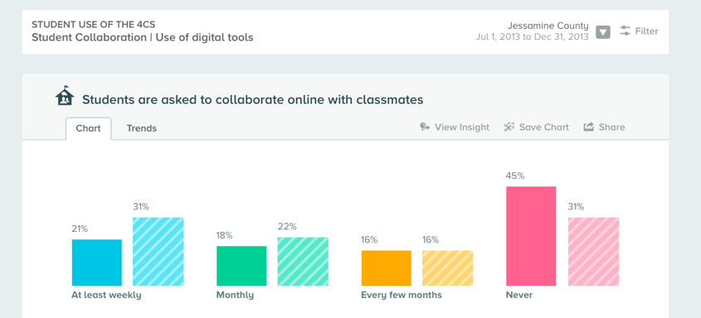
Student Use of 4Cs
Student Use of 4Cs
Jessamine County vs. KY state in 2013
Notes:
When Jessamine’s leadership team examined their data in 2016, they saw an expected increase in the Access domain. They also saw that their hard work to ensure meaningful adoption of this increased access had paid off. Both professional development scores and use of the 4Cs increased. The district is now operating at state averages or surpassing them in both PD and the 4Cs.

Slide 14
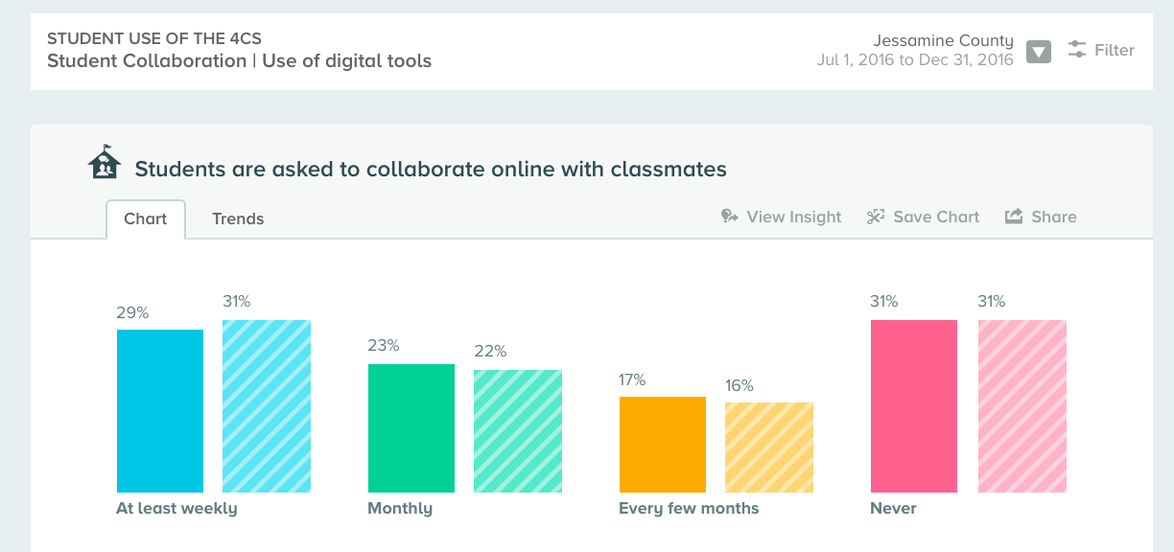
Student Use of 4Cs
Student Use of 4Cs
Jessamine County vs. KY state in 2016
Notes:
To Erin Waggoner, the Director of Technology, the increase in the 4Cs demonstrates professional development success in itself. The convergence of increased access and increased use of the 4Cs indicates that educators are using the additional technology to enhance classroom learning. Waggoner explains, It’s powerful to see the link between training delivered and changes in instructional practices.

Slide 15
Key Question
How do I ensure that all students are on positive trajectories to graduate?
Notes:
(A) Ed Leader Question
How do I ensure that every student has the opportunity to graduate?

Slide 16
Evolution of Early Warning Systems
FIRST GENERATION Threshold Model |  | NEXT GENERATION Predictive Analytics
Intuitive (Balfanz Model) |  | Research-based (Mazin)
Systematic, consistent criteria |  | Customized, flexible criteria
Dichotomous yes/no |  | Draws upon multiple dynamic data points
Later identification- higher grades |  | Early identification- middle & elementary grades
Few risk indicators |  | Many risk indicators based on historical data & grade level
Static one-size-fits-all |  | Real-time district data
Limited accuracy- false positives |  | Research-based (Balfanz)
Notes:
(B.1) Position the challenge in reality
Traditional threshhold system vs predictive systems
Early attempts to create identification systems for dropout prevention have followed a threshold system, which is essentially a checklist approach, like you see here. This checklist system is based off of the work of Balfanz. This approach is proactive rather than reactive, is research-based, and has consistent criteria; however, because it is a threshold based system, this means that students are not at risk until they hit a certain threshold (for instance, 10% in attendance, 2.0 for GPA, and 2+ behavioral incidences). The problem with that is that risk is not a yes/no answer but risk manifests itself on a continuum. Additionally, this is a one size fits all approach for elementary through high school and we know that a risky 1st grader looks very different than a risky 9th grader.
State-of-the-art predictive analytics
Draws upon multiple data points spanning the domains of academics, attendance, behavior, and demographics
Customized to districts & grade levels
Looks at actual dropouts in the district and, using available data across all domains, fits the best predictive models that would have predicted those dropouts. Such predictive models are then applied retroactively to students still in the district.
Defined:
Predictive analytics is the use of data, statistical algorithms and machine-learning techniques to identify the likelihood of future outcomes based on unique historical data
Goal
Go beyond descriptive statistics and reporting on what has happened
Provide a best assessment on what will happen in the future
Result
Streamline decision making
Produce new insights that lead to better actions
Predictive models use known results to develop (or train) a model that can be used to predict values for different or new data

Slide 17

Threshold vs. Predictive Analytics
Indicators (Timeframe is Prior 12 months) | Student Data | Check-list | BB Predictive Analytics
 |  |  | Indicator Level | Overall Domain Risk
Attendance Rate | 91.0% | Not Detected | Moderate | High
First 30 Day Attendance Rate | 80.0% |  | High
Tardy Rate | 3.7% |  | High
Suspensions | 1 | Not Detected | High | High
# of Major Behavioral Incidents | 0 |  | Low
# of Minor Behavioral Incidents | 2 |  | Moderate
Academic Indicator (GPA) | 2.80 | Not Detected | High | High
Courses Passed | 100.0% |  | Low
State Assessment: Math* | Slightly Below |  | Low
State Assessment: Reading* | Far Below |  | High
State Assessment: Science* | Below |  | High
State Assessment: Social Studies* | Below |  | High
Grade Retention (prior 12 months) | No |  | Low
Jack
5th Grader
Notes:
(B.2) Position the challenge in reality
I would like for this slide to have multiple slides –
first one covers up the check-list column and bb predictive analytics – also, remove “Overall Risk is High” text until the 3rd slide
Next slide uncovers the checklist “traditional data systems do not catch that jack is at risk”
Next slide uncovers bb anlytics “predictive analytics looks at a combination of factors and identifies that jack is high risk”
“Let’s make this real…” This is Jack and he is a current student within WV (of course we changed his name to protect his true identity). Jack's profile is precisely the reason that predictive analytics is extremely important to use when identifying students. Let's look at his 3 main areas of attendance, behavior and academics. ---- Go through checklist vs predictions for accuracy
Ask: Would Jack have been on anyone’s radar for showing signs of risk using a threshold system?
This is the exact profile of a student that predictive analytics is able to identify- the students that are falling through the cracks and that are not showing significant signs of risk in any one area, but are moderate risk in multiple areas.
Because the EW system identifies students such as Jack earlier than high school, while showing subtle signs of risk, educators within WV were able to deploy interventions to address his needs before they became high risk in multiple areas.
Remind people to illustrative of a particular student in a particular situation

Slide 18
Threshold vs. Predictive Analytics
Indicators (Timeframe is Prior 12 months) | Student Data | Check-list | BB Predictive Analytics
 |  |  | Indicator Level | Overall Domain Risk
Attendance Rate | 91.0% | Not Detected | Moderate | High
First 30 Day Attendance Rate | 80.0% |  | High
Tardy Rate | 3.7% |  | High
Suspensions | 1 | Not Detected | High | High
# of Major Behavioral Incidents | 0 |  | Low
# of Minor Behavioral Incidents | 2 |  | Moderate
Academic Indicator (GPA) | 2.80 | Not Detected | High | High
Courses Passed | 100.0% |  | Low
State Assessment: Math* | Slightly Below |  | Low
State Assessment: Reading* | Far Below |  | High
State Assessment: Science* | Below |  | High
State Assessment: Social Studies* | Below |  | High
Grade Retention (prior 12 months) | No |  | Low
Jack
5th Grader
NOTE: Jack would not have been identified using the Checklist System because:
Jack is in 5th grade
Jack wouldn’t have met the threshold on any of the checklist “flags.”
Notes:
(B.2) Position the challenge in reality
I would like for this slide to have multiple slides –
first one covers up the check-list column and bb predictive analytics – also, remove “Overall Risk is High” text until the 3rd slide
Next slide uncovers the checklist “traditional data systems do not catch that jack is at risk”
Next slide uncovers bb anlytics “predictive analytics looks at a combination of factors and identifies that jack is high risk”
“Let’s make this real…” This is Jack and he is a current student within WV (of course we changed his name to protect his true identity). Jack's profile is precisely the reason that predictive analytics is extremely important to use when identifying students. Let's look at his 3 main areas of attendance, behavior and academics. ---- Go through checklist vs predictions for accuracy
Ask: Would Jack have been on anyone’s radar for showing signs of risk using a threshold system?
This is the exact profile of a student that predictive analytics is able to identify- the students that are falling through the cracks and that are not showing significant signs of risk in any one area, but are moderate risk in multiple areas.
Because the EW system identifies students such as Jack earlier than high school, while showing subtle signs of risk, educators within WV were able to deploy interventions to address his needs before they became high risk in multiple areas.
Remind people to illustrative of a particular student in a particular situation

Slide 19
Threshold vs. Predictive Analytics
Indicators (Timeframe is Prior 12 months) | Student Data | Check-list | BB Predictive Analytics
 |  |  | Indicator Level | Overall Domain Risk
Attendance Rate | 91.0% | Not Detected | Moderate | High
First 30 Day Attendance Rate | 80.0% |  | High
Tardy Rate | 3.7% |  | High
Suspensions | 1 | Not Detected | High | High
# of Major Behavioral Incidents | 0 |  | Low
# of Minor Behavioral Incidents | 2 |  | Moderate
Academic Indicator (GPA) | 2.80 | Not Detected | High | High
Courses Passed | 100.0% |  | Low
State Assessment: Math* | Slightly Below |  | Low
State Assessment: Reading* | Far Below |  | High
State Assessment: Science* | Below |  | High
State Assessment: Social Studies* | Below |  | High
Grade Retention (prior 12 months) | No |  | Low
Jack
5th Grader
Overall Risk is High
NOTE: Jack would not have been identified using the Checklist System because:
Jack is in 5th grade
Jack wouldn’t have met the threshold on any of the checklist “flags.”
Notes:
(B.2) Position the challenge in reality
I would like for this slide to have multiple slides –
first one covers up the check-list column and bb predictive analytics – also, remove “Overall Risk is High” text until the 3rd slide
Next slide uncovers the checklist “traditional data systems do not catch that jack is at risk”
Next slide uncovers bb anlytics “predictive analytics looks at a combination of factors and identifies that jack is high risk”
“Let’s make this real…” This is Jack and he is a current student within WV (of course we changed his name to protect his true identity). Jack's profile is precisely the reason that predictive analytics is extremely important to use when identifying students. Let's look at his 3 main areas of attendance, behavior and academics. ---- Go through checklist vs predictions for accuracy
Ask: Would Jack have been on anyone’s radar for showing signs of risk using a threshold system?
This is the exact profile of a student that predictive analytics is able to identify- the students that are falling through the cracks and that are not showing significant signs of risk in any one area, but are moderate risk in multiple areas.
Because the EW system identifies students such as Jack earlier than high school, while showing subtle signs of risk, educators within WV were able to deploy interventions to address his needs before they became high risk in multiple areas.
Remind people to illustrative of a particular student in a particular situation

Slide 20
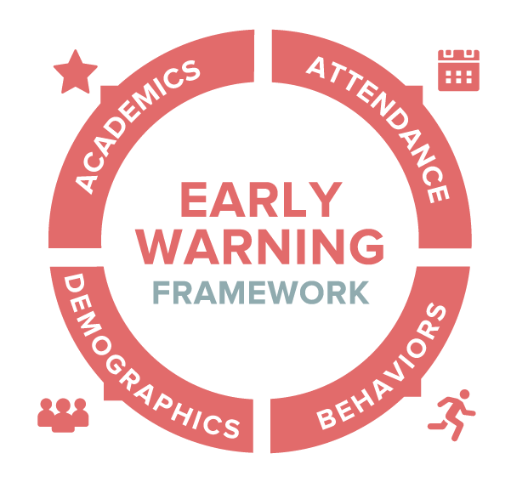

The Power of Predictive Analytics
ACADEMICS
Academic Indicator -
Core Academic Courses
Academic Indicator - All Courses
Assessments - Social Studies
Assessments - District
Assessments - English
Assessments - Math
Assessments - Science
Grade Retention
Remedial Courses
Pass Rate - All Courses
ATTENDANCE
Attendance - First 30 Days
Attendance – Total
Tardies
BEHAVIORS
Behaviors - Major
Behaviors - Minor
Disciplinary Referrals
Expulsions
Suspensions
DEMOGRAPHICS
Age
Ethnicity
Gender
Free & Reduced Lunch
504 Status
Special Education (IEP)
Limited English Proficiency
Mobility
Notes:
(C) Research
This is the research-based framework for the BrightBytes Early Warning module developed in partnership with Mazin education.
districts collect hundreds and even thousands of data points in their Student information systems (SIS). When the BrightBytes Early Warning module connects with this system, it finds and groups this overwhelming amount of data into its 24 success indicators, which are organized into the four domains, Academics, Attendance, Behavior, and Demographics. Each of these factors is weighted dynamically based on the organization’s historic data. The framework then provides a unique analysis to provide a personalized analysis for each student, school, and district.

Slide 21
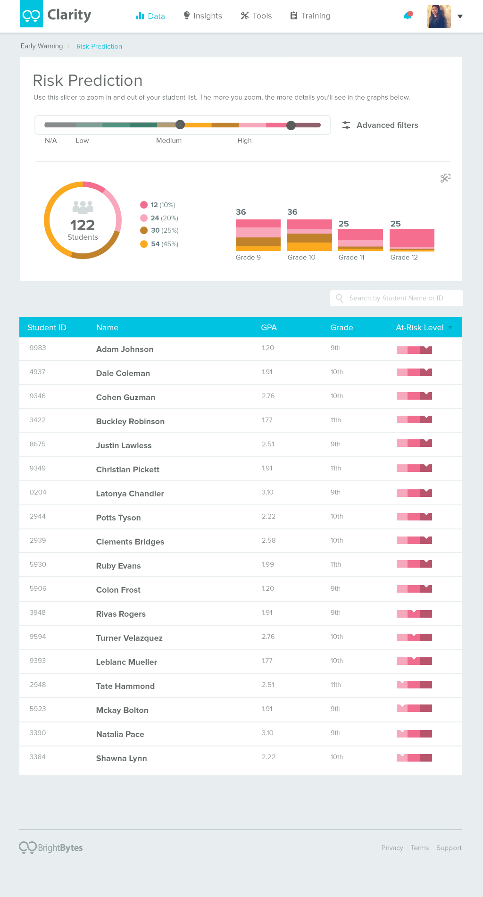
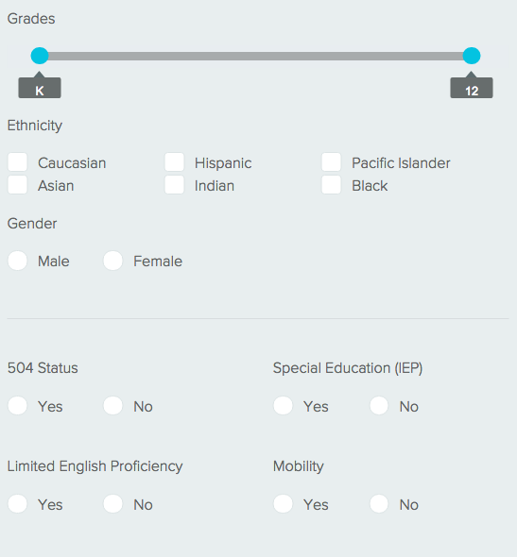
Aggregate Reports & Filter by Triggers
Filter by specific triggers
Notes:
(D) Data finding
Sure – what’s the right screen? Showing a student’s risk changing over time?

Slide 22
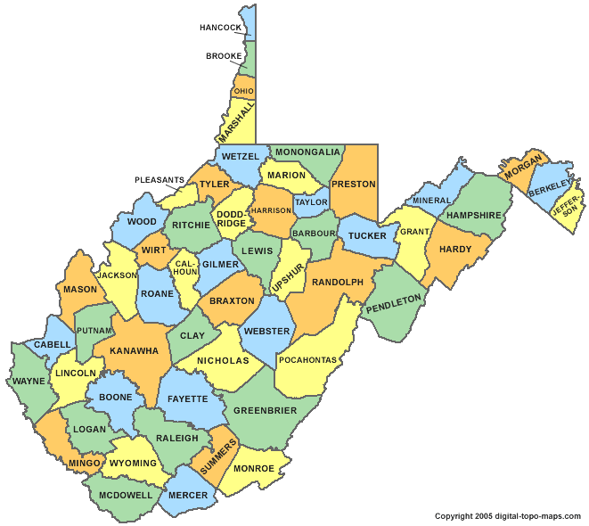

West Virginia is recognized as one of the fastest moving states with a 86.4% graduation rate in 2014-2015.
Notes:
West Virginia improved their graduation rates from 75.5% in 2008-2009 to 86.5% in 2014-2015. West Virginia is now among the top 5 states in terms of improving graduation rates
(E) Outcome
Tailored data analytics
Improved accuracy claim – don’t we have some WV dropout improvement claim for this?
Wv grad rate improvements
Moved to predicative model

Slide 23
Key Question
We invest heavily in technology. Which tools are having the greatest impact?
Notes:
(A) Edleader question
Finally, let’s look at how we can use data to evaluate and improve program impact.
We invest in a lot of instructional technology – which tools are being used, which tools are having the greatest impact?

Slide 24
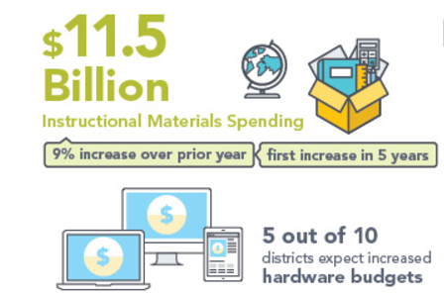
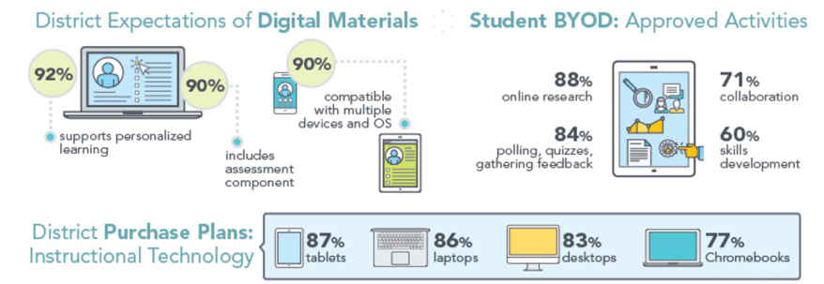
A National Perspective
Source: MDR 2015-2016
Notes:
(B) Position the challenge in reality
Can we add some research on how much the average district spends on each student for instructional software each year?
we share that we often have rigorous processes for adopting new software
But we rarely evaluate the tools with the same rigor year after year
How can we know what’s working and what’s not working if we don’t do that?

Slide 25
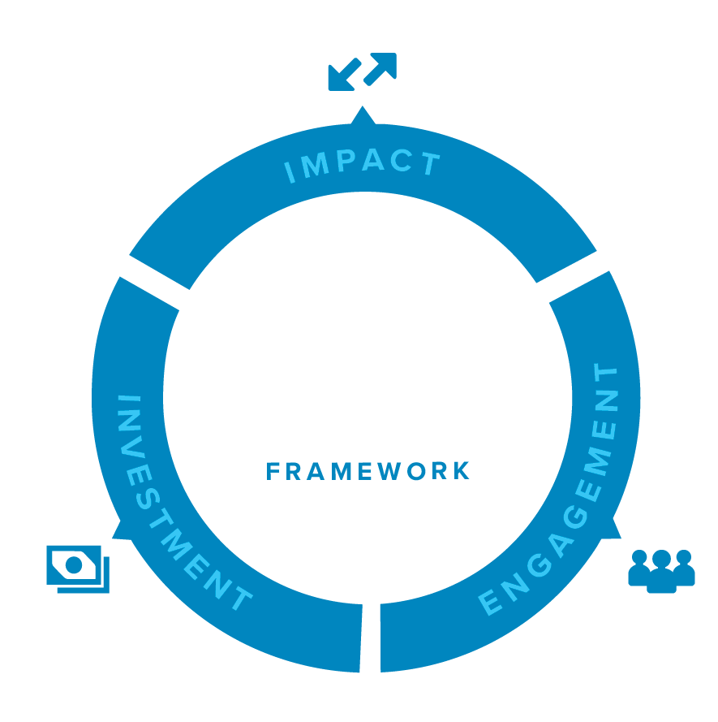
Capture the Full View
IMPACT DOMAIN
Achievement
Other Learning Outcomes
ENGAGEMENT DOMAIN
Usage
Perception
INVESTMENT DOMAIN
Subscription
Adoption
Notes:
(C ) Research
Outcomes framework
A lot of the work that Ryan discussed we’ve been applying at scale…..not everyone has access to a university research team, the platform/module scales this research and data analytics.
Maybe Ryan can jump in here an join the discussion
How can we mobilize and humanize data around program impact to help us understand the conditions in which specific technology programs have the most impact. We want to see levels of engagement, how students are progressing, and we want to capture the size of investments, which in turn leads to the relative impact. We’ve developed a module that is based on a framework that captures data and analyzes it against a framework that addressed impact, investment and engagement.
Evaluate the lifecycle of the technology process.
There is great research into the initial purchase, but what about the efficacy of the program?
We should have enough data and info to ask the right questions about our programs.

Slide 26
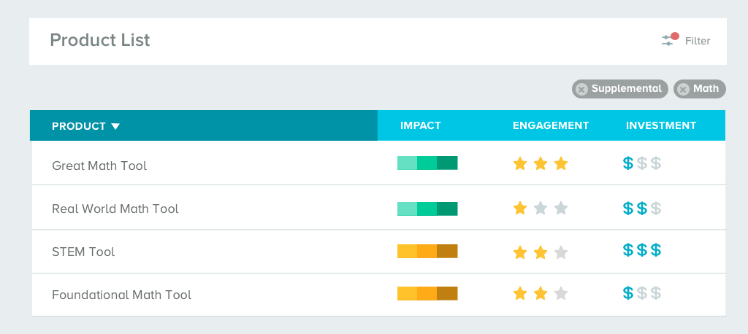
Make the Right Choices
Assess products through a research and data-backed framework

Slide 27
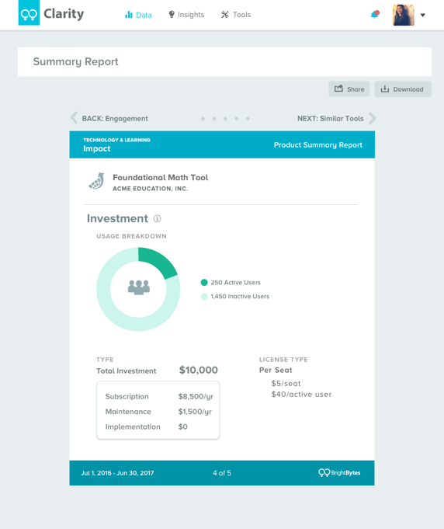
Defend Your Hardest Decisions
Empower yourself with data and trends

Slide 28
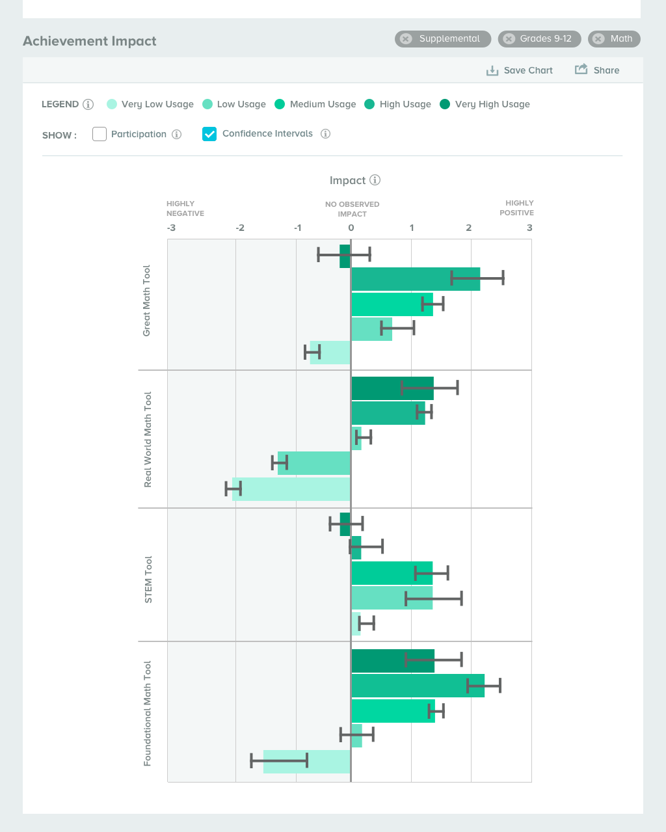
Know the Impact on Student Outcomes
See which areas are most impacted by your investments
Notes:
You’ll notice the user has now checked the “Confidence Intervals” option at the top of the chart. Once they select this, the confidence intervals are layered on top of each usage level bar. The user can now see how confident we are in the impact each usage level is having on student math achievement. The min and max of the confidence interval (i.e., the “whiskers) represent the range within which you are 95% confident the true impact will land. The confidence intervals will shrink as the sample size grows and variability in the student test scores diminishes. As this happens, we get closer to determining the true impact of the tool on math achievement for the population of students using the tool.

Slide 29
Benefits of Big Data and Learning Analytics
Improved understanding of the specific factors that impact learning
Increased responsive, individualized learning opportunities
Ability to make data-driven decisions to improve student outcomes
Better understanding of our organization’s strengths and areas in need of improvement
Notes:
A lot of the work that Ryan discussed we’ve been applying at scale…..not everyone has access to a university research team, the platform/module scales this research and data analytics.
Maybe Ryan can jump in here an join the discussion
Admittedly, this message doesn’t really hit like I hoped it would:
At a very high level – those challenges come in three major dimensions
Better understand your own reality within a larger context – if 1 in 5 schools are using a common research and data framework, then I can learn how I compare to organizations that look like me (CASE)
Find deeper meaning in our own organization – each environment is unique, how can we better understand that uniqueness to make better sense of my own data (EW)
Combining the two… (Outcomes)

Slide 30
The Clarity Decision Support Platform
Simplified Data
Sharable Reports
Actionable Next Steps
Ongoing Progress
Notes:
[Secondary talking points] This is how and why the BrightBytes Clarity platform was created. To provide education organizations with a solution for gathering and interpreting their data against research-based frameworks and delivering actionable next steps for continuous improvement.
Simplified Data
Sharable Reports
Actionable Next Steps
Ongoing Progress

Slide 31
Civitas Learning

Slide 32
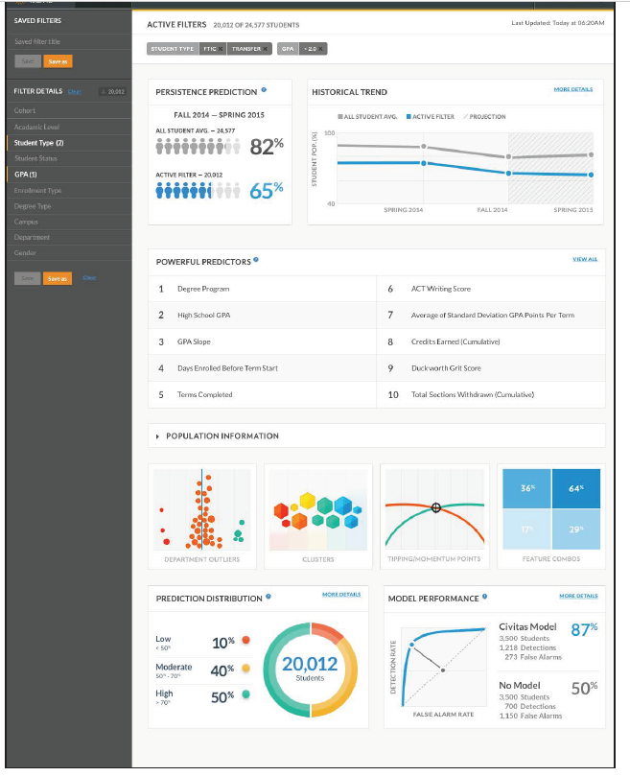

Slide 33
Purdue->Ellucian Course Signals

Slide 34
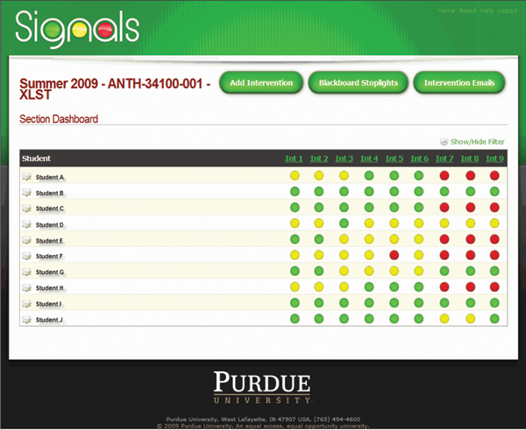

Slide 35
Evidence for reduced rate of failure/dropout
(Arnold, 2010; Arnold & Pistilli, 2012)
  Some debate on this (e.g. Essa, 2013)
(Milliron et al., 2014)
Often depends on how you look at the data (Dawson et al., 2017)

Slide 36
What are some potential predictors that a student is at-risk?
(K-12 or college)

Slide 37
Which of these indicators are creepy?

Slide 38
Which of these indicators are actionable?

Slide 39
Which of these indicators are readily feasible to obtain?

Slide 40
What are some ways we could use at-risk prediction?

Slide 41
What are the benefits of using at-risk prediction?

Slide 42
What are the risks of using at-risk prediction?

Slide 43
What are some other types of risk in education that we could predict?

Slide 44
Questions? Comments?

