Slide 1
Big Data, Education, and Society
March 14, 2018

Slide 2
Assignment 1
Great job on the whole – some really interesting ideas and really thoughtful suggestions

Slide 3
Assignment 1
Several of you didn’t follow the assignment’s guidelines on participating in conversations on the forum
Note that Assignment 2 is posted on the course webpage
http://www.upenn.edu/learninganalytics/ryanbaker/BDES2018/assignments.html
I encourage you to read the assignment carefully and make sure to follow the instructions there

Slide 4
Assignment 2
Let’s go there and review assignment 2 now
Any questions?

Slide 5
Rational Modeling
Where your model is created by a smart human being, rather than an exhaustive computer

Slide 6
Also called
Knowledge engineering
Cognitive modeling

Slide 7
Knowledge Engineering at its best
Knowledge engineering is the art of a human being
  Becoming deeply familiar with the target construct
  Carefully studying the data, including possibly process data (such as think-alouds)
  Understanding the relevant theory and how it applies
  Thoughtfully crafting an excellent model

Slide 8
Knowledge Engineering at its best
In its classical version
  A knowledge engineer and a domain expert work together to model the construct
  Through an iterative process
  Where the knowledge engineer interviews the expert, creates models, goes through the model and its implications with the expert, gets feedback, enhances the models, and repeats the process
  Until both the knowledge engineer and domain expert believe the model has fully captured the expert’s reasoning

Slide 9

Knowledge Engineering at its best
Achieves higher construct validity than data mining
Achieves comparable performance in data
And can transfer better to new data in some cases, by capturing more general aspects of the construct
(Paquette et al., 2014, 2015)

Slide 10
Knowledge Engineering at its best
Tests a model’s sensitivity to variations in how the construct is specified
(e.g. Kovanovic et al., 2015)

Slide 11
Questions? Comments?

Slide 12




Example of excellent knowledge engineering
Aleven et al.’s (2004, 2006) help-seeking model

Slide 13
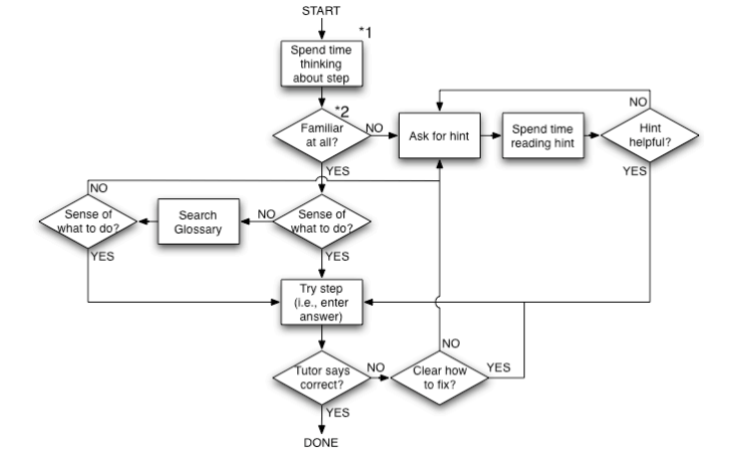
A prescriptive model of good help-seeking behavior in an online tutor

Slide 14
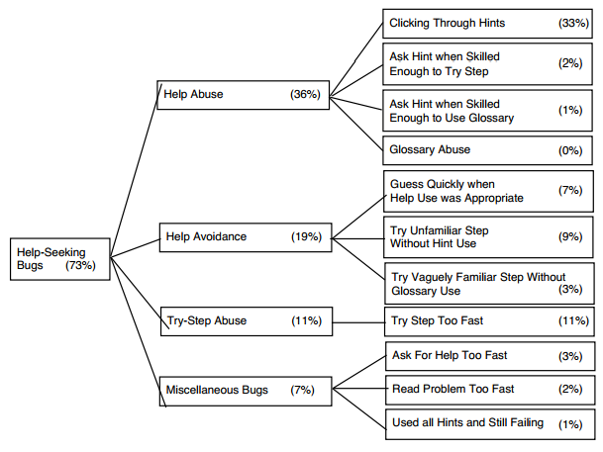
With a taxonomy of errors in student help-seeking

Slide 15
Developed based on
Thorough study of dozens of scientific articles
Years of experience in designing online learning environments
Intensive study of log files of student interaction with learning system
Plus experience watching kids use educational software in real classrooms

Slide 16
Resultant models
Predictive of student learning (Aleven et al., 2004, 2006) and preparation for future learning (Baker et al., 2011)
Specific aspects of model correlate to data-mined detectors of same constructs, and improve data-mined models if added to them (Roll et al., 2005)

Slide 17
Questions? Comments?

Slide 18
Knowledge Engineering at its worst
Knowledge engineering (and the other terms) are sometimes used to refer to
  Someone making up a simple model very quickly
  And then calling the resultant construct by a well-known name
  And not testing on data in any way
  And asserting that their model is the construct, despite having no evidence

Slide 19
Knowledge Engineering at its worst
Achieves poorer construct validity than data mining
Predicts desired constructs poorly, sometimes even worse than chance
  Due to over-simplifying a complex construct
  Or even failing to match it
Can slow scientific progress by introducing false results
Can hurt student outcomes by intervening at the wrong times

Slide 20
How can you tell if knowledge engineering is bad
If a data mining model is bad
  It’s usually relatively easy to identify, from the features, the validation procedure, or the goodness metrics
Telling top-notch knowledge engineering from junk is a little harder
The hard work is in the researcher’s brain, and the process is usually invisible
But… look for very simple models of complex constructs

Slide 21
Whether You Use Knowledge Engineering or Data Mining…
You should be testing your models on data in some fashion
Even if you can’t get a direct measure (training labels)
You can usually get some kind of indirect measure (predicting student learning, for example)

Slide 22
It’s not an either-or…
Some research has used knowledge engineering to discover what basic operators domain experts think in terms of
And then re-combine those operators in a broader range of ways
(Paquette et al., 2014)

Slide 23
It’s not an either-or…
Knowledge-engineered models sometimes depend on cut-offs or numerical parameters that are hard to determine rationally
These parameters can be empirically fit using data
Some variants of Aleven et al.’s model do this
As does Bayesian Knowledge Tracing (next week)

Slide 24
Let’s discuss the Muldner article
Is this good knowledge engineering or bad knowledge engineering?
Are the conclusions drawn using this model warranted?

Slide 25
Questions? Comments?

Slide 26
Upcoming office hours
March 21 9am-930am or by appointment

