Slide 1
Big Data, Education, and Society
April 18, 2018

Slide 2
Assignment 3
Any questions about assignment 3?

Slide 3
Assignment 4
Any questions about assignment 4?

Slide 4
Discrimination and the
Perpetuation of Bias

Slide 5
Algorithmic Bias
(Garcia, 2016)
Nothing to do with the bias-variance trade-off

Slide 6
Algorithmic Bias
(Garcia, 2016)
When an prediction model discovers bias in existing decision-making and then perpetuates/systematicizes/extends it

Slide 7
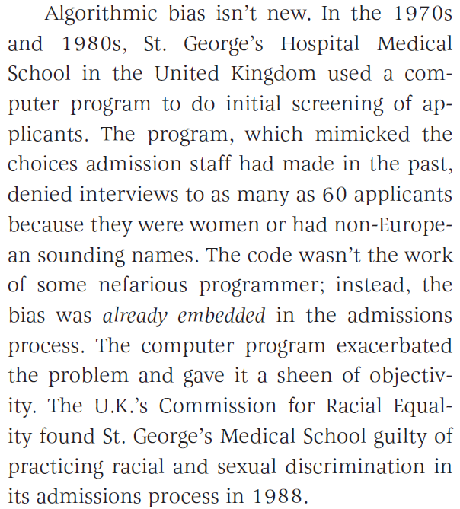
Example
(Garcia, 2016)

Slide 8
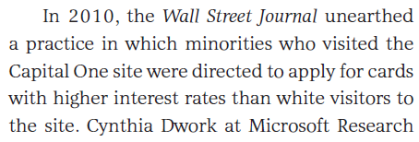
Example
(Garcia, 2016)

Slide 9
Example
(Corbett-Davies et al., 2017)
For example, when ProPublica examined computer-generated risk scores in Broward County, Fla., in 2016, it found that black defendants were substantially more likely than whites to be rated a high risk of committing a violent crime if released. Even among defendants who ultimately were not re-arrested, blacks were more likely than whites to be deemed risky. These results elicited a visceral sense of injustice and prompted a chorus of warnings about the dangers of artificial intelligence.

Slide 10
Comments? Questions?

Slide 11
Corbett-Davies et al. (2017) argument
Yet those results don’t prove the algorithm itself is biased against black defendants — a point we’ve made previously, including in peer-reviewed research. The Broward County classifications are based on recognized risk factors, like a documented history of violence. The classifications do not explicitly consider a defendant’s race.
Because of complex social and economic causes, black defendants in Broward County are in reality more likely than whites to be arrested in connection with a violent crime after release, and so classifications designed to predict such outcomes necessarily identify more black defendants as risky. This would be true regardless of whether the judgments were made by a computer or by a human decision maker.
It is not biased algorithms but broader societal inequalities that drive the troubling racial differences we see in Broward County and throughout the country. It is misleading and counterproductive to blame the algorithm for uncovering real statistical patterns. Ignoring these patterns would not resolve the underlying disparities.

Slide 12
What are your thoughts on this argument?

Slide 13
What could be solutions to preventing algorithmic bias?

Slide 14
What could be solutions to preventing algorithmic bias?
Avoid using demographic variables as predictors (GPDR)
Diversity in people developing models (Garcia, 2016)
Predict outcomes that are not biased – example given of violent crime (less biased) instead of all crime (more biased) (Corbett-Davies et al., 2017)

Slide 15
What could be solutions to preventing algorithmic bias?
“Right to explanation” (GPDR)
Inspect model outcomes for bias
  Do visibly biased outcomes result? (Garcia, 2016)
  Is the model more biased than its training data?
Openness as to model internals and predictions (Garcia, 2016)

Slide 16
Which of these solutions are practically feasible in learning analytics?
And which aren’t?
Why/why not?

Slide 17
Open University UK situation

Slide 18
Open University UK situation
How should they have addressed the problem?

Slide 19
Assemble into your
*assignment* groups

Slide 20
Assemble into your
*assignment* groups
How could your proposed innovation become problematic or damaged due to algorithmic bias
  Either actual or perceived?
What, if anything, could you do to mitigate that risk?

Slide 21
Be ready to present (briefly) to the class
What is your innovation?
What is the risk of algorithmic bias?
What steps could you take to address it?

Slide 22
Now present to the class
The class:
Do you think this is the biggest risk of algorithmic bias?
Do you have any concerns that their solution will not work?
After we complete critique in terms of these…
Do you have other potential solutions?

Slide 23
Upcoming office hours
4/25 930am-1030am

