Slide 1
Advanced Methods and Analysis for the Learning and Social Sciences
PSY505
Spring term, 2012
February 6, 2012

Slide 2
Today’s Class
Advanced BKT and Learning Decomposition

Slide 3

Learning Decomposition
(Beck et al., 2006)
A, -b, B: Free parameters
t1, t2: Number of practice of types 1, 2
  For example, with help request, without help request

Slide 4
Interpretation
A: Performance on first trial
b: Improvement per trial
B: Practice type weight
  If B>1, t1 leads to more learning than t2
  If B<1, t2 leads to more learning than t1
  If B=1, t1 and t2 are equal

Slide 5
Example
Let’s make up some data where students improve a little with t1 and a lot with t2
Then we’ll see how LD fits it

Slide 6
Advantages?

Slide 7
Advantages?
Very easy to interpret

Slide 8
Disadvantages?

Slide 9
Disadvantages?
Statistical significance testing is hard
Requires computing confidence intervals for a parameter in exponential regression, and determining if 1 is inside confidence interval

Slide 10
Variant
Take the log
Log Performance = -bBt1 - bt2 + c
Conduct logistic regression
  Log performance = dt1 + et2 + c
  Possible to compute standard error for d and e
  Therefore, possible to compute a statistical test as to whether d and e are significantly different

Slide 11
Comments? Questions?

Slide 12
Advanced BKT

Slide 13
Classic BKT
Not learned
p(T)
Learned
p(L₀)
p(G)
1-p(S)
correct
correct
Two Learning Parameters
p(L₀) Probability the skill is already known before the first opportunity to use the skill in problem solving.
p(T) Probability the skill will be learned at each opportunity to use the skill.
Two Performance Parameters
p(G) Probability the student will guess correctly if the skill is not known.
p(S) Probability the student will slip (make a mistake) if the skill is known.

Slide 14
Extensions to BKT
Largely take the form of relaxing the assumption that parameters vary by skill, but are constant for all other factors

Slide 15
Beck et al.’s (2008) Help Model
p(T|H)
Not learned
Learned
p(T|~H)
p(L₀|H),
p(L₀|~H)
p(G|~H), p(G|H)
1-p(S|~H)
1-p(S|H)
correct
correct

Slide 16
Fit…
The same way as regular BKT

Slide 17
Beck et al.’s (2008) Help Model
Parameters per skill: 8
Effect on future prediction: slightly worse

Slide 18
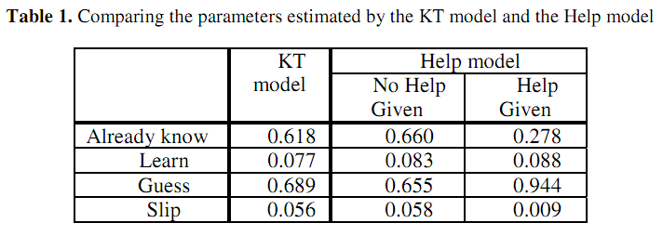
Beck et al.’s (2008) Help Model
What do these parameters suggest?

Slide 19
Beck et al.’s (2008) Help Model
Learning decomposition disagrees; which should we trust?

Slide 20
Moment-By-Moment Learning Model
(Baker, Goldstein, & Heffernan, 2010)
Probability you Just Learned
p(J)
Not learned
p(T)
Learned
p(L₀)
p(G)
1-p(S)
correct
correct

Slide 21
P(J)
P(T) = chance you will learn if you didn’t know it
P(J) = probability you JustLearned
  P(J) = P(~L_{n} ^ T)

Slide 22
P(J) is distinct from P(T)
  P(T) is held fixed for each skill
  P(J) is contextual (calculated for each problem)
  You *could* make P(T) contextual too
    But a contextual P(T) would not be interpretable for high P(Ln)
For example:
P(L_{n}) = 0.1
P(T) = 0.6
P(J) = 0.54
P(L_{n}) = 0.96
P(T) = 0.6
P(J) = 0.02
Learning!
Little Learning

Slide 23
Labeling P(J)
Based on this concept:
  “The probability a student did not know a skill but then learns it by doing the current problem, given their performance on the next two.”
P(J) = P(~L_{n} ^ T | A₊₁₊₂ )
*For full list of equations, see
Baker, Goldstein, & Heffernan (2010)

Slide 24
Breaking down P(~L_{n} ^ T | A₊₁₊₂ )
We can calculate P(~L_{n} ^ T | A₊₁₊₂ ) with an application of Bayes’ theorem
P(~L_{n} ^ T | A₊₁₊₂ ) =
Bayes’ Theorem: P(A | B) =
P(A₊₁₊₂ | ~L_{n} ^ T) * P(~L_{n} ^ T)
P (A₊₁₊₂ )
P(B | A) * P(A)
P(B)

Slide 25
Breaking down P(A₊₁₊₂ )
P(~L_{n} ^ T ) is computed with BKT building blocks {P(~L_{n}), P(T)}
P(A₊₁₊₂ ) is a function of the only three relevant scenarios, {L_{n}, ~L_{n} ^ T, ~L_{n} ^ ~T}, and their contingent probabilities
P(A₊₁₊₂ ) = P(A₊₁₊₂ | L_{n}) P(L_{n})
+ P(A₊₁₊₂ | ~L_{n} ^ T) P(~L_{n} ^ T)
+ P(A₊₁₊₂ | ~L_{n} ^ ~T) P(~L_{n} ^ ~T)

Slide 26
Breaking down P(A₊₁₊₂ | L_{n}) P(L_{n}):
One Example
P(A₊₁₊₂ = C, C | L_{n} ) = P(~S)P(~S)
P(A₊₁₊₂ = C, ~C | L_{n} ) = P(~S)P(S)
P(A₊₁₊₂ = ~C, C | L_{n} ) = P(S)P(~S)
P(A₊₁₊₂ = ~C, ~C | L_{n} ) = P(S)P(S)
skill | problemID | userID | correct | L_{n-1} | L_{n} | G | S | T | P(J)
similar-figures | 71241 | 52128 | 0 | .56 | .21036516 | .299 | .1 | .067 | .002799
similar-figures | 71242 | 52128 | 0 | .21036516 | .10115955 | .299 | .1 | .067 | .00362673
similar-figures | 71243 | 52128 | 1 | .10115955 | .30308785 | .299 | .1 | .067 | .00218025
similar-figures | 71244 | 52128 | 0 | .30308785 | .12150209 | .299 | .1 | .067 | .00346442
similar-figures | 71245 | 52128 | 0 | .12150209 | .08505184 | .299 | .1 | .067 | .00375788
(Correct marked C, wrong marked ~C)

Slide 27
Features of P(J)
Distilled from logs of student interactions with tutor software
Broadly capture behavior indicative of learning
  Selected from same initial set of features previously used in detectors of
    gaming the system (Baker, Corbett, Roll, & Koedinger, 2008)
    off-task behavior (Baker, 2007)
    carelessness (Baker, Corbett, & Aleven, 2008)

Slide 28
Features of P(J)
All features use only first response data
Later extension to include subsequent responses only increased model correlation very slightly – not significantly
(Baker, Goldstein, & Heffernan, 2011)

Slide 29
Features of P(J)
Argument could be made that using BKT probabilities (L_{n}) in the prediction of the label (~L_{n} ^ T) is wrong
  We consider this to be valid – theoretically important part of model is the T, not the L_{n}
The model maintains a 0.301 correlation coefficient even without L_{n} or L_{n}-1

Slide 30
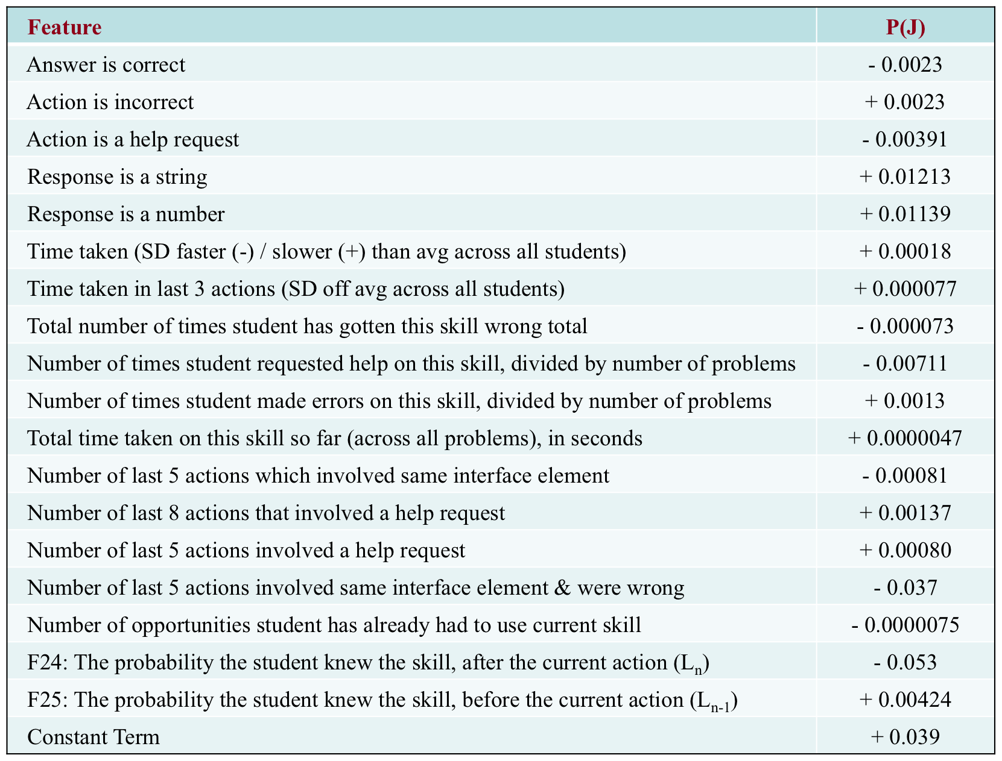
The final model

Slide 31
Interpretation
P(J) is higher following incorrect responses
  People learn from their mistakes
However, P(J) decreases as the total number of times student got this skill wrong increases
  Might need intervention not available in the tutor

Slide 32
Interpretation
P(J) is lower following help requests
P(J) is higher when help has been used recently, i.e. in the last 5 and/or 8 steps

Slide 33
Replication
We replicated this result in another intelligent tutor, ASSISTments (Razzaq et al., 2007)
Correlation between models and labels: 0.397

Slide 34
Model use
Does learning in intelligent tutors have more of a character of
  gradual learning (such as strengthening of a memory association – cf. Newell & Rosenbloom, 1981; Heathcote, Brown, & Mewhort, 2000)
  or learning given to “eureka”/insight moments, where a skill is understood suddenly? (Lindstrom & Gulz, 2008)
Does this vary by skill?

Slide 35
Model use
Both types of learning known to occur but the conditions leading to each are still incompletely known (Bowden et al., 2005)
Opportunity to study these issues in real learning, which is still uncommon – most research in insight takes place for toy problems in lab settings (as pointed out by Bowden et al., 2005; Kounios et al., 2008)

Slide 36
To investigate this
We can plot P(J) over time, and see how “spiky” the graph is
Spikes indicating moments of higher learning

Slide 37
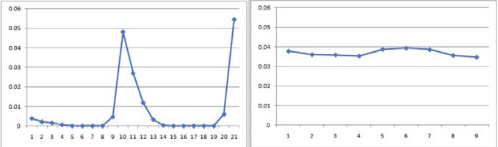
Real Data for A Student
“Entering a common multiple”
P(J)
OPTOPRAC

Slide 38
Real Data for Same Student
“Identifying the converted value in the problem statement of a scaling problem”
P(J)
OPTOPRAC

Slide 39
As you can see…
One skill was learned gradually, the other skill was learned suddenly
Note that the first graph had *two* spikes
This was actually very common in the data, even more common than single spikes
  We are still investigating why this happens

Slide 40
We can quantify the difference between these graphs
We can quantify the degree to which a learning sequence involves a “eureka” moment, through a metric we call “spikiness”
For a given student/skill pair, spikiness =
Max P(J)/Avg P(J)
  Scaled from 1 to infinity

Slide 41
Looking at spikiness
We only consider action sequences at least 6 problem steps long
  (Shorter sequences tend to more often look spiky, which is a mathematical feature of using a within-sequence average)
We only consider the first 20 problem steps
  After that, the student is probably floundering

Slide 42
Spikiness by skill
Min: 1.12
Max: 113.52
Avg: 8.55
SD: 14.62
Future work: What characterizes spiky skills versus gradually-learned skills?

Slide 43
Spikiness by student
Min: 2.22
Max: 21.81
Avg: 6.81
SD: 3.09
Students are less spiky than skills

Slide 44
Interestingly
The correlation between a student’s spikiness, and their final average P(L_{n}) across skills is a high 0.71, statistically significantly different than chance
Suggests that learning spikes may be an early predictor of whether a student is going to achieve good learning of specific material
  May someday be the basis of better knowledge tracing

Slide 45
Also…
The cross-validated correlation between a student’s average P(J)
And their performance on a test of preparation for future learning (cf. Bransford & Schwartz, 1999) where the student needs to read a text to learn a related skill
Is 0.35
  statistically significantly different than chance
  higher than the predictive power of Bayesian Knowledge-Tracing for this same test
  (Baker, Gowda, & Corbett, 2011)
Suggests that this model is capturing deep aspects of learning not captured in existing knowledge assessments

Slide 46
Worth Noting
Generally, across all actions on a skill, the P(J) model doesn’t quite add up to a total of 1
In general, our model is representative of P(J) at lower levels but tends to underestimate the height of spikes
  May be a result of using a linear modeling approach for a fundamentally non-linear phenomenon
  May also be that P(J) is actually too high in the training labels (where it often sums up to significantly more than 1)
  Could be normalized -- for the purposes of spikiness analyses, we believe the model biases towards seeing less total spikiness

Slide 47
Baker, Corbett, & Aleven’s (2008)
Contextual Guess and Slip model
Not learned
p(T)
Learned
p(L₀)
p(G)
1-p(S)
correct
correct

Slide 48
Contextual Slip:
The Big Idea
Why one parameter for slip
  For all situations
  For each skill
When we can have a different prediction for slip
  For each situation
  Across all skills

Slide 49
In other words
P(S) varies according to context
For example
  Perhaps very quick actions are more likely to be slips
  Perhaps errors on actions which you’ve gotten right several times in a row are more likely to be slips

Slide 50
Baker, Corbett, & Aleven’s (2008)
Contextual Guess and Slip model
Guess and slip fit using contextual models across all skills
Parameters per skill: 2 + (P (S) model size)/skills + (P (G) model size)/skills
2.11 parameters per skill

Slide 51
How are these models developed?
Very similar to P(J)

Slide 52
How are these models developed?
Take an existing skill model
(developed using Dirichlet Priors)
Label a set of actions with the probability that each action is a guess or slip, using data about the future
Use these labels to machine-learn models that can predict the probability that an action is a guess or slip, without using data about the future
Use these machine-learned models to compute the probability that an action is a guess or slip, in knowledge tracing

Slide 53
2. Label a set of actions with the probability that each action is a guess or slip, using data about the future
Predict whether action at time N is guess/slip
Using data about actions at time N+1, N+2
This is only for labeling data!
Not for use in the guess/slip models

Slide 54
2. Label a set of actions with the probability that each action is a guess or slip, using data about the future
The intuition:
If action N is right
And actions N+1, N+2 are also right
  It’s unlikely that action N was a guess
If actions N+1, N+2 were wrong
  It becomes more likely that action N was a guess

Slide 55
The Math
Similar to P(J)

Slide 56
3. Use these labels to machine-learn models that can predict the probability that an action is a guess or slip
Same features as P(J)
Linear regression, in Weka
  Did better on cross-validation than fancier algorithms
One guess model
One slip model

Slide 57
4. Use these machine-learned models to compute the probability that an action is a guess or slip, in knowledge tracing
Within Bayesian Knowledge Tracing
Exact same formulas
Just substitute a contextual prediction about guessing and slipping for the prediction-for-each-skill

Slide 58
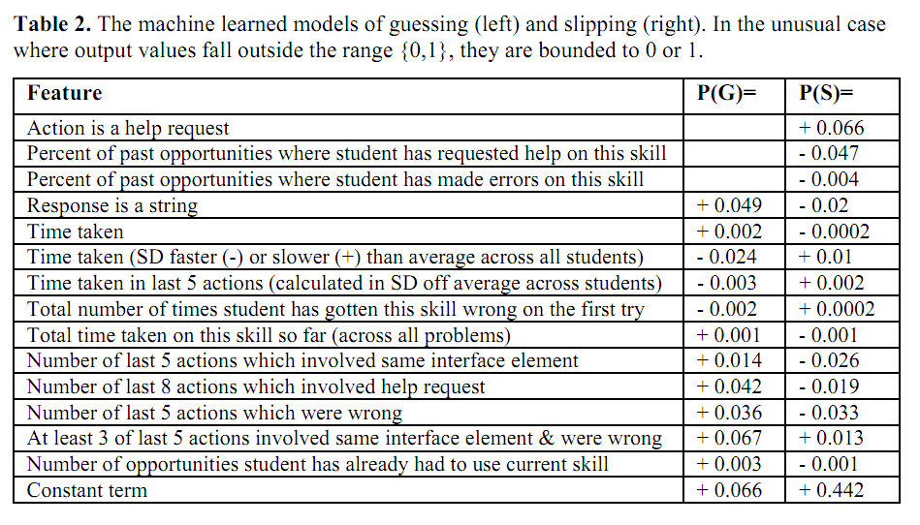
Interpretation of Models?

Slide 59
Baker, Corbett, & Aleven’s (2008)
Contextual Guess and Slip model
Effect on future prediction: very inconsistent
Much better on Cognitive Tutors for middle school, algebra, geometry (Baker, Corbett, & Aleven, 2008a, 2008b)
Much worse on Cognitive Tutor for genetics (Baker et al., 2010, 2011) and ASSISTments (Gowda et al., 2011)
Any hypotheses for why?

Slide 60
That said
P(S) models transfer between data sets from USA and Philippines (Sao Pedro et al., 2011), and between different versions of same tutor (Sao Pedro et al., 2011)
Average P(S) predicts post-test (Baker et al., 2010)
Average P(S) predicts shallow learners (Baker, Gowda, & Corbett, under review)

Slide 61
That said
P(S) negatively associated with boredom, confusion (San Pedro et al., 2011)
P(S) positively associated with engaged concentration (San Pedro et al., 2011)
P(S) associated with having neither performance goals or learning goals (Hershkovitz et al., 2011)

Slide 62
What does P(S) mean?

Slide 63
What does P(S) mean?
Carelessness? (San Pedro et al., 2011)
  Maps very cleanly to theory of carelessness in Clements (1982)
Shallow learning? (Baker, Gowda, & Corbett, under review)
  Student’s knowledge is imperfect and works on some problems and not others, so it appears that the student is slipping
How could we tell these apart?

Slide 64
BKT-Prior Per Student
(Pardos et al., 2010)
p(L₀) = Student’s average correctness on all prior problem sets
Not learned
p(T)
Learned
p(G)
1-p(S)
correct
correct

Slide 65
Pardos et al.’s (2010)
Prior Per Student model
Much better on ASSISTments and Cognitive Tutor for genetics (Pardos et al., 2010; Baker et al., 2011)
Much worse on ASSISTments (Gowda et al., 2011)

Slide 66
Key point
Contextualization approaches do not appear to lead to overall improvement on predicting within-tutor performance
But they are useful for other purposes
  Predicting robust learning
  Understanding learning constructs

Slide 67
Other Contextualization Ideas?
All 4 parameters have been contextualized…
But how could they be contextualized differently?

Slide 68
BKT with Multiple Skills

Slide 69
Conjunctive Model
(Pardos et al., 2008)
The probability a student can answer an item with skills A and B is
P(CORR|A^B) = P(CORR|A) * P(CORR|B)
But how should credit or blame be assigned to the various skills?

Slide 70
Koedinger et al.’s (2011)
Conjunctive Model
Equations for 2 skills

Slide 71
Koedinger et al.’s (2011)
Conjunctive Model
Generalized equations

Slide 72
Koedinger et al.’s (2011)
Conjunctive Model
Handles case where multiple skills apply to an item better than classical BKT

Slide 73
Other BKT Extensions?
Additional parameters?
Additional states?

Slide 74
Many others
Compensatory Multiple Skills (Pardos et al., 2008)
Clustered Skills (Ritter et al., 2009)

Slide 75
Other Comments and Questions?

Slide 76
Next Class
Monday, February 13
3pm-5pm
AK232
Classification and Behavior Detection
Sao Pedro, M.A., Baker, R.S.J.d., Gobert, J., Montalvo, O. Nakama, A. (in press) Leveraging Machine-Learned Detectors of Systematic Inquiry Behavior to Estimate and Predict Transfer of Inquiry Skill. To appear in User Modeling and User-Adapted Interaction.
Baker, R.S.J.d., Corbett, A.T., Roll, I., Koedinger, K.R. (2008) Developing a Generalizable Detector of When Students Game the System. User Modeling and User-Adapted Interaction, 18, 3, 287-314.
Assignments Due: None

Slide 77
The End

