Slide 1
Advanced Methods and Analysis for the Learning and Social Sciences
PSY505
Spring term, 2012
January 30, 2012

Slide 2
Today’s Class
Bayesian Knowledge Tracing

Slide 3
How does BKT differ from PFA?

Slide 4
How does BKT differ from PFA?
Assesses latent knowledge as well as probability of correctness
Only handles one skill per item (extensions can handle this)

Slide 5
How does BKT differ from IRT?

Slide 6
How does BKT differ from IRT?
Takes learning into account
Ignores item-level differences in difficulty

Slide 7
What is the typical use of BKT?
Assess a student’s knowledge of topic X
Based on a sequence of items that are dichotomously scored
  E.g. the student can get a score of 0 or 1 on each item
Where each item corresponds to a single skill
Where the student can learn on each item, due to help, feedback, scaffolding, etc.

Slide 8
Key assumptions
Each item must involve a single latent trait or skill
  Different from PFA
Each skill has four parameters
From these parameters, and the pattern of successes and failures the student has had on each relevant skill so far, we can compute latent knowledge P(Ln) and the probability P(CORR) that the learner will get the item correct

Slide 9
Key Assumptions
Two-state learning model
  Each skill is either learned or unlearned
In problem-solving, the student can learn a skill at each opportunity to apply the skill
A student does not forget a skill, once he or she knows it

Slide 10
Model Performance Assumptions
If the student knows a skill, there is still some chance the student will slip and make a mistake.
If the student does not know a skill, there is still some chance the student will guess correctly.

Slide 11
Corbett and Anderson’s Model
Not learned
p(T)
Learned
p(L₀)
p(G)
1-p(S)
correct
correct
Two Learning Parameters
p(L₀) Probability the skill is already known before the first opportunity to use the skill in problem solving.
p(T) Probability the skill will be learned at each opportunity to use the skill.
Two Performance Parameters
p(G) Probability the student will guess correctly if the skill is not known.
p(S) Probability the student will slip (make a mistake) if the skill is known.

Slide 12
Bayesian Knowledge Tracing
Whenever the student has an opportunity to use a skill, the probability that the student knows the skill is updated using formulas derived from Bayes’ Theorem.

Slide 13


Formulas

Slide 14
BKT
Only uses first problem attempt on each item (just like PFA)
What are the advantages and disadvantages?
Note that several variants to BKT break this assumption at least in part – more on that later

Slide 15
Knowledge Tracing
How do we know if a knowledge tracing model is any good?
Our primary goal is to predict knowledge

Slide 16
Knowledge Tracing
How do we know if a knowledge tracing model is any good?
Our primary goal is to predict knowledge
But knowledge is a latent trait

Slide 17
Knowledge Tracing
How do we know if a knowledge tracing model is any good?
Our primary goal is to predict knowledge
But knowledge is a latent trait
But we can check those knowledge predictions by checking how well the model predicts performance

Slide 18
Fitting a Knowledge-Tracing Model
In principle, any set of four parameters can be used by knowledge-tracing
But parameters that predict student performance better are preferred

Slide 19
Knowledge Tracing
So, we pick the knowledge tracing parameters that best predict performance
Defined as whether a student’s action will be correct or wrong at a given time

Slide 20
Fit Methods
There are many fit methods
Before we go into them in detail, let’s discuss the homework solutions

Slide 21
Homework Solutions

Slide 22
Sweet’s BKT Solution
Sweet, can you please talk us through your spreadsheet?
Also, tell us (but no need to show us) how you computed the parameter values

Slide 23
Zak’s BKT Solution
Zak got the exact same parameter values as Sweet did
Zak, why did this happen?

Slide 24
Goodness
Zak PFA 12,122.77 (dummy values)
Sweet PFA 10,896.09 (fit in Matlab)
Sweet BKT 8140.995
Zak BKT 8140.995

Slide 25
Thoughts?
Why might BKT have worked better than PFA?

Slide 26
Excel issues
Several folks had Excel crashing issues on this assignment
Anyone want to discuss the problems you had?
We can discuss how to fix them

Slide 27
Fit Methods
Hill-Climbing
Hill-Climbing (Randomized Restart)
Iterative Gradient Descent (and variants)
Expectation Maximization (and variants)
Brute Force/Grid Search

Slide 28
Hill-Climbing
The simplest space search algorithm
Start from some choice of parameter values
Try moving some parameter value in either direction by some amount
  If the model gets better, keep moving in the same direction by the same amount until it stops getting better
    Then you can try moving by a smaller amount
  If the model gets worse, try the opposite direction

Slide 29
Hill-Climbing
Vulnerable to Local Minima
  a point in the data space where no move makes your model better
  but there is some other point in the data space that *is* better
Unclear if this is a problem for BKT
  IGD (which is a variant on hill-climbing) typically does worse than Brute Force (Baker et al., 2008)
  Pardos et al. (2010) did not find evidence for local minima (but with simulated data)

Slide 30
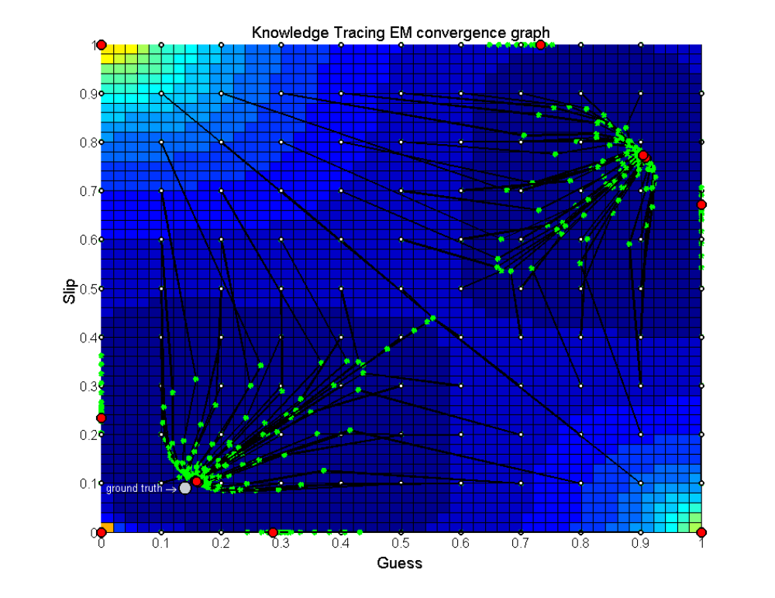
Pardos et al., 2010

Slide 31
Let’s try Hill-Climbing
On assignment data set
For one skill
Let’s use 0.1 as the starting point for all four parameters

Slide 32
Hill-Climbing with Randomized Restart
One way of addressing local minima is to run the algorithms with randomly selected different initial parameter values

Slide 33
Let’s try Hill-Climbing
On assignment data set
For one skill
Let’s run four times with different randomly selected parameters

Slide 34
Iterative Gradient Descent
Find which set of parameters and step size (may be different for different parameters) leads to the best improvement
Use that set of parameters and step size
Repeat

Slide 35
Conjugate Gradient Descent
Variant of Iterative Gradient Descent (used by Albert Corbett and Excel)
Rather complex to explain
“I assume that you have taken a ﬁrst course in linear algebra, and that you have a solid understanding of matrix multiplication and linear independence” – J.G. Shewchuk, An Introduction to the Conjugate Gradient Method Without the Agonizing Pain. (p. 5 of 58)

Slide 36
Expectation Maximization
(Thanks to Joe Beck for explaining this to me)
Starts with initial values for L0, T, G, S
Estimates student knowledge P(Ln) at each problem step
Estimates L0, T, G, S using student knowledge estimates
If goodness is substantially different from last time it was estimated, and max iterations has not been reached, go to step 2

Slide 37
Expectation Maximization
EM is vulnerable to local minima just like hill-climbing and gradient descent
Randomized restart typically used

Slide 38
Let’s try Expectation Maximization
By hand in Excel
Log likelihood is typically used, but for ease of real-time calculation we will use SSR

Slide 39
Brute Force/Grid Search
Try all combination of values at a 0.01 grain-size:
L0=0, T=0, G= 0, S=0
L0=0.01, T=0, G= 0, S=0
L0=0.02, T=0, G= 0, S=0
…
L0=1,T=0,G=0,S=0
…
L0=1,T=1,G=0.3,S=0.3
I’ll explain this soon

Slide 40
Which is best?
EM better than CGD
  Chang et al., 2006 ΔA’= 0.05
CGD better than EM
  Baker et al., 2008 ΔA’= 0.01
EM better than BF
  Pavlik et al., 2009 ΔA’= 0.003, ΔA’= 0.01
  Gong et al., 2010 ΔA’= 0.005
  Pardos et al., 2011 Δ RMSE= 0.005
  Gowda et al., 2011 ΔA’= 0.02
BF better than EM
  Pavlik et al., 2009 ΔA’= 0.01, ΔA’= 0.005
  Baker et al., 2011 ΔA’= 0.001
BF better than CGD
  Baker et al., 2010 ΔA’= 0.02

Slide 41
Maybe a slight advantage for EM
The differences are tiny

Slide 42
Model Degeneracy
(Baker, Corbett, & Aleven, 2008)

Slide 43
Conceptual Idea Behind Knowledge Tracing
Knowing a skill generally leads to correct performance
Correct performance implies that a student knows the relevant skill
Hence, by looking at whether a student’s performance is correct, we can infer whether they know the skill

Slide 44
Essentially
A knowledge model is degenerate when it violates this idea
When knowing a skill leads to worse performance
When getting a skill wrong means you know it

Slide 45
Theoretical Degeneracy
P(S)>0.5
  A student who knows a skill is more likely to get a wrong answer than a correct answer
P(G)>0.5
  A student who does not know a skill is more likely to get a correct answer than a wrong answer

Slide 46
Empirical Degeneracy
Actual behavior by a model that violates the link between knowledge and performance

Slide 47
Empirical Degeneracy: Test 1
(Concrete Version)
(Abstract version given in paper)
If a student’s first 3 actions in the tutor are correct
The model’s estimated probability that the student knows the skill
Should be higher than before these 3 actions.

Slide 48
Test 1 Passed
P(L₀)= 0.2
Bob gets his first three actions right
P(L₃)= 0.4

Slide 49
Test 1 Failed
P(L₀)= 0.2
Maria gets her first three actions right
P(L₃)= 0.1

Slide 50
Empirical Degeneracy: Test 2
(Concrete Version)
(Abstract version in paper)
If the student makes 10 correct responses in a row
The model should assess that the student has mastered the skill

Slide 51
Test 2 Passed
P(L₀)= 0.2
Teresa gets her first seven actions right
P(L₇)= 0.98
The system assesses mastery and moves Teresa on to new material

Slide 52
Test 2 Failed
P(L₀)= 0.2
Ido gets his first ten actions right
P(L₁₀)= 0.44
Over-practice for Ido

Slide 53
Test 2 Really Failed
P(L₀)= 0.2
Elmo gets his first ten actions right
P(L₁₀)= 0.42
Elmo gets his next 300 actions right
P(L₃₁₀)= 0.42

Slide 54
Test 2 Really Failed
P(L₀)= 0.2
Elmo gets his first ten actions right
P(L₁₀)= 0.42
Elmo gets his next 300 actions right
P(L₃₁₀)= 0.42
Elmo’s school quits using the tutor

Slide 55
Model Degeneracy
Joe Beck has told me in personal communication that he has an alternate definition of Model Degeneracy that he prefers
I don’t know which paper it’s in, and could not find it before class
  I emailed him, and will let you know what he says

Slide 56
Extensions
There have been many extensions to BKT
We will discuss some of the most important ones in class on February 8

Slide 57
BKT .vs. PFA
Should we use BKT or PFA within educational software? Why?
What situations might BKT be better for?
What situations might PFA be better for?

Slide 58
BKT
Questions?
Comments?

Slide 59
Next Class
Wednesday, February 1
3pm-5pm
AK232
Diagnostic Metrics: ROC, A', AUC, Precision, Recall, LL, BiC
Fogarty, J., Baker, R., Hudson, S. (2005) Case Studies in the use of ROC Curve Analysis for Sensor-Based Estimates in Human Computer Interaction. Proceedings of Graphics Interface (GI 2005), 129-136.
Davis, J., Goadrich, M. (2006) The relationship between Precision-Recall and ROC curves. Proceedings of the 23rd international conference on Machine learning.
Russell, S., Norvig, P. (2010) Artificial Intelligence: A Modern Approach. Ch. 20: Learning Probabilistic Models.

Slide 60
The End

