Slide 1
Advanced Methods and Analysis for the Learning and Social Sciences
PSY505
Spring term, 2012
January 23, 2012

Slide 2
Today’s Class
Item Response Theory

Slide 3
What is the key goal of IRT?

Slide 4
What is the key goal of IRT?
Measuring how much of some latent trait a person has
How intelligent is Bob?
How much does Bob know about snorkeling?
  SnorkelTutor

Slide 5
What is the typical use of IRT?

Slide 6
What is the typical use of IRT?
Assess a student’s knowledge of topic X
Based on a sequence of items that are dichotomously scored
  E.g. the student can get a score of 0 or 1 on each item

Slide 7
Scoring
Not a simple average of the 0s and 1s
  That’s an approach that is used for simple tests, but it’s not IRT
Instead, a function is computed based on the difficulty and discriminability of the individual items

Slide 8
Key assumptions
There is only one latent trait or skill being measured per set of items
  There are other models that allow for multiple skills per item, we’ll talk about them later in the semester
Each learner has ability θ
Each item has difficulty b and discriminability a
From these parameters, we can compute the probability P(θ) that the learner will get the item correct

Slide 9
Note
The assumption that all items tap the same latent construct, but have different difficulties, is a very different assumption than is seen in other approaches such as BKT (which we’ll talk about later)
Why might this be a good assumption?
Why might this be a bad assumption?

Slide 10
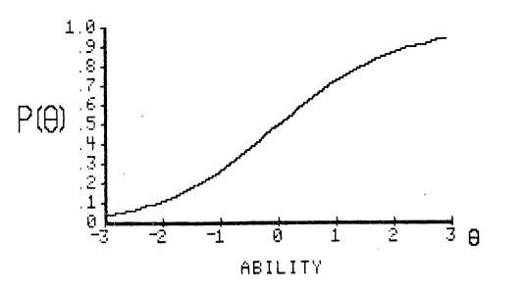
Item Characteristic Curve
Can anyone walk the class through what this graph means?

Slide 11
Item Characteristic Curve
If Iphigenia is an Idiot, but Joelma is a Jenius, where would they fall on this curve?

Slide 12
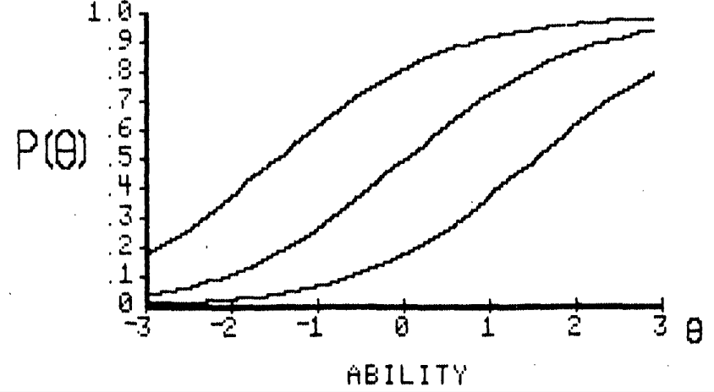
Which parameter do these three graphs differ in terms of?

Slide 13
Which of these three graphs represents a difficult item? Which represents an easy item?

Slide 14
For a genius, what is the probability of success on the hard item? For an idiot, what is the probability of success on the easy item?
What are the implications of this?

Slide 15
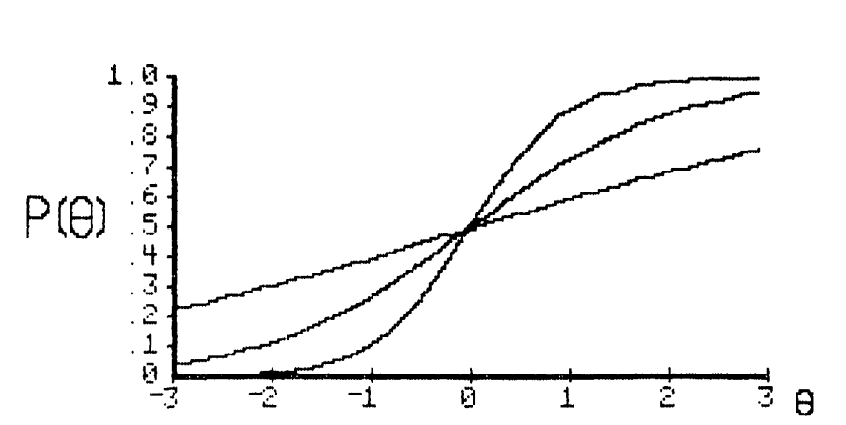
Which parameter do these three graphs differ in terms of?

Slide 16
Which of these three items has low discriminability? Which has high discriminability? Which of these items would be useful on a test?

Slide 17
What would a graph with extremely low discriminability look like? Can anyone draw it on the board? Would this be useful on a test?

Slide 18
What would a graph with extremely high discriminability look like? Can anyone draw it on the board? Would this be useful on a test?

Slide 19
Mathematical formulation
The logistic function

Slide 20
The Rasch (1PL) model
Simplest IRT model, very popular
There is an entire special interest group of AERA devoted solely to the Rasch model (RaschSIG)

Slide 21
The Rasch (1PL) model
No discriminability parameter
Parameters for student ability and item difficulty

Slide 22
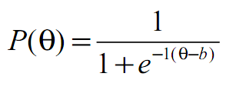
The Rasch (1PL) model
Each learner has ability θ
Each item has difficulty b

Slide 23
The Rasch (1PL) model
Let’s enter this into Excel, and create the item characteristic curve

Slide 24
The Rasch (1PL) model
Let’s try the following values:
θ = 0, b = 0? θ = 3, b = 0? θ = -3, b = 0?
θ = 0, b = 3? θ = 0, b = -3? θ = 3, b = 3?
θ = -3, b = -3?
What do each of these param sets mean?
What is P(θ)?

Slide 25
The 2PL model
Another simple IRT model, very popular
Discriminability parameter a added

Slide 26
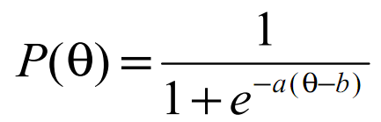
Rasch
2PL

Slide 27
The 2PL model
Another simple IRT model, very popular
Discriminability parameter a added
Let’s enter it into Excel, and create the item characteristic curve

Slide 28
The 2PL model
What do these param sets mean?
What is P(θ)?
θ = 0, b = 0, a = 0 θ = 3, b = 0, a = 0
θ = 0, b = 3, a = 0

Slide 29
The 2PL model
What do these param sets mean?
What is P(θ)?
θ = 0, b = 0, a = 1 θ = 0, b = 0, a = -1
θ = 3, b = 0, a = 1 θ = 3, b = 0, a = -1
θ = 0, b = 3, a = 1 θ = 0, b = -3, a = -1

Slide 30
The 2PL model
What do these param sets mean?
What is P(θ)?
θ = 3, b = 0, a = 1 θ = 3, b = 0, a = 2
θ = 3, b = 0, a = 10 θ = 3, b = 0, a = 0.5
θ = 3, b = 0, a = 0.25 θ = 3, b = 0, a = 0.01

Slide 31
Model Degeneracy
Where a model works perfectly well computationally, but makes no sense/does not match intuitive understanding of parameter meanings
What parts of the 2PL parameter space are degenerate?
What does the ICC look like?

Slide 32
The 3PL model
A more complex model
Adds a guessing parameter c

Slide 33
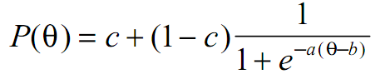
The 3PL model

Slide 34
What is the meaning of the c and (1-c) parts of the function?

Slide 35
The 3PL model
A more complex model
Adds a guessing parameter c
Let’s enter it into Excel, and create the item characteristic curve

Slide 36
The 3PL model
What do these param sets mean?
What is P(θ)?
θ = 0, b = 0, a = 1, c = 0
θ = 0, b = 0, a = 1, c = 1
θ = 0, b = 0, a = 1, c = 0.35

Slide 37
The 3PL model
What do these param sets mean?
What is P(θ)?
θ = 0, b = 0, a = 1, c = 1
θ = -5, b = 0, a = 1, c = 1
θ = 5, b = 0, a = 1, c = 1

Slide 38
The 3PL model
What do these param sets mean?
What is P(θ)?
θ = 1, b = 0, a = 0, c = 0.5
θ = 1, b = 0, a = 0.5, c = 0.5
θ = 1, b = 0, a = 1, c = 0.5

Slide 39
The 3PL model
What do these param sets mean?
What is P(θ)?
θ = 1, b = 0, a = 1, c = 0.5
θ = 1, b = 0.5, a = 1, c = 0.5
θ = 1, b = 1, a = 1, c = 0.5

Slide 40
The 3PL model
What do these param sets mean?
What is P(θ)?
θ = 0, b = 0, a = 1, c = 2
θ = 0, b = 0, a = 1, c = -1

Slide 41
Model Degeneracy
Where a model works perfectly well computationally, but makes no sense/does not match intuitive understanding of parameter meanings
What parts of the 3PL parameter space are degenerate?
What does the ICC look like?

Slide 42
Fitting an IRT model
Typically done with Maximum Likelihood Estimation (MLE)
  Which parameters make the data most likely
We’ll do it here with Maximum a-priori estimation (MAP)
  Which parameters are most likely based on the data

Slide 43
The difference
Mostly a matter of religious preference
  In many models (though not IRT) they are the same thing
  MAP is usually easier to calculate
  Statisticians frequently prefer MLE
  Data Miners sometimes prefer MAP
  In this case, we use MAP solely because it’s easier to do in real-time

Slide 44
Let’s fit IRT parameters to this data
irt-modelfit-set1-v1.xlsx
Let’s start with a Rasch model

Slide 45
Let’s fit IRT parameters to this data
We’ll use SSR (sum of squared residuals) as our goodness criterion
  Lower SSR = less disagreement between data and model = better model
  This is a standard goodness criterion within statistical modeling
  Why SSR rather than just sum of residuals?
  What are some other options?

Slide 46
Let’s fit IRT parameters to this data
Fit by hand
Fit using Excel Equation Solver
Other options:
  Iterative Gradient Descent
  Grid Search
  Expectation Maximization

Slide 47
Items and students
Who are the best and worst students?
Which items are the easiest and hardest?

Slide 48
2PL
Now let’s fit a 2PL model
Are the parameters similar?
How much difference do the items have in terms of discriminability?

Slide 49
2PL
Now let’s fit a 2PL model
Is the model better? (how much?)

Slide 50
2PL
Now let’s fit a 2PL model
Is the model better? (how much?)
  It’s worth noting that I generated this simulated data using a Rasch-like model
  What are the implications of this result?

Slide 51
Reminder
IRT models are typically fit using the (more complex) Expectation Maximization algorithm rather than in the fashion used here
We’ll talk more about fit algorithms in a future class

Slide 52
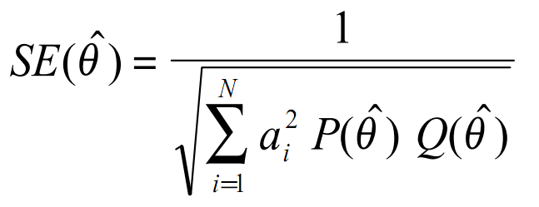
Standard Error in Estimation of Student Knowledge
(1 – P(θ))

Slide 53
Standard Error in Estimation of Student Knowledge
1.96 standard errors in each direction = 95% confidence interval
Standard error bars are typically 1 standard error
  If you compare two different values, each of which have 1 standard error bars
  Then if they do not overlap, they are significantly different
    This glosses over some details, but is basically correct

Slide 54
Standard Error in Estimation of Student Knowledge
Let’s estimate the standard error in some of our student estimates in the data set
Are there any students for whom the estimates are not trustworthy?

Slide 55
Final Thoughts
IRT is the classic approach to assessing knowledge through tests
Extensions are used heavily in Computer-Adaptive Tests
Not frequently used in Intelligent Tutoring Systems
  Where models that treat learning as dynamic are preferred; more next class

Slide 56
IRT
Questions?
Comments?

Slide 57
Next Class
Wednesday, January 25
3pm-5pm
AK232
Performance Factors Analysis
Pavlik, P.I., Cen, H., Koedinger, K.R. (2009) Performance Factors Analysis -- A New Alternative to Knowledge Tracing. Proceedings of AIED2009.
Pavlik, P.I., Cen, H., Koedinger, K.R. (2009) Learning Factors Transfer Analysis: Using Learning Curve Analysis to Automatically Generate Domain Models. Proceedings of the 2nd International Conference on Educational Data Mining.

Slide 58
The End

