Slide 1
Advanced Methods and Analysis for the Learning and Social Sciences
PSY505
Spring term, 2012
April 11, 2012

Slide 2
Today’s Class
Power Analysis

Slide 3
Statistical Power

Slide 4
Power Analysis
A set of methods for determining
The probability that you will obtain a statistically significant result, assuming a true effect size and sample size of a certain magnitude

Slide 5
Or
The reverse
Given a certain true effect size, and a desired probability of obtaining a statistically significant result, what sample size is needed?

Slide 6
Why? When?
Why might a researcher want to do each type of power analysis?
When might a researcher want to do each type of power analysis?

Slide 7
When used
Effect size + Power --> Sample Size
  Usually used before running study to pick sample size

Slide 8
When used
Effect size + Sample Size --> Power
  Usually used after running study to explain to thesis committee why more subjects are needed
  Can also be used to choose between or justify choice of statistical test

Slide 9
Power analysis
Can be computed from
  “Effect Size”/ Cohen’s d
    (M1 – M2)/ (pooled SD, e.g. σ)
  r
  Difference in two r values
  And several other metrics

Slide 10
Power analysis
Can be computed for
  Single-group t-test
  Two-group t-test
  Paired t-test
  F test
  Sign test
  Etc., etc., etc.

Slide 11
Mathematical Details
Differ for different statistical tests and metrics
(see Lachin paper for several examples)
Possible to do this in online power calculators

Slide 12
Big Idea
Given the sample size, true effect size, and true standard deviation
Every time you run the study you will get a different exact result, governed by the true standard deviation and sample size
With power analysis, you can determine the probability that you’ll get
  a sample effect size in the range you want
  a statistically significant result

Slide 13
Sign Test Example
(Courtesy of John McDonald)

Slide 14
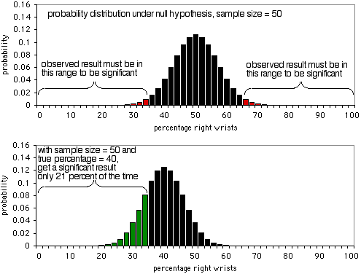

Slide 15
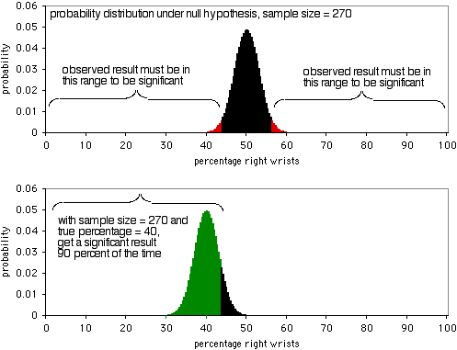

Slide 16
Monte Carlo Example
Simple test: Is the group mean greater or less than zero?
Let’s compare to online power calculator at
http://www.divms.uiowa.edu/~rlenth/Power/

Slide 17
What is a good value for power?
Conventionally, power = 0.80 is treated as “good”
Kind of a magic number
  How much risk are you willing to accept?

Slide 18
Comments? Questions?

Slide 19
I need 3 volunteers

Slide 20
Play with calculator
http://www.cs.uiowa.edu/~rlenth/Power/
Two-sample t-test

Slide 21
Volunteer #1
  If the true effect size is 0.5 σ,
  how big a sample do you need to achieve Power = 0.8?

Slide 22
Volunteer #2
  If the true effect size is 0.2 σ,
  how big a sample do you need to achieve Power = 0.8?

Slide 23
Volunteer #3
  If your control condition gains 20 points pre-post
  And your experimental condition gains 40 points pre-post
  And the pooled standard deviation is 30 points
  And you have 20 students in each condition
  What’s your statistical power?

Slide 24
Comments? Questions?

Slide 25
How can statistical power be increased?
Both in theory, and in real life

Slide 26
How can statistical power be increased?
Increase sample size

Slide 27
How can statistical power be increased?
Increase difference in means
  Make your intervention better

Slide 28
How can statistical power be increased?
Increase difference in means
  Make your control condition worse
    Some researchers make the mistake of picking a control condition that’s impossibly good
      ScienceAssistments versus
      ScienceAssistments, with one less potential IV
    This doesn’t mean you should fish for a control condition that is absurdly awful
      Principle-based explanation in ASSISTments versus
      Explaining fractions through interpretive dance
      Fun fractions game versus
      Learning math through reading textbooks

Slide 29
How can statistical power be increased?
Increase difference in means
  Make your control condition worse
    Some researchers make the mistake of picking a control condition that’s impossibly good
      ScienceAssistments versus
      ScienceAssistments, with one less potential IV
    This doesn’t mean you should fish for a control condition that is absurdly awful
      Principle-based explanation in ASSISTments versus
      Explaining fractions through interpretive dance
      Fun fractions game versus
      Learning math through reading textbooks written in Danish

Slide 30
How can statistical power be increased?
Reduce standard deviation through
  more homogenous sample
  stratification of sample (and include stratification in model)
  Improvement of measure reliability

Slide 31
Comments? Questions?

Slide 32
Jacob Cohen on Statistical Power
“It is not at all clear why researchers continue to ignore power analysis. The passive acceptance of this state of affairs by editors and reviewers is even more of a mystery. At least part of the reason may be the low level of consciousness about effect size… I have suggested that the neglect of power analysis simply exemplifies the slow movement of methodological advance… An associate editor of this journal suggests another reason: Researchers find too complicated, or do not have at hand, either my book or other reference material for power analysis”

Slide 33
Jacob Cohen on Statistical Power
It’s true that one sees
  Relatively few statistical power analyses in published papers
  More than a few analyses with low statistical power
Why might that be?
  Aside from “low levels of consciousness”

Slide 34
Some Reasons Why
Sample sizes determined by feasibility rather than a priori decision

Slide 35
Some Reasons Why
Larger sample sizes in real-world research often imply heterogeneity (and higher variance)
Between running a study with insignificant statistical power, and running no study at all…

Slide 36
Some Reasons Why
Hard to guess a priori what level of effect size is reasonable

Slide 37
Some Reasons Why
Statistical power harder to do for the complex statistical tests that are increasingly common

Slide 38
Asgn. 10
Questions?
Comments?

Slide 39

Next Class
No Class Monday!
Patriots Day

Slide 40
Next Class
Wednesday, April 18
3pm-5pm
AK232
Post-hoc Adjustments
Readings
Rosenthal, R., Rosnow, R.L. (1991) Essentials of Behavioral Research: Methods and Data Analysis, 2nd edition. p. 329-333.
Verhoven, K.J.F., Simonsen, K.L., McIntyre, L.M. (2005)Implementing false discovery rate control: increasing your power. Oikos, 108, 643-647.
Assignments Due: None

Slide 41
The End

