Slide 1
Advanced Methods and Analysis for the Learning and Social Sciences
PSY505
Spring term, 2012
February 27, 2012

Slide 2
Today’s Class
Regression and Regressors

Slide 3
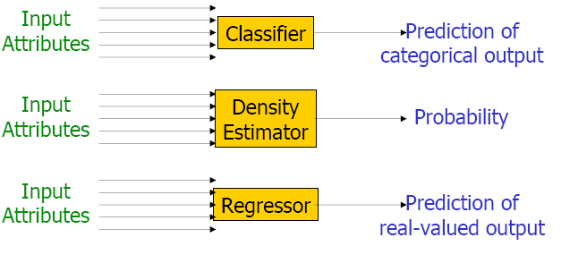
Two Key Types of Prediction
This slide adapted from slide by Andrew W. Moore, Google
http://www.cs.cmu.edu/~awm/tutorials

Slide 4
Regression
There is something you want to predict (“the label”)
The thing you want to predict is numerical
  Number of hints student requests
  How long student takes to answer
  What will the student’s test score be

Slide 5
Regression
Associated with each label are a set of “features”, which maybe you can use to predict the label
Skill pknow time totalactions numhints
ENTERINGGIVEN 0.704 9 1 0
ENTERINGGIVEN 0.502 10 2 0
USEDIFFNUM 0.049 6 1 3
ENTERINGGIVEN 0.967 7 3 0
REMOVECOEFF 0.792 16 1 1
REMOVECOEFF 0.792 13 2 0
USEDIFFNUM 0.073 5 2 0
….

Slide 6
Regression
The basic idea of regression is to determine which features, in which combination, can predict the label’s value
Skill pknow time totalactions numhints
ENTERINGGIVEN 0.704 9 1 0
ENTERINGGIVEN 0.502 10 2 0
USEDIFFNUM 0.049 6 1 3
ENTERINGGIVEN 0.967 7 3 0
REMOVECOEFF 0.792 16 1 1
REMOVECOEFF 0.792 13 2 0
USEDIFFNUM 0.073 5 2 0
….

Slide 7
Linear Regression
The most classic form of regression is linear regression

Slide 8
Linear Regression
The most classic form of regression is linear regression
Numhints = 0.12*Pknow + 0.932*Time –
0.11*Totalactions
Skill pknow time totalactions numhints
COMPUTESLOPE 0.544 9 1 ?

Slide 9
Linear Regression
Linear regression only fits linear functions (except when you apply transforms to the input variables, which most statistics and data mining packages can do for you…)

Slide 10
Non-linear inputs
What kind of functions could you fit with
Y = X²
Y = X³
Y = sqrt(X)
Y = 1/x
Y = sin X
Y = ln X

Slide 11
Linear Regression
However…
It is blazing fast
It is often more accurate than more complex models, particularly once you cross-validate
  Data Mining’s “Dirty Little Secret”
  Caruana & Niculescu-Mizil (2006)
It is feasible to understand your model
(with the caveat that the second feature in your model is in the context of the first feature, and so on)

Slide 12
Example of Caveat
Let’s study a classic example

Slide 13
Example of Caveat
Let’s study a classic example
Drinking too much prune nog at a party, and having to make an emergency trip to the Little Researcher’s Room

Slide 14
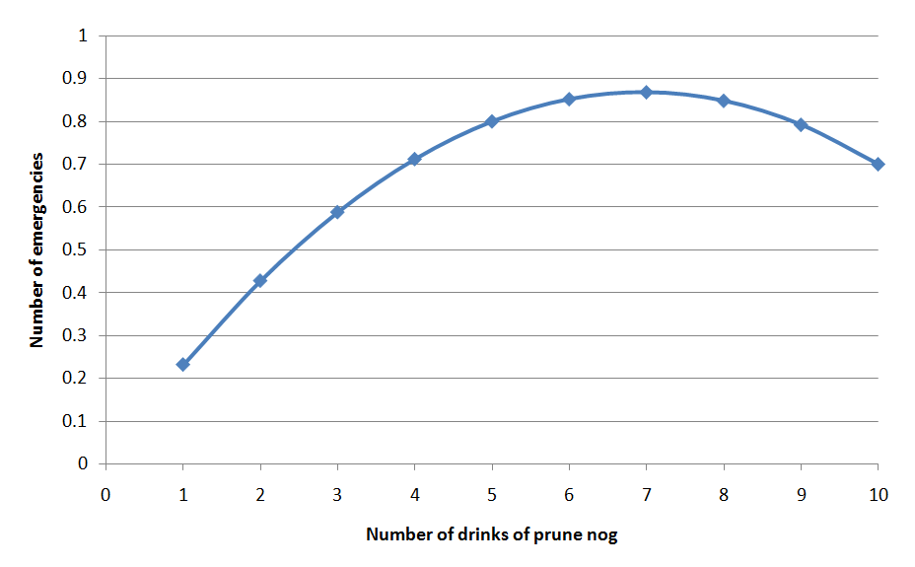
Data

Slide 15
Data
Some people are resistent to the deletrious effects of prunes and can safely enjoy high quantities of prune nog!

Slide 16
Learned Function
Probability of “emergency”=
0.25 * # Drinks of nog last 3 hours
- 0.018 * (Drinks of nog last 3 hours)²
But does that actually mean that
(Drinks of nog last 3 hours)² is associated with less “emergencies”?

Slide 17
Learned Function
Probability of “emergency”=
0.25 * # Drinks of nog last 3 hours
- 0.018 * (Drinks of nog last 3 hours)²
But does that actually mean that
(Drinks of nog last 3 hours)² is associated with less “emergencies”?
No!

Slide 18
Example of Caveat
(Drinks of nog last 3 hours)² is actually positively correlated with emergencies!
  r=0.59

Slide 19
Example of Caveat
The relationship is only in the negative direction when (Drinks of nog last 3 hours) is already in the model…

Slide 20
Example of Caveat
So be careful when interpreting linear regression models (or almost any other type of model)

Slide 21
Comments? Questions?

Slide 22
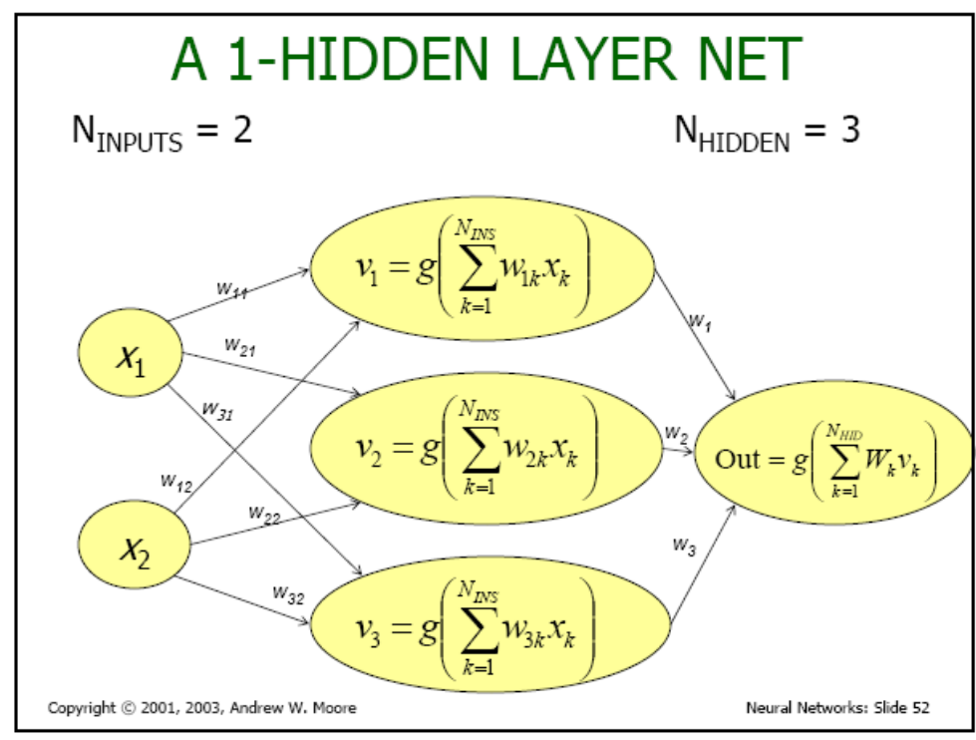
Neural Networks
Another popular form of regression is neural networks
(called
Multilayer
Perceptron
in Weka)
This image courtesy of Andrew W. Moore, Google
http://www.cs.cmu.edu/~awm/tutorials

Slide 23
Neural Networks
Neural networks can fit more complex functions than linear regression
It is usually near-to-impossible to understand what the heck is going on inside one

Slide 24
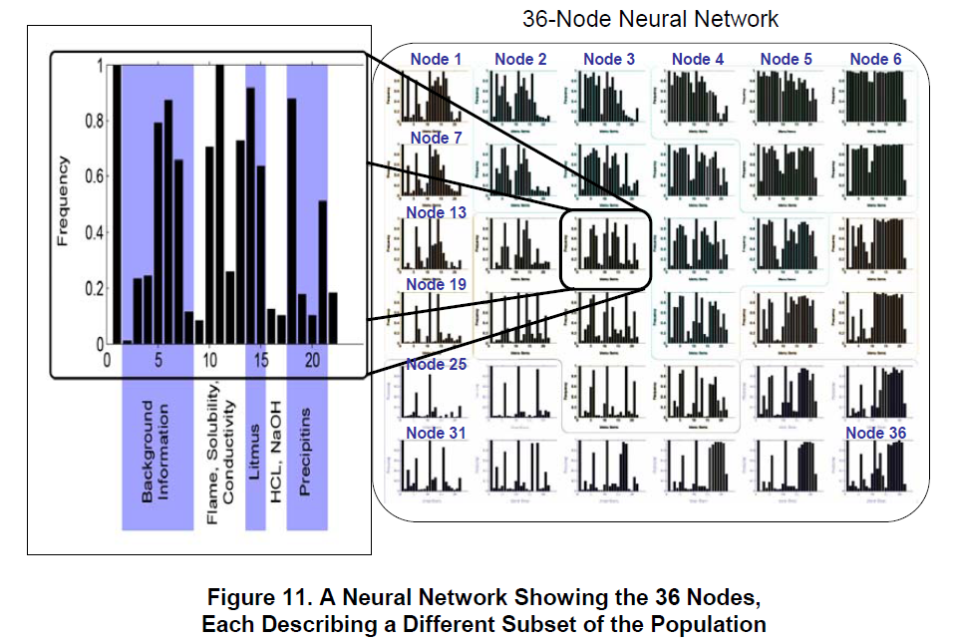
Soller & Stevens (2007)

Slide 25
In fact
The difficulty of interpreting non-linear models is so well known, that New York City put up a road sign about it

Slide 26
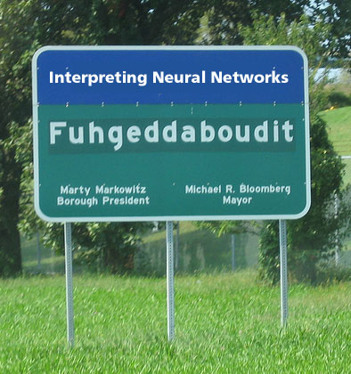

Slide 27
Regression Trees

Slide 28
Regression Trees (non-Linear)
If X>3
  Y = 2
  else If X<-7
    Y = 4
    Else Y = 3

Slide 29
Linear Regression Trees
(Model Trees, RepTree)
If X>3
  Y = 2A + 3B
  else If X< -7
    Y = 2A – 3B
    Else Y = 2A + 0.5B + C

Slide 30
Create a Linear Regression Tree to
Predict Emergencies

Slide 31
And of course…
There are lots of fancy regressors in any Data Mining package
SMOReg (support vector machine)
Poisson Regression
LOESS Regression
For more, see http://www.autonlab.org/tutorials/bestregress11.pdf
http://www.autonlab.org/tutorials/neural13.pdf
http://www.autonlab.org/tutorials/svm15.pdf

Slide 32
Assignment 6
Let’s discuss your solutions to assignment 6

Slide 33
How can you tell if a regression model is any good?

Slide 34
How can you tell if a regression model is any good?
Correlation is a classic method
(Or its cousin r²)

Slide 35
What data set should you generally test on?
The data set you trained your classifier on
A data set from a different tutor
Split your data set in half, train on one half, test on the other half
Split your data set in ten. Train on each set of 9 sets, test on the tenth. Do this ten times.
Any differences from classifiers?

Slide 36
What are some stat tests you could use?

Slide 37
What about?
Take the correlation between your prediction and your label
Run an F test
So
F(1,9998)=50.00, p<0.00000000001

Slide 38
What about?
Take the correlation between your prediction and your label
Run an F test
So
F(1,9998)=50.00, p<0.00000000001
All cool, right?

Slide 39
As before…
You want to make sure to account for the non-independence between students when you test significance
An F test is fine, just include a student term

Slide 40
As before…
You want to make sure to account for the non-independence between students when you test significance
An F test is fine, just include a student term
(but note, your regressor itself should not predict using student as a variable… unless you want it to only work in your original population)

Slide 41
Alternatives
Bayesian Information Criterion
(Raftery, 1995)
Makes trade-off between goodness of fit and flexibility of fit (number of parameters)
i.e. Can control for the number of parameters you used and thus adjust for overfitting
Said to be statistically equivalent to k-fold cross-validation

Slide 42
Asgn. 7

Slide 43
Next Class
Wednesday, February 29
3pm-5pm
AK232
Learnograms
Readings
None
Assignments Due: None

Slide 44
The End

Slide 45
Bonus Slides
If there’s time

Slide 46
BKT with Multiple Skills

Slide 47
Conjunctive Model
(Pardos et al., 2008)
The probability a student can answer an item with skills A and B is
P(CORR|A^B) = P(CORR|A) * P(CORR|B)
But how should credit or blame be assigned to the various skills?

Slide 48
Koedinger et al.’s (2011)
Conjunctive Model
Equations for 2 skills

Slide 49
Koedinger et al.’s (2011)
Conjunctive Model
Generalized equations

Slide 50
Koedinger et al.’s (2011)
Conjunctive Model
Handles case where multiple skills apply to an item better than classical BKT

Slide 51
Other BKT Extensions?
Additional parameters?
Additional states?

Slide 52
Many others
Compensatory Multiple Skills (Pardos et al., 2008)
Clustered Skills (Ritter et al., 2009)

