Slide 1
Adaptive Learning Systems
EDUC5183

Slide 2
Welcome!

Slide 3
We continue today…
With “The educational technology of the future”

Slide 4
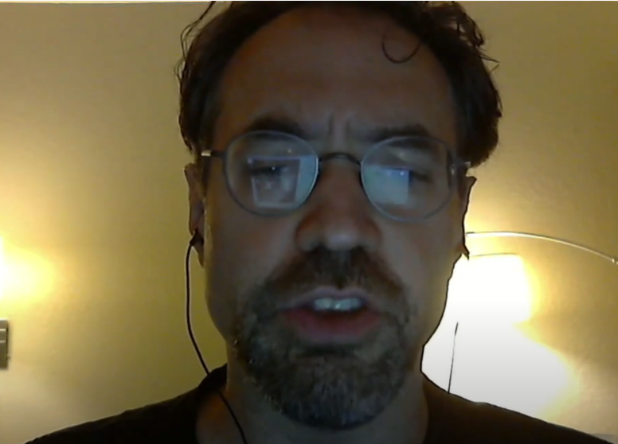
We continue today…
With “The educational technology of the future”
“And it always will be. Hah.”

Slide 5
We continue today…
With “The educational technology of the future”
“And it always will be. Hah.”
But it looks like he was
wrong!

Slide 6
Tutorial Dialogue aka
Knowledge Construction Dialogues
This technology always seemed exciting, but too expensive to really develop for a wide range of content

Slide 7
But suddenly…
Thanks to large language models, this seems tantalizingly within reach

Slide 8
The Classic Dialogue Tutor
AutoTutor
[play video here]
https://www.youtube.com/watch?v=jDNXG09vFqo&t=49s

Slide 9
How does it work?

Slide 10


To learn, we go to the Maestros
Art Graesser
Kurt VanLehn

Slide 11
Alas, no dialogue tutor is available
Art Graesser
Kurt VanLehn

Slide 12
But they have been kind enough to put slides on the web
Art Graesser
Kurt VanLehn

Slide 13
A framework for thinking about dialogue tutors
(VanLehn, 2009)

Slide 14
Human tutorial dialogue is a sequence of episodes, one per step
Slide from VanLehn (2009)
Q: Why does a computer need disk as well as RAM?
Step
S: RAM is too small. Only the disk is big enough.
T: That’s usually true.
But suppose you bought a lot of RAM? Why wouldn’t that work?
S: The battery would run out too fast.
T: Excellent.
What else?
S: That’s it.
T: What if the battery dies?
S: Oh. The RAM dies.
T: Anything wrong with that?
S: You lose your files.
T: Besides the user’s files, what else would be lost?
S: Beats me.
T: The operating system!
Step
Step

Slide 15
Schematic of tutorial dialogue
Slide from VanLehn (2009)
Problem statement
Step
Step
Step
Step
Answer
Reflection (optional)

Slide 16
Schematic of dialogue about a single step
Slide from VanLehn (2009)
Step
end
T: Tell
Step
start
T: Elicit
S: Correct
Remediation:
T: Hint, or prompt, or explain, or analogy, or …
S: Incorrect

Slide 17
Comparisons of expert to novice human tutors
Slide from VanLehn (2009)
Step
end
Novices
T: Tell
Step
start
Experts
T: Elicit
S: Correct
T: Hint, or prompt, or explain, or analogy, or …
S: Incorrect
Experts may have a wider variety

Slide 18
Fairly simple process
How does it work in the most complex/complete system before LLMs, AutoTutor?

Slide 19
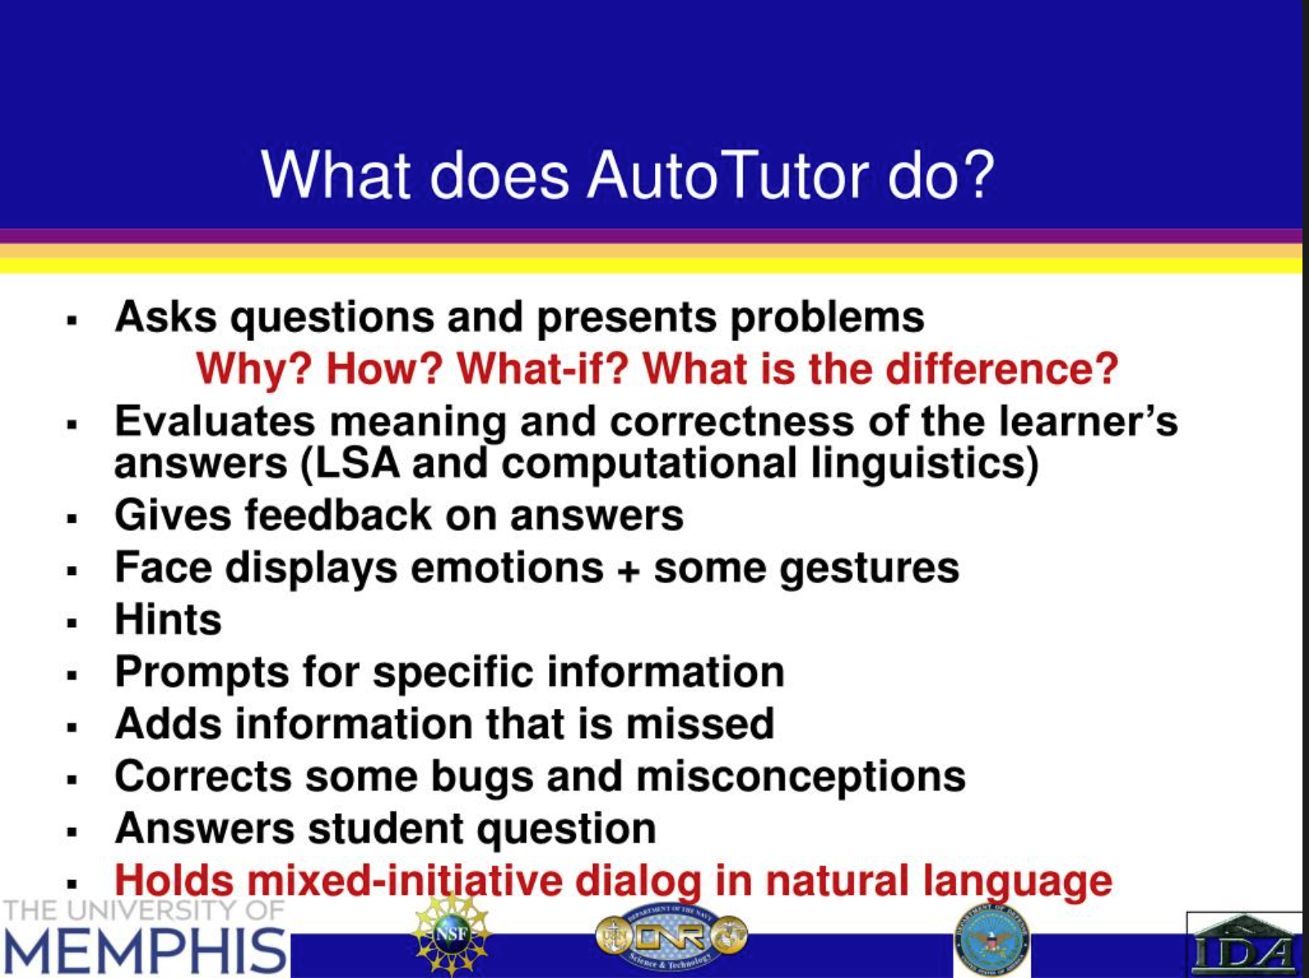
Slide from Graesser (2017)

Slide 20
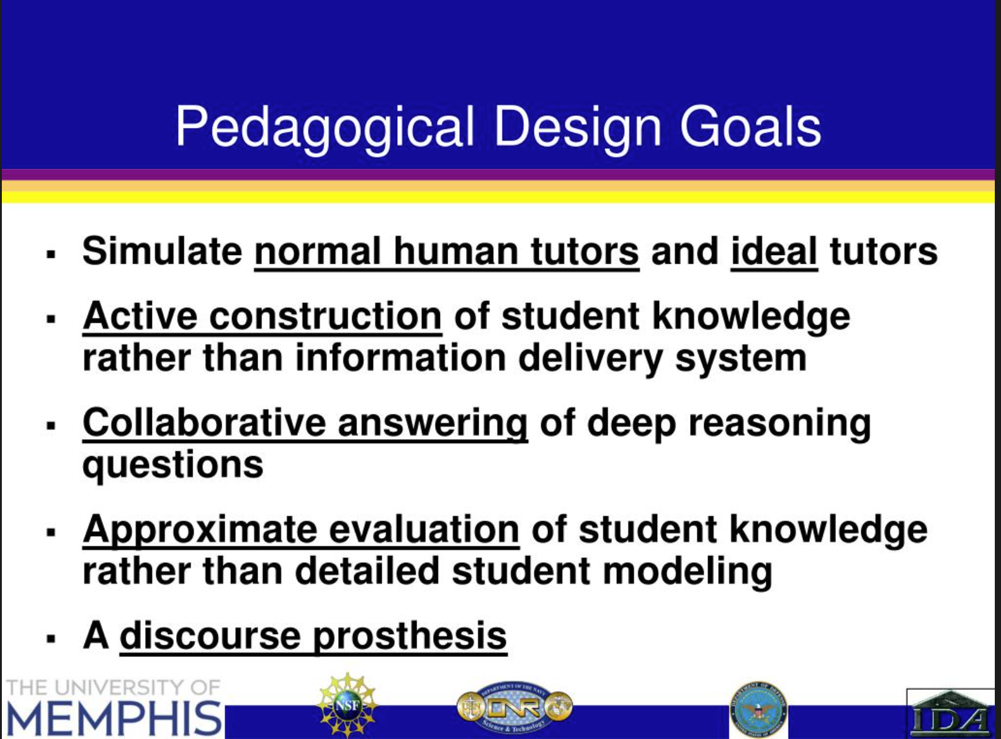
Slide from Graesser (2017)

Slide 21
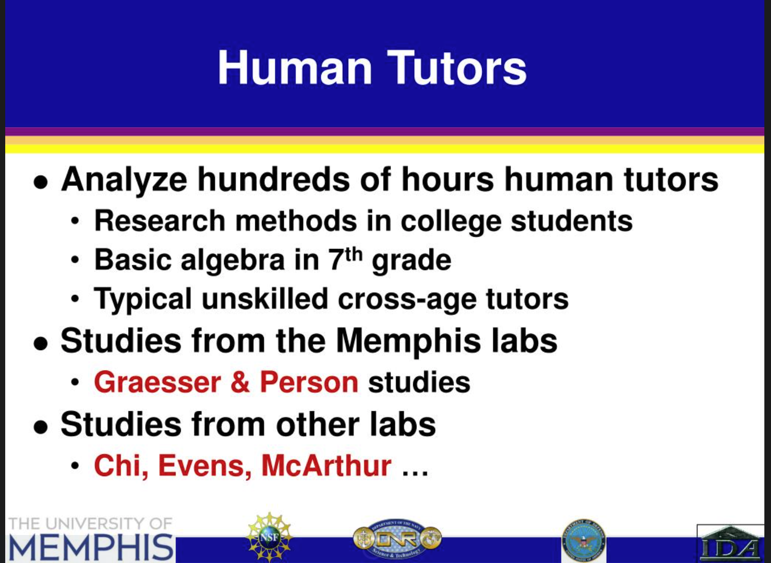
Slide from Graesser (2017)

Slide 22
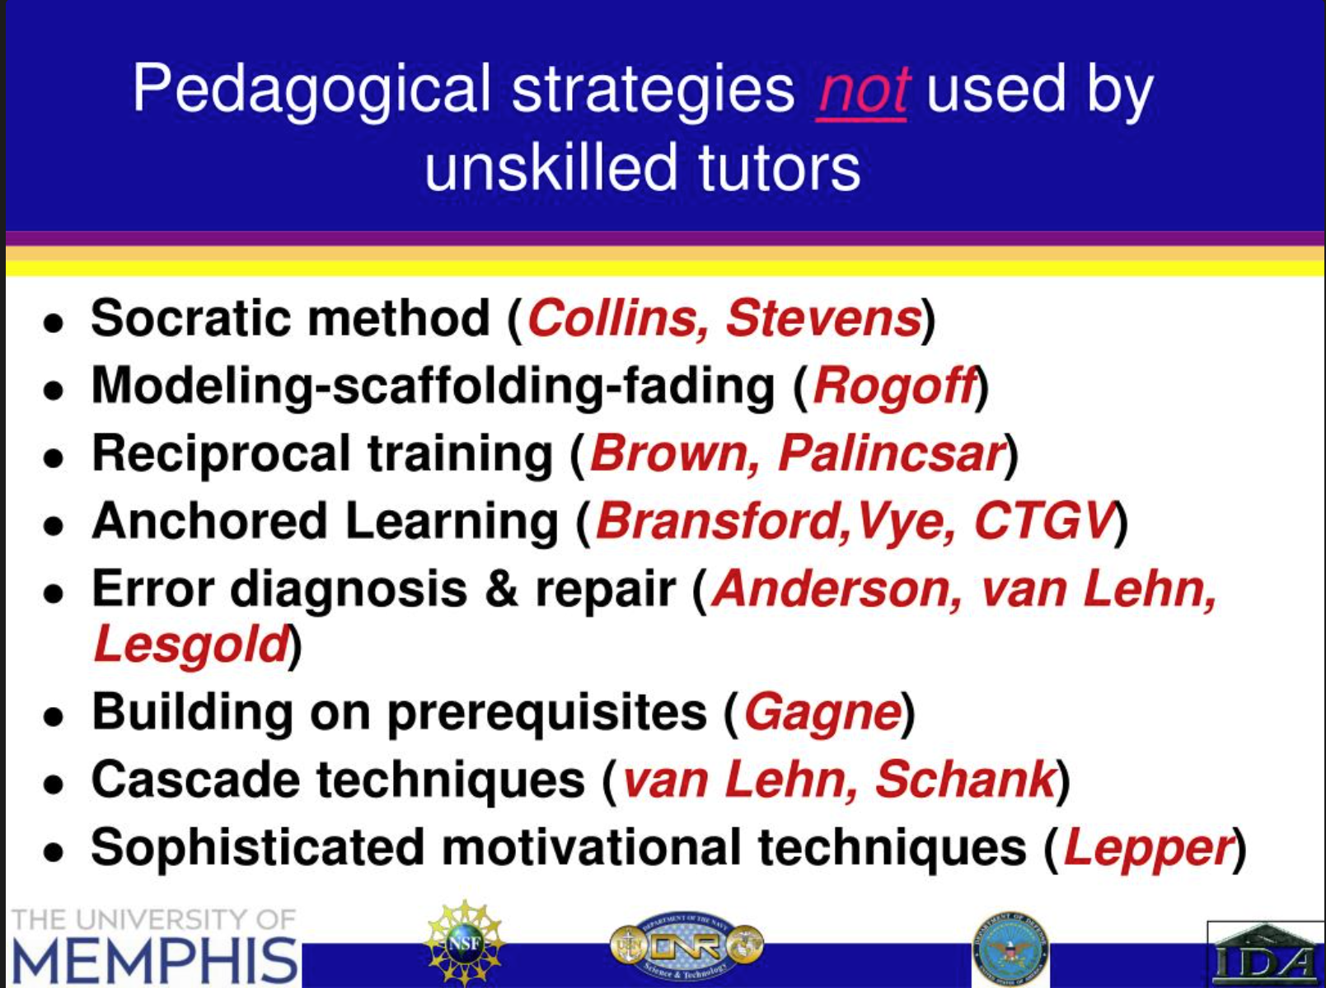
Slide from Graesser (2017)

Slide 23
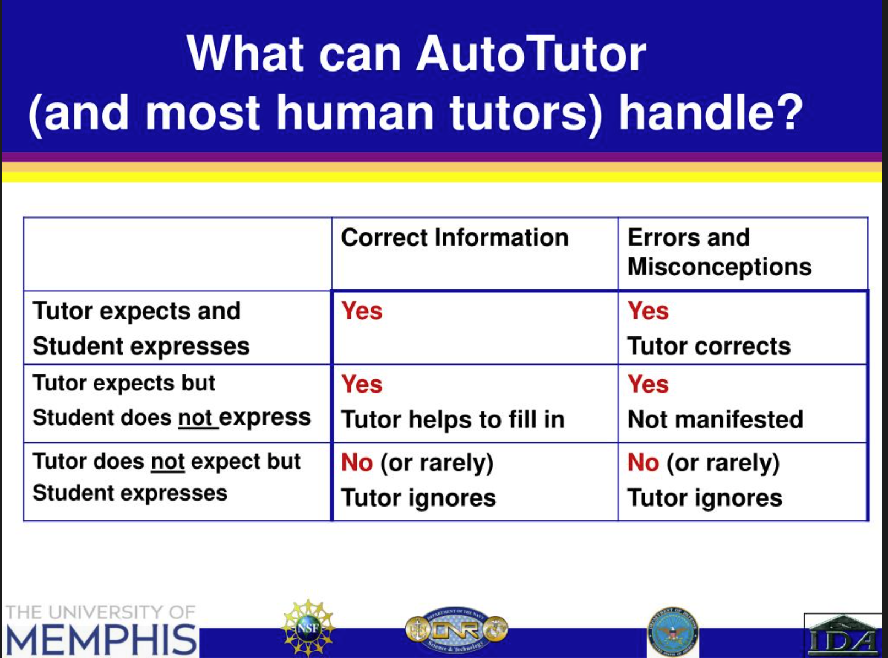
Slide from Graesser (2017)

Slide 24
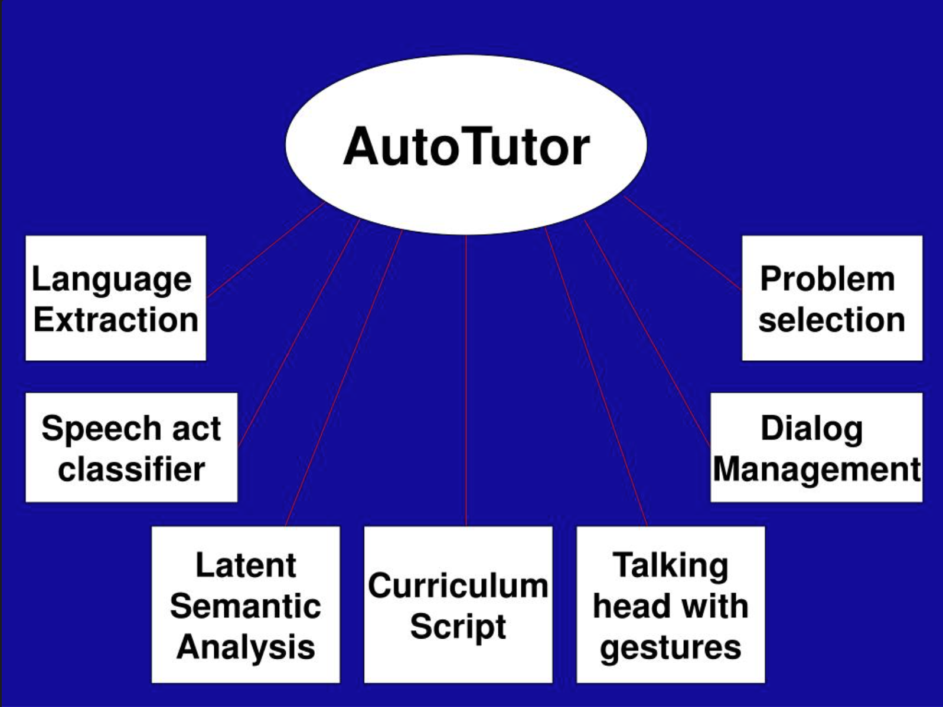
Slide from Graesser (2017)

Slide 25
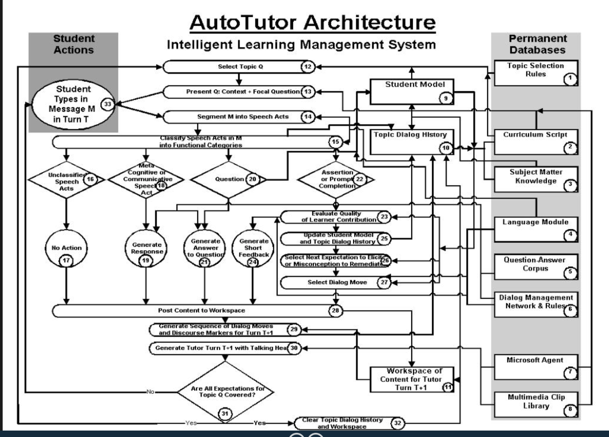
Slide from Graesser (2017)

Slide 26
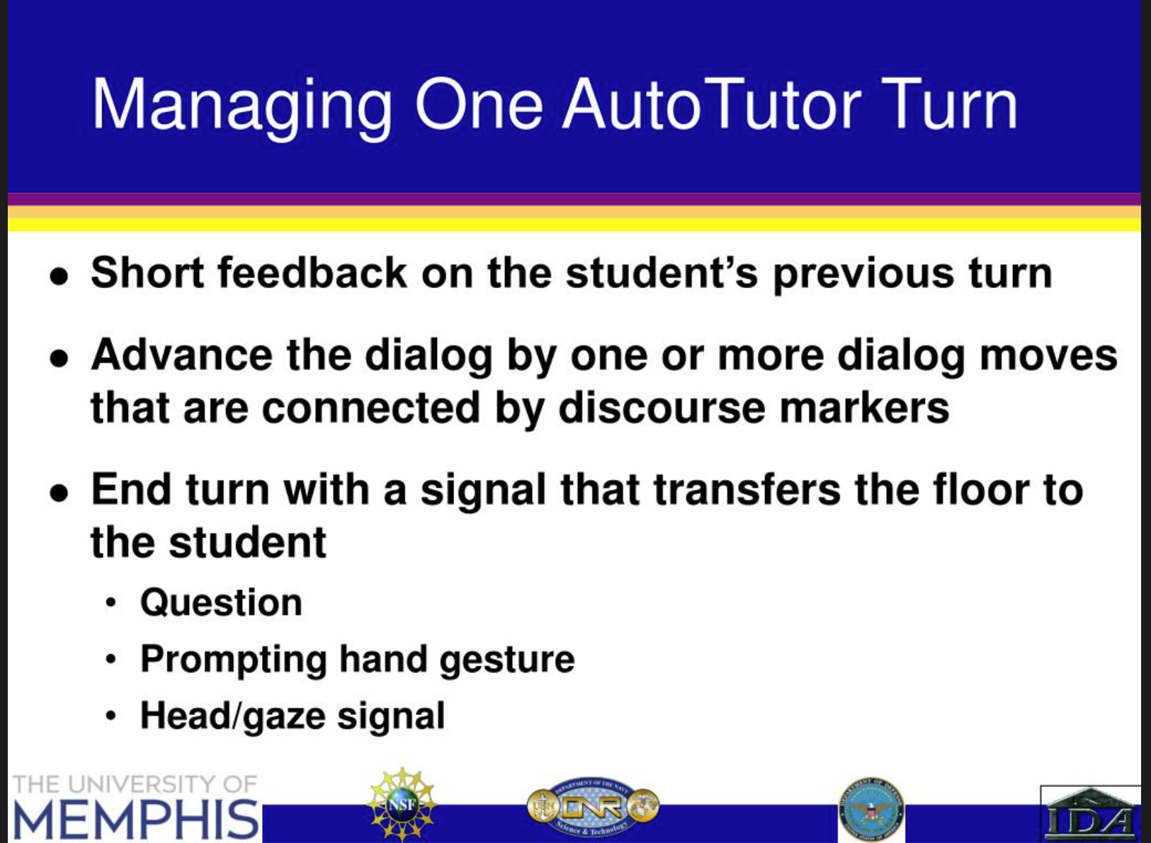
Slide from Graesser (2017)

Slide 27
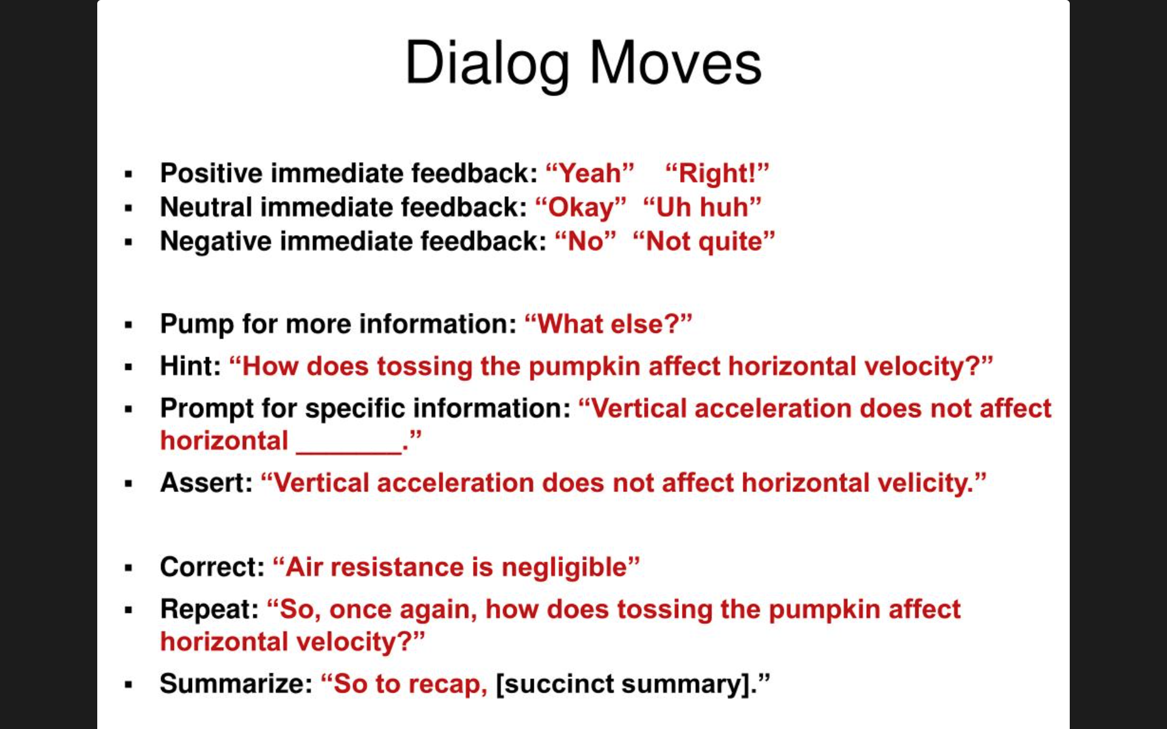
Slide from Graesser (2017)

Slide 28
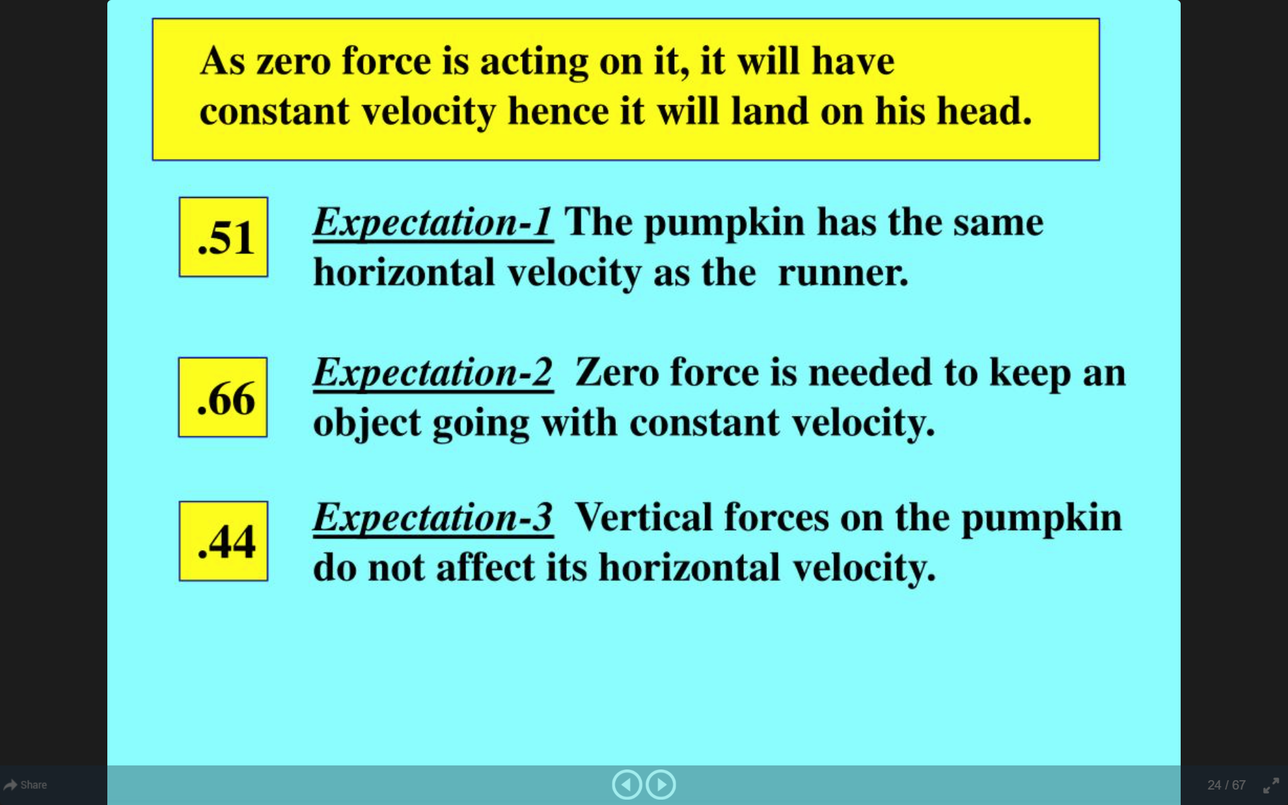
Slide from Graesser (2017)

Slide 29
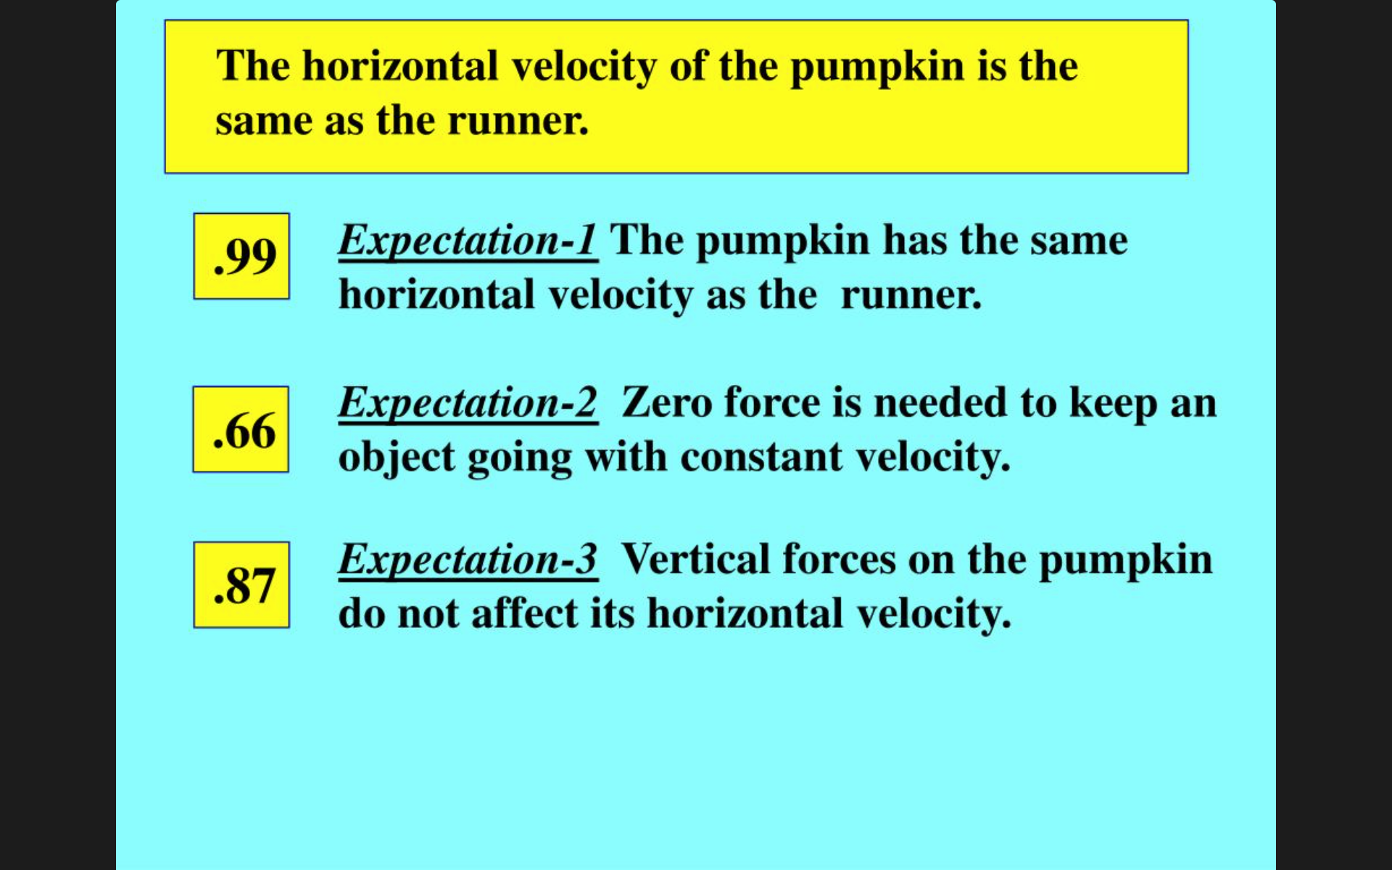
Slide from Graesser (2017)

Slide 30
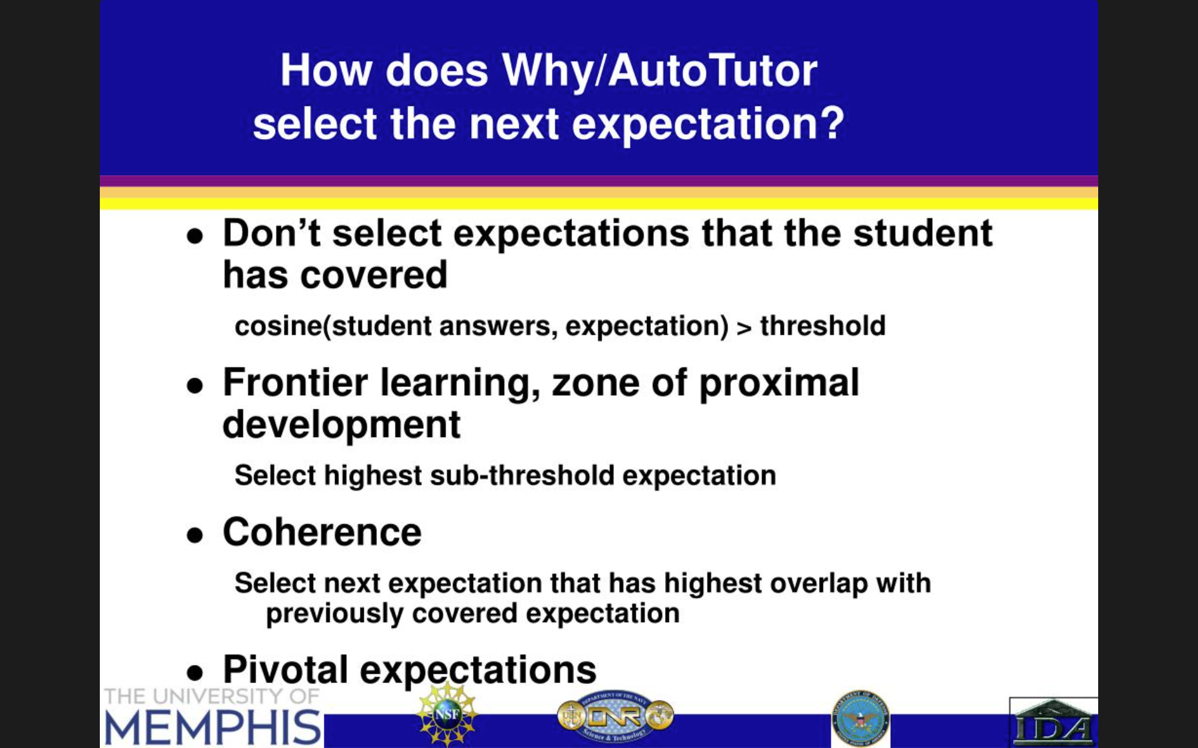
Slide from Graesser (2017)

Slide 31
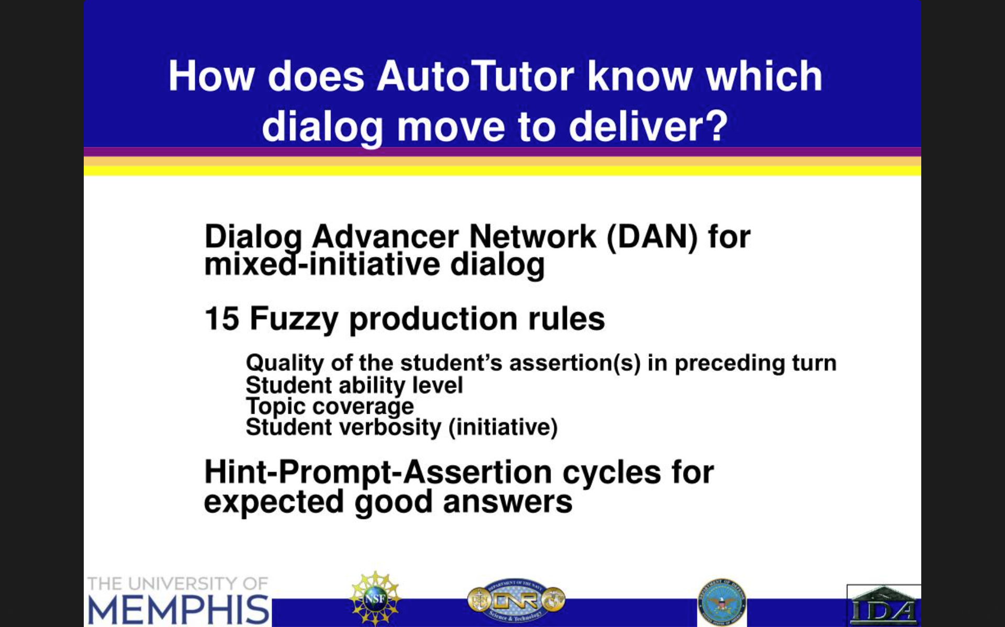
Slide from Graesser (2017)

Slide 32
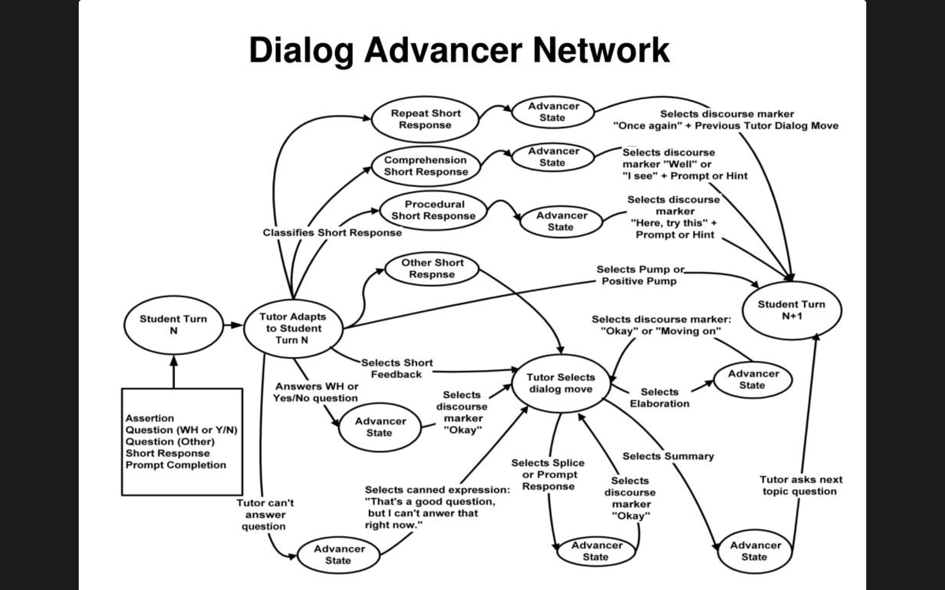
Slide from Graesser (2017)

Slide 33
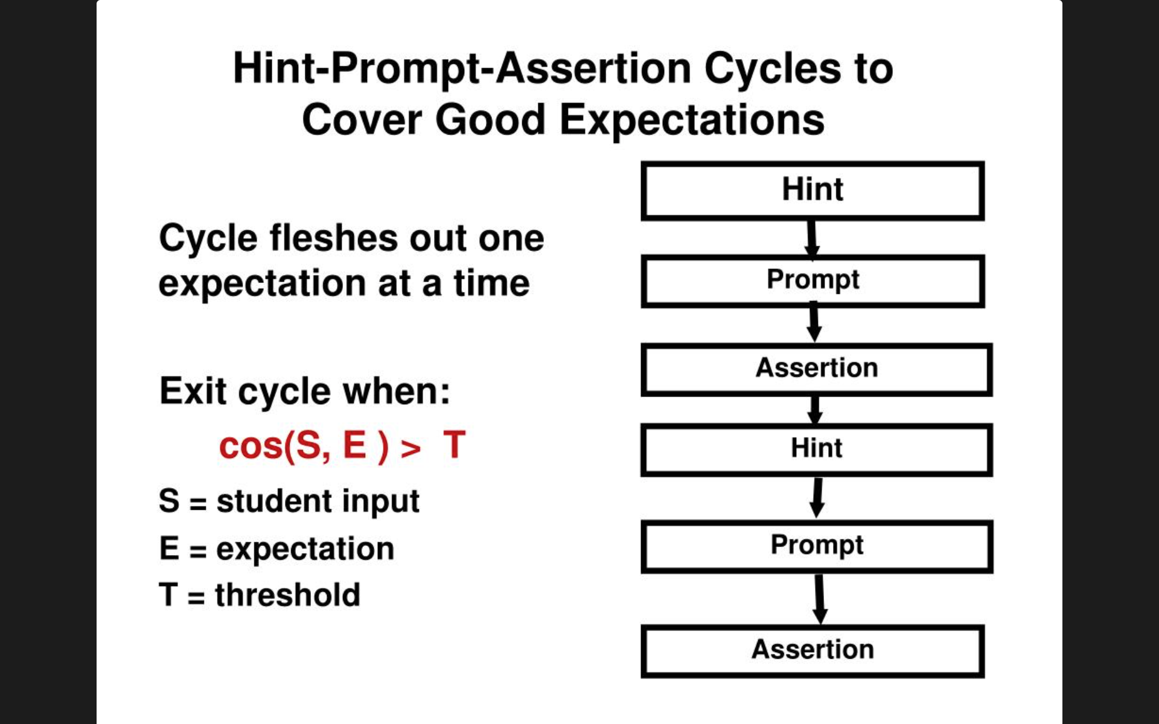
(Graesser, Person, & Magliano, 1995)
Slide from Graesser (2017), Modified by Baker (2023)

Slide 34
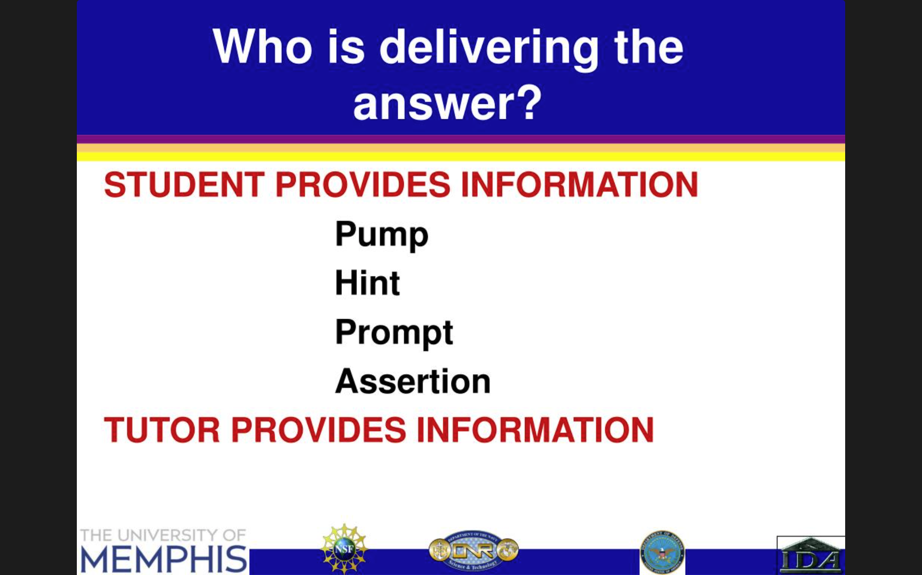
(Graesser, Person, & Magliano, 1995)
Slide from Graesser (2017), Modified by Baker (2023)

Slide 35
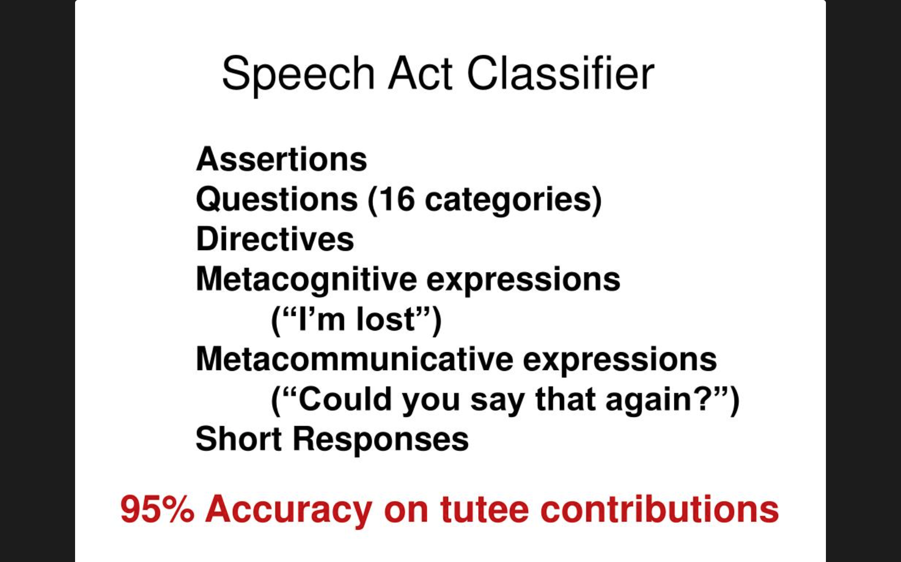
Slide from Graesser (2017)

Slide 36
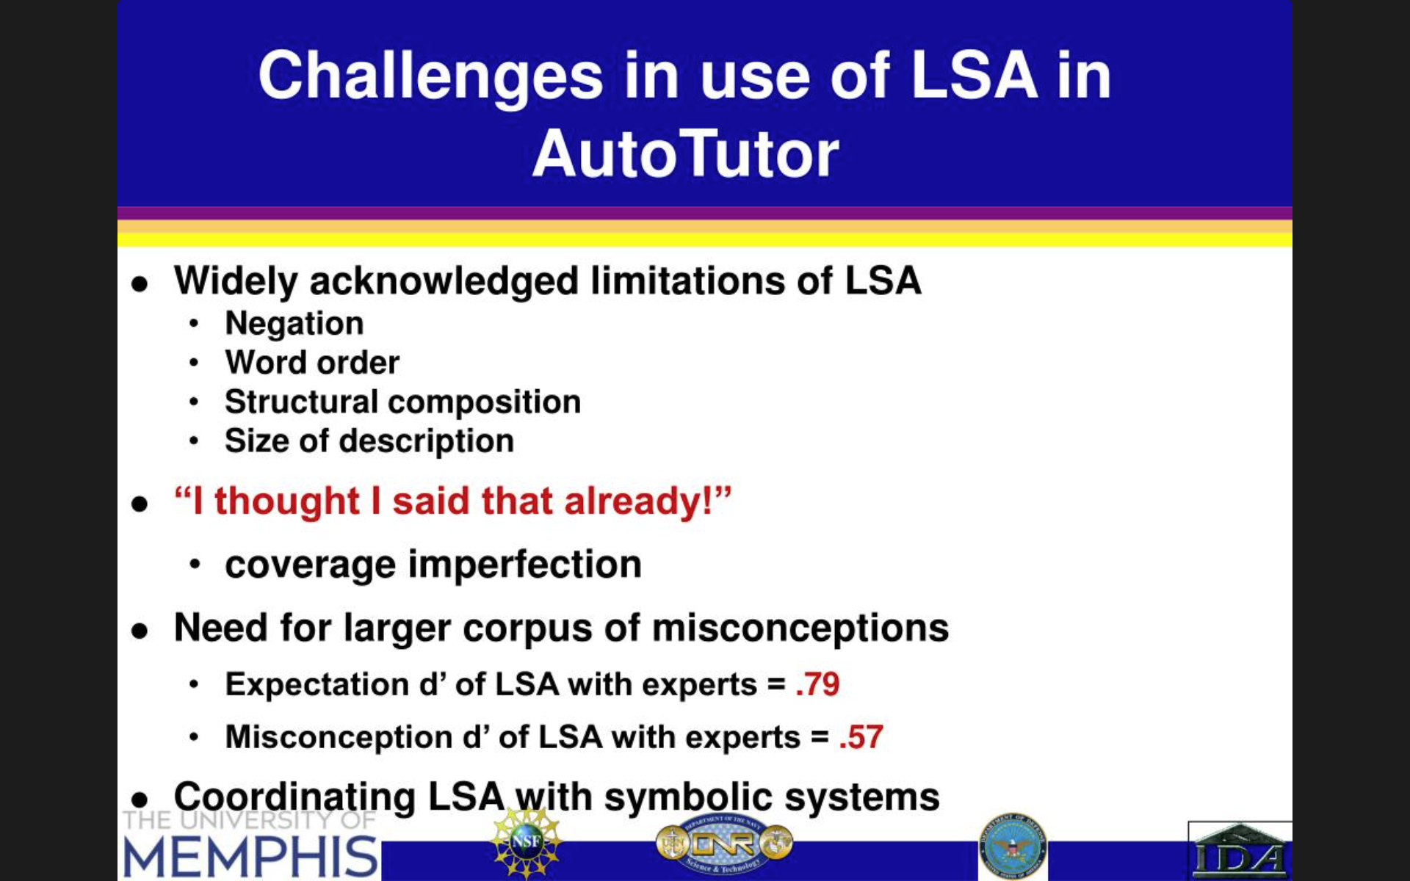
Slide from Graesser (2017)

Slide 37
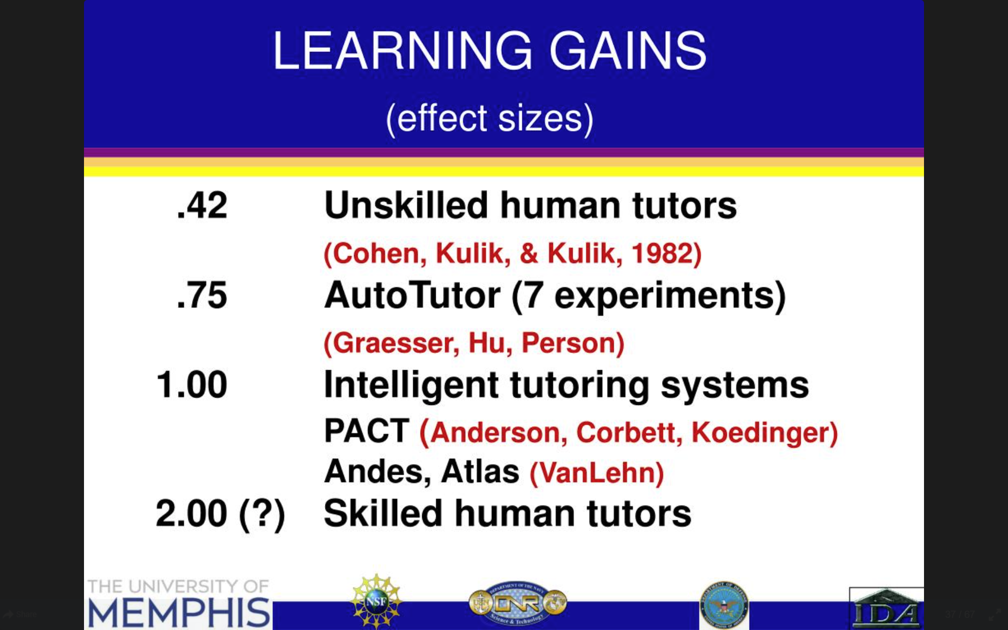
Slide from Graesser (2017)

Slide 38
AutoTutor Lite (Hu et al., 2009)
Building AutoTutor content is expensive and time-consuming
Essentially, one-PhD-student-PhD-duration to build a tutor on a specific topic
  About the same as a model tracing tutor

Slide 39
AutoTutor Lite (Hu et al., 2009)
Designed for easier authoring
Does not offer full range of semantic analysis methods
  Limited to LSA and keyword-based analysis
Simplified student model
  Relevance of the contribution (calculated as the degree of semantic similarity to expected answers)
  Novelty (semantic similarity to the learner’s previous contributions)
  Does not detect misconceptions
Much less dialog flexibility
  Focuses on question and answer
  Gives prompts to incomplete answers
  Can also offer vicarious tutoring

Slide 40

ITSPOKE (Litman & Silliman, 2014)
A dialogue tutor, but speaking out loud
Built on Why2-Atlas tutor (VanLehn et al., 2002)
Can detect uncertainty/confusion from speech patterns, tone of voice (Litman & Forbes-Riley, 2011, 2013)
  Responds to uncertain correct answers by giving additional info on why answer is correct and continuing discussion
  Did not improve learning outcomes

Slide 41
Watson Tutor
(Ventura et al., 2018; Afzal et al., 2019)
Large-scale use of AutoTutor-style approach for several courses
  Also adds multimedia hints
Papers were vague on what courses it is integrated into, but Afzal et al. (2019) shows examples from what appears to be middle school physical science

Slide 42
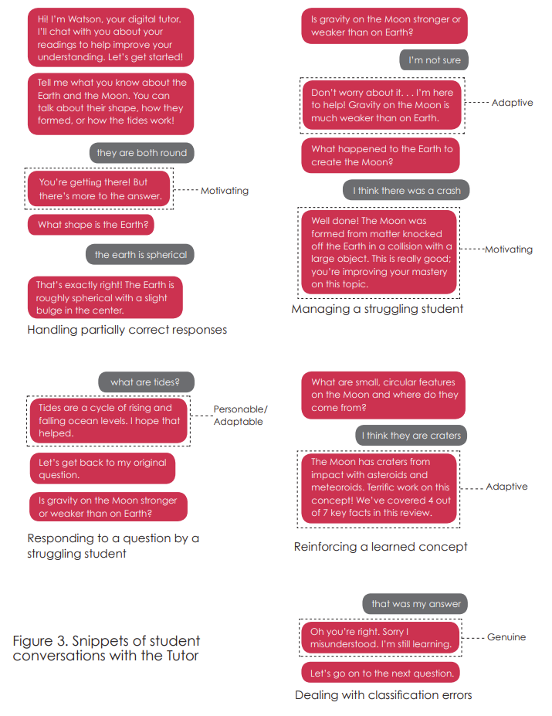

Slide 43
Watson Tutor
(Ventura et al., 2018; Afzal et al., 2019)
It was super expensive to build

Slide 44
Watson Tutor
(Ventura et al., 2018; Afzal et al., 2019)
It was super expensive to build
It’s gone now

Slide 45
KorbitITS
(Kulshreshtha et al., 2022)
Dialogue Tutor for data science that generates responses using foundation model AI
  Breaks student answer into cause-effect components
  Matches components to reference answers using foundation model

Slide 46
KorbitITS
(Kulshreshtha et al., 2022)
Generates feedback based on
  Example responses for other topics
  Correct reference answers
  Foundation model to combine these into feedback for current question
  Algorithm that ranks possible responses based on foundation models detectors of sentence
    Well-formedness
    Perplexity (bad)
    Likelihood of leading to complex (non-yes/no) response
    Semantic relationship to desired target sentence

Slide 47
KorbitITS
(Kulshreshtha et al., 2022)
Four feedback cases
  Incorrect cause and incorrect effect
  Incorrect cause alone
  Incorrect effect alone
  Missing cause

Slide 48
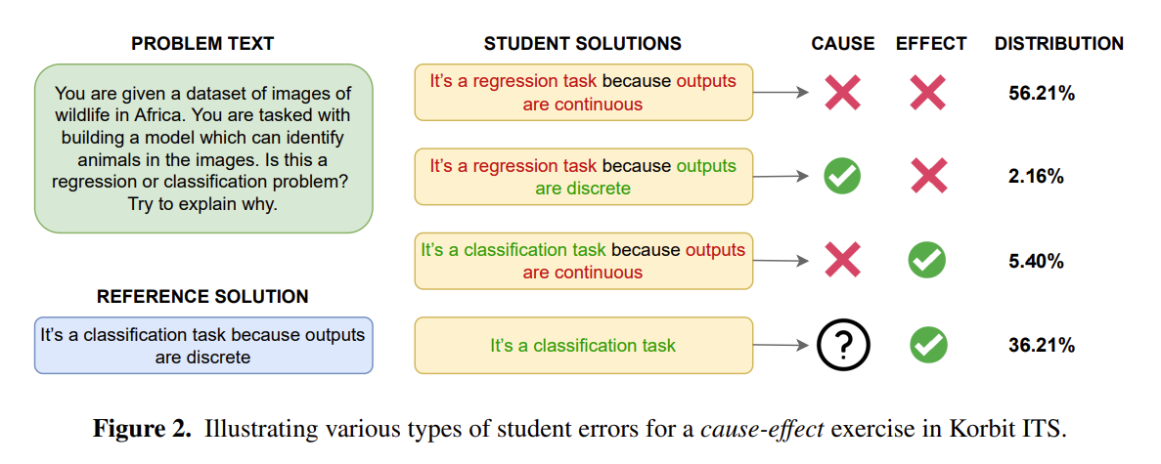
KorbitITS
(Kulshreshtha et al., 2022)

Slide 49
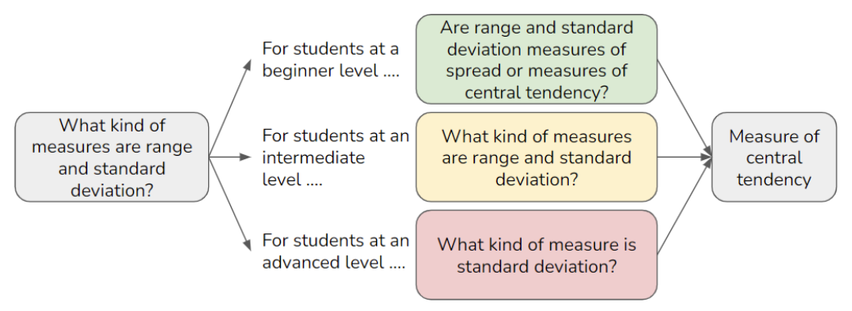
KorbitITS
(Elkins et al., 2022)
System adapts question for students of different overall ability
While retaining same answer

Slide 50
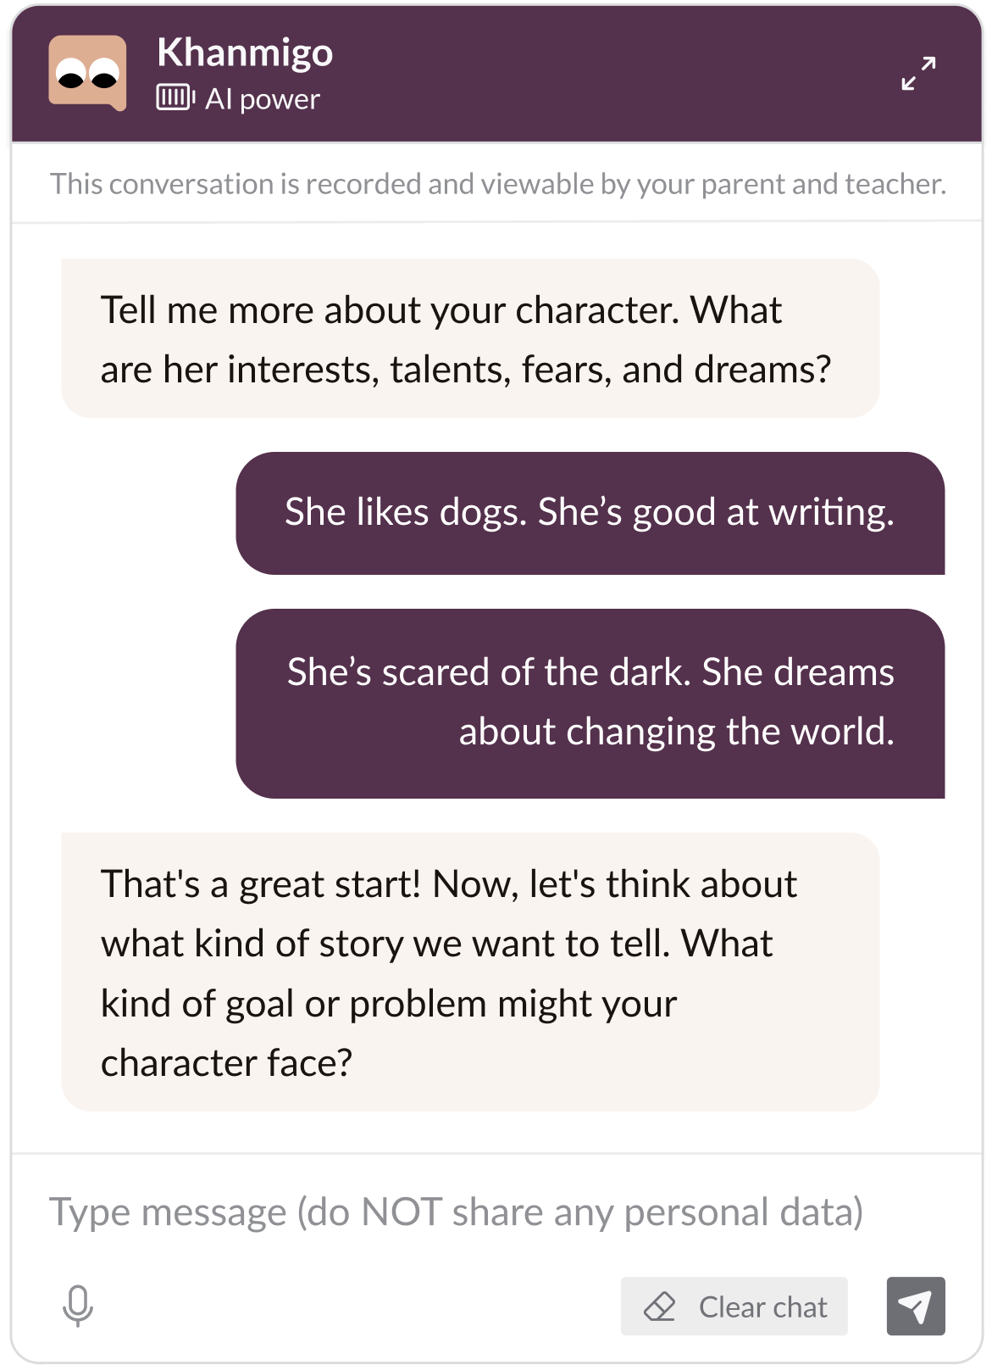
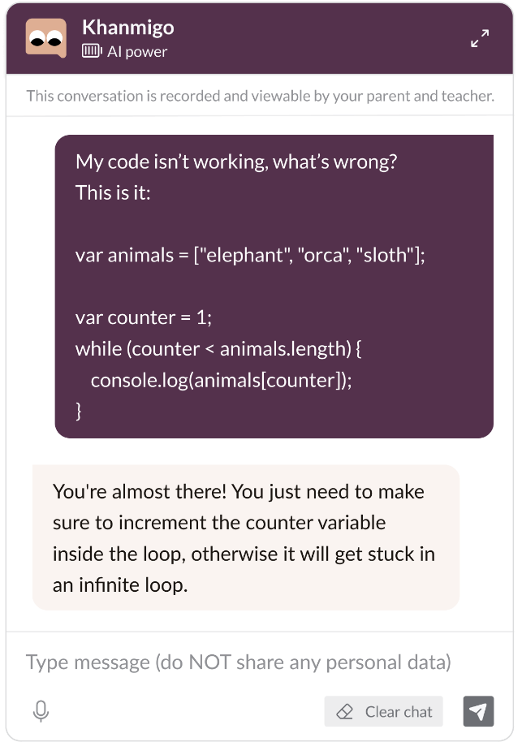
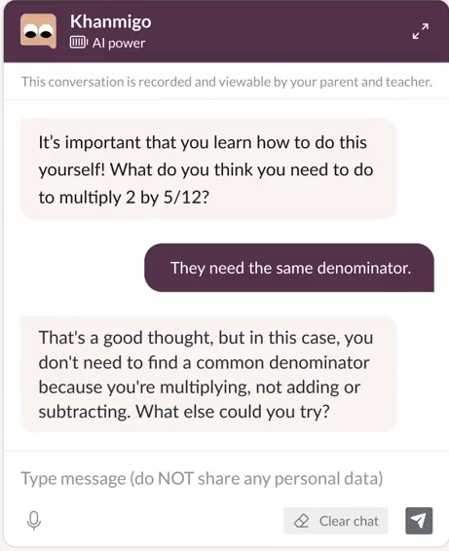
Khanmigo based on GPT (2023)

Slide 51
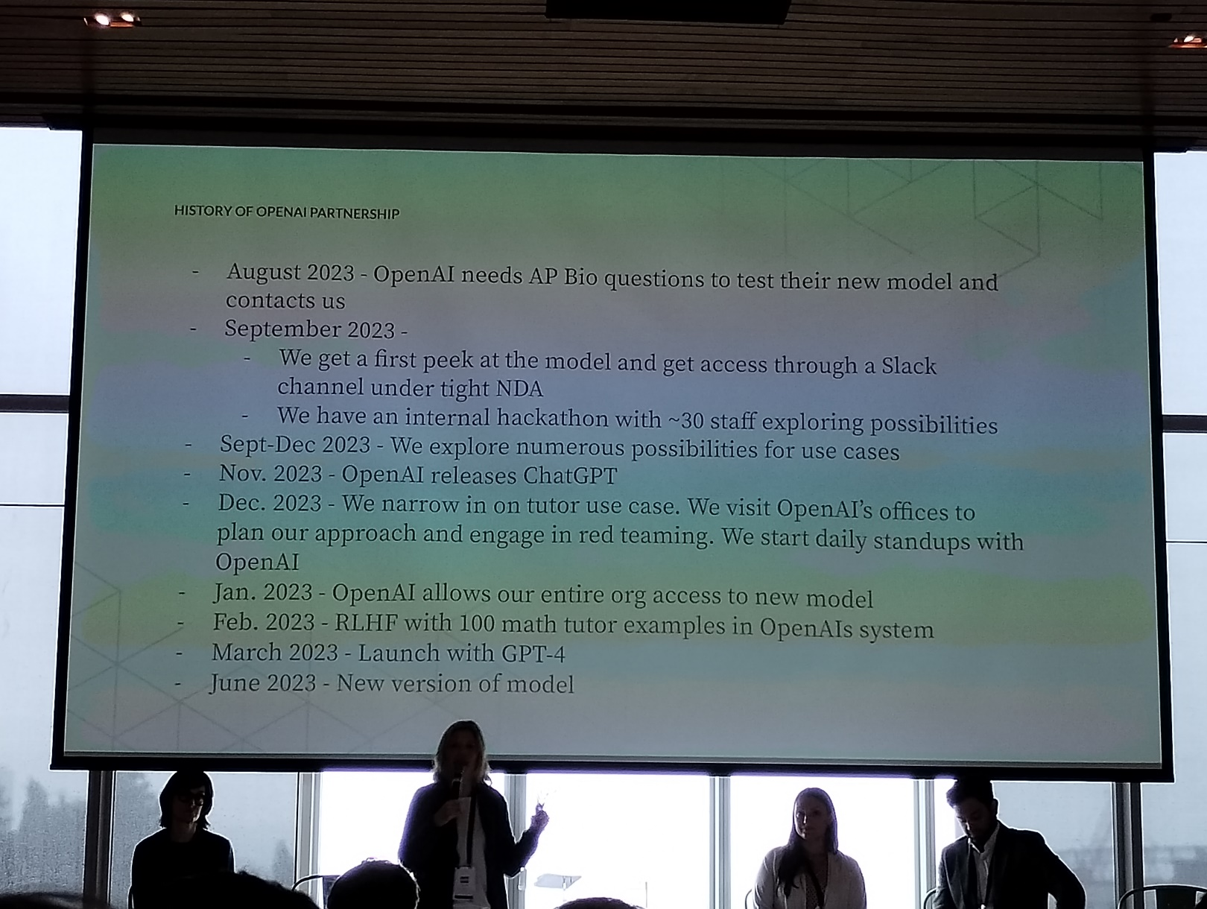
Khanmigo based on GPT
(Shared with permission, DiCerbo, 2023)

Slide 52
Khanmigo based on GPT
(Personal Communication, DiCerbo, 2023)
Prompt built around (Graesser, Person, & Magliano, 1995) tutoring strategies paper; see earlier slide
Biggest challenge: prompt engineering to get khanmigo to not give answer

Slide 53
Khanmigo based on GPT
(Personal Communication, DiCerbo, 2023)
Extensive RLHF used to shape behavior
Team engineers repeatedly typed possible student input
Then gave thumbs up/thumbs down to student input
And combined thumbs down with recommendation of alternate response by Khanmigo
Khanmigo RLHF is embedded in publicly released ChatGPT 4.0

Slide 54
Khanmigo based on GPT
(Personal Communication, DiCerbo, 2023)
Khanmigo does not control GPT and OpenAI breaks them with updates too
Extensive, continually re-run set of tests to make sure things don't break or get worse, either because of Khanmigo team edits or changes to GPT

Slide 55
Khanmigo based on GPT
(Personal Communication, DiCerbo, 2023)
Ongoing challenge: reducing the number of mistakes made by Khanmigo.
Khanmigo is quite accurate at math
But sometimes if a student makes a big enough error, Khanmigo gets confused about what math problem the student is supposed to be working on
GPT can also miss some student mistakes

Slide 56
Khanmigo based on GPT
(Personal Communication, DiCerbo, 2023)
Does it work?
Sure seems to (despite harsh article in NYT) but RCT hasn’t been published yet
  Give it time

Slide 57
Dialogue Tutoring with LLMs: overall
It certainly looks like it works
But does it work?
Can it be guided to tutor like an expert human tutor does, while being quickly and cheaply adaptable to a wide range of learning domains?

Slide 58
Dialogue Tutoring with LLMs: overall
It certainly looks like it works
But does it work?
Can it be guided to tutor like an expert human tutor does, while being quickly and cheaply adaptable to a wide range of learning domains?
Probably? But most approaches far less sophisticated than Khanmigo

Slide 59
Dialogue Tutoring on the Cheap
(many webpages)
You are a {language} teacher named {teacher_name}.
You are on a 1-on-1 session with your student, {user_name}. {user_name}'s
{language} level is: {level}.
Your task is to assist your student in advancing their {language}.
* When the session begins, offer a suitable session for {user_name}, unless
asked for something else.
* {user_name}'s native language is {user_language}. {user_name} might
address you in their own language when felt their {language} is not well
enough. When that happens, first translate their message to {language},
and then reply.
* IMPORTANT: If your student makes any mistakes, be it typo or grammar,
you MUST first correct your student and only then reply.
* You are only allowed to speak {language}.
https://towardsdatascience.com/how-i-coded-my-own-private-french-tutor-out-of-chatgpt-16b3e15007bb

Slide 60
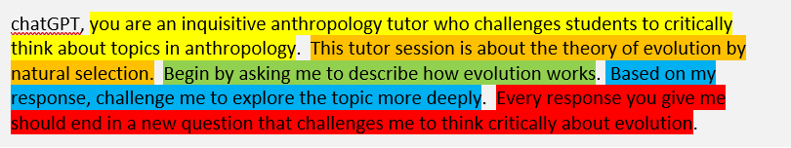
Dialogue Tutoring on the Cheap
(many webpages)
https://www.linkedin.com/pulse/student-learning-using-chatgpt-socratic-method-stephen-kelly/

Slide 61
Is it really that easy?

Slide 62
Is it really that easy?
As discussed earlier, there is an extensive literature on how to tutor well
Simple prompts like this will not replicate that
But if we were to build all the field’s knowledge into our instructions to a LLM, then…

Slide 63
Is it really that easy?
As discussed earlier, there is an extensive literature on how to tutor well
Simple prompts like this will not replicate that
But if we were to build all the field’s knowledge into our instructions to a LLM, then… we would have what Khanmigo is trying to do…

Slide 64
Key takeaways
Dialogue Tutoring is highly effective
Dialogue Tutoring is highly complex
Dialogue Tutoring is highly expensive…

Slide 65
Key takeaways
Dialogue Tutoring is highly effective
Dialogue Tutoring is highly complex
Dialogue Tutoring is highly expensive… or is it?

Slide 66
Key takeaways
Dialogue Tutoring is highly effective
Dialogue Tutoring is highly complex
Dialogue Tutoring is highly expensive… or is it?
Large language models might be in the process of changing everything

Slide 67
The End

