Slide 1
Adaptive Learning Systems
EDUC5183

Slide 2
Welcome!
To the second of this week’s 3 videos
  Meta-cognition
  Self-regulated learning
  Engagement

Slide 3
Within SRL,
Adaptive Learning Systems
Typically focus on detecting
  Metacognitive strategies
  Metacognitive skills
  Self-regulated learning behaviors

Slide 4
Within SRL,
Adaptive Learning Systems
Typically focus on detecting
  Metacognitive strategies
  Metacognitive skills
  Self-regulated learning behaviors
What’s the difference?
  There are clearly differences, but the field often treats these like they are interchangeable

Slide 5
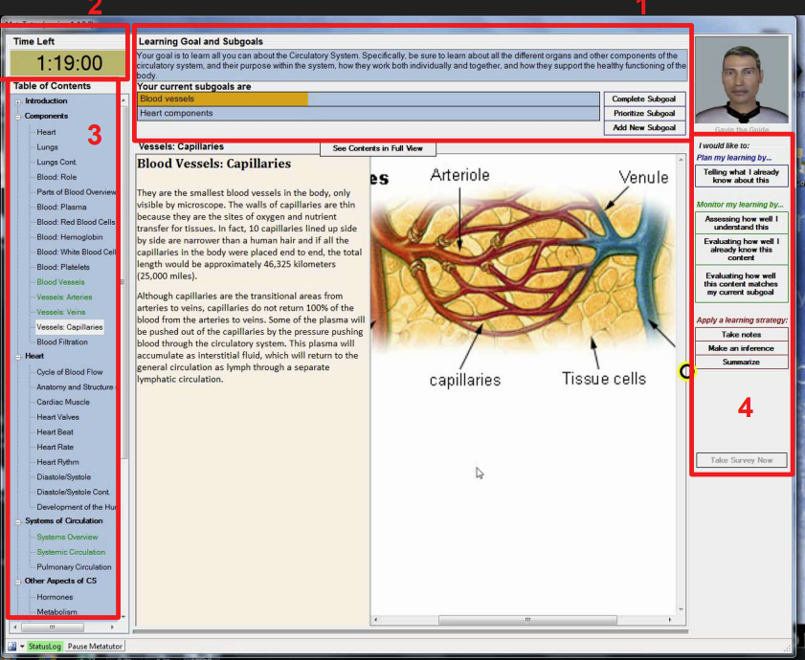
BTW, MetaTutor: Also Self-Report of Planning, Strategies

Slide 6
Core SRL behavior: Self-Explanation

Slide 7
Self-Explanation
When the student explains the content or meaning of a text they have just read (or a result they have just obtained, or a step in a worked example, etc., etc.) to themselves, in their own words
Can be prompted by adaptive learning system
Leads to better understanding
(Chi et al., 1989; Pirolli & Recker, 1994; Aleven et al., 2004; meta-analysis in Bisra et al., 2018)

Slide 8
Self-Explanation
“…Good students seem to generate explanations which relate to the principles stated in the text, as well as relating the consecutive example statements to each other” (Chi et al., 1989)

Slide 9
Qualities of Good Self-Explanation
(Chi et al., 1989; Chi & VanLehn, 1991)
Considering conditions under which specific actions are advisable
Inferring consequences of an action
Considering meaning of mathematical expression

Slide 10
Qualities of Good Self-Explanation
(Renkl, 1997)
Identifying the sub-goal achieved by each operator
Attempting to anticipate the next solution step

Slide 11
Qualities of Bad Self-Explanation
(Chi et al., 1989; Renkl, 1997)
Simply re-phrasing the content
Making trivial inferences

Slide 12
Why is self-explanation beneficial?
Self-explanation helps fill in gaps in student knowledge that are not immediately clear from the text or worked example (Chi & Bassok, 1989)

Slide 13
Why is self-explanation beneficial?
By self-explaining, the learner re-derives the process used to conduct the step, and can then make analogies to that process later (VanLehn et al., 1991)

Slide 14
Why is self-explanation beneficial?
Self-explanation is targeted to exactly what a student is struggling to comprehend
(Chi, 2000)

Slide 15
Why is self-explanation beneficial?
Self-explanation leads to revision of incorrect or incomplete mental models (Chi, 2000)

Slide 16
Interactive scaffolds for self-explanation

Slide 17
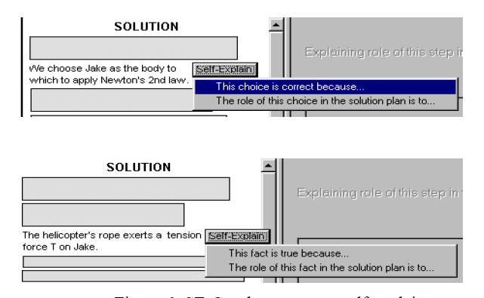
Conati & VanLehn, 2000

Slide 18
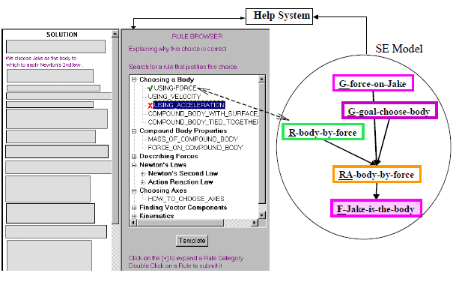
Conati & VanLehn, 2000

Slide 19
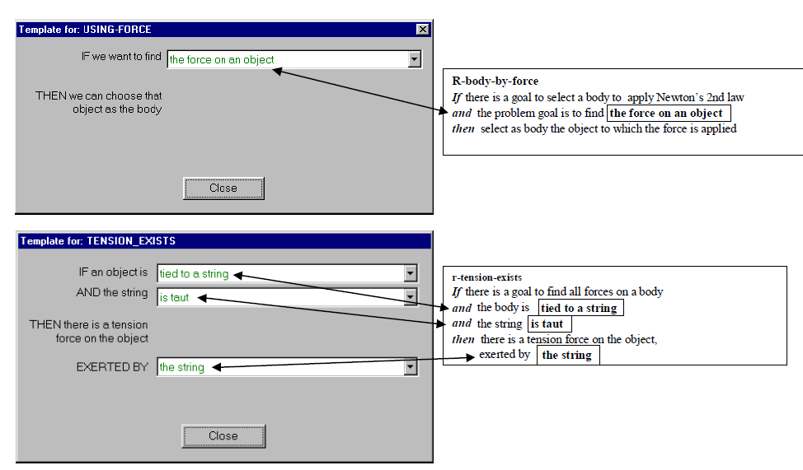
Conati & VanLehn, 2000

Slide 20
Conati & VanLehn, 2000
Student model is used to infer which steps student does not understand
  Student is required to self-explain those steps

Slide 21
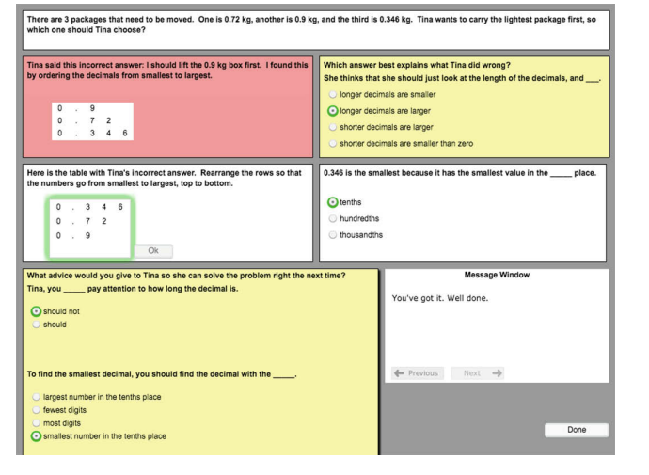
Richey et al. (2019)

Slide 22
Self-explanation in natural language
Tried in some studies (Aleven et al., 2004)
Didn’t seem to lead to benefits over menu-based self-explanation

Slide 23
A range of other metacognitive strategies/skills
Many other common strategies/skills framed in terms of a particularly popular pair of models of SRL

Slide 24
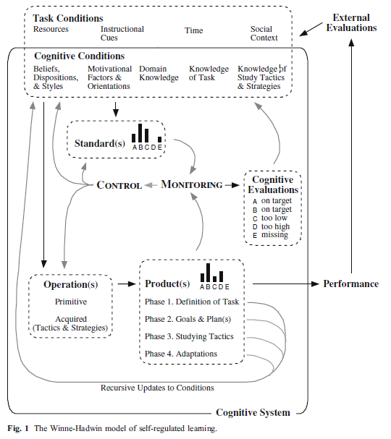
Winne’s Models of SRL: COPES
(Winne & Hadwin,
1998)
Conditions
Operations
Products
Evaluations
Standards

Slide 25
Winne & Hadwin (1998):
Four Phases
Phase 1. Learners develop a model of the task by interpreting task conditions (contextual constraints and affordances that involve, for e.g., time limits, material resources, help available) and cognitive conditions (e.g., knowledge of the task domain, memories of challenges experienced with similar tasks and strategies that proved effective).

Slide 26
Winne & Hadwin (1998):
Four Phases
Phase 2. Learners create goals relative to their model of the task (e.g., to increase knowledge about a particular topic). Then, they select cognitive operations operationalized as study tactics and learning strategies that they predict can contribute to achieving these goals.

Slide 27
Winne & Hadwin (1998):
Four Phases
Phase 3. Learners engage in learning by applying their chosen tactics and strategies. As they do, chosen tactics and strategies create provisional updates to the initial knowledge and beliefs (e.g., Am I learning more about this topic? Is this strategy as helpful as I thought it would be), “steps” toward the ultimate goal of the task.

Slide 28
Winne & Hadwin (1998):
Four Phases
Phase 4. Each cognitive operation a learner applies constructs products (knowledge, research reports, models or diagrams). When evaluations of products are available, either from the environment (e.g., a peer’s comment or a computer’s beep) or in the learner’s working memory, learners may choose to stay with or revise those products. As well, they may adjust their model of the task and adapt goals and strategies accordingly.

Slide 29
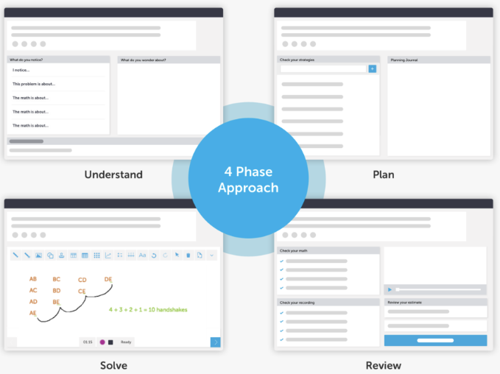
CueThink:
Built on Winne & Hadwin Model

Slide 30
Phase | Task
Understand | “What I notice is” “What I wonder is” “Estimate your answer”
Plan | “Choose your strategies” Planning journal
Solve | Video creation tools Whiteboard Math Tools Recording tools
Review | Check your math Check your recording Review your estimate Final answer Review classmate answers Review feedback

Slide 31
Winne’s Models of SRL:
SMART (Winne, 2000)
Searching
Monitoring
Assembling
Rehearsing
Translating

Slide 32
(Zhang et al., 2022)
SRL Indicator | Working Definition
Numerical Representation (NR) | The learner’s representation of the problems includes numerical components and demonstrates a level of understanding of how the numerical values are used in the math problem.
Contextual Representation (CR) | The learner’s representation of the problem includes contextual details relating to the setting/characters/situations within the given math problem.
Strategy Orientation (SO) | Learners explicitly state a plan for how they will find the answer for the given math problem, decomposing information into a step-by-step process.
Outcome Orientation (OO) | The learner provides only a numerical estimate of the final answer for the given math problem, suggesting that learners are focused on the output instead of the process itself.
Data Transformation (DT) | The learner manipulates the ways information is represented to them in the problem to find a solution. This suggests active problem solving.
Following Plans (FP) | When making a plan, learners correctly and meaningfully incorporate the strategies they selected into the plan.
Incorporating Information (II) | When making a plan, learners correctly and meaningfully incorporate information previously assembled into the plan.

Slide 33
(Nasiar et al., 2023)
SRL Indicator | Working Definition
Strategy Augmentation (SA) | Selecting a strategy not in the pre-defined set offered to students and not given by the teacher to all students

Slide 34
Messages to support SRL
A common approach to supporting SRL: messages to learner when student not demonstrating appropriate strategy
We saw examples in Aleven’s Help-Seeking Tutor earlier in the semester

Slide 35
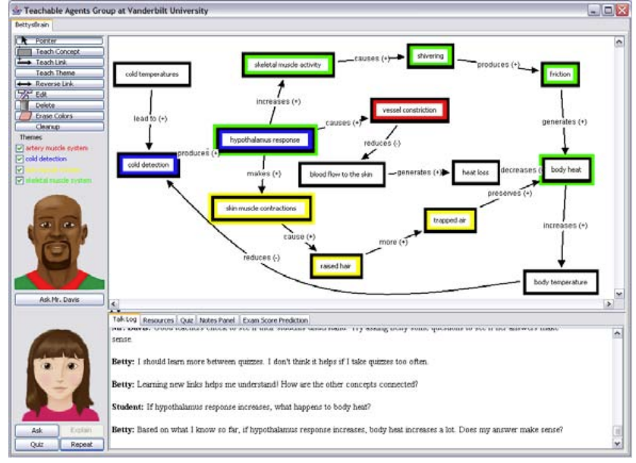
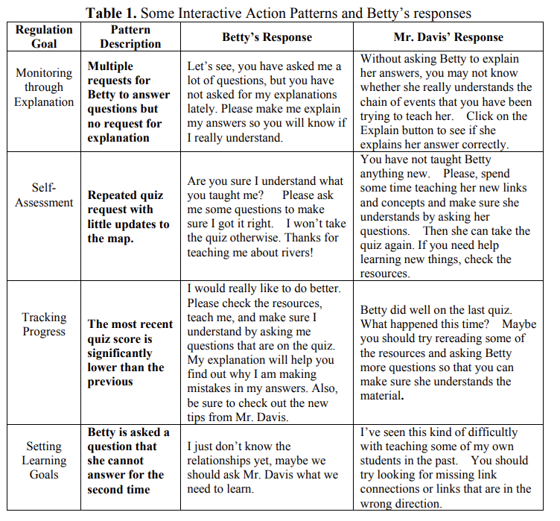
Betty’s Brain (Biswas et al., 2009)

Slide 36
Evidence for Effectiveness
Betty’s Brain generally effective (Segedy et al., 2013)
Hints that support debugging and assessment by students particularly associated with learning gains (Munshi et al., 2022)

Slide 37
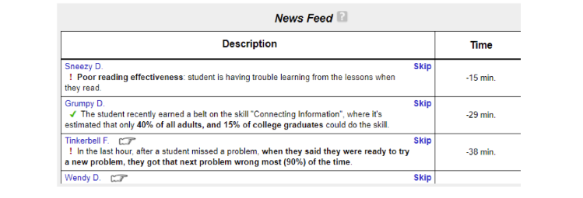
CSMLearn: SRL Support given by Instructional Coach

Slide 38
Concern (Ocumpaugh et al., in press)
SRL messages often focus on what the student can’t do (deficits) rather than focusing on what the student can do (assets)
Work underway to frame SRL messages in terms of what students have already demonstrated they can do in some situations (Nasiar et al., in progress)

Slide 39
Key take-aways
SRL depends on meta-cognition
Specific SRL behaviors can be positive and can be scaffolded
Self-explanation: scaffolding approaches and effectiveness well-established
Positive examples for other SRL behaviors, but considerable work remains to understand, detect, and fully leverage

Slide 40
Next video: engagement

Slide 41
The End

