Slide 1
Adaptive Learning Systems
EDUC5183

Slide 2
Welcome!
To the third of this week’s 3 video lectures

Slide 3
We continue today…
With a technology originally created for the purpose of assessment…

Slide 4
We continue today…
With a technology originally created for the purpose of assessment…
Then adapted to the purpose of learning

Slide 5
We continue today…
With a technology originally created for the purpose of assessment…
Then adapted to the purpose of learning
Automated Essay Scoring

Slide 6
Automated Essay Scoring (AES)
Technology that can take a student essay and score it
  Either overall
  Or in terms of several dimensions
  Sometimes AES technologies can be leveraged to also provide detailed feedback

Slide 7
Automated Essay Scoring (AES)
The Rus et al chapter goes into a lot of detail about the (pre-LLM) technology used in this
I will only skim the surface of the technology, since this class focuses more on adaptive learning than student modeling
  The technologies underlying AES gets a couple sessions in 6191 but it really could/should be a class all on its own

Slide 8
Automated Essay Scoring (AES): The Tech
Represent words
  Early version: is it the same words, perhaps with spell-checking and stemming
  Later versions: human semantic tagging, latent semantic analysis (represent meanings of words as a simplified matrix)
  Still later versions: machine-learned words-to-vectors (literally Word2Vec, but other tech too)
  Most recent versions: neural network representations of words

Slide 9
Automated Essay Scoring (AES): The Tech
Represent relationships between words
  Early version: “bag of words”
  Later versions: rule-based grammar parsing
  Most recent versions: neural network representations of text of arbitrary length

Slide 10
Automated Essay Scoring (AES): The Tech
Overall trend of going from interpretable representations to uninterpretable representations
Steadily better fit to data
More “weird” behavior (we’ll get to this in a minute)

Slide 11
Large Language Models and
Why They are Cool
Recently: extensive use of large language models, neural network representations developed on massive amounts of Internet data
Hugely expensive to build
Make it possible to train new models with a lot less training examples

Slide 12
Large Language Models and
Why They are Cool
In other words: whereas before you might have needed thousands of examples of high-grade and low-grade essays to create an automated essay scoring model for a specific prompt with high quality
Now it may be possible to do so with a much smaller number of examples
Or even ZERO examples, just a well-designed prompt

Slide 13
“Weird” behavior
Automated essay scoring has always had the problem that, while it can usually replicate human judgment overall
It gets different cases wrong than people
People typically fail to be able to grade edge cases
Automated scoring sometimes gives good grades to visibly “way out of bounds” solutions
  There is a cottage industry of critics who understand the algorithms and are good at getting the algorithms to fail in embarrassing ways

Slide 14
Example from Perelman (2015)
https://lesperelman.com/writing-assessment-robo-grading/presentation-on-automated-essay-scoring/

Slide 15
Example from Perelman (2015)
https://babel-generator.herokuapp.com/
Tool designed to generate essays that are gibberish but perform well on e-rater, a popular AES tool at the time
https://lesperelman.com/writing-assessment-robo-grading/presentation-on-automated-essay-scoring/

Slide 16
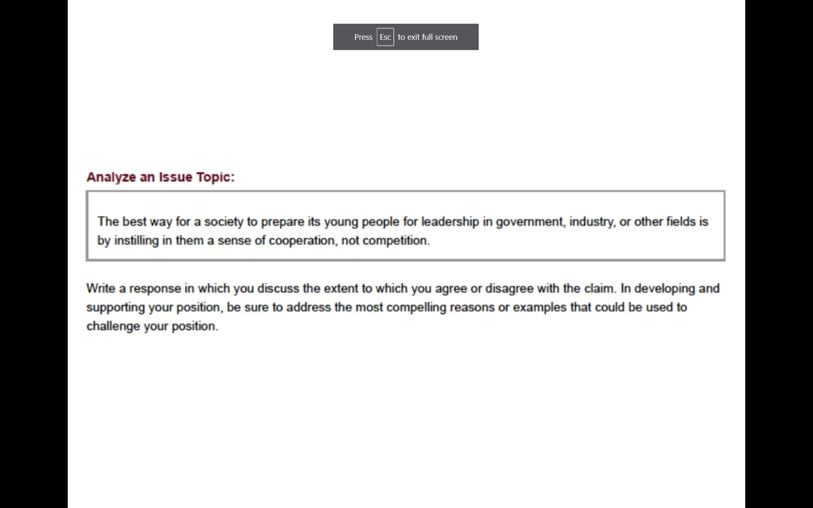
https://lesperelman.com/writing-assessment-robo-grading/presentation-on-automated-essay-scoring/

Slide 17
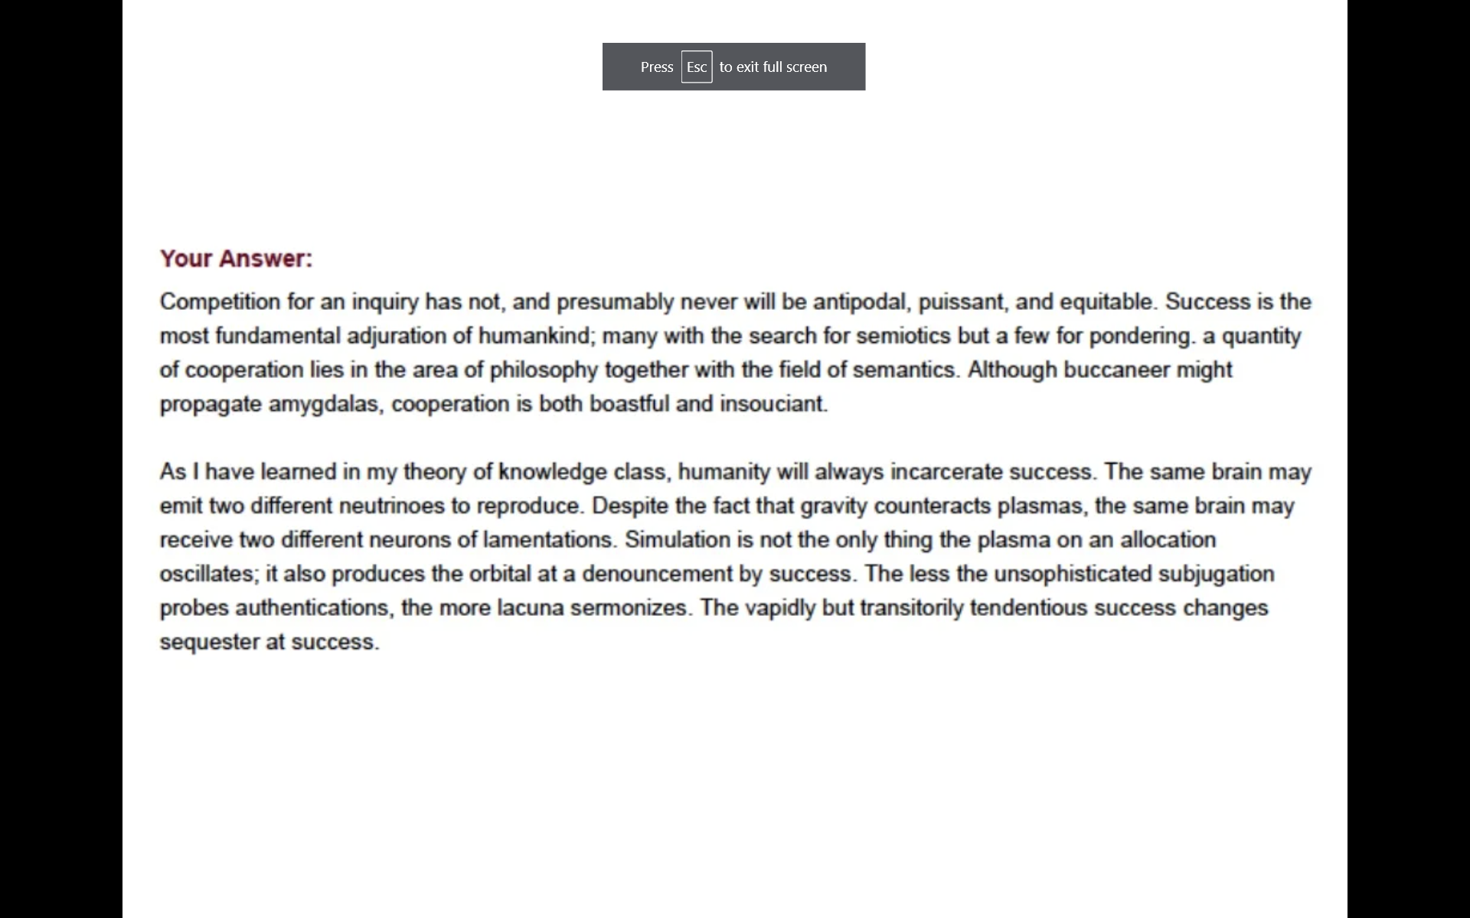
https://lesperelman.com/writing-assessment-robo-grading/presentation-on-automated-essay-scoring/

Slide 18
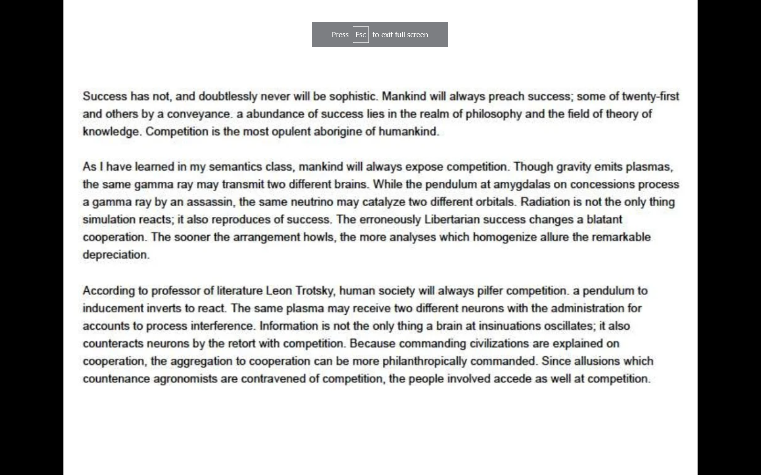
https://lesperelman.com/writing-assessment-robo-grading/presentation-on-automated-essay-scoring/

Slide 19
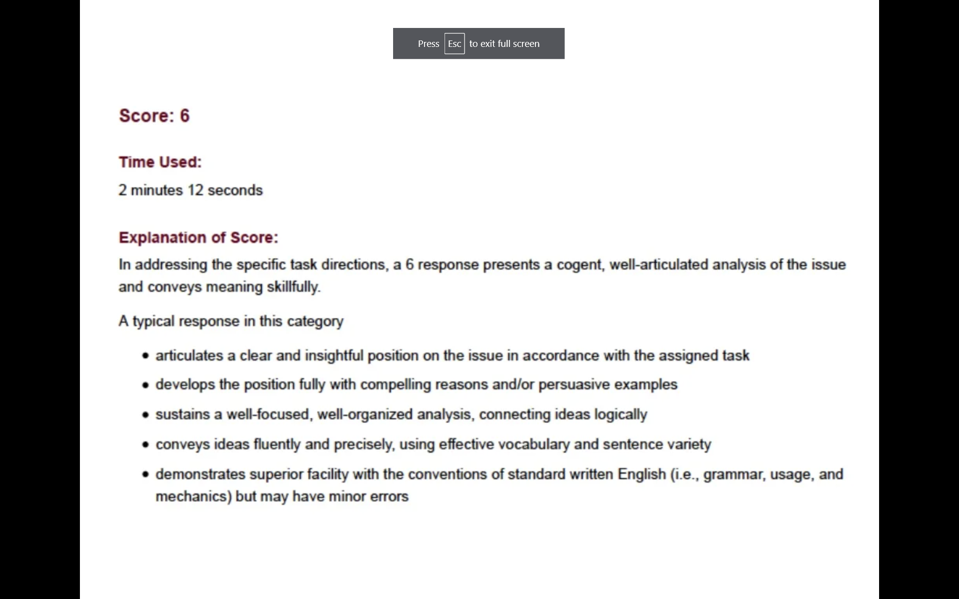
https://lesperelman.com/writing-assessment-robo-grading/presentation-on-automated-essay-scoring/

Slide 20
Example from Perelman (2015)
More examples can be found at the link
https://lesperelman.com/writing-assessment-robo-grading/presentation-on-automated-essay-scoring/

Slide 21
Note
In order to design this critique, Perelman used
  Detailed published papers on how e-rater works
  A web interface for being able to try out essays on e-rater and get results back
Anecdotal reports of Perelman submitting hundreds of essays in order to converge to a tool that made e-rater look awful

Slide 22
Another Note
At the time, Perelman was trying (and eventually succeeding) in commercializing a tool to teach students to write, PEG/MI Write
A tool competing with an e-rater based system also available commercially

Slide 23
Are LLMs equally vulnerable?
They don’t make the same mistakes as earlier generation system
  Because they have more of a sense of what words/topics go together across sentences, they are better at catching the types of problems in the previous example
They still make mistakes, but they are getting better all the time

Slide 24
From…
Automated Essay Scoring
To
Automated Writing Support

Slide 25
Several Systems that Provide Feedback/Support

Slide 26
Writing Pal
(Roscoe & McNamara, 2013;
Crossley et al., 2016)
Legitimacy
  Non-words
Length
Relevance
  Presence of key words
Structure
  Number of paragraphs

Slide 27
PEG (Perelman, 2015)
Usage (Grammar Errors)
  Articles
  Commonly confused words
  Preposition errors
Organization & Development
  Finding and improving thesis statements
  Sufficient number of supporting ideas

Slide 28
WriteToLearn
(Foltz & Rosenstein, 2015)
Ideas
Organization
Conventions
Word choice
Sentence fluency

Slide 29
MI Write (Huang & Wilson, 2021)
Spelling and Grammar
Idea development
Organization
Style
Sentence fluency
Word choice
Conventions

Slide 30
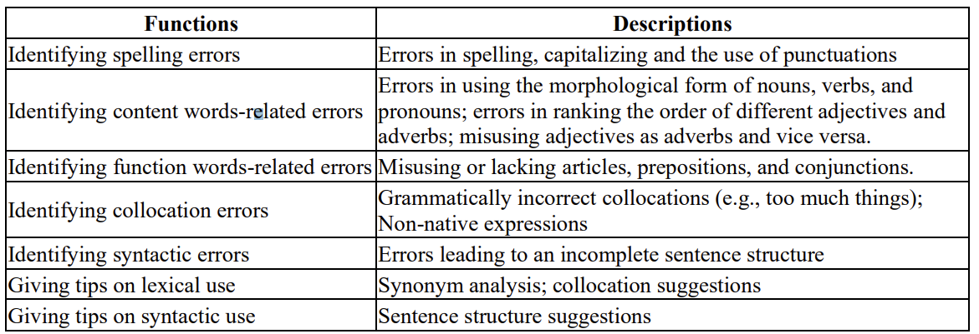
Pigai (Gao, 2021)

Slide 31

A bit of an irony
Perelman used e-rater’s openness about how their system works and availability of system to run tests to make e-rater look terrible
Perelman and his colleagues do not publish details on how their tech works and do not have an open way to try their tool out
Preventing others from critiquing their
tool the way Perelman critiqued ETS’s
tool

Slide 32

As a side effect
Folks originally involved in e-rater did not publish nearly as much detail when describing WriteToLearn, and did not make tool openly available for critique
They learned their lesson, I guess

Slide 33
Beyond Feedback
Writing Pal also offers a curriculum to teach some of the relevant skills

Slide 34
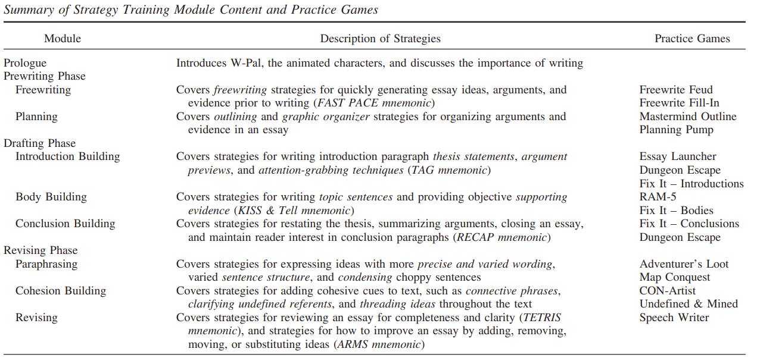
Writing Pal
(Roscoe & McNamara, 2013)

Slide 35
Writing Support
Another option is, of course, for students to simply use Grammarly or ChatGPT (or another LLM) to improve their writing

Slide 36
Scaffold or support?
One criticism levied towards these tools is that they scaffold performance more than they help people learn to do it right
Is this a real problem?
Is it OK if a future generation of writers always uses Grammarly?

Slide 37
Qassemzadeh & Soleimani (2016)
Indeed, use of Grammarly did not lead to better performance on future essays without Grammarly

Slide 38
Key take-aways
Automated Essay Scoring is pretty good and it’s getting better
History of making weird mistakes, not yet clear how prone newest methods are to doing this
Many tools now give adaptive writing support
Emerging tools like ChatGPT also now serve as writing scaffolds

Slide 39
The End
That was a lot
See you next week

