Slide 1
Adaptive Learning Systems
EDUC5183

Slide 2
Welcome!

Slide 3
We continue today…
With the question on everyone’s minds 15 year ago
The Future of Intelligent Tutoring Systems: Will it be Model Tracing or Constraint-Based Models?

Slide 4
We continue today…
With the question on everyone’s minds 15 year ago
The Future of Intelligent Tutoring Systems: Will it be Model Tracing or Constraint-Based Models?
The answer: mostly neither
(but systems of each type are used at scale)

Slide 5
This difference comes down to…

Slide 6
How should we assess correctness?
Easiest option:
Design content that has a simple answer
Record what that simple answer is
Is this good enough?

Slide 7
What about…
… when we want to generate correct answers for a lot of content
… when we want to assess process as well as final answer
… when we want to recognize different kinds of errors (and why they occurred)
… when we want to handle answers that aren’t just a number or a word

Slide 8
What about…
… when we want to generate correct answers for a lot of content
… when we want to assess process as well as final answer
… when we want to recognize different kinds of errors (and why they occurred)
… when we want to handle answers that aren’t just a number or a word
  We’ll revisit this one next week

Slide 9
Model Tracing

Slide 10
Model Tracing Requires…
… A cognitive model
Which requires…
… A cognitive architecture

Slide 11
The basic idea
A cognitive modeling architecture is a framework for developing models of human {behavior, learning}.
The architecture forces you to make your model plausible based on what we know about humans.

Slide 12

ACT-R
“Adaptive Character of Thought”
“Atomic Components of Thought”
“Anderson’s Cool Theory”

Slide 13
ACT-R
“Adaptive Character of Thought”
“Atomic Components of Thought”
“Anderson’s Cool Theory”
Cognitive modeling in education mostly similar to ACT-R 2
ACT-R now on version 7, but newer
versions focus on finer-grained neuro
and not useful for adaptive learning

Slide 14
ACT-R’s strengths
Accurate and predictive models of human performance at complex tasks.
Models the cognitive processes that lead to behavior:
  Decision-Making
  Problem-Solving
  Analogy (more with earlier versions)
  Memory Retrieval and Strengthening
  Learning to be an Expert

Slide 15
The ACT-R Architecture
The human mind is modeled by a set of systems.
Each individual system is serial
Multiple systems can be running at once
Visual Perception
Auditory Perception
Motor Skills
Productions
Declarative Memory

Slide 16
Performance
Interaction between production rules and chunks of declarative memory
  Each chunk can have sub-chunks
  Each chunk has a certain strength of activation, which predicts speed and accuracy of recall
  (this may be familiar from past weeks)

Slide 17
Performance
Interaction between production rules and chunks of declarative memory
  Each production also has a strength of activation
  When productions reach a certain strength, they become “compiled” with neighboring productions into “automatized behavior”

Slide 18
Production-System Models
Represent performance (and therefore skill) as a set of if-then rules (“productions”)
  Can be written in plain English

Slide 19
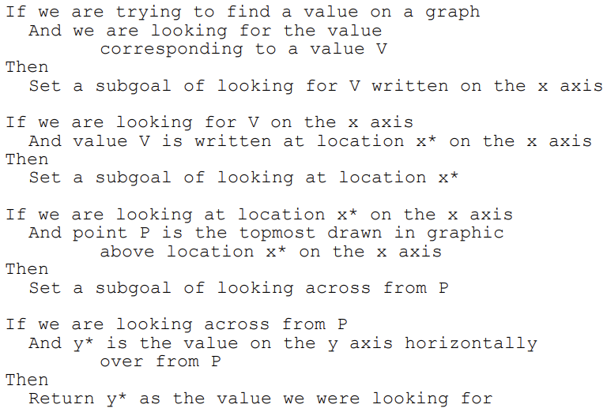
Example (Baker et al., 2001)

Slide 20
Model Tracing
A production-rule model of correct and incorrect behavior (“bug rules”) is created
As a student solves problems, the model is used to interpret whether the student’s behavior is correct or incorrect
  This information is used to give feedback, and for knowledge tracing

Slide 21
Benefits
Can be used to answer new problems
Provides natural way for diagnosing problems in process; determining where problem occurs
Provides natural link between “bugs” and cognition that produces them

Slide 22
Drawbacks
A huge to pain to develop
Hard to represent full range of wrong reasoning
Typically represents single chain of reasoning, but correct answer can often be obtained in multiple ways

Slide 23
To address these limitations…

Slide 24
Example-Tracing Tutors
(Aleven et al., 2016)
Method for making it easier to create a model-tracing tutor without needing to write production rules

Slide 25
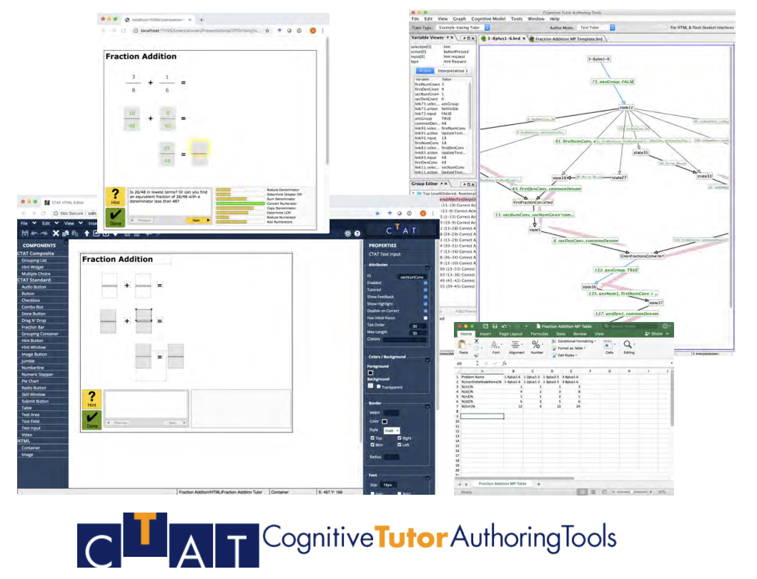

Slide 26
Example-Tracing Tutors
(Aleven et al., 2016)
Programming-by-demonstration
  Expert demonstrates correct behavior on each problem
Can be used to demonstrate multiple paths to solution

Slide 27
Used by
Over 850 authors
  Way more than model tracing tutors
Over 60,000 students
  Way less than model tracing tutors

Slide 28
Comparison to Model Tracing
Much less flexible
Much much faster

Slide 29
Constraint-based models

Slide 30
Constraint-based models
Model performance in a very different fashion
With a list of conditions that must be met
If all conditions are met, the answer is correct
Every constraint has a bug message attached to it

Slide 31
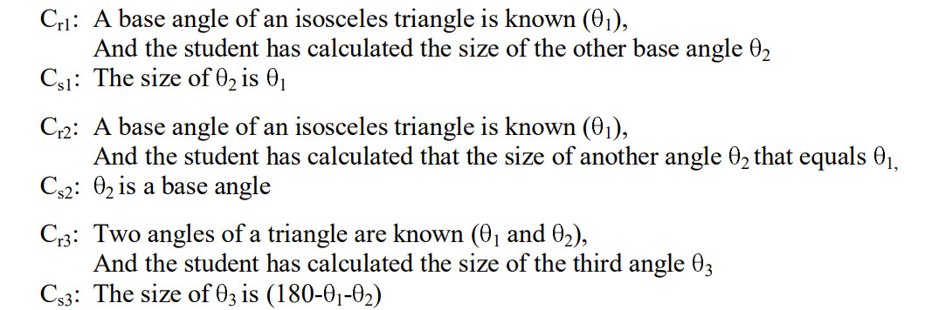
Constraint-based model: example

Slide 32
Constraint-Based Tutoring
Has been argued to be more effective for ill-defined domains, where student problem-solving may take a huge number of paths, but an incorrect solution can be recognized
(Weerasinghe & Mitrovic, 2006)

Slide 33
An LLM future?
It’s possible that LLMs could become the way we do much of this from now on
At least for answers that can be represented verbally
Which includes algebra problem solving (e.g. McNichols et al., 2023)
Still at its beginnings…

Slide 34
Key Take-Aways
Recognizing that an answer is incorrect and why is a major task for adaptive learning systems
There are several approaches with different trade-offs: Canned Answers, Model Tracing, Constraint-Based Models, Example Tracing, and LLMs

Slide 35
The End

