Slide 1
Adaptive Learning Systems
EDUC5183

Slide 2
Welcome!

Slide 3
We continue today…
With a technology that one sees in a lot of contemporary learning systems
Technology: hints and feedback
Is it adaptive?
It can be…

Slide 4
We continue today…
Rich base of research literature going back decades
Still a lot of gaps in that literature and promising directions never followed up on…

Slide 5
Let’s start with feedback

Slide 6
Feedback
“In this review, feedback is conceptualized as information provided by an agent (e.g., teacher, peer, book, parent, self, experience) regarding aspects of one’s performance or understanding. A teacher or parent can provide corrective information, a peer can provide an alternative strategy, a book can provide information to clarify ideas, a parent can provide encouragement, and a learner can look up the answer to evaluate the correctness of a response. Feedback thus is a “consequence” of performance.” – Hattie & Timperley (2007)

Slide 7
A student is doing math problems
What’s 3+6?
2x + 9 = 13. What’s x?
The student gives a wrong answer
What’s the simplest feedback we can give them?

Slide 8
Correctness feedback

Slide 9
The Next Step Up:
Giving the correct answer
The student gets the wrong answer
We give them the right answer

Slide 10
Bug Messages
Students makes a common error
We tell them why it was wrong

Slide 11
BUGGY/DEBUGGY
(VanLehn, 1982, 1987)
Early work in intelligent tutoring attempted to classify every possible bug and the reason it occurred

Slide 12
BUGGY/DEBUGGY
(VanLehn, 1982, 1987)
104 bugs in learning subtraction
But are all these errors important to specifically correct?

Slide 13
Preconceptions/Misconceptions
There are some stable misconceptions/preconceptions (Thissen-Roe et al., 2004)
But they are fairly rare and usually need a bigger intervention than a one-line message (Clement, 1983)

Slide 14
Contemporary Use of Bug Messages
Typically for an easy-to-repair issue
Working in the wrong part of the interface
Wrong units or type of answer

Slide 15
Is Feedback Effective Overall?
Yes
Hattie & Timperley (2007) review 12 meta-analyses reviewing several hundred studies
And the answer is yes

Slide 16
Is All Feedback Effective?
No
Wisniewski, Zierer, & Hattie (2020) re-review the literature and find that feedback can vary greatly in effectiveness
They recommend against asking the question “Is Feedback Effective?”

Slide 17
Delayed or Immediate Feedback?
Should we tell the student their answer is wrong right away?
Or should we give them time to figure it out on their own?

Slide 18
Delayed or Immediate Feedback?
A debate since Pressey (1950)/Brackbill et al. (1962) and still ongoing
Delayed feedback better (Metcalfe et al., 2009; Mullet et al., 2014)
Immediate feedback better (Kulik & Kulik, 1988; Lu et al., 2019)
No difference (Butler & Roediger, 2008; Nakata, 2015; Fyfe et al., 2019)

Slide 19
Delayed or Immediate Feedback?
What’s Going on Here
In 1988, Kulik & Kulik said that it really depends on the design of the study
That still seems to be the case today, with most studies on one side of the debate or the other poking at methodological flaws in the other side
  For example, Lu et al (2019) discovered longer time between hint and test for immediate feedback condition than delayed feedback conditions in Metcalfe’s studies, and replicated those studies with equal time to test, getting the opposite result

Slide 20
Levels of Feedback
(Hattie & Timperley, 2007)
Task performance
Process of understanding how to do a task
Regulatory or metacognitive processes
Self/personal level
(unrelated to the specifics of the task)

Slide 21
Feedback on Task Performance:
Key Review Findings
Generally effective
Better when high-level rather than extremely specific
  Example in Hattie & Timperley: telling students how many degrees off their LOGO solution was leads students to focus on tweaking rather than deeper problems
Most useful: simple feedback on simple problems

Slide 22
Feedback on Task Process:
Key Review Findings
Supporting students on detecting their errors is beneficial
Helping students learn to identify cues that help them determine how to solve the problem is beneficial

Slide 23
Some notes (McKendree, 1990)
Feedback more effective when it:
  Helps students understand when a procedure applies and doesn’t apply
  Helps students see how to break down a problem into steps

Slide 24
Example: Adaptive Scaffolding of Error Detection/Correction
(Mathan, 2003; Koedinger et al., 2009)
When student makes an error in creating formula, system leads student through realizing that formula is incorrect, and inferring why the result is different than what was expected/desired
Scaffolding skill in error correction

Slide 25
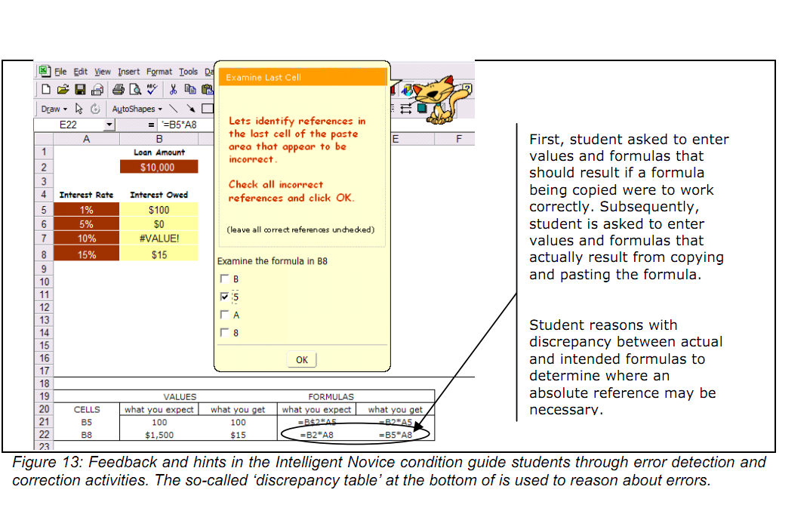

Slide 26
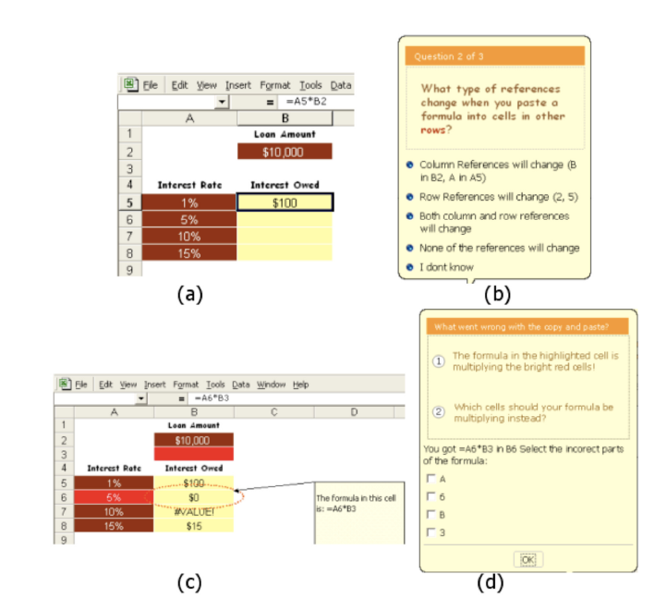

Slide 27
Results
Led to better learning, transfer, retention

Slide 28
Feedback on Self-Regulation:
Key Review Findings
Effective if it helps students devote more effort to task and target their effort better
Effective if it helps students know how and when to seek help
Effective if it increases self-efficacy, but…

Slide 29
Feedback on Self-Regulation:
Key Review Findings
Praising student for their ability usually has negative effects

Slide 30
Hints
On-demand learning supports
“Hints” and “help” used inter-changeably in ITS literature

Slide 31
Hints: Simplest version
Simply telling the student the answer
Often called a “bottom-out hint”

Slide 32
Hints: Another simplest version
Offering a single “tip” on demand

Slide 33
Hints: Tips
A lot of ways one can give a “tip” (Heiner et al., 2004)
With different implications for learning outcomes
For example, in young children learning to read, telling them the meaning of the word they were trying to read helped more than breaking down word into syllables (Heiner et al., 2004)

Slide 34
Multi-step hints
System offers multiple hint levels, which student can click forward on
Early levels orient student towards task goal
Later levels explain process
Final bottom-out hint
(Anderson et al., 1995)

Slide 35
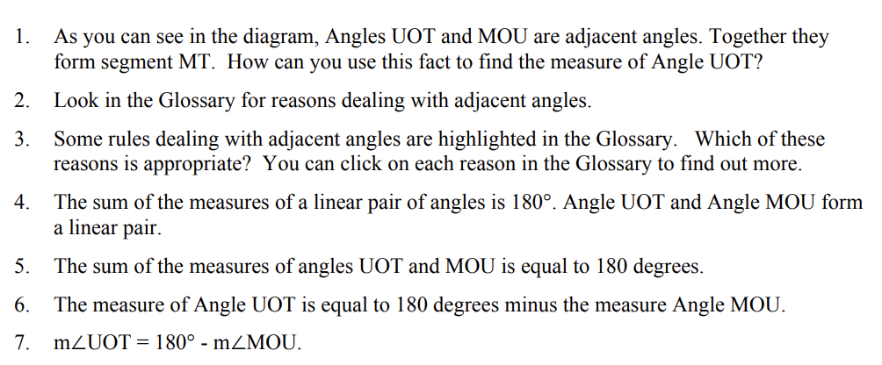
Multi-step hints
System offers multiple hint levels, which student can click forward on
Example from Aleven et al (2006)

Slide 36
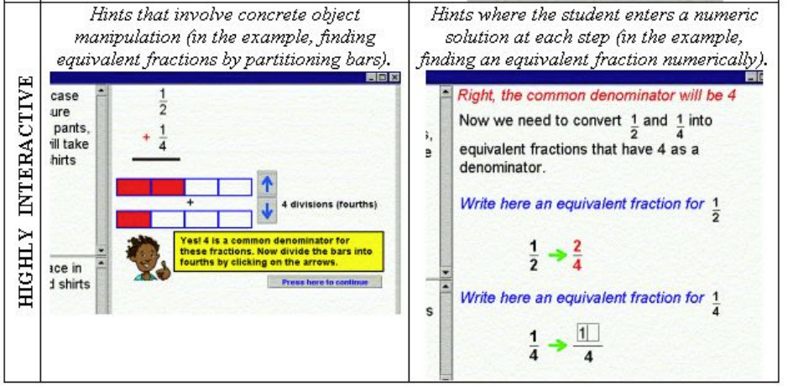
Interactive Hints
(Arroyo et al., 2000)

Slide 37
Interactive Hints
Mixed results: interactive hints better for girls but worse for boys (Arroyo et al., 2000)
Attempted replication: interactive hints no better for boys or girls (Pardos et al., 2011)

Slide 38
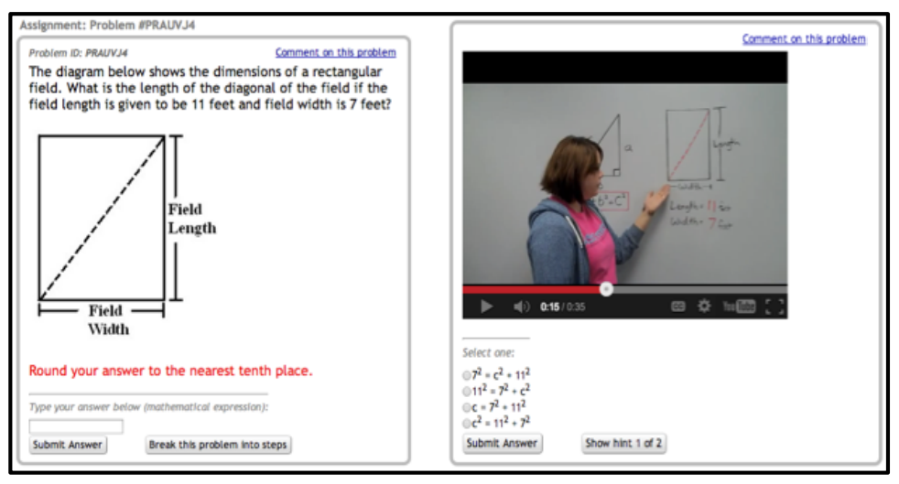
Video Hints
(Ostrow & Heffernan, 2014)

Slide 39
Video Hints
(Ostrow & Heffernan, 2014)
Video hints associated with better learning
Some clear advantages (gesture, interacting with whiteboard) that aren’t always useful
But still not heavily used

Slide 40
Hint use
Hint use can be effective or ineffective

Slide 41
Model of Help-Seeking
(Aleven et al., 2003)
1. Become aware of need for help
2. Decide to seek help
3. Identify potential helper(s)
4. Use strategies to elicit help
5. Evaluate help-seeking episode

Slide 42
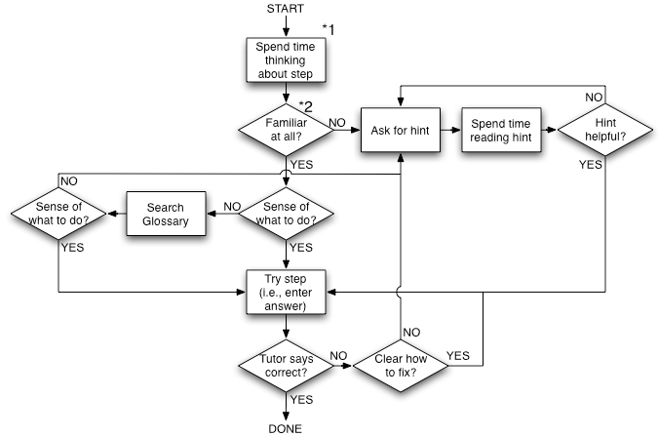
Model of Cognitive Tutor Help-Seeking
(Aleven et al., 2006)

Slide 43
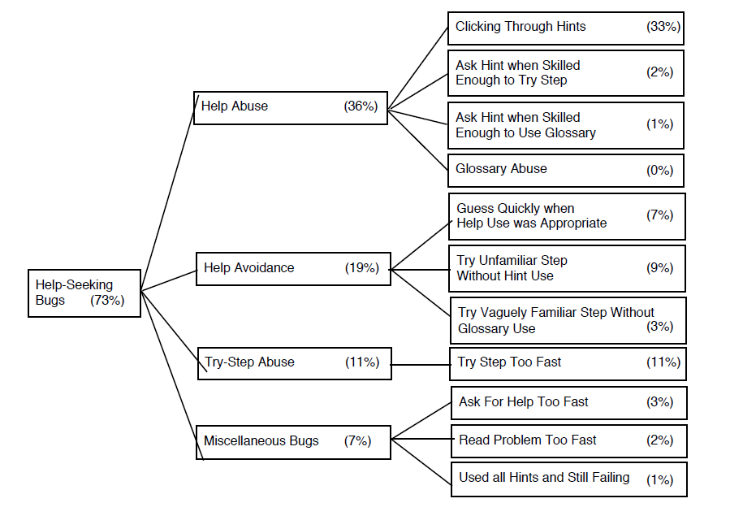
Aleven et al.’s (2006) help-seeking bugs
Gaming the System

Slide 44
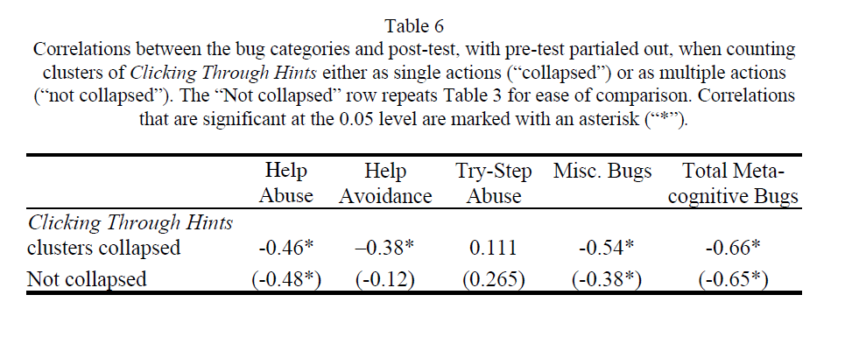
(Differential) Impacts of Help-Seeking
(Aleven et al., 2006)

Slide 45
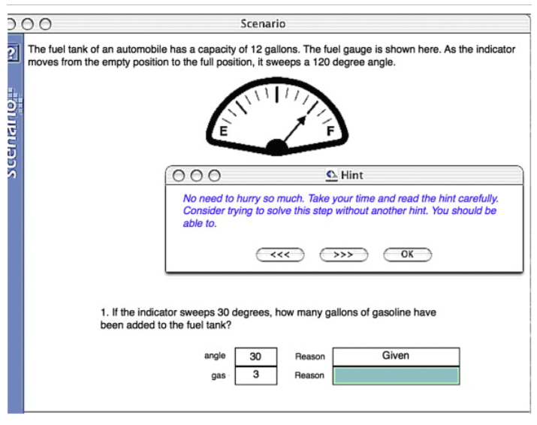
Attempt to tutor help-seeking
(Roll et al., 2007, 2011)

Slide 46
Result
Led to better help-seeking behavior
Better help-seeking behavior seen even on entirely new content
No impact on learning of domain content

Slide 47
Recent Development: Auto-Generation of Hints and Feedback
Recent work has used large language models to automate the creation of hints and feedback (Pardos & Bhandari, 2023; Pankiewicz & Baker, 2023; Nguyen et al., 2023)
  Leads to better learning than feedback in existing learning system (Pankiewicz & Baker, 2023)
  Leads to worse learning than hints authored by expert human tutors (Pardos & Bhandari, 2023)
  Better for concepts than skills (Nguyen et al., 2023)
Has the potential to make it a lot cheaper to author hints and feedback

Slide 48
Some Takeaways
Feedback is good
  But it matters what kind of feedback you give
Hints are good
  But it matters what kind of hints you give
  And what the student does with the hints
Seemingly straightforward topic,
still a lot to be done

Slide 49
The End

