Slide 1
Adaptive Learning Systems
EDUC5183

Slide 2
Welcome!

Slide 3
We continue today…
With another relatively advanced and relatively technologically mature aspect of contemporary learning systems
Technology: knowledge graphs
Adaptivity it supports: prerequisite and postrequisite selection

Slide 4
Knowledge Graph
“Knowledge graphs/spaces provide an ontology or model of the knowledge and skills needed for a specific task or domain knowledge (Doignon & Falmagne, 2012) and are used to select what content a student should work on next.” – Baker, Boser, & Snow, 2021

Slide 5
Note
A knowledge space is a type of knowledge graph
The only real difference between knowledge spaces and other types of knowledge graphs (like Bayesian Networks) is the math under the hood
That math isn’t really important for this class, but I will discuss its implications later in the session

Slide 6
Prerequisite
A prerequisite is a skill, concept, or knowledge component that is required to learn a different skill, concept, or knowledge component

Slide 7
Prerequisite Knowledge Graph
A prerequisite knowledge graph shows the relationship between skills, specifically focusing on mapping out the prerequisite relationships

Slide 8
Prerequisite Knowledge Graph
A prerequisite knowledge graph shows the relationship between skills, specifically focusing on mapping out the prerequisite relationships

Slide 9
Prerequisite Knowledge Graph
Partial Order Knowledge Spaces (POKS) are Prerequisite Knowledge Graphs
  Specifically, in a POKS there is only one way to learn a piece of knowledge
  Other types of knowledge graphs may allow multiple paths (i.e. two different things can both be prereqs)
  Note that POKS still allows for multiple prerequisites (i.e. a skill requires two prerequisite skills before it can be learned)

Slide 10
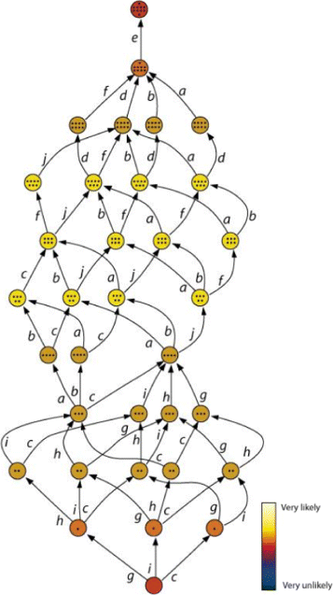
Subset of
ALEKS Knowledge Space
(Essa, 2016)
ALEKS is one of the
most widely-used
and successful adaptive
learning systems

Slide 11
The outer fringe
Of a knowledge space or knowledge graph
Is the set of knowledge components that can be learned next

Slide 12
Essa notes
Knowledge spaces and knowledge graphs can be built by humans and refined using data
But they can also be discovered totally from data (Brunskill, 2011; Desmarais & Liu, 1995; Chen et al., 2016; Chen et al., 2018)
We’ll come back to this within VIVI-SD

Slide 13
How prerequisite knowledge graphs are used by Adaptive Learning Systems
Place student in curriculum
Pick or recommend next topic(s)
Go back to prereqs for struggling student

Slide 14
Knowledge Graphs are trade secrets
Khan Academy shared theirs at one point, but they don’t seem to do so anymore
ASSISTments shares an old one, but it’s not very extensive
Companies spend hundreds of thousands of dollars to build good ones
Lots of repeated effort

Slide 15
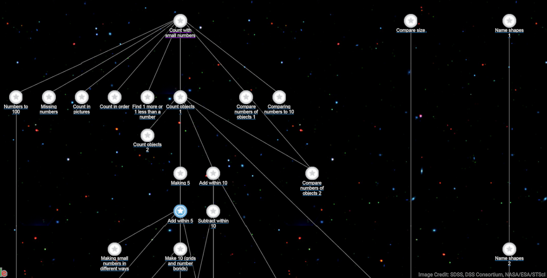
Khan Academy KG (old screenshot)

Slide 16
Zou et al. article
They find that students learn more if teachers follow recommendations about which skills the student is ready to learn
Note that both a knowledge graph and mastery learning (BKT) are used

Slide 17
Brief Digression about the Implications of the Math
Knowledge spaces sometimes tend to be over-confident about student knowledge compared to Bayesian Networks
  They (typically) make decisions based on much less evidence

Slide 18
Brief Digression about the Implications of the Math
Bayesian Networks sometimes tend to over-propagate information
  If configured in standard ways, and not calibrated properly, they sometimes adjust estimates of skills very far away from the one the student is learning now
  They take substantial data to properly calibrate

Slide 19
Brief Digression about the Implications of the Math
Desmarais has written several papers showing that BN fit data better than KS
  Desmarais research trajectory story
KS still popular, because data fit isn’t everything

Slide 20
Key takeaways
Many modern adaptive learning systems use prerequisite knowledge graphs to pick what a student should do next, or for initial placement
Can lead to much more efficient use of student time, and better learning
Expensive to develop

Slide 21
The End

