Slide 1
Adaptive Learning Systems
EDUC5183

Slide 2
Intelligent Tutors/Adaptive Learning Systems are used at scale
In classrooms around the world
And they often work – successful efficacy trials for many systems showing better learning than traditional curricula

Slide 3
Intelligent Tutors/Adaptive Learning Systems are used at scale
In classrooms around the world
But whether they work depends on how teachers use them

Slide 4
Modalities
Homework
Blended Learning
  Students use learning system in classroom

Slide 5
Blended Learning
Students use learning system totally individually
Students mostly use learning system individually but discuss occasionally
Yoked collaboration (Ogan et al., 2012)

Slide 6
Who here has seen one of these strategies being used in a classroom?
Students use learning system totally individually (Philippines – Rodrigo and colleagues)
Students mostly use learning system individually but discuss occasionally (USA, UAE)
Yoked collaboration (Costa Rica, Mexico, Brazil – Ogan and colleagues)

Slide 7
ITS/AL design needs to be different for these use cases
Students use learning system totally individually
Students mostly use learning system individually but discuss occasionally
Yoked collaboration

Slide 8
But design usually focuses on…
Students use learning system totally individually, occasionally talking to teacher
Students mostly use learning system individually but discuss occasionally
Yoked collaboration

Slide 9
That said…
There are certainly learning systems out there that are focused on collaboration
But those systems are often very different in design than an ITS

Slide 10
Off-Task Behavior
How should off-task behavior be handled when students are collaborating?
Off-task behavior in moderation can re-engage bored students (Baker et al., 2011) and improve group work dynamics (Kreijns, 2004)

Slide 11
What is the teacher doing?
Disengagement
Availability for discussion
Proactive Remediation (Miller et al., 2015; first discussed in Schofield, 1995)

Slide 12
Proactive Remediation
(Miller et al., 2015)
“In this paper, we focus on proactive remediation, dynamically planned intervention by the teacher with one or more students. In a proactive remediation, the teacher decides to provide help to one or more students on a topic that they are not currently struggling with, based on evidence that the student(s) need to learn that topic. The teacher plans such interventions using formative assessment data provided by the tutoring system. Proactive remediation is different from the traditional view of on-task conversations in blended learning [10], where the student discusses the current material being presented in the tutor, with another student or the teacher.” (Miller et al., 2015)

Slide 13
Blended learning teaching practices
Wise & Jung (2019)
Whole-class scaffolding, devoting more attention to explaining specific concepts that were difficult for students: “I [could] even adjust sometimes on the fly during the semester if it seems like students are not learning what they are hoping to learn in the class, or not learning what I think I want them to be learning in the course”
Targeted scaffolding, focusing attention on particular students… who seemed to be disengaged or struggling: “I intervened with them a bit earlier than I might have otherwise as they hadn’t missed so many classes”

Slide 14
Changing instruction
Using data on student performance to change instruction in subsequent class (Xhakaj et al., 2017)
As seen in ASSISTments 2019 video
If you haven’t watched it yet, pause this video and go watch that one
https://www.youtube.com/watch?v=kGxQsN0DBUU

Slide 15
Changing instruction
Increasing coverage of difficult topics
Selecting students with misconceptions to call on (a common practice in traditional Russian classrooms, done based on hand-grading; Khachatryan, 2020)
Selecting students with great answers to call on

Slide 16
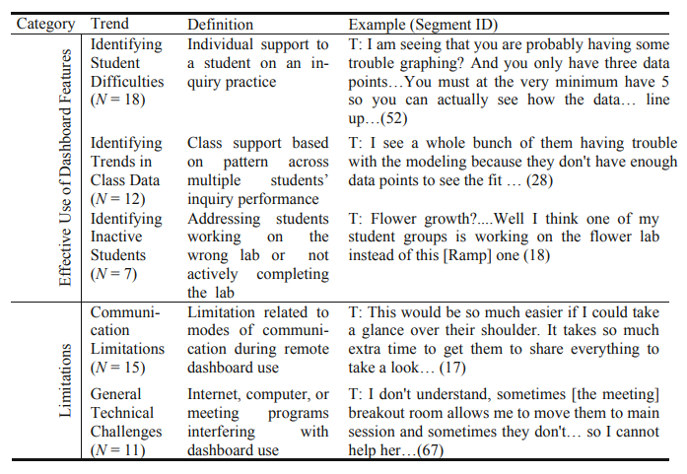
Remote learning teaching practices
(Dickler et al., 2021)

Slide 17
Different challenges for classroom orchestration
When all students are working on the same content on the same day
(ASSSISTments, Alef NextGen)
When different students are working on totally different topics at the same time (MATHia, ALEKS)

Slide 18
Information Resources Teachers Use
Examples
Mostly, but not all, dashboards

Slide 19
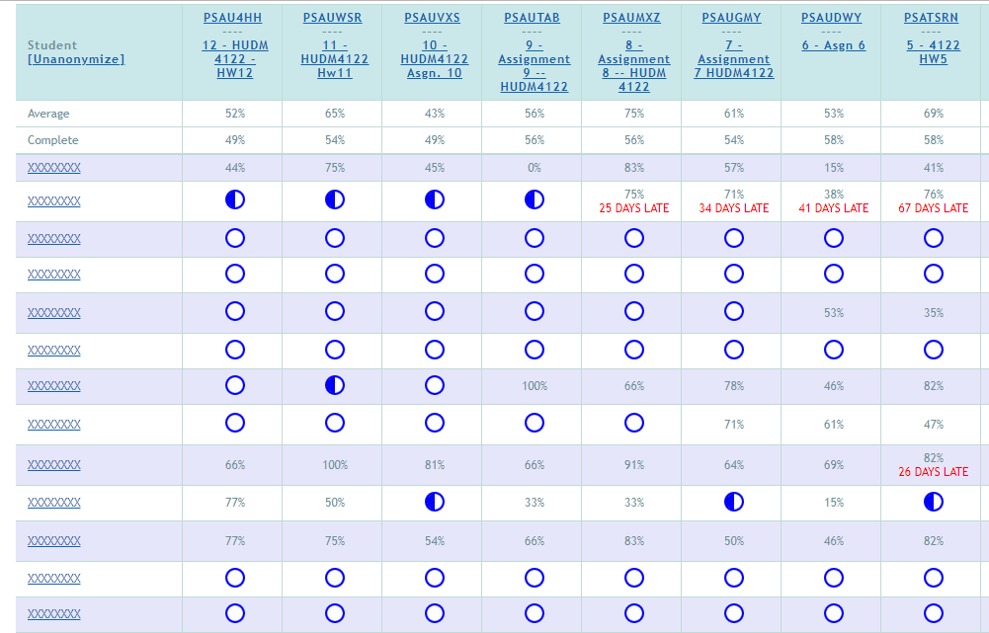
ASSISTments

Slide 20
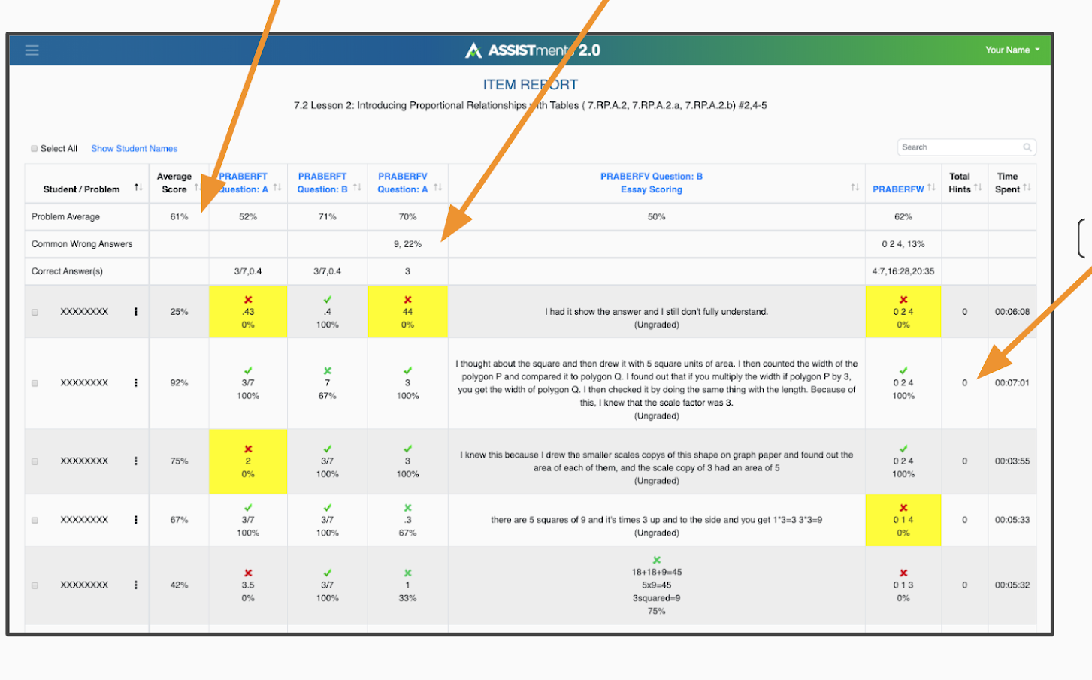
ASSISTments

Slide 21
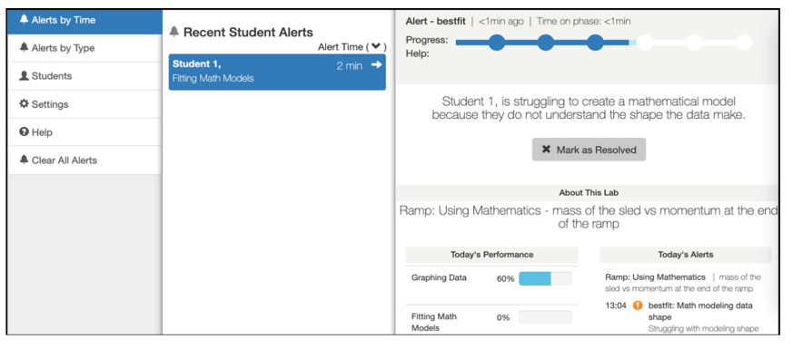
Inq-Blotter

Slide 22
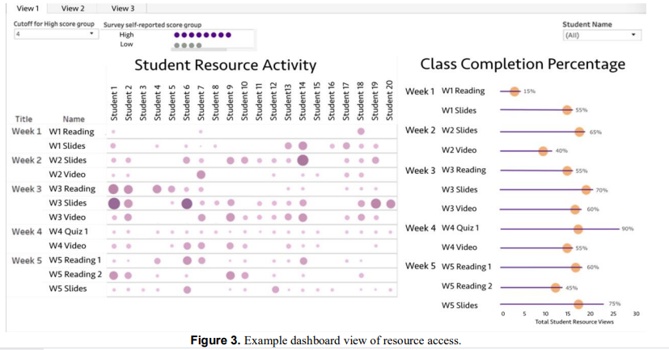
Wise & Jung

Slide 23
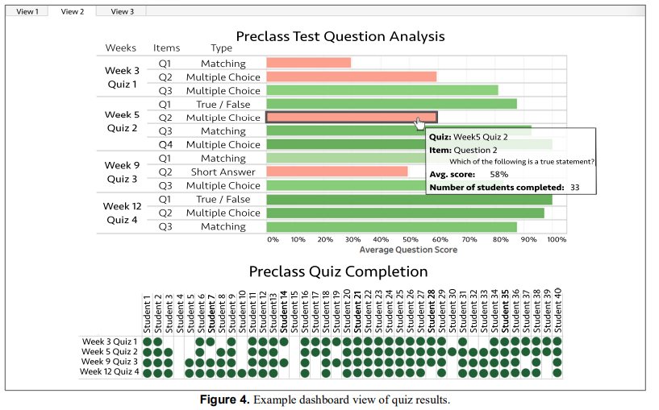
Wise & Jung

Slide 24
Some tensions in report design
(Duncan et al)
Detail versus big picture
Mastery versus progress
Benchmarking between students or with reference to a goal

Slide 25
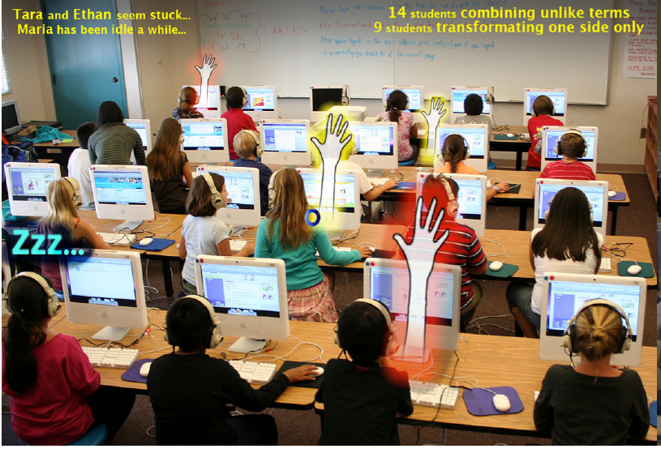
Holstein et al

Slide 26
Teacher Control
Teachers often want to have control of system and student experience
For example, ability to re-order topics and advance a student who is not making progress

Slide 27
Teacher Control
Teachers often want to have control of system and student experience
For example, ability to re-order topics and advance a student who is not making progress
Not allowing this can lead to de-adoption

Slide 28
Teacher Control
These choices often lead to lower learning effectiveness (Sales et al., 2016; Ritter et al., 2016)

Slide 29
Teacher Control
These choices often lead to lower learning effectiveness (Sales et al., 2016; Ritter et al., 2016)
Challenge: allowing choice but scaffolding and guiding teachers to make good choices

Slide 30
Teacher Preparation
Adaptive learning systems usually obtain better results in their second year of classroom use (Pane et al., 2014; Roschelle et al., 2016)
Teachers know how to use them more effectively
Challenge: supporting teachers in learning more quickly how to use systems effectively, to get better first-year performance

Slide 31
Key Take-aways
Good classroom implementation is difficult!
But the technology won’t work without good classroom implementation
A lot of open questions and challenges – far more work has gone into the tech than the implementation

Slide 32
The End

