Slide 1

Some challenges for the next 18 years of learning analytics
Ryan S. Baker
@BakerEDMLab

Slide 2
Learning Analytics has been really successful
In just 9 short years since the first conference!

Slide 3
Learning Analytics has been really successful
Student at-risk prediction systems now used at scale in higher ed and K-12, and making a difference
Adaptive learning systems now used at scale in higher ed and K-12, and making a difference

Slide 4
Learning Analytics has been really successful
A steady stream of discoveries and models in a range of once-difficult areas to study
  Collaborative learning
  Classroom participation and online connections
  Motivation and engagement
  Meta-cognition and self-regulated learning

Slide 5
I could give a talk about that
Full of praise and shout-outs

Slide 6
Full of warm fuzzies

Slide 7
Full of warm fuzzies
And we’d all forget it by tomorrow afternoon

Slide 8
So…
I’d like to talk about the next 18 years instead
Twice as long as the history of LAK so far

Slide 9
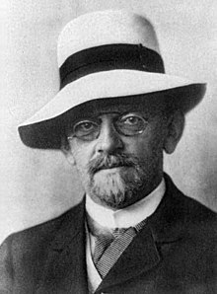
But first
I’d like to say a word about David Hilbert

Slide 10
Who here has heard of David Hilbert?

Slide 11
David Hilbert
Mathematician

Slide 12
David Hilbert
Mathematician
Visionary

Slide 13
David Hilbert
Mathematician
Wearer of
Spiffy Hats
Visionary

Slide 14
In 1900
Hilbert gave a talk at the International Congress of Mathematicians
At this talk, he outlined the some problems that he thought would be particularly important for mathematicians over the following years

Slide 15
This talk
One of the most eloquent scientific speeches of all time – I encourage you to read it
https://mathcs.clarku.edu/~djoyce/hilbert/problems.html

Slide 16
Hilbert
Framed problems concretely
Discussed what it would take to solve these problems
And listed what would be necessary to demonstrate that these problems had been solved

Slide 17
Hard problems
Only 10 of 23 have been solved as of right now

Slide 18
In the years since…
There have been many lists of problems or grand challenges, including several in our field
And yet few have been anywhere near as influential as Hilbert’s Problems
Most of them just list big, difficult, vague problems
  Very different from Hilbert
(But of course the Turing Test/Loebner Prize, Millenium Prize…)

Slide 19
Today, I’d like to suggest a list of problems to you

Slide 20
Today, I’d like to suggest a list of problems to you
Though I know I am no Hilbert…

Slide 21

Today, I’d like to suggest a list of problems to you
Though I know I am no Hilbert…
Though I do like spiffy hats

Slide 22
And learning analytics isn’t mathematics…

Slide 23
But I hope you will give me a few moments of your time
To discuss what I see as some of the bigger upcoming challenges in our field (not necessarily new to this talk)
With a conscious attempt to emulate Hilbert by trying to frame specific problems
With conditions for how we know we will have made concrete progress towards solving them

Slide 24
I’ve been lucky enough to get feedback on these ideas from some of the brightest people in the world
Alex Bowers
Christopher Brooks
Heeryung Choi
Neil Heffernan
Shamya Karumbaiah
Yoon Jeon Kim
Richard Scruggs
Stephanie Teasley

Slide 25
All the bad ideas are wholly mine

Slide 26
All the bad ideas are wholly mine

Slide 27
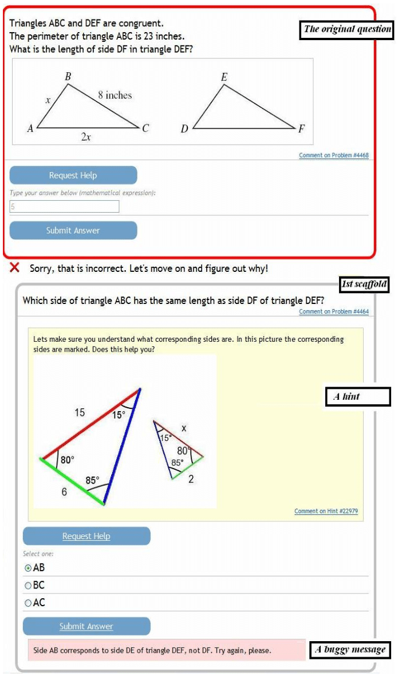

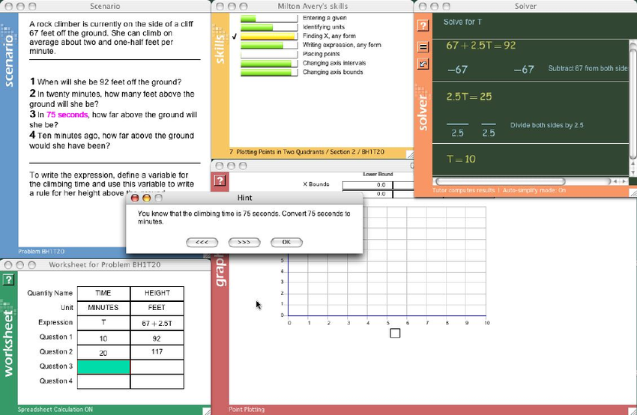
1. Transferability:
The (learning system) Wall

Slide 28
Challenge
Learning systems learn so much about a student…
But the next learning system starts from scratch

Slide 29
Challenge
A student might use Dreambox one year, Cognitive Tutor a couple years later, ALEKS a couple years after that
  Each system learns a lot about the student
  Which is forgotten the second they move on
A student might use Dreambox for some lessons, and Khan Academy for others
  Each system has to discover the exact same thing about the student

Slide 30
Challenge
It’s like there is a wall between learning systems
And no information can get in or out

Slide 31
Challenge
It’s like there is a wall between learning systems
And no information can get in or out
“If you seek better learning for students, tear down this wall!”

Slide 32
Challenge
Not just a between-system problem
Even between lessons
A student’s struggle or rapid success in one lesson usually does not influence estimation in later lessons

Slide 33
Early progress
Eagle et al. (2016) have shown that there could be better student models if we transferred information between lessons within a student and a platform
But it was just a secondary data analysis on 3 lessons

Slide 34
Contest
Take a student model developed using interaction data from one learning system
Take model inferences from a student “Maria” who has used that system
Take a second learning system developed by a different team
Use system 1’s model inference to change system 2’s model inference for Maria and system 2’s behavior for Maria

Slide 35
Contest
The change
  Could be different content the student starts with
  Could be different learning rate (e.g. Liu & Koedinger, 2015)
  Could be different interpretation of incorrect answers or other behavior

Slide 36
Contest
The original model for the second system must be a “good model” for that construct
  With goodness metrics on held-out data that are good enough to be published on their own in LAK, JLA, EDM, JEDM after 2015
  i.e. AUC = 0.75 for behavioral disengagement, 0.65 for affect, 0.65 for latent knowledge estimation…
  Publication in one of those venues after 2015 is also good enough!

Slide 37
Contest
The new model for the second system must be able to take entirely new set of students
And achieve better prediction than the original model

Slide 38
Contest
And the system behavior change must be able to actually run in the two systems
  i.e. the two systems are actually connected; this is not just an analysis for the sake of publishing

Slide 40

2. Effectiveness:
Differentiating Interventions and Changing Lives
“Assignment deadline reminders for some,
tiny American flags for others.”

Slide 41
Today
We have many platforms that infer which students are at-risk on the basis of learning analytics on LMS or other university/K-12 data
Used by instructors and other school personnel to make decisions about how to better support students, including selecting students for targeted interventions

Slide 42
Today
Some evidence that these systems lead to better outcomes for students (e.g. Arnold & Pistilli, 2012; Miliron, Malcolm, & Kil, 2014)
But also ongoing debate as to how substantial the effect is (Sonderlund, Hughes, & Smith, 2018)

Slide 43
And beyond that
Are we really changing lives, or are we patching short-term problems?

Slide 44
Contest
Take a group of undergraduates enrolled at accredited university (whatever that means in the local context)
Randomly assign students to condition with intervention (E) or no intervention (C); OR establish equivalence for quasi-experiment where model based on prior achievement and demographics cannot find significant differences between conditions E and C
Condition can last up to a year long

Slide 45
Contest
Assign learning analytics-based intervention to subset of students in condition E, where model/criterion determines which students actually receive intervention, and 10-50% of students in E receive intervention
Publish or publicly declare the model/criterion

Slide 46
Contest
Identify in advance, with documentation
 | Experimental Condition (E) | Control Condition (C)
Model thinks should receive intervention | E*: Receives intervention | C*: Does not receive intervention
Model does not think should receive intervention | E&: Does not receive intervention | C&: Does not receive intervention

Slide 47
Contest
At least three years after intervention
Collect success outcome such as
  Standardized test score
  Attendance of graduate school
  Employment in field
  Personal income
  Personal happiness

Slide 48
Contest
Demonstrate that E* performs statistically significantly better than C*, with effect size of Cohen’s d > 0.3 (or equivalent)
Demonstrate that E& does not perform statistically significantly better than C&, with effect size of Cohen’s d < 0.3 (or equivalent)

Slide 49
A real challenge
Pashler, McDaniel, Rohrer, & Bjork (2009) proposed a similar test to visualizer/verbalizer learning styles, and found that all of the research they found failed this test

Slide 51
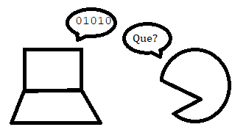
3. Interpretability:
Instructors speak Spanish,
Algorithms speak Swahili

Slide 52
Challenge
We put a ton of effort into building models of important phenomena
We craft the perfect recurrent neural network and validate that it has brilliant predictive performance

Slide 53
Challenge
And then it makes a prediction that a user – an instructor, for instance – finds non-intuitive

Slide 54
Challenge
And then it makes a prediction that a user – an instructor, for instance – finds non-intuitive
And we can’t explain it

Slide 55
Challenge
And then it makes a prediction that a user – an instructor, for instance – finds non-intuitive
And we can’t explain it
And the instructor – reasonably enough – doesn’t trust it

Slide 56
Challenge
And then they don’t use it

Slide 57
Challenge
Make the decision-making processes of deep learning or a comparable advanced algorithm understandable for an instructor (or other similar stakeholder, such as an academic advisor) without technical background

Slide 58
Challenge
Build a model that predicts a learner success outcome
  High school dropout
  College course failure
Using an “advanced algorithm” with at least 100 parameters

Slide 59
Contest
This model must be a “good model” for that construct
  With goodness metrics on held-out data that are good enough to be published on their own in LAK, JLA, EDM, JEDM after 2015

Slide 60
Contest
Find 5 data scientists and 5 instructors who were not on the original development team
Design an explanation of how the algorithm works – visualization, video, text, interactivity are fine, but no human to answer questions

Slide 61
Contest
Give them 5 case-studies/examples of specific students
Ask them to tell you what decision the algorithm will make for each student, and explain why

Slide 62
Contest
Do the instructors agree with the data scientists at least 80% of the time
In terms of both final decision and reasons for it
Coded with Kappa > 0.6 by two independent researchers with a psychology background

Slide 64
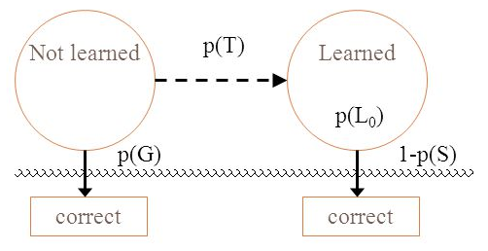
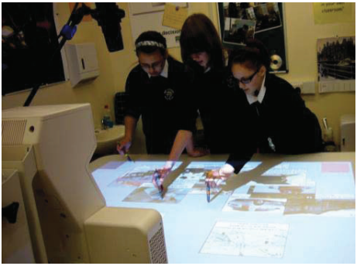
4. Applicability:
Knowledge Tracing Beyond the Screen
Image adapted from Martinez-Maldonado et al., 2011

Slide 65
Challenge
We have been reasonably successful at producing models that can infer learner knowledge – or at least predict immediate correctness – in computer-based learning environments
But mostly, these environments involve one student sitting at one computer and providing textual input: numbers, multiple choice responses, etc.

Slide 66
Challenge
Most learning still doesn’t take place with one student sitting at one computer
There’s collaborative project work
And discussion forum-based learning
And classrooms where teachers and students talk to each other

Slide 67
Challenge
Can we detect student knowledge in these contexts as well?

Slide 68
Contest
Take audio, visual, and/or physical data on learning
From a setting where there are at least 4 students engaged in the same activity at the same time
Build a model that can infer at least 4 distinct skills or knowledge components for each student

Slide 69
Contest
This model must be able to predict immediate future performance on these skills
And, for a sample of at least 60 students not used to train the model
The model must achieve AUC ROC greater than 0.65

Slide 71

5. Generalizability:
The General-Purpose Boredom Detector
Clever
Tutor
SIM
Microworld
Adapty

Slide 72
Success by several research groups
Detect academic emotion/affect solely from interactions
  Boredom
  Engaged Concentration
  Frustration
  Confusion
  Delight/Joy

Slide 73
Challenge
Current models are not generalizable
They have to be rebuilt almost from scratch for new learning platforms
  Some common tools for field observation, data synchronization
  Some experience in feature engineering that generalizes
  But still a lot of work – around $75K (Hollands & Bakir, 2015)

Slide 74
Challenge
It’s not clear what changes to a learning system cause them to break down
My colleagues and I have seen that gaming the system models break down when hints are removed from learning system, but not when affective agent is added

Slide 75
Contest
Build a model of student boredom using interaction data from one or more learning systems
Apply it to data from an entirely new system built by a different development team, where the interaction is not broadly identical
  i.e. not just a different topic or area in the same learning system
  i.e. ASSISTments → Cognitive Tutor is OK
Apply model with no tweaking or re-fitting or modifications
  Features must be defined the same way or in some way that is general across systems (i.e. OK to define 1 SD slower than mean speed in terms of each system’s speed)

Slide 76
Contest
Collect ground truth
  Binary or categorial self-report
  Field observations or video coding where Kappa > 0.6
Demonstrate that model achieves AUC ROC greater than 0.65 in the new system

Slide 77
Early Progress
Paquette et al. (2015)
  interaction-based detector of gaming the system
  built on Cognitive Tutor data
  validated in ASSISTments
Hutt et al. (2019)
  interaction-based detector of affect
  built for Algebra course in Algebra Nation
  validated in Geometry course in Algebra Nation

Slide 79

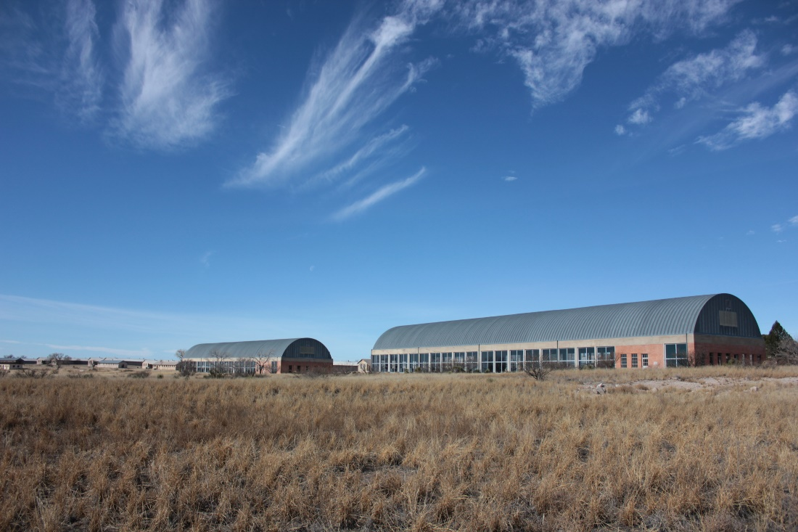
6. Generalizability:
The New York City and Marfa problem

Slide 80
Challenge
Models are built mostly on the samples that are ready at hand
Current population of university students
Current user base of adaptive learning system
Students who are relatively easy to survey or observe

Slide 81
Challenge
What happens when your population changes?
Your university starts taking in a lot of transfer students from Nevada
Your learning system in adopted in Alaska
You need to use your model for students different than the ones you surveyed or observed
A challenge for inclusion

Slide 82
The “New York City and Marfa problem”
Hard to collect data and do research in New York City because of very restrictive rules
Hard to collect data and do research in Marfa, TX because it’s 194 miles from El Paso International Airport, which is not exactly a huge airport itself
But we want our analytics to be just as valid for these students as for students who are easier to research

Slide 83
One solution
Collect data from all the populations you want the model to work on, and then try to validate your model on these populations (e.g. Ocumpaugh et al., 2014)

Slide 84
One solution
Collect data from all the populations you want the model to work on, and then try to validate your model on these populations (e.g. Ocumpaugh et al., 2014)
Both sensible and impractical

Slide 85
One solution
Collect data from all the populations you want the model to work on, and then try to validate your model on these populations (e.g. Ocumpaugh et al., 2014)
Both sensible and impractical
More feasible to collect “all the data” in MOOCs than blended learning systems, for example

Slide 86
One solution
Collect data from all the populations you want the model to work on, and then try to validate your model on these populations (e.g. Ocumpaugh et al., 2014)
Both sensible and impractical
But even in MOOCs, we don’t even know what the relevant populations are!

Slide 87
Challenge
Develop a model that “just works” for new population

Slide 88
Contest
Build a model of one of the following constructs
  High school dropout
  College course failure
  Affect
  Disengaged Behavior
  Learning Strategy

Slide 89
Contest
This model must be a “good model” for that construct
  With goodness metrics on held-out data that are good enough to be published on their own in LAK, JLA, EDM, JEDM after 2015

Slide 90
Contest
Collect data for a population that is “substantially different” than the original population
  Data not available when original model developed

Slide 91
Contest
Substantially different: population is more than 50% belonging to group that was under 10% present in original training set, where group differs from original training set in terms of:
  Degree of urbanicity (rural versus non-rural)
  Race (Nationally recognized census category)
  Ethnic group (Nationally recognized census category)
  Native language
  Nationality (Citizenship)
  Poverty (using nationally appropriate and common category)

Slide 92
Contest
Prediction for new population must:
  Have degradation of less than 0.1 in AUC ROC or Pearson/Spearman correlation
  Remain better than chance in AUC ROC or Pearson/Spearman correlation

Slide 94
Challenges: A Reprise
Transferability: The (learning system) Wall
Effectiveness: Differentiating Interventions and
Changing Lives
Interpretability: Instructors speak Spanish, Algorithms speak Swahili
Applicability: Knowledge Tracing Beyond the Screen
Generalizability: The General-Purpose Boredom Detector
Generalizability: The NYC and Marfa problem
Notes:
Number these once I have the whole list

Slide 95
An Incentive for Solving These Challenges

Slide 96
An Incentive for Solving These Challenges
I’d like to announce a prize that will go to the teams that are first to solve each of these challenges

Slide 97
But first, a word on how this prize was established…

Slide 98
We all know…

Slide 99
We all know…
That there are many generous billionaires out there

Slide 100
We all know…
That there are many generous billionaires out there
Who strive to give back to the world from what they have earned

Slide 101
We all know…
That there are many generous billionaires out there
Who strive to give back to the world from what they have earned
Who yearn to better support education however they can

Slide 102
We all know…
That there are many generous billionaires out there
Who strive to give back to the world from what they have earned
Who yearn to better support education however they can
And for whom $45,000 is the merest of pocket change, not even worth picking up if it fell on the street

Slide 103
And…

Slide 104
And…
None of them will take my calls

Slide 105
So…

Slide 106
Announcing…
The Baker Learning Analytics Prizes

Slide 107
Announcing…
The Baker Learning Analytics Prizes
BLAP

Slide 108
With an award of…
Notes:
The award is… rifles through pockets

Slide 109
With an award of…
Drum roll please
Notes:
The award is… rifles through pockets

Slide 110
$1

Slide 111
Concluding Thoughts
In this talk, I’ve proposed a few challenges that I think would bring our field forward, and some conditions under which we would know there has been progress
I hope you’ve found them compelling

Slide 112
Concluding Thoughts
In this talk, I’ve proposed a few challenges that I think would bring our field forward, and some conditions under which we would know there has been progress
I hope you’ve found them compelling
Or at least thought-provoking

Slide 113
Concluding Thoughts
Ultimately, a field moves forward if it takes on big goals that make a difference

Slide 114
Concluding Thoughts
One of the things we have to watch out for is becoming obsessed with tiny optimizations on small problems

Slide 115
Concluding Thoughts
What I’ve presented today might not be the right big goals

Slide 116
Concluding Thoughts
What I’ve presented today might not be the right big goals
But at minimum I hope I’ve provoked you to think about what the right big goals would then be

Slide 117
See you in 2037
When – I hope – we will have achieved all of these goals
Or will have generally agreed that they are wrong-headed

Slide 118
Thank you!

Slide 119
PCLA @ LAK2019
Gardner, J., Brooks, C., Baker, R. Evaluating the Fairness of Predictive Student Models Through Slicing Analysis. [Nominated for Best Paper Award] THURSDAY 1030am
Andres, J.M.A.L., Ocumpaugh, J., Baker, R., Slater, S., Paquette, S., Jiang, Y., Bosch, N., Munshi, A., Moore, A., Biswas, G. Affect Sequences and Learning in Betty's Brain. THURSDAY 4pm
Molenaar, I., Horvers, A., Dijkstra, R., Baker, R. Towards Hybrid Human-System Regulation: Understanding Children' SRL Support Needs in Blended Classrooms. FRIDAY 1130am
Anderson, H., Boodhwani, A., Baker, R. Predicting Graduation at a Public R1 University. Poster.
Karumbaiah, S., Ocumpaugh, J., Labrum, M.J., Baker, R.S. Temporally Rich Features Capture Variable Performance Associated with Elementary Students' Lower Math Self-concept. Workshop.
Molenaar, I., Horvers, A., Dijkstra, R., Baker, R. Designing Dashboards to support learners’ Self-Regulated Learning. Workshop

